Slide 1
手把手
托福听力练习流程-全部
TPO 34 Conversation 1

Slide 2
开始界面

Slide 3
一、句子听写训练

Slide 4
☆
TPO34 Conversation1
句单
报告
约师
00: 00
初步听写
补充听写
核对原句
翻译句意

Slide 5
句单
报告
约师
__________________________________________________________________.
(woman) ______________________?
(man) __________, ________________, __________________________, ___________________________, __________________,_______,______,__________________________________________, ______________________? _________________________________________________________________________. _________________?
(woman) ____________________________________. ____________________________.
(man) ____, _________________________________? _________________________?
(woman) _________________________. ___________________________________________________________________, _____________________, ________________________.
00: 00
Notes:
点击某个句子，突显；点击可进入下一个界面

Slide 6
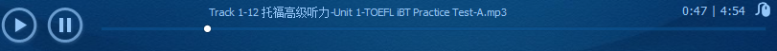
句单
报告
约师
x
初步听写
00: 00
☆
Sentence 1
,
4’23”
Notes:
第一步

Slide 7
句单
报告
约师
x
补充听写
00: 00
☆
Sentence 1
,
4’23”
4’23”
Notes:
第二步，可以补充听两遍

Slide 8
句单
报告
约师
x
补充听写
00: 00
☆
Sentence 1
初稿
,
最终稿
,
原句
67%
Listening to a conversation between a student and an employee in the university library.
4’23”
Notes:
显示原句的同时标出错误的地方，并再次听一遍

Slide 9
句单
报告
约师
x
翻译句意
00: 00
☆
Sentence 1
听写稿
67%
,
原句
Listening to a conversation between a student and an employee in the university library.
翻译
听一段在学生和学校图书馆员工间的对话。
4’23”
Notes:
显示原句的同时标出错误的地方，并再次听一遍

Slide 10
二、句子跟读训练
Notes:
如果句子正确率在70%以下，都强行进入跟读训练

Slide 11
☆
TPO34 Conversation1
句单
报告
约师
00: 00
跟读
普通模式
慢速模式
切分模式

Slide 12
约师
x
普通跟读
00: 00
☆
Sentence 1
跟读稿
67%
Listening to a conversation between and a enploye in the university library.
原句
Listening to a conversation between a student and an employee in the university library.
慢速
切分
4’23”
Notes:
正确率不到80%的，一直跟读，但最多20遍，20遍以后自动保存下次继续；如果没有到20遍就退出的，就保存。学生也可以直接选择慢速或切分模式标出连读音让学生注意。

Slide 13
约师
x
普通跟读
00: 00
☆
Sentence 1
跟读稿
67%
Listening to a conversation between and a enploye in the university library.
原句标注
Listening to a conversation between a student and an employee in the university library.
慢速
切分
4’23”
Notes:
正确率不到80%的，一直跟读，但最多20遍，20遍以后自动保存下次继续；如果没有到20遍就退出的，就保存。学生也可以直接选择慢速或切分模式标出连读音让学生注意。
此处为原文标注连读和重音处。

Slide 14
句单
报告
约师
x
慢速跟读
00: 00
☆
Sentence 1
调速带
跟读稿
67%
Listening to a conversation between and a enploye in the university library.
原句
Listening to a conversation between a student and an employee in the university library.
原速
切分
6’36”
Notes:
除了慢速，其它都一样

Slide 15
句单
报告
约师
x
慢速跟读
00: 00
☆
Sentence 1
调速带
跟读稿
67%
Listening to a conversation between and a enploye in the university library.
原句标注
Listening to a conversation between a student and an employee in the university library.
原速
切分
6’36”
Notes:
除了慢速，其它都一样

Slide 16
句单
报告
约师
x
切分跟读
00: 00
☆
Sentence 1
跟读稿
75%
between and a enploye
原句
between a student and an employee.
慢速
原速
4’23”
Notes:
除了部分切分，其它都一样，可以切分成一段一段。切分的部分要通过90%

Slide 17
句单
报告
约师
x
切分跟读
00: 00
☆
Sentence 1
跟读稿
75%
between and a enploye
原句
between a student and an employee.
慢速
原速
4’23”
Notes:
除了部分切分，其它都一样，可以切分成一段一段。切分的部分要通过90%。通过的字体显示为绿色

Slide 18
三、句群意思提炼训练

Slide 19
句单
报告
约师
00: 00
Listening to a conversation between a student and an ________________.
(woman) Ready to _________?
(man) Just about, before I do though, this book on______________, I’ve been using this book quite a bit for a ___________ and I’d like to ___________,
The man wants to _________________________.
Buy the book he read
Borrow the book he read
Return the book he read

Slide 20
句单
报告
约师
00: 00
and, well, it’s __________ and there were _________on the shelf just now, so I was wondering _______________? I was _______________the other day and he said ____________________________. Is that right?
(woman) He’s probably talking about ___________________. We have one ______________.
The man knows that _________________________.
The university rarely sells books
The library sometimes sells books
The library sells books every two years

Slide 21
四、原文分步训练

Slide 22
☆
TPO34 Conversation1
句单
报告
约师
00: 00
听取全篇
划分考点
整理笔记
回答问题
核对答案

Slide 23
句单
报告
约师
__________________________________________________________________.
(woman) ______________________?
(man) __________, ________________, __________________________, ___________________________, __________________,_______,______,__________________________________________, ______________________? _________________________________________________________________________. _________________?
(woman) ____________________________________. ____________________________.
(man) ____, _________________________________? _________________________?
(woman) _________________________. ________________________________________________________________, _____________________, ________________________.
00: 00
X1.5
X2
Notes:
听取全篇

Slide 24
句单
报告
约师
__________________________________________________________________.
(woman) ______________________?
(man) __________, ________________, __________________________, ___________________________, __________________,_______,______,__________________________________________, ______________________? _________________________________________________________________________. _________________?
(woman) ____________________________________. ____________________________.
(man) ____, _________________________________? _________________________?
(woman) _________________________. ________________________________________________________________, _____________________, ________________________.
00: 00
Notes:
整篇听力

Slide 25
__________________________________________________________________.
(woman) ______________________?
(man) __________, ________________, __________________________, ___________________________, __________________,_______,______,__________________________________________, ______________________? _________________________________________________________________________. _________________?
(woman) ____________________________________. ____________________________.
(man) ____, _________________________________? _________________________?
(woman) _________________________. ________________________________________________________________, _____________________, ________________________.
句单
报告
约师
笔记整理
00: 00
Notes:
？？？

Slide 26
What is the conversation mainly about?
A) The library’s policies for its annual book sale
B) The man’s search for material for his research project
C) How the library attempts to preserve old books
D) How students can access library books in storage
句单
报告
约师
笔记整理
00: 00
What does the woman say about books in storage?
A) They will be put back on the shelves at some point in the future.
B) They are mostly older books that were donated to the library.
C) They can be checked out by written request.
D) They are not available for student use.
What are the criteria for deciding whether a book is put up for sale? [choose two answers]
A) It contains outdated information.
B) The information in the book is available in other formats.
C) It has not been checked out for a number of years.
D) It has been in the collection for more than ten years.
Why does the woman mention that volunteer positions fill up quickly?
A) She is surprised that so many students are interested in volunteering.
B) She wants to emphasize that the sale will be held soon.
C) She wants to assure the man that there will be enough people working at the sale.
D) She thinks the man may want to apply for one of the positions.
Notes:
根据笔记回答问题，左右可滚动

Slide 27
What does the woman say about books in storage?
A) They will be put back on the shelves at some point in the future.
B) They are mostly older books that were donated to the library.
C) They can be checked out by written request.
D) They are not available for student use.
句单
报告
约师
笔记整理
00: 00
What are the criteria for deciding whether a book is put up for sale? [choose two answers]
A) It contains outdated information.
B) The information in the book is available in other formats.
C) It has not been checked out for a number of years.
D) It has been in the collection for more than ten years.
Why does the woman mention that volunteer positions fill up quickly?
A) She is surprised that so many students are interested in volunteering.
B) She wants to emphasize that the sale will be held soon.
C) She wants to assure the man that there will be enough people working at the sale.
D) She thinks the man may want to apply for one of the positions.
What advice does the woman give to the man about the book he wants to buy?
A) He should try to buy it from an online bookseller.
B) He should find out if there is an electronic version of it.
C) He should inform the collection department of his interest in it.
D) He should look for it in a local bookstore.
Notes:
根据笔记回答问题，左右可滚动

Slide 28
What is the conversation mainly about?
A) The library’s policies for its annual book sale
B) The man’s search for material for his research project
C) How the library attempts to preserve old books
D) How students can access library books in storage
句单
报告
约师
笔记整理
00: 00
What does the woman say about books in storage?
A) They will be put back on the shelves at some point in the future.
B) They are mostly older books that were donated to the library.
C) They can be checked out by written request.
D) They are not available for student use.
What are the criteria for deciding whether a book is put up for sale? [choose two answers]
A) It contains outdated information.
B) The information in the book is available in other formats.
C) It has not been checked out for a number of years.
D) It has been in the collection for more than ten years.
Why does the woman mention that volunteer positions fill up quickly?
A) She is surprised that so many students are interested in volunteering.
B) She wants to emphasize that the sale will be held soon.
C) She wants to assure the man that there will be enough people working at the sale.
D) She thinks the man may want to apply for one of the positions.
Notes:
判断正确与否

Slide 29
四、题型训练

Slide 30
☆
TPO34 Conversation1
句单
报告
约师
00: 00
听取全篇
选择考点
对应考点
回答问题
核对答案

Slide 31
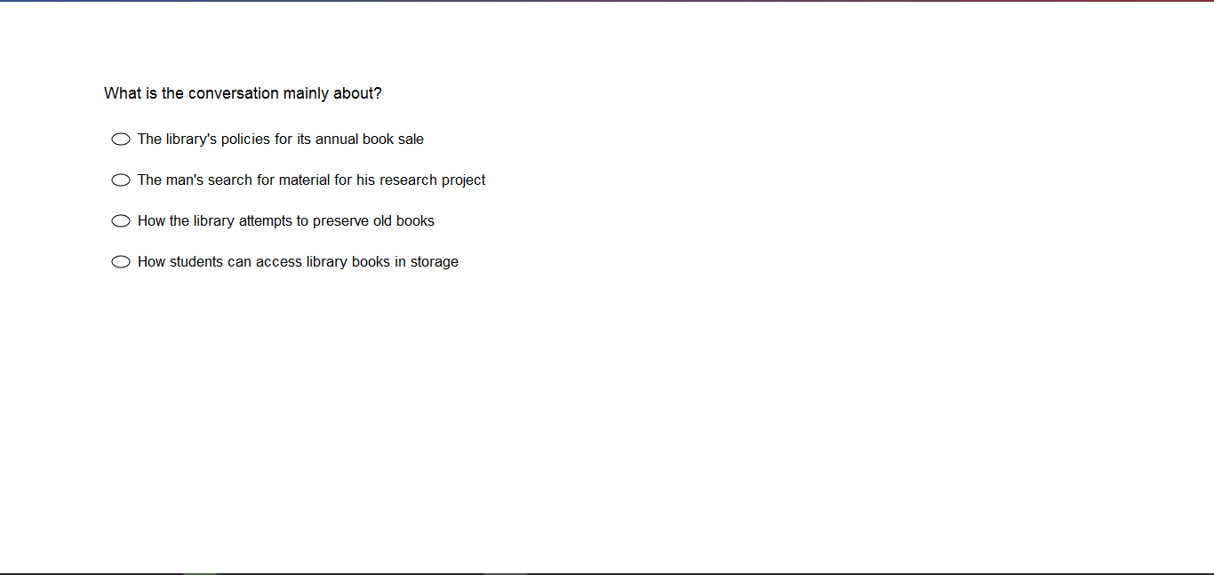
句单
报告
约师
00: 00
x
原
Notes:
不点击“原”，光标随着句子移动

Slide 32
句单
报告
约师
00: 00
(woman) Ready to check out?
(man) Just about, before I do though, this book on early navigation, I’ve been using this book quite a bit for a research project and I’d like to own it actually, and, well, it’s an old book and there were two copies on the shelf just now, so I was wondering if I could buy one? I was talking to this guy the other day and he said the library sold books on occasion. Is that right?
(woman) He’s probably talking about our annual book sale. We have one every spring.
(man) OK, how do you decide which book to sell? Are they duplicates?
(woman) A lot are duplicates. If we have more than one copy of a title and it hasn’t been checked out in a few years, in that case, it might end up in the sale.
(man) I’ve actually tried to find this book on-line but no luck so far. I was really hoping to buy it.
(woman) Well, that particular book, well, it probably won’t be up for sale this year. Most of the books in the sale come from off-site storage.
原
Notes:
点击“原”，呈现原文，点击选择，播放听取全篇，点击喇叭，播放；点击暂停，暂停播放

Slide 33
句单
报告
约师
00: 00
(woman) Ready to check out?
(man) Just about, before I do though, this book on early navigation, I’ve been using this book quite a bit for a research project and I’d like to own it actually, and, well, it’s an old book and there were two copies on the shelf just now, so I was wondering if I could buy one? I was talking to this guy the other day and he said the library sold books on occasion. Is that right?
(woman) He’s probably talking about our annual book sale. We have one every spring.
(man) OK, how do you decide which book to sell? Are they duplicates?
(woman) A lot are duplicates. If we have more than one copy of a title and it hasn’t been checked out in a few years, in that case, it might end up in the sale.
(man) I’ve actually tried to find this book on-line but no luck so far. I was really hoping to buy it.
(woman) Well, that particular book, well, it probably won’t be up for sale this year. Most of the books in the sale come from off-site storage.
x
原
Notes:
原句对应选择答案，点击相应的选项

Slide 34
句单
报告
约师
00: 00
√
(woman) Ready to check out?
(man) Just about, before I do though, this book on early navigation, I’ve been using this book quite a bit for a research project and I’d like to own it actually, and, well, it’s an old book and there were two copies on the shelf just now, so I was wondering if I could buy one? I was talking to this guy the other day and he said the library sold books on occasion. Is that right?
(woman) He’s probably talking about our annual book sale. We have one every spring.
(man) OK, how do you decide which book to sell? Are they duplicates?
(woman) A lot are duplicates. If we have more than one copy of a title and it hasn’t been checked out in a few years, in that case, it might end up in the sale.
(man) I’ve actually tried to find this book on-line but no luck so far. I was really hoping to buy it.
(woman) Well, that particular book, well, it probably won’t be up for sale this year. Most of the books in the sale come from off-site storage.
x
原
Notes:
核对后答案是A

Slide 35
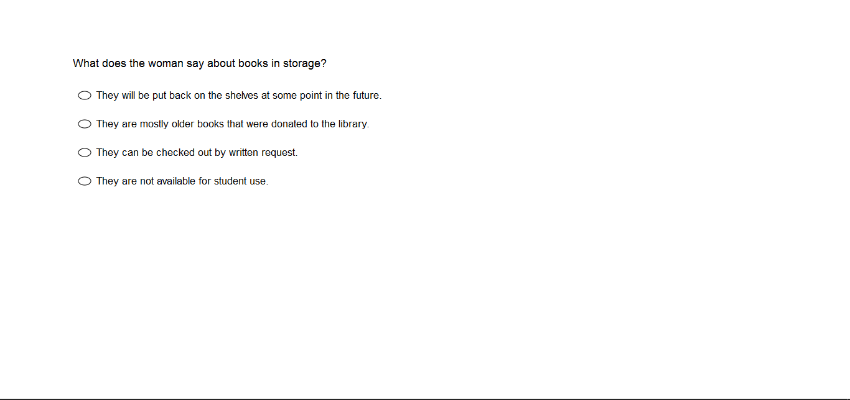
句单
报告
约师
00: 00
x
原
Notes:
回答问题（2）

Slide 36
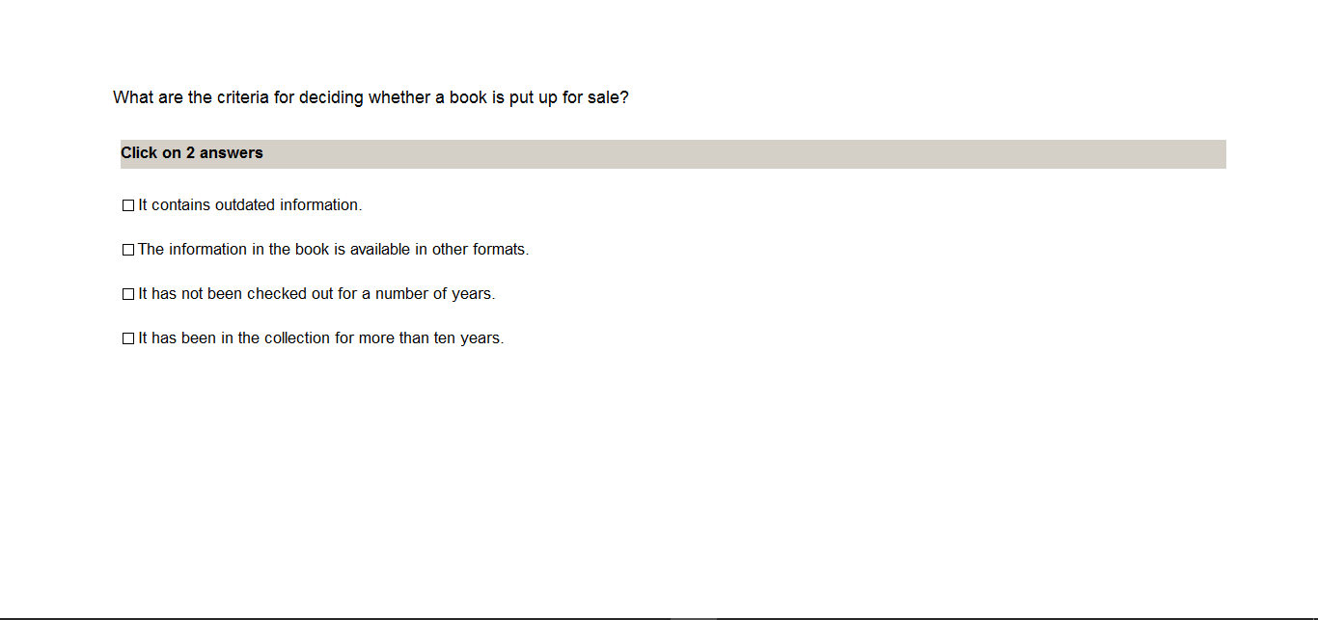
句单
报告
约师
00: 00
x
原
Notes:
回答问题（3）

Slide 37
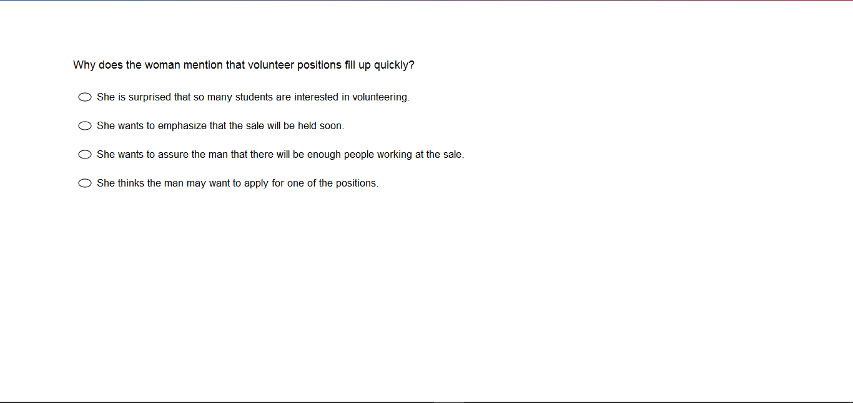
句单
报告
约师
00: 00
x
原
Notes:
回答问题（4）

Slide 38
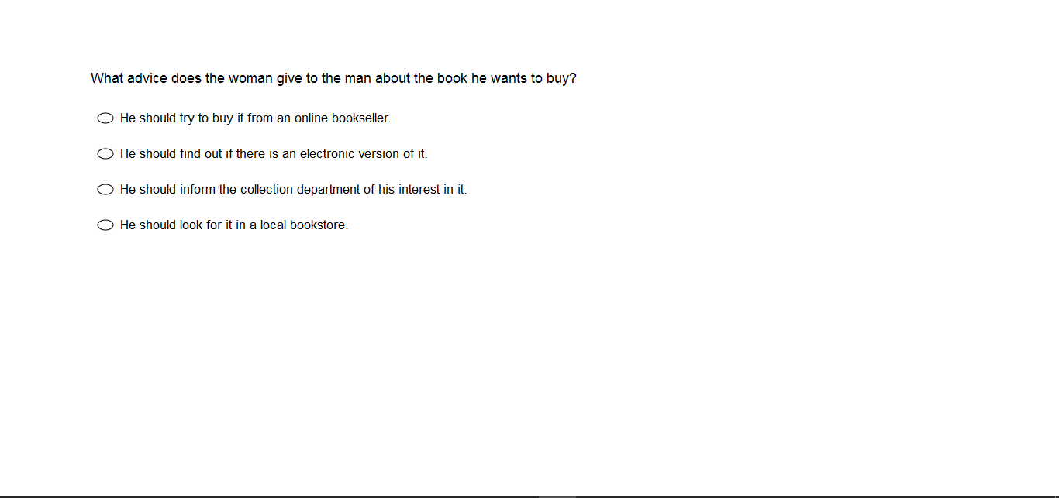
句单
报告
约师
00: 00
x
原
Notes:
回答问题（5）

