Slide 1
2018-11-27

Slide 2
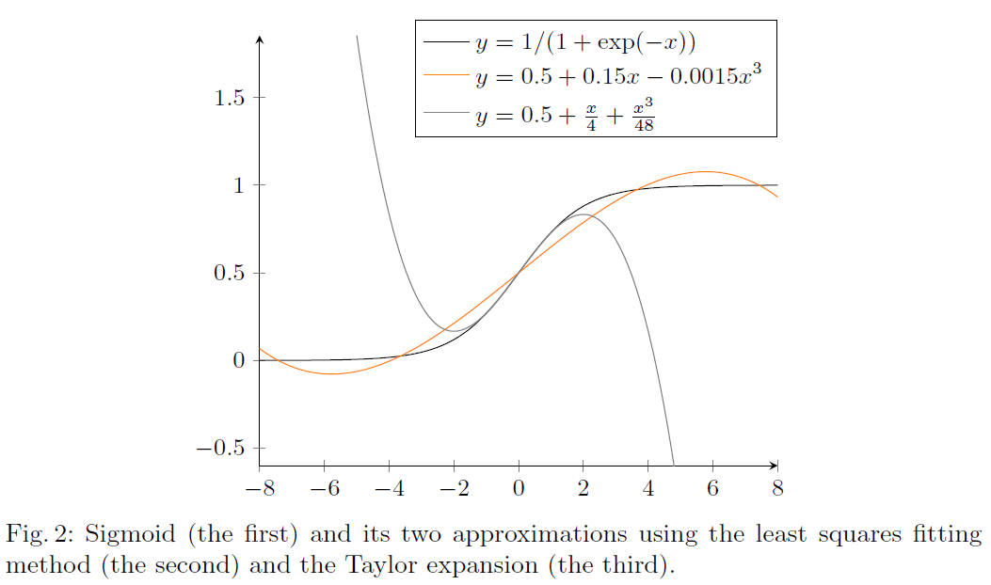
Logistic Regression Based on Homomorphic Encryption
Efficient Logistic Regression on Large Encrypted Data.

Slide 3

Logistic Regression Based on Homomorphic Encryption
$$weights\left[i\right]=weights\left[i\right]+α∙(y_{i}−sigmoid\left(z\right))∙data[i][j]$$
$$⋯⋯+α∙(y_{i}−\left(0.5+0.15∙z−0.0015∙z^{3}\right))∙data[i][j]$$
$$z= \left\langle data\left[i\right], weights\right\rangle$$

