Slide 1
2018-12-11

Slide 2
HEAAN Library
Version
V1.0 Implementation of Original HEAAN scheme
V1.1 Implementation of Original HEAAN scheme with bootstrapping
V2.1 Faster Implementation of HEAAN scheme
版本更新较快
测试用例参数
// TestScheme::testEncrypt(17, 1000, 30, 4);
TestScheme::testEncrypt(17, 1000, 30);
TestScheme::testEncrypt(1200, 30, 4); // HEAAN.cpp

Slide 3
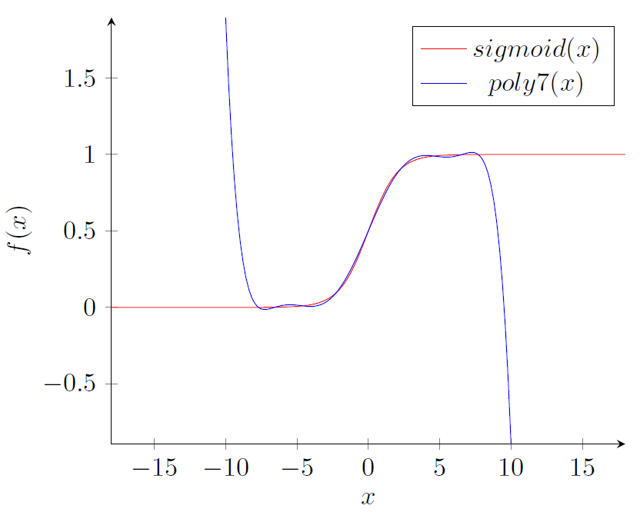
Logistic Regression Based on Homomorphic Encryption
对原始数据预处理（归一化…）、构建模型、评估模型

