Slide 1
2018-07-16

Slide 2
CONTENT
Somewhat Practical Fully Homomorphic Encryption
A review of homomorphic encryption and software tools for encrypted statistical machine learning
Fan and Vercauteren

Slide 3

The scheme of Fan and Vercauteren
Message $m$ must be converted to a polynomial representation $m=m\left(x\right)$.
$m=\sum_{n=0}^{b−1}{a_{n}2^{n}} \underset{⇒}{}$ $m\left(x\right)=\sum_{n=0}^{b−1}{a_{n}x^{n}}$
Key Generation:
The secret key $k_{s}$is simply a uniform random draw from $R_{2}∈\left(−1\right.,\left.1\right]$.
( sample a $b=2^{d−1}$ binary vector for the polynomial coefficients. )

Slide 4
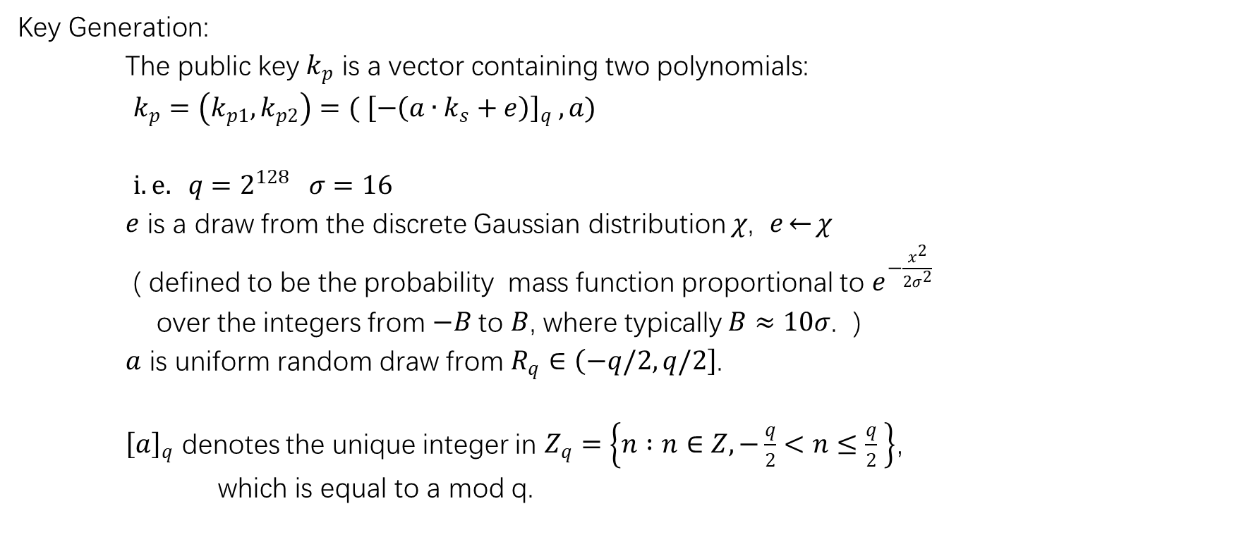
The scheme of Fan and Vercauteren
Key Generation:
The public key $k_{p}$ is a vector containing two polynomials:
$k_{p}=\left(k_{p1},k_{p2}\right)=({ \left[−\left(a∙k_{s}+e\right)\right]}_{q} , a)$
$i.e. q=2^{128} σ=16$
$e$ is a draw from the discrete Gaussian distribution $χ$, $e\overset{←}{}χ$
( defined to be the probability mass function proportional to $e^{−\frac{x^{2}}{2σ^{2}}}$
over the integers from $−B$to $B$, where typically $B≈10σ$. )
$a$ is uniform random draw from $R_{q}∈\left(−q/2\right.,\left.q/2\right]$.
${\left[a\right]}_{q}$ denotes the unique integer in $Z_{q}=\left\{n :n∈Z, −\frac{q}{2}<n≤\frac{q}{2} \right\}$，
which is equal to a mod q.

Slide 5
The scheme of Fan and Vercauteren
Key Generation:
The public key $k_{p}$ is a vector containing two polynomials:
$k_{p}=\left(k_{p1},k_{p2}\right)=({ \left[−\left(a∙k_{s}+e\right)\right]}_{q} , a)$
$i.e. q=2^{128} σ=16$
$e$ is a draw from the discrete Gaussian distribution $χ$, $e\overset{←}{}χ$
( defined to be the probability mass function proportional to $e^{−\frac{x^{2}}{2σ^{2}}}$
over the integers from $−B$to $B$, where typically $B≈10σ$. )
$a$ is uniform random draw from $R_{q}∈\left(−q/2\right.,\left.q/2\right]$.
${\left[a\right]}_{q}$ denotes the unique integer in $Z_{q}=\left\{n :n∈Z, −\frac{q}{2}<n≤\frac{q}{2} \right\}$，
which is equal to a mod q.

Slide 6
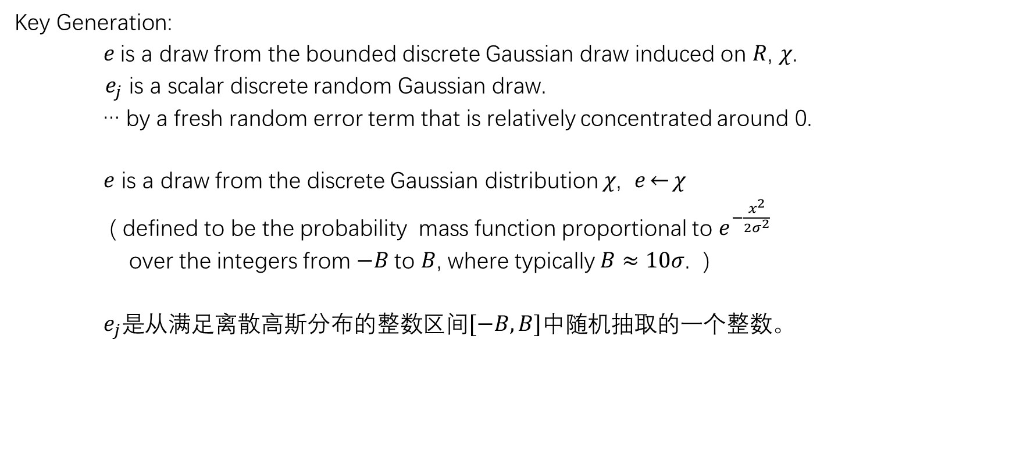
The scheme of Fan and Vercauteren
Key Generation:
$e$is a draw from the bounded discrete Gaussian draw induced on $R$, $χ$.
$e_{j}$ is a scalar discrete random Gaussian draw.
… by a fresh random error term that is relatively concentrated around 0.
$e$ is a draw from the discrete Gaussian distribution $χ$, $e\overset{←}{}χ$
( defined to be the probability mass function proportional to $e^{−\frac{x^{2}}{2σ^{2}}}$
over the integers from $−B$to $B$, where typically $B≈10σ$. )
$e_{j}是$从满足离散高斯分布的整数区间$[−B, B]$中随机抽取的一个整数。

Slide 7

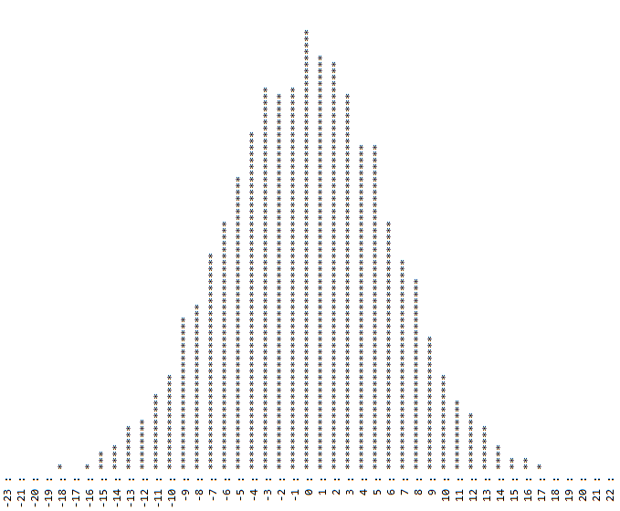
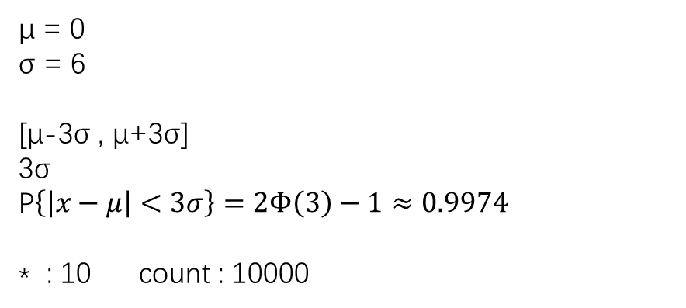
The scheme of Fan and Vercauteren
μ = 0
σ = 6
[μ-3σ , μ+3σ]
3σ
P$\left\{\left|x−μ\right|<3σ\right\}=2Φ\left(3\right)−1≈0.9974$
* : 10 count : 10000
a draw from the discrete Gaussian draw over [-10σ , 10σ]

Slide 8
The scheme of Fan and Vercauteren
μ = 0
σ = 6
[μ-3σ , μ+3σ]
3σ
P$\left\{\left|x−μ\right|<3σ\right\}=2Φ\left(3\right)−1≈0.9974$
* : 10 count : 10000
a draw from the discrete Gaussian draw over [-10σ , 10σ]

Slide 9
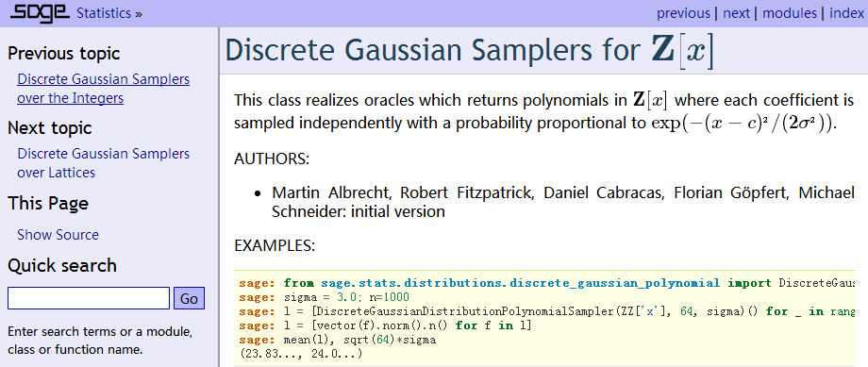
The scheme of Fan and Vercauteren
http://www.sagemath.org/

Slide 10
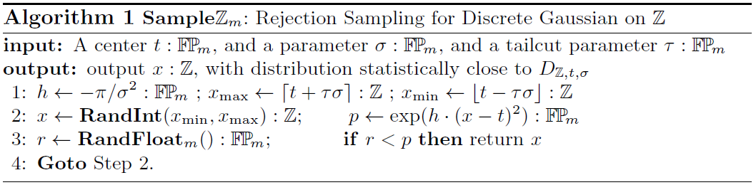
Rejection Sampling for Discrete Gaussian on Z
Faster Gaussian Lattice Sampling using Lazy Floating-Point Arithmetic
Léo Ducas and Phong Q. Nguyen

Slide 11
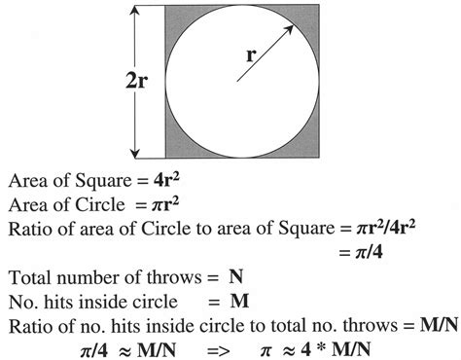

Estimating the value of $π$
Estimating the value of "Pi" by Monte Carlo Methods

Slide 12
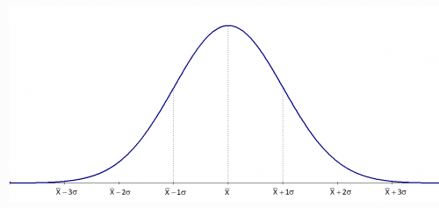
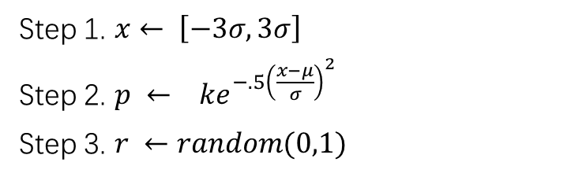
Rejection Sampling for Discrete Gaussian on Z
Step 1. $x← \left[−3σ, 3σ\right]$
Step 2. $p ← ke^{−.5{\left(\frac{x−μ}{σ}\right)}^{2}}$
Step 3. $r ←random(0,1)$

Slide 13
The scheme of Fan and Vercauteren
FV scheme : Encrypt, Decrypt, Add, Multiply
Next : Turn somewhat HE to Fully HE

