Slide 1
2018-07-30

Slide 2
Fully Homomorphic Encryption without Bootstrapping
Zvika Brakerski Craig Gentry Vinod Vaikuntanathan
Efficient Fully Homomorphic Encryption from (Standard) LWE
Zvika Brakerski Vinod Vaikuntanathan

Slide 3
Efficient Fully Homomorphic Encryption from (Standard) LWE
Zvika Brakerski Vinod Vaikuntanathan
Show that Somewhat HE can be based on LWE,
using a new re-linearization technique.
We introduce a new dimension-modulus reduction technique,
which shortens the ciphertexts and reduces the decryption complexity

Slide 4
Efficient Fully Homomorphic Encryption from (Standard) LWE
Zvika Brakerski Vinod Vaikuntanathan
Re-linearization technique:
does not require hardness assumptions on ideals.
In contrast, all previous schemes relied on complexity assumptions
related to ideals in various rings.

Slide 5
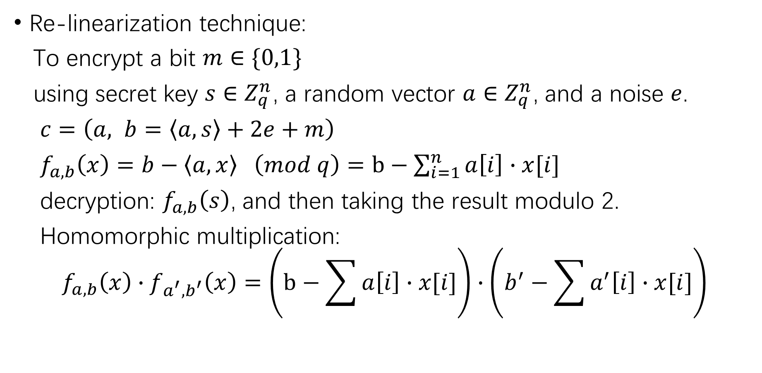
Re-linearization technique:
To encrypt a bit $m∈\{0,1\}$
using secret key $s∈Z_{q}^{n}$, a random vector $a∈Z_{q}^{n}$, and a noise $e$.
$c=\left(a, b=\left\langle a, s\right\rangle +2e+m\right)$
$f_{a,b}\left(x\right)=b−\left\langle a, x\right\rangle \left(mod q\right)=b−\sum_{i=1}^{n}{a\left[i\right]}∙x[i]$
decryption: $f_{a,b}\left(s\right)$, and then taking the result modulo 2.
Homomorphic multiplication:
$$f_{a,b}\left(x\right)∙f_{a^{′},b^{′}}\left(x\right)=\left(b−\sum{a\left[i\right]}∙x[i]\right)∙\left(b^{′}−\sum{a^{′}\left[i\right]}∙x[i]\right)$$

Slide 6
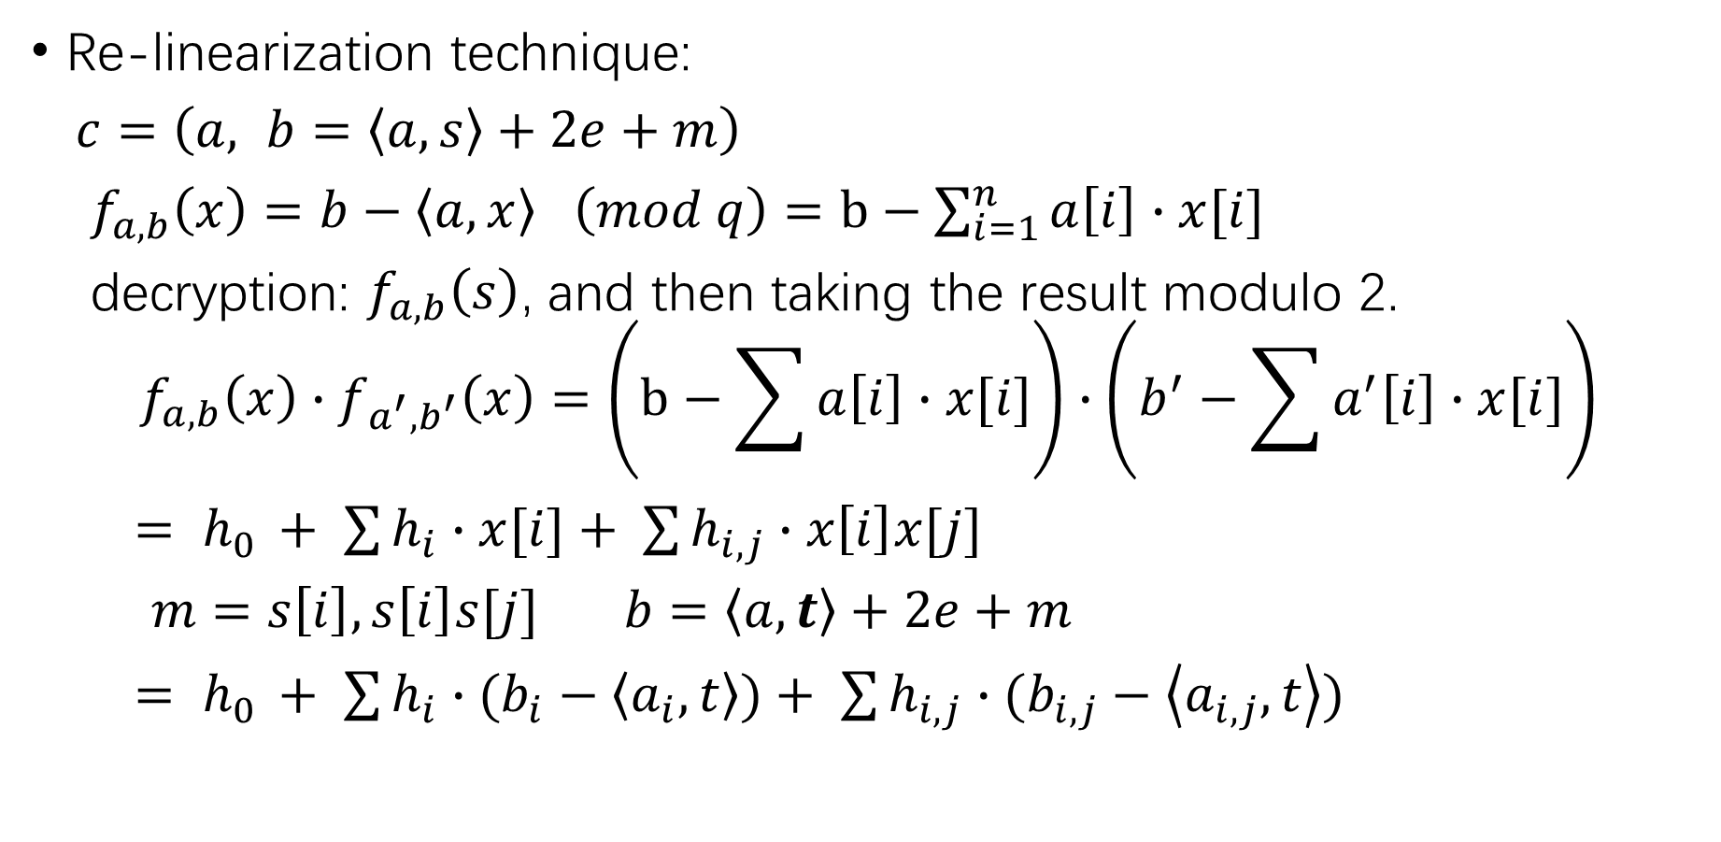
Re-linearization technique:
$c=\left(a, b=\left\langle a, s\right\rangle +2e+m\right)$
$f_{a,b}\left(x\right)=b−\left\langle a, x\right\rangle \left(mod q\right)=b−\sum_{i=1}^{n}{a\left[i\right]}∙x[i]$
decryption: $f_{a,b}\left(s\right)$, and then taking the result modulo 2.
$$f_{a,b}\left(x\right)∙f_{a^{′},b^{′}}\left(x\right)=\left(b−\sum{a\left[i\right]}∙x[i]\right)∙\left(b^{′}−\sum{a^{′}\left[i\right]}∙x[i]\right)$$
$= h_{0 }+ \sum{h_{i}∙x[i]}+ \sum{h_{i, j}}∙x\left[i\right]x[j]$
$m=s\left[i\right],s\left[i\right]s[j] b=\left\langle a, t\right\rangle +2e+m$
$= h_{0 }+ \sum{h_{i}∙(b_{i}−\left\langle a_{i}, t\right\rangle )}+ \sum{h_{i, j}}∙(b_{i,j}−\left\langle a_{i,j}, t\right\rangle )$

Slide 7
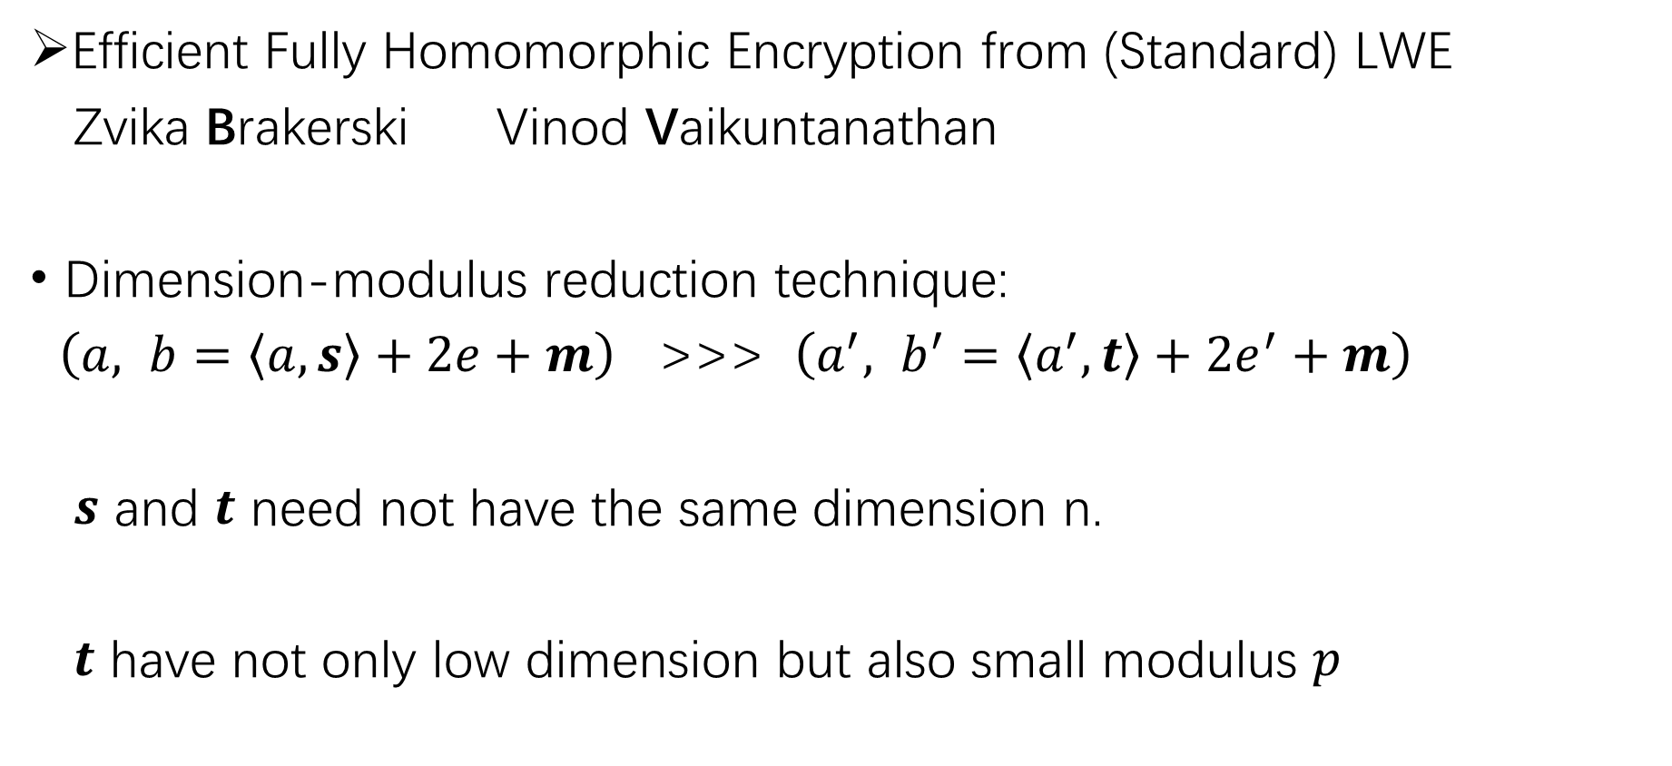
Efficient Fully Homomorphic Encryption from (Standard) LWE
Zvika Brakerski Vinod Vaikuntanathan
Dimension-modulus reduction technique:
$\left(a, b=\left\langle a, s\right\rangle +2e+m\right)$ >>> $\left(a^{′}, b^{′}=\left\langle a^{′}, t\right\rangle +2e^{′}+m\right)$
$s$ and $t$ need not have the same dimension n.
$t$ have not only low dimension but also small modulus $p$

Slide 8
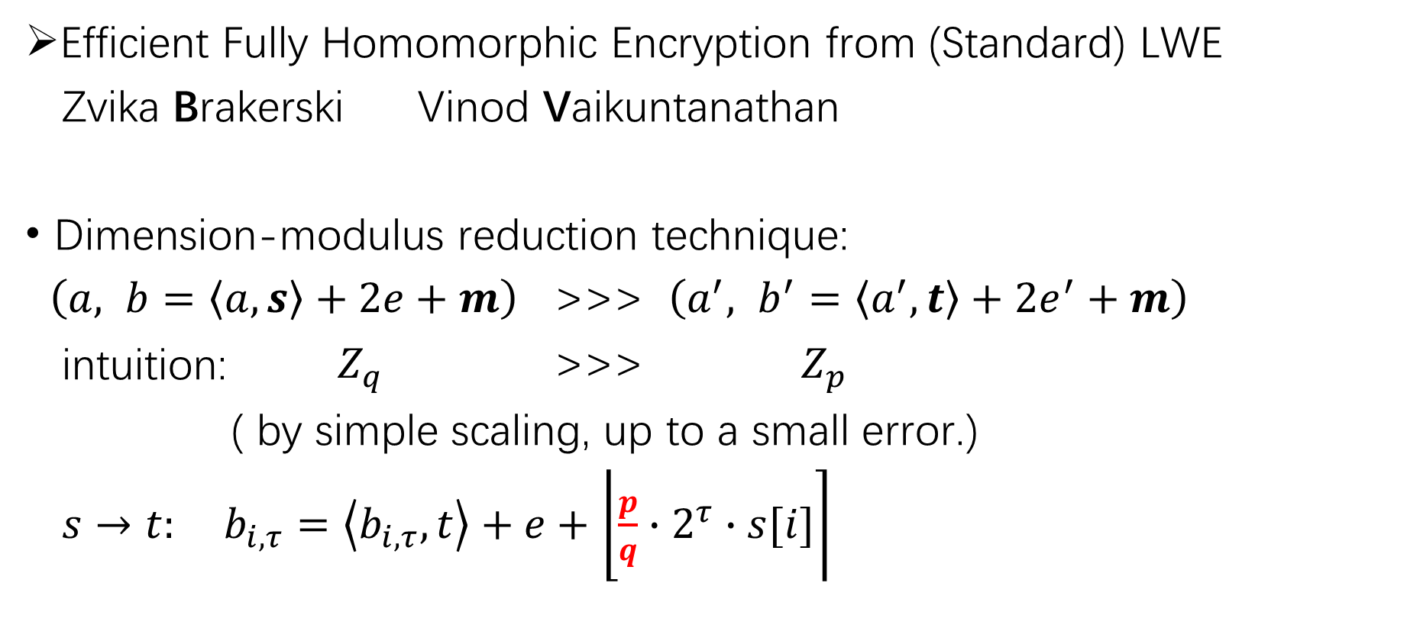
Efficient Fully Homomorphic Encryption from (Standard) LWE
Zvika Brakerski Vinod Vaikuntanathan
Dimension-modulus reduction technique:
$\left(a, b=\left\langle a, s\right\rangle +2e+m\right)$ >>> $\left(a^{′}, b^{′}=\left\langle a^{′}, t\right\rangle +2e^{′}+m\right)$
intuition: $Z_{q}$ >>> $Z_{p}$
( by simple scaling, up to a small error.)
$s→t:$ $b_{i,τ}=\left\langle b_{i,τ}, t\right\rangle +e+$ $\left.\left\lfloor \frac{p}{q}\right.∙2^{τ}∙s[i]\right\rceil$

Slide 9
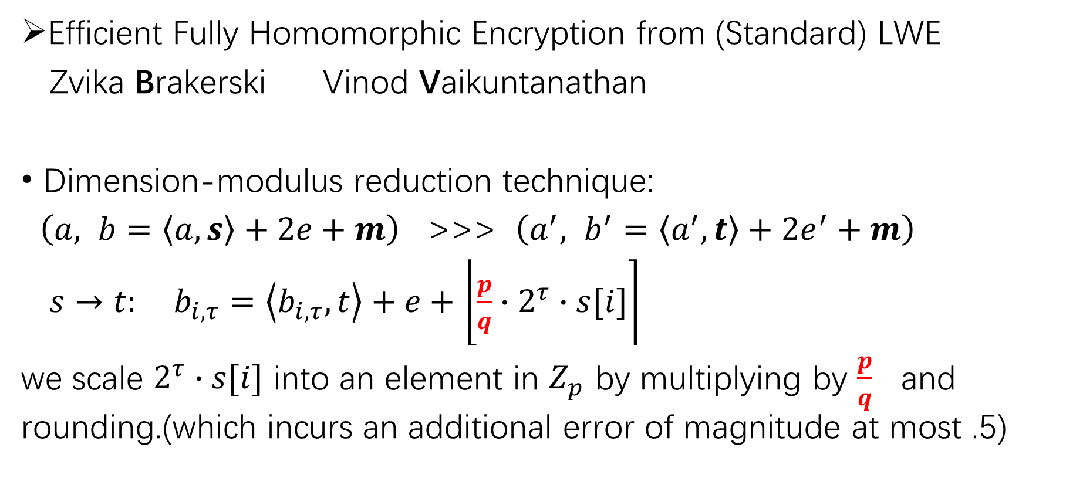
Efficient Fully Homomorphic Encryption from (Standard) LWE
Zvika Brakerski Vinod Vaikuntanathan
Dimension-modulus reduction technique:
$\left(a, b=\left\langle a, s\right\rangle +2e+m\right)$ >>> $\left(a^{′}, b^{′}=\left\langle a^{′}, t\right\rangle +2e^{′}+m\right)$
$s→t:$ $b_{i,τ}=\left\langle b_{i,τ}, t\right\rangle +e+$ $\left.\left\lfloor \frac{p}{q}\right.∙2^{τ}∙s[i]\right\rceil$
we scale $2^{τ}∙s[i]$ into an element in $Z_{p}$ by multiplying by $\frac{p}{q}$ and rounding.(which incurs an additional error of magnitude at most .5)

Slide 10
Efficient Fully Homomorphic Encryption from (Standard) LWE
Zvika Brakerski Vinod Vaikuntanathan
Re-linearization: FV RLWE
Dimension-modulus reduction: BGV

Slide 11
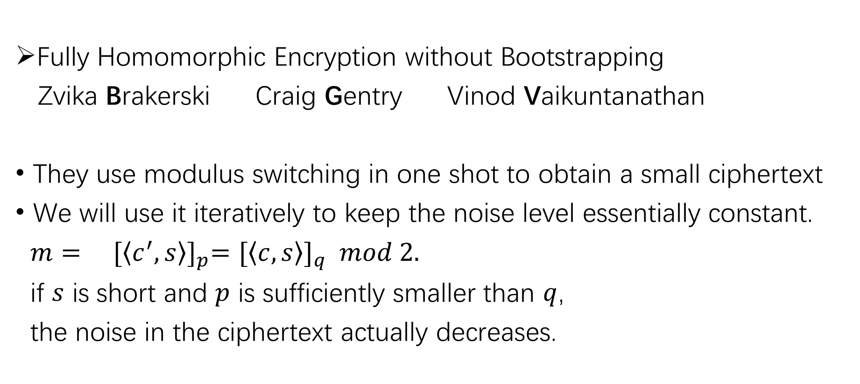
Fully Homomorphic Encryption without Bootstrapping
Zvika Brakerski Craig Gentry Vinod Vaikuntanathan
They use modulus switching in one shot to obtain a small ciphertext
We will use it iteratively to keep the noise level essentially constant.
$m= {[\left\langle c^{′}, s\right\rangle ]}_{p}={[\left\langle c, s\right\rangle ]}_{q} mod 2.$
if $s$ is short and $p$ is sufficiently smaller than $q$,
the noise in the ciphertext actually decreases.

Slide 12
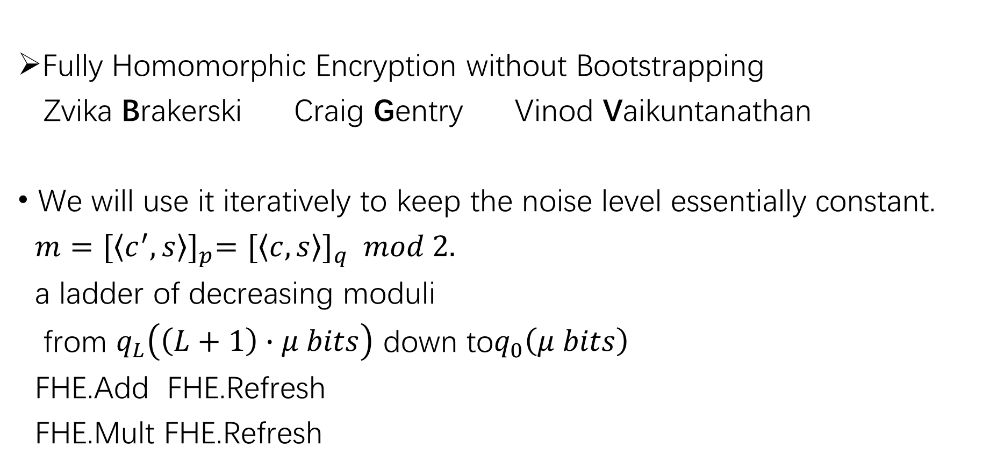
Fully Homomorphic Encryption without Bootstrapping
Zvika Brakerski Craig Gentry Vinod Vaikuntanathan
We will use it iteratively to keep the noise level essentially constant.
$m={[\left\langle c^{′}, s\right\rangle ]}_{p}={[\left\langle c, s\right\rangle ]}_{q} mod 2.$
a ladder of decreasing moduli
from $q_{L}\left(\left(L+1\right)∙μ bits\right)$ down to$q_{0}\left(μ bits\right)$
FHE.Add FHE.Refresh
FHE.Mult FHE.Refresh

Slide 13
目前已有的两个实现方案
BGV方案: Helib (Linux)
Java BGV

