Slide 1
2018-09-10

Slide 2
ML Condential: Machine Learning on Encrypted Data
Thore Graepel, Kristin Lauter, and Michael Naehrig
ML Confidential Protocol
Linear Means (LM) Classier
Fisher's Linear Discriminant(FLD) Classier
（on a publicly available data set）

Slide 3
ML Confidential Protocol
Key Generation: The Data Owner executes the HE.Keygen algorithm
publishes the public key, securely stores the private key locally
Encryption and Upload of Training Data: … encrypt preprocessed
version of the training set data, i.e. sufficient statistics
Training:
Classification:
Verification of the Learned Model:

Slide 4
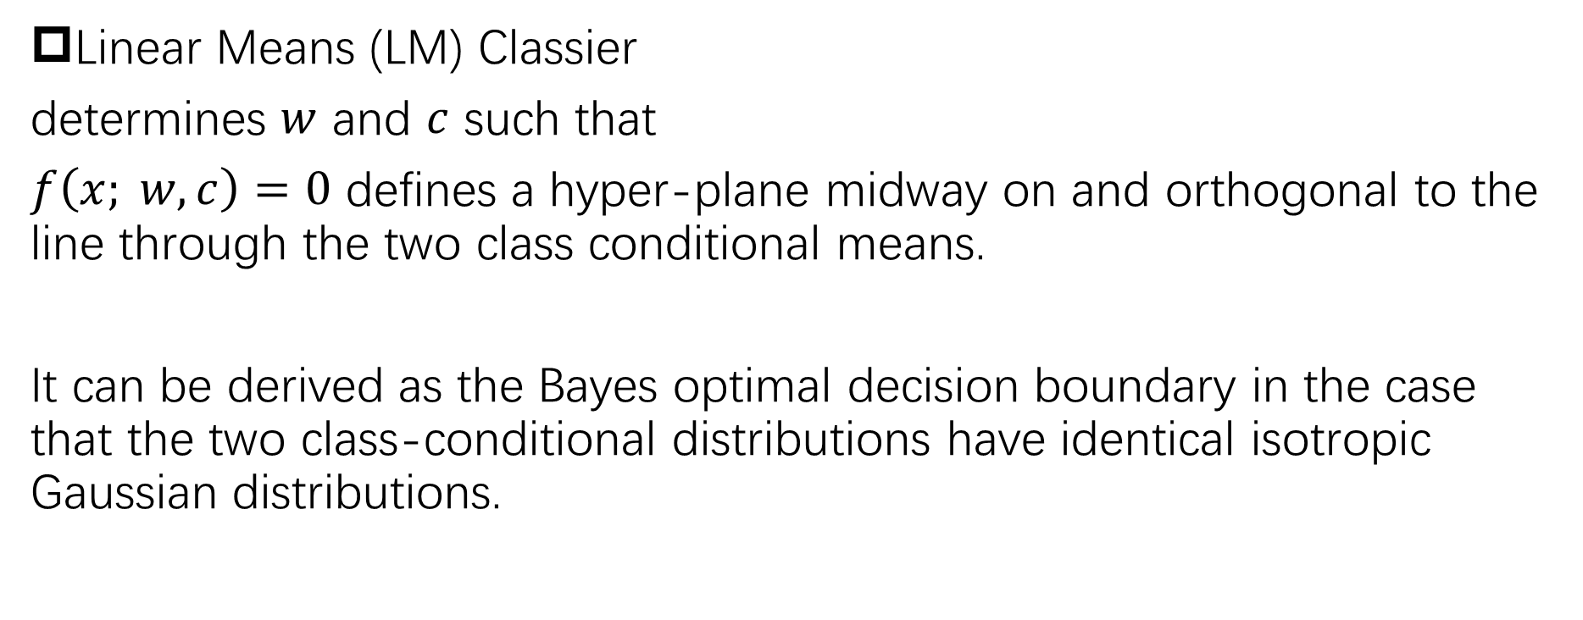
Linear Means (LM) Classier
determines $w$ and $c$ such that
$f\left(x; w,c\right)=0$ defines a hyper-plane midway on and orthogonal to the line through the two class conditional means.
It can be derived as the Bayes optimal decision boundary in the case that the two class-conditional distributions have identical isotropic Gaussian distributions.

Slide 5
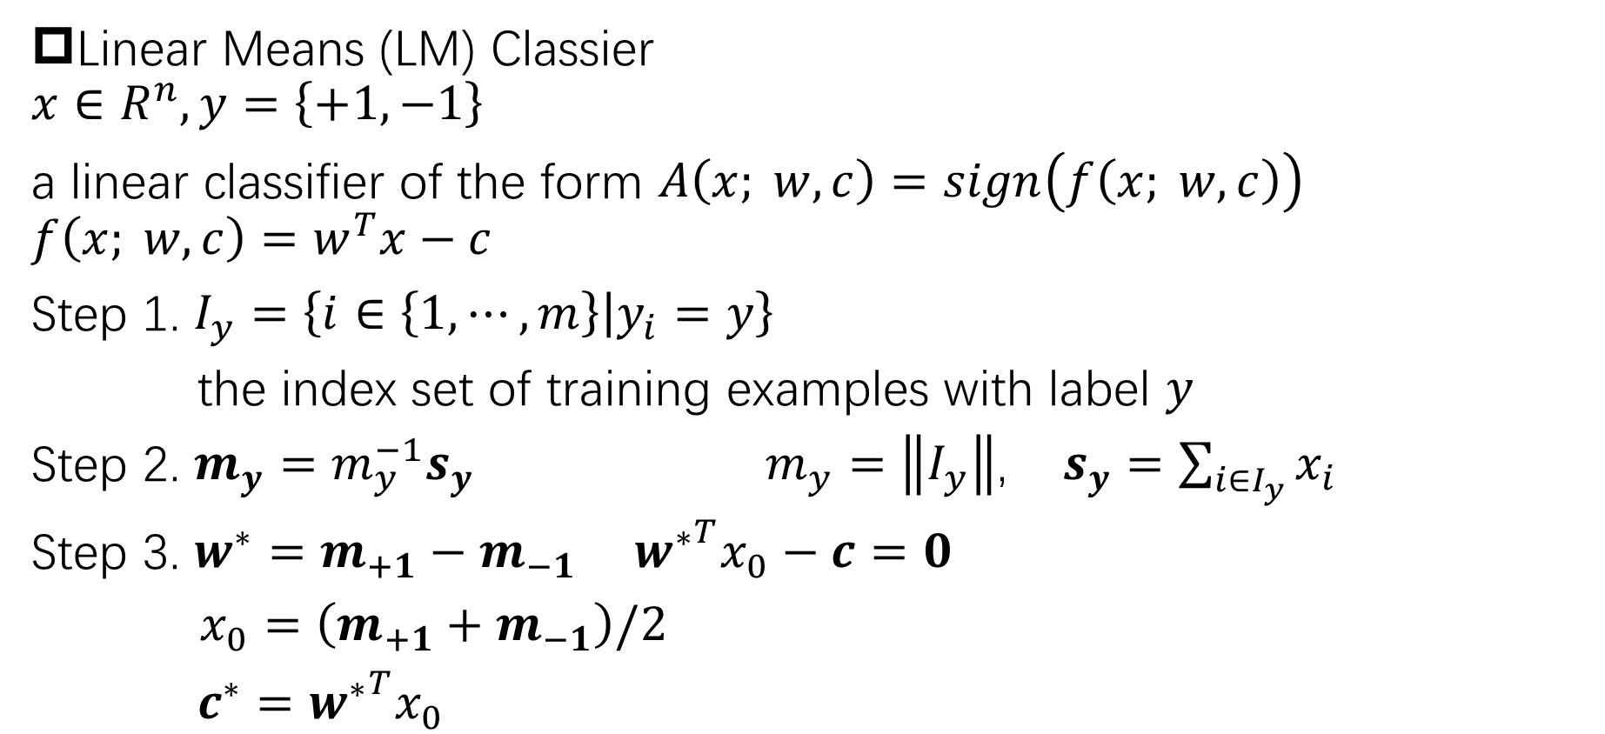
Linear Means (LM) Classier
$$x∈R^{n}, y=\left\{+1, −1\right\}$$
a linear classifier of the form $A\left(x; w,c\right)=sign\left(f\left(x; w,c\right)\right)$
$$f\left(x; w,c\right)=w^{T}x−c$$
Step 1. $I_{y}=\left\{i∈\left\{1,⋯,m\right\}\left|y_{i}=y\right.\right\}$
the index set of training examples with label $y$
Step 2. $m_{y}=m_{y}^{−1}s_{y}$ $m_{y}=\left\|I_{y}\right\|$, $s_{y}=\sum_{i∈I_{y}}{x_{i}}$
Step 3. $w^{∗}=m_{+1}−m_{−1}$ ${w^{∗}}^{T}x_{0}−c=0$
$x_{0}=\left(m_{+1}+m_{−1}\right)/2$
$c^{∗}={w^{∗}}^{T}x_{0}$

Slide 6
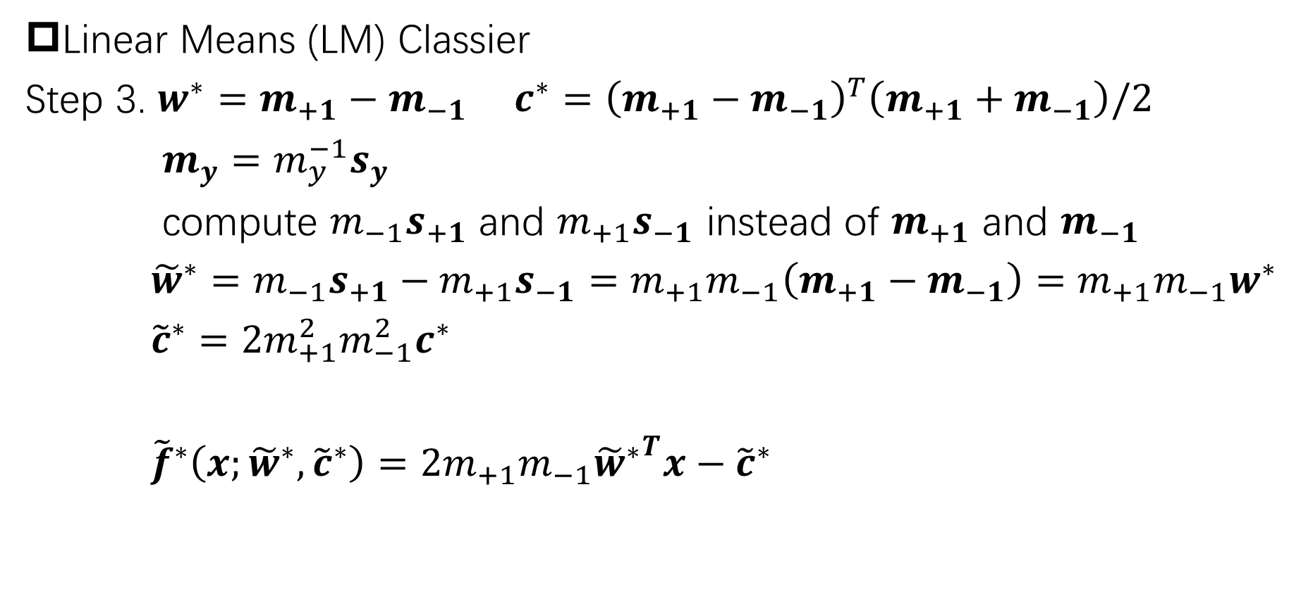
Linear Means (LM) Classier
Step 3. $w^{∗}=m_{+1}−m_{−1}$ $c^{∗}={\left(m_{+1}−m_{−1}\right)}^{T}\left(m_{+1}+m_{−1}\right)/2$
$m_{y}=m_{y}^{−1}s_{y}$
compute $m_{−1}s_{+1}$ and $m_{+1}s_{−1}$ instead of $m_{+1}$ and $m_{−1}$
${\tilde{w}}^{∗}=m_{−1}s_{+1}−m_{+1}s_{−1}=m_{+1}m_{−1}\left(m_{+1}−m_{−1}\right)=m_{+1}m_{−1}w^{∗}$
${\tilde{c}}^{∗}=2m_{+1}^{2}m_{−1}^{2}c^{∗}$
${\tilde{f}}^{∗}\left(x;{\tilde{w}}^{∗},{\tilde{c}}^{∗}\right)=2m_{+1}m_{−1}{{\tilde{w}}^{∗}}^{T}x−{\tilde{c}}^{∗}$

