Slide 1
2018-09-17

Slide 2
ML Condential: Machine Learning on Encrypted Data
Thore Graepel, Kristin Lauter, and Michael Naehrig
ML Confidential Protocol
Linear Means (LM) Classier
Fisher's Linear Discriminant(FLD) Classier
（on a publicly available data set）

Slide 3
ML Confidential Protocol
Key Generation: The Data Owner executes the HE.Keygen algorithm
publishes the public key, securely stores the private key locally
Encryption and Upload of Training Data: … encrypt preprocessed
version of the training set data, i.e. sufficient statistics
Training:
Classification:
Verification of the Learned Model:

Slide 4
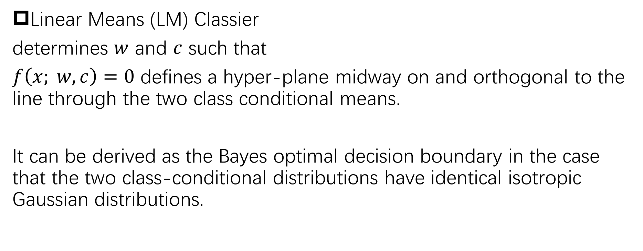
Linear Means (LM) Classier
determines $w$ and $c$ such that
$f\left(x; w,c\right)=0$ defines a hyper-plane midway on and orthogonal to the line through the two class conditional means.
It can be derived as the Bayes optimal decision boundary in the case that the two class-conditional distributions have identical isotropic Gaussian distributions.

Slide 5
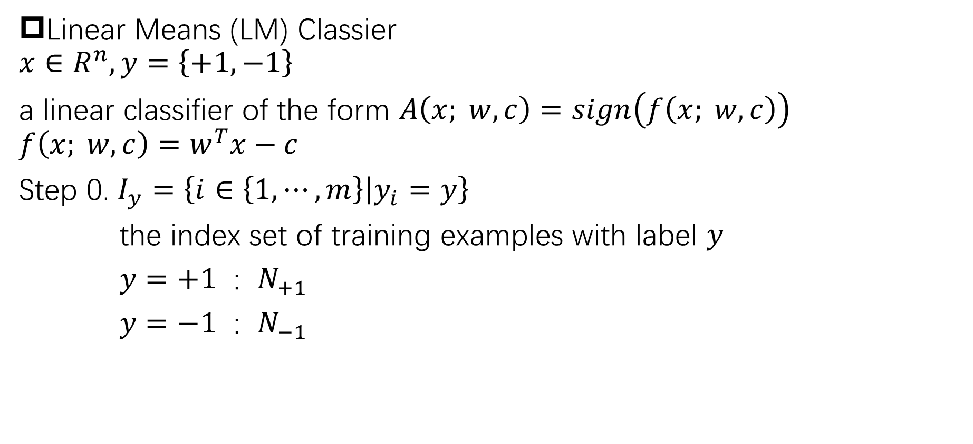
Linear Means (LM) Classier
$$x∈R^{n}, y=\left\{+1, −1\right\}$$
a linear classifier of the form $A\left(x; w,c\right)=sign\left(f\left(x; w,c\right)\right)$
$$f\left(x; w,c\right)=w^{T}x−c$$
Step 0. $I_{y}=\left\{i∈\left\{1,⋯,m\right\}\left|y_{i}=y\right.\right\}$
the index set of training examples with label $y$
$y=+1$ : $N_{+1}$
$y=−1$ : $N_{−1}$

Slide 6
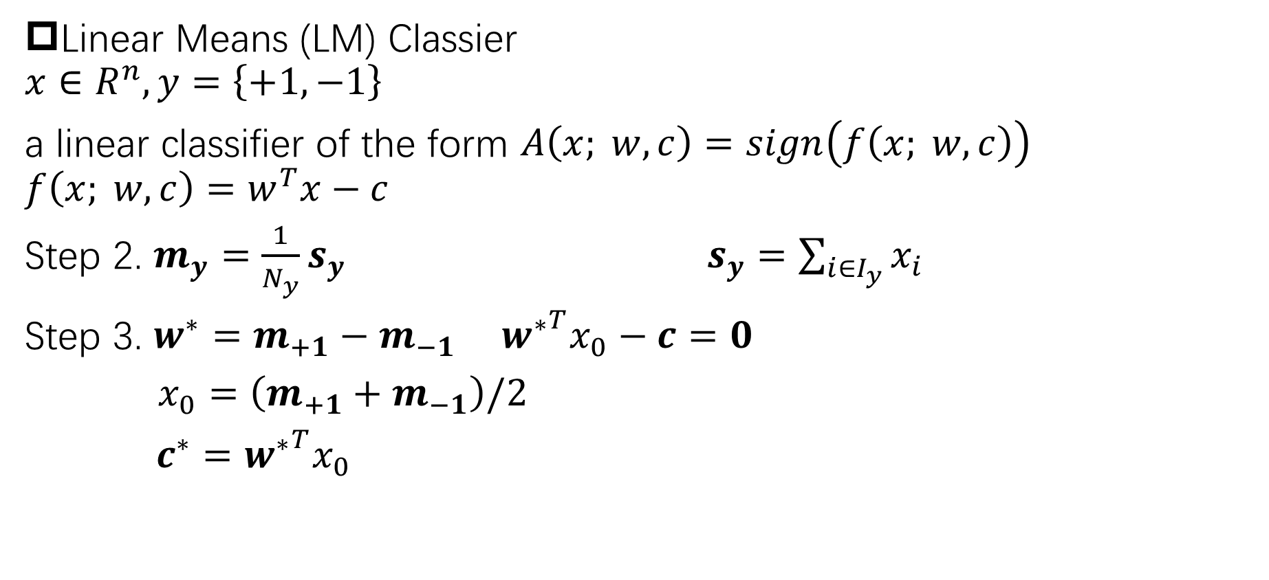
Linear Means (LM) Classier
$$x∈R^{n}, y=\left\{+1, −1\right\}$$
a linear classifier of the form $A\left(x; w,c\right)=sign\left(f\left(x; w,c\right)\right)$
$$f\left(x; w,c\right)=w^{T}x−c$$
Step 2. $m_{y}=\frac{1}{N_{y}}s_{y}$ $s_{y}=\sum_{i∈I_{y}}{x_{i}}$
Step 3. $w^{∗}=m_{+1}−m_{−1}$ ${w^{∗}}^{T}x_{0}−c=0$
$x_{0}=\left(m_{+1}+m_{−1}\right)/2$
$c^{∗}={w^{∗}}^{T}x_{0}$

Slide 7
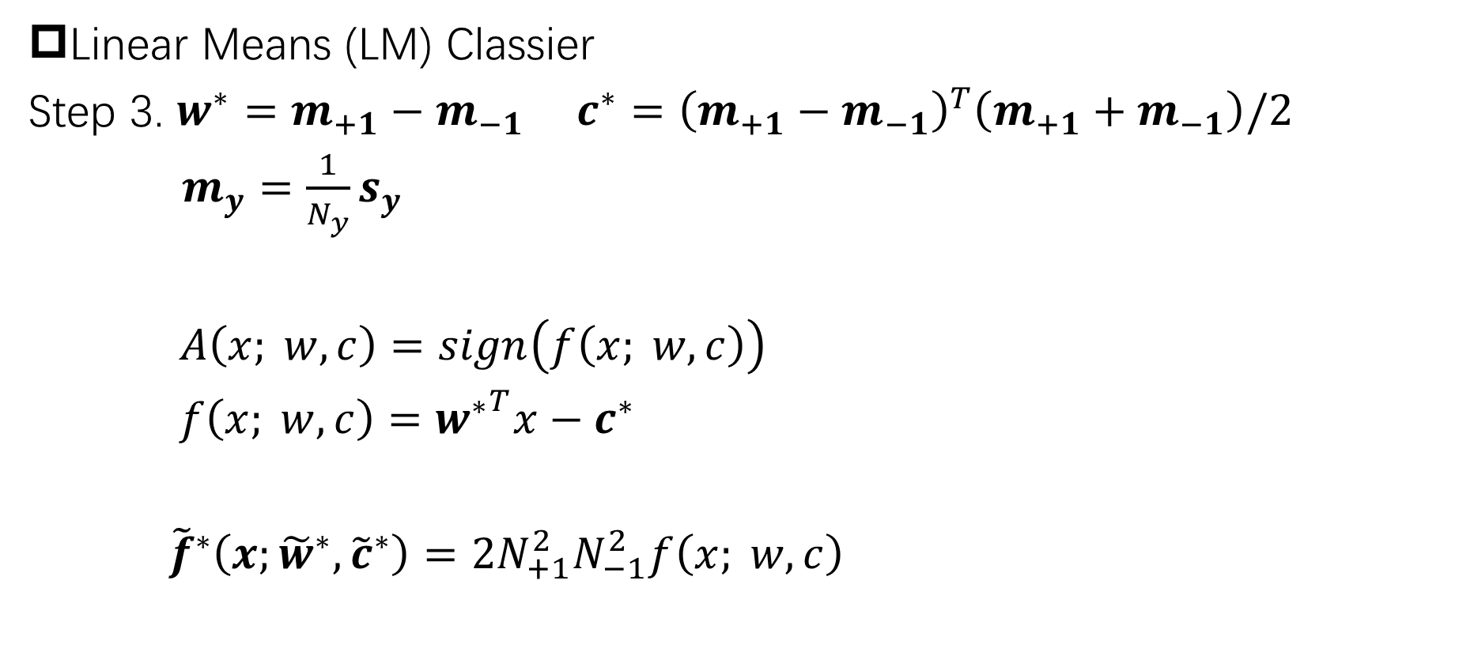
Linear Means (LM) Classier
Step 3. $w^{∗}=m_{+1}−m_{−1}$ $c^{∗}={\left(m_{+1}−m_{−1}\right)}^{T}\left(m_{+1}+m_{−1}\right)/2$
$m_{y}=\frac{1}{N_{y}}s_{y}$
$A\left(x; w,c\right)=sign\left(f\left(x; w,c\right)\right)$
$f\left(x; w,c\right)={w^{∗}}^{T}x−c^{∗}$
${\tilde{f}}^{∗}\left(x;{\tilde{w}}^{∗},{\tilde{c}}^{∗}\right)=2N_{+1}^{2}N_{−1}^{2}f\left(x; w,c\right)$

Slide 8
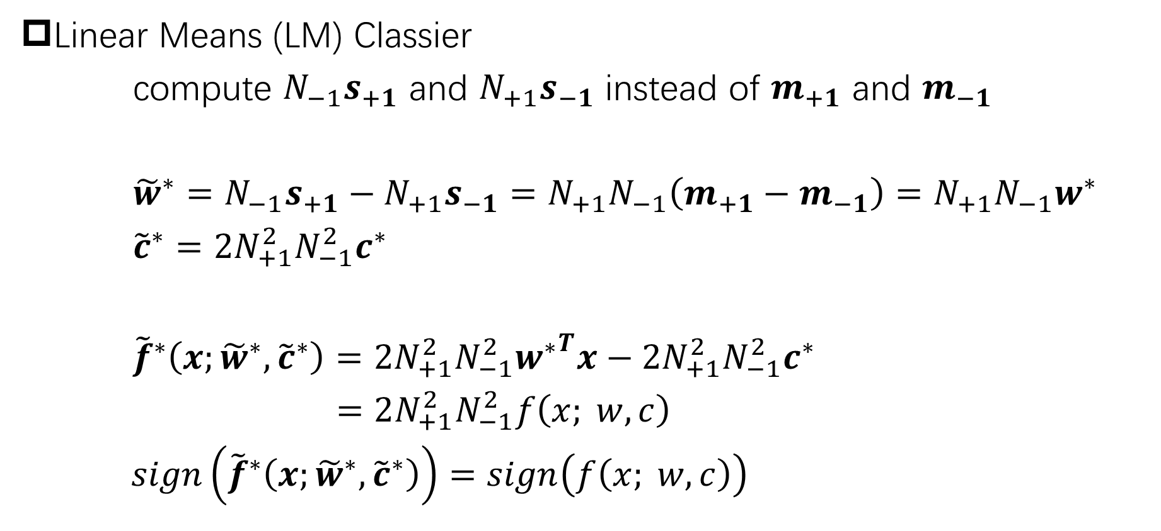
Linear Means (LM) Classier
compute $N_{−1}s_{+1}$ and $N_{+1}s_{−1}$ instead of $m_{+1}$ and $m_{−1}$
${\tilde{w}}^{∗}=N_{−1}s_{+1}−N_{+1}s_{−1}=N_{+1}N_{−1}\left(m_{+1}−m_{−1}\right)=N_{+1}N_{−1}w^{∗}$
${\tilde{c}}^{∗}=2N_{+1}^{2}N_{−1}^{2}c^{∗}$
${\tilde{f}}^{∗}\left(x;{\tilde{w}}^{∗},{\tilde{c}}^{∗}\right)=2N_{+1}^{2}N_{−1}^{2}{w^{∗}}^{T}x−2N_{+1}^{2}N_{−1}^{2}c^{∗}$
$=2N_{+1}^{2}N_{−1}^{2}f\left(x; w,c\right)$
$sign\left({\tilde{f}}^{∗}\left(x;{\tilde{w}}^{∗},{\tilde{c}}^{∗}\right)\right)=sign\left(f\left(x; w,c\right)\right)$

Slide 9
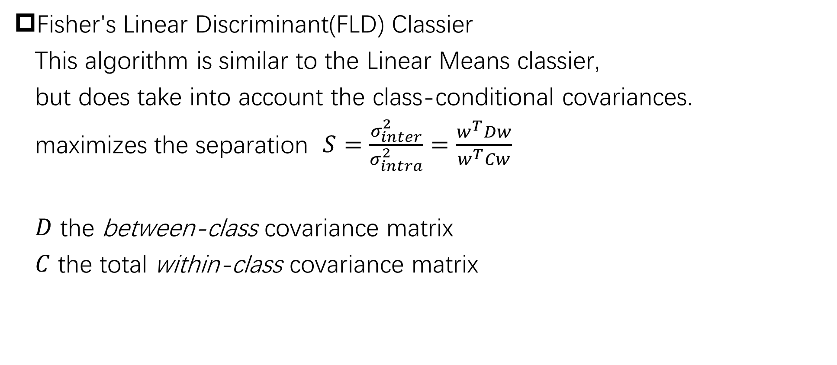
Fisher's Linear Discriminant(FLD) Classier
This algorithm is similar to the Linear Means classier,
but does take into account the class-conditional covariances.
maximizes the separation $S=\frac{σ_{inter}^{2}}{σ_{intra}^{2}}=\frac{w^{T}Dw}{w^{T}Cw}$
$D$ the between-class covariance matrix
$C$ the total within-class covariance matrix

Slide 10
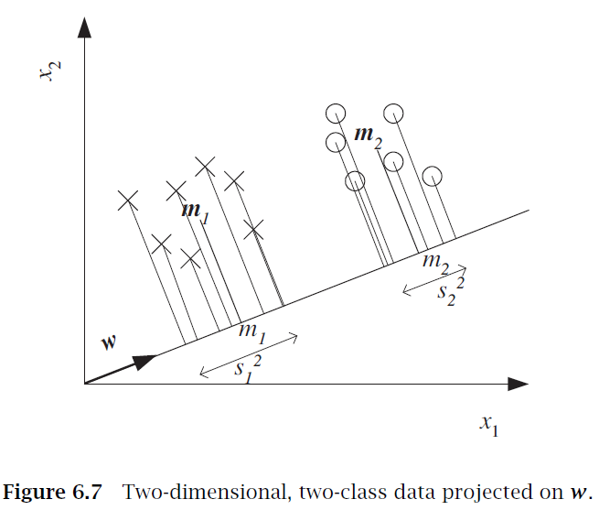

Fisher's Linear Discriminant(FLD) Classier
want $\left|m_{1}−m_{2}\right|$ to be large
and $s_{1}^{2}+s_{2}^{2}$ to be small
Introduction to Machine Learning (2nd) Ethem Alpaydın

Slide 11
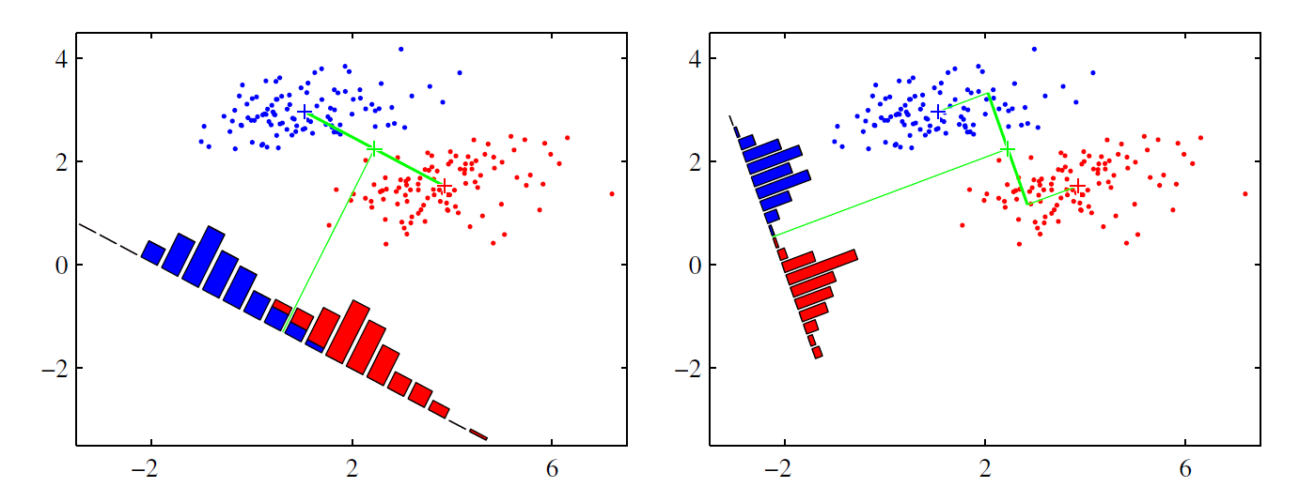
Pattern Recognition and Machine Learning Christopher M. Bishop

Slide 12
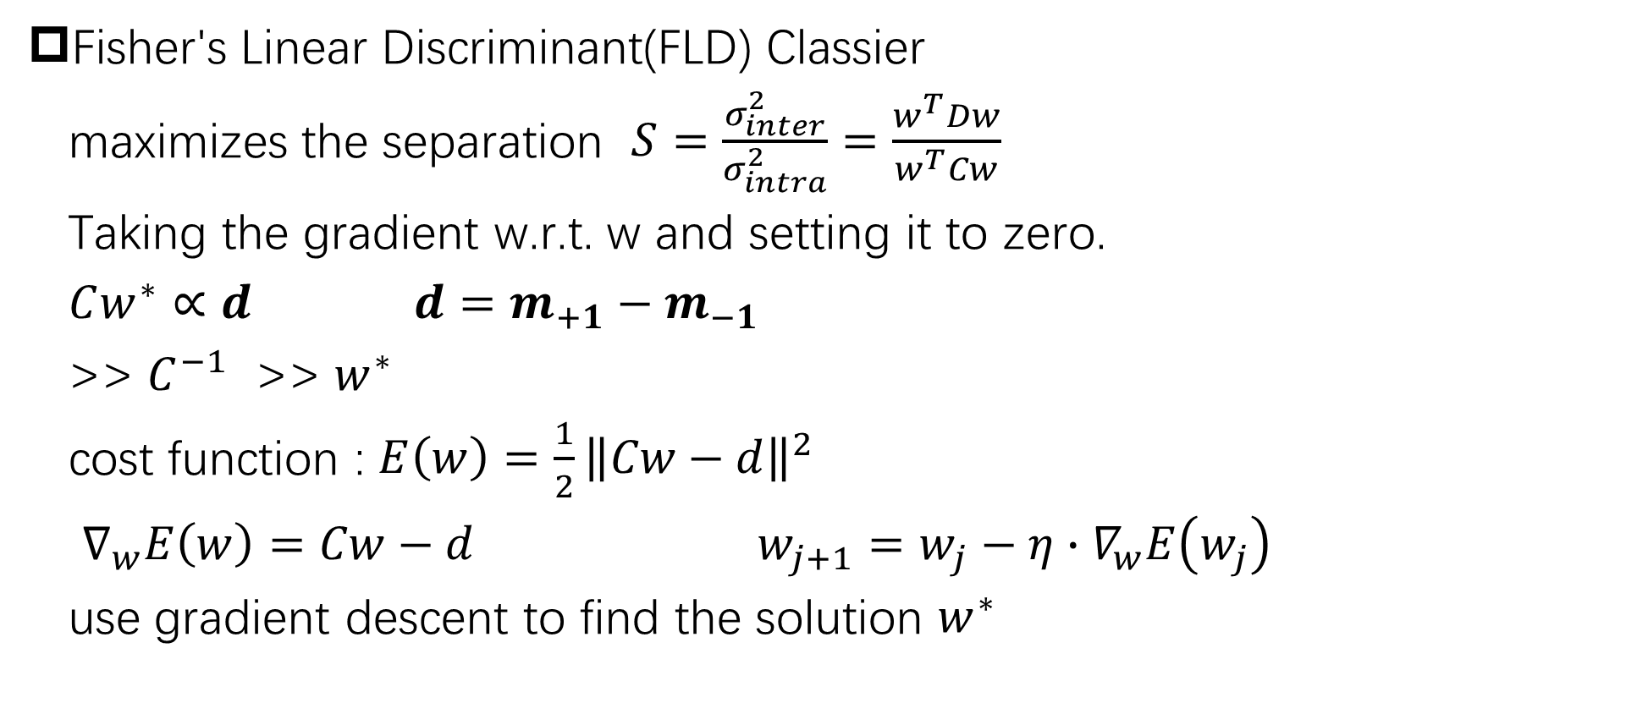
Fisher's Linear Discriminant(FLD) Classier
maximizes the separation $S=\frac{σ_{inter}^{2}}{σ_{intra}^{2}}=\frac{w^{T}Dw}{w^{T}Cw}$
Taking the gradient w.r.t. w and setting it to zero.
$Cw^{∗}∝d$ $d=m_{+1}−m_{−1}$
>> $C^{−1}$ >> $w^{∗}$
cost function : $E\left(w\right)=\frac{1}{2}{\left\|Cw−d\right\|}^{2}$
$∇_{w}E\left(w\right)=Cw−d$ $w_{j+1}=w_{j}−η∙∇_{w}E\left(w_{j}\right)$
use gradient descent to find the solution $w^{∗}$

Slide 13
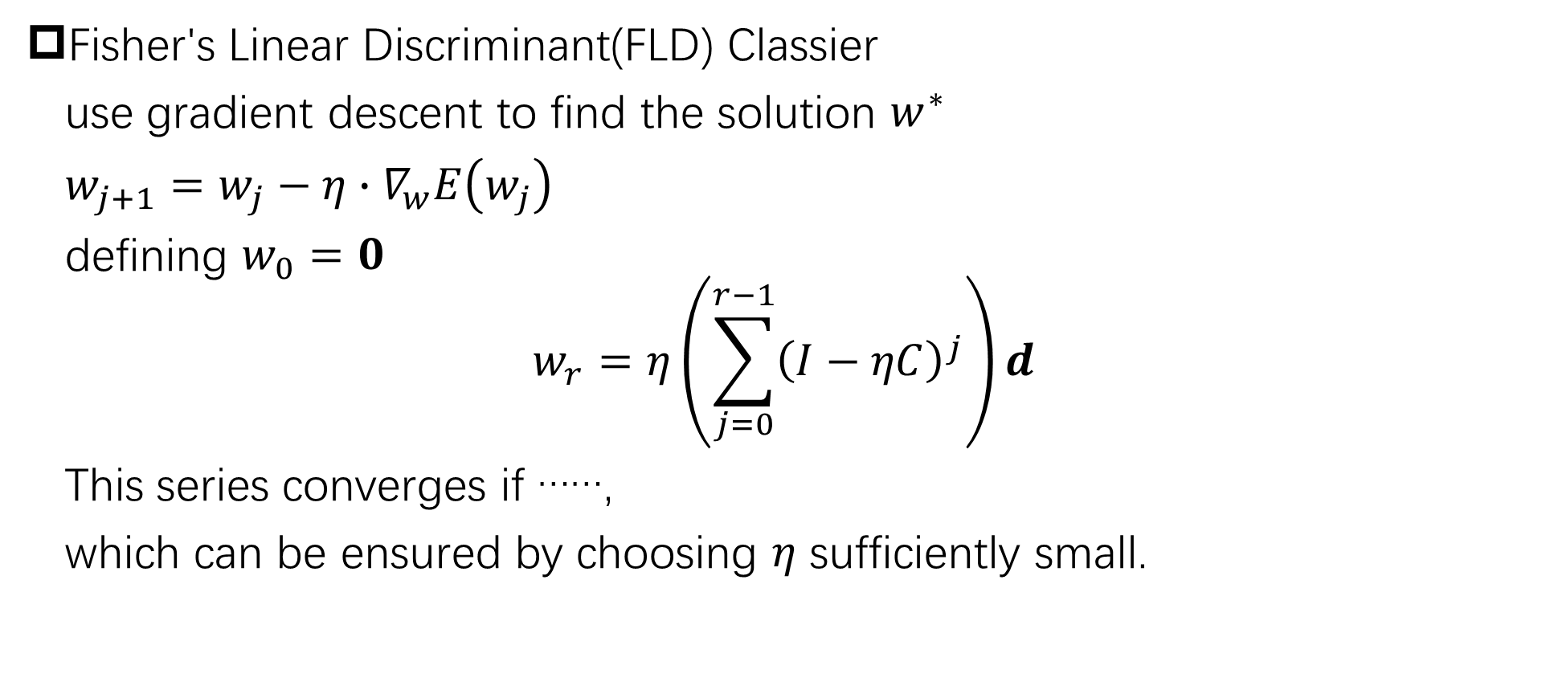
Fisher's Linear Discriminant(FLD) Classier
use gradient descent to find the solution $w^{∗}$
$w_{j+1}=w_{j}−η∙∇_{w}E\left(w_{j}\right)$
defining $w_{0}=0$
$$w_{r}=η\left(\sum_{j=0}^{r−1}{{\left(I−ηC\right)}^{j}}\right)d$$
This series converges if ……,
which can be ensured by choosing $η$ sufficiently small.

Slide 14
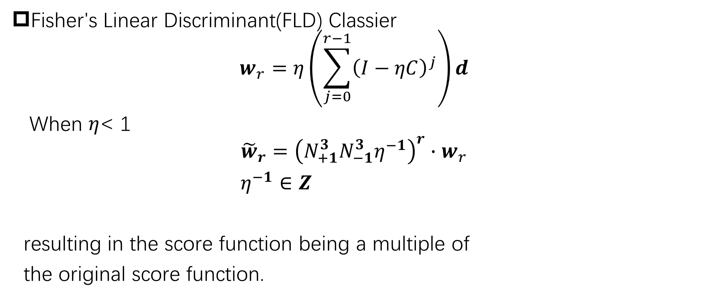
Fisher's Linear Discriminant(FLD) Classier
$$w_{r}=η\left(\sum_{j=0}^{r−1}{{\left(I−ηC\right)}^{j}}\right)d$$
When $η$< 1
$${\tilde{w}}_{r}={\left(N_{+1}^{3}N_{−1}^{3}η^{−1}\right)}^{r}∙w_{r}$$
$η^{−1}∈Z$
resulting in the score function being a multiple of
the original score function.

Slide 15
HElib
Logistic Regression

