Slide 1
2018-09-25

Slide 2
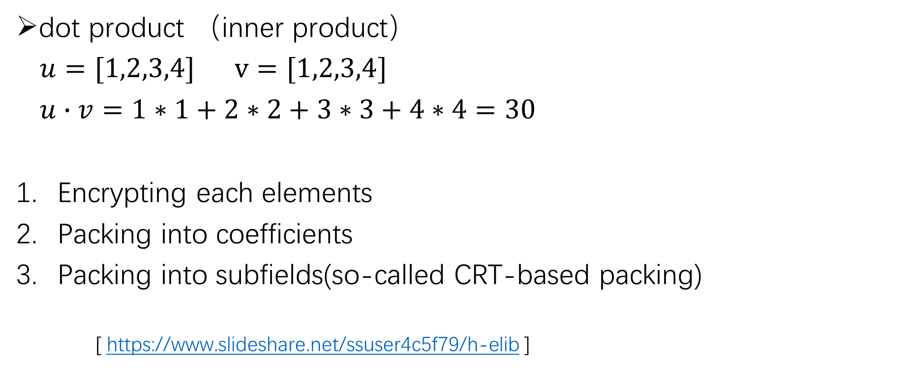
HElib
dot product （inner product）
$u=[1,2,3,4]$ $v=[1,2,3,4]$
$u∙v=1∗1+2∗2+3∗3+4∗4=30$
Encrypting each elements
Packing into coefficients
Packing into subfields(so-called CRT-based packing)
[ https://www.slideshare.net/ssuser4c5f79/h-elib ]

Slide 3
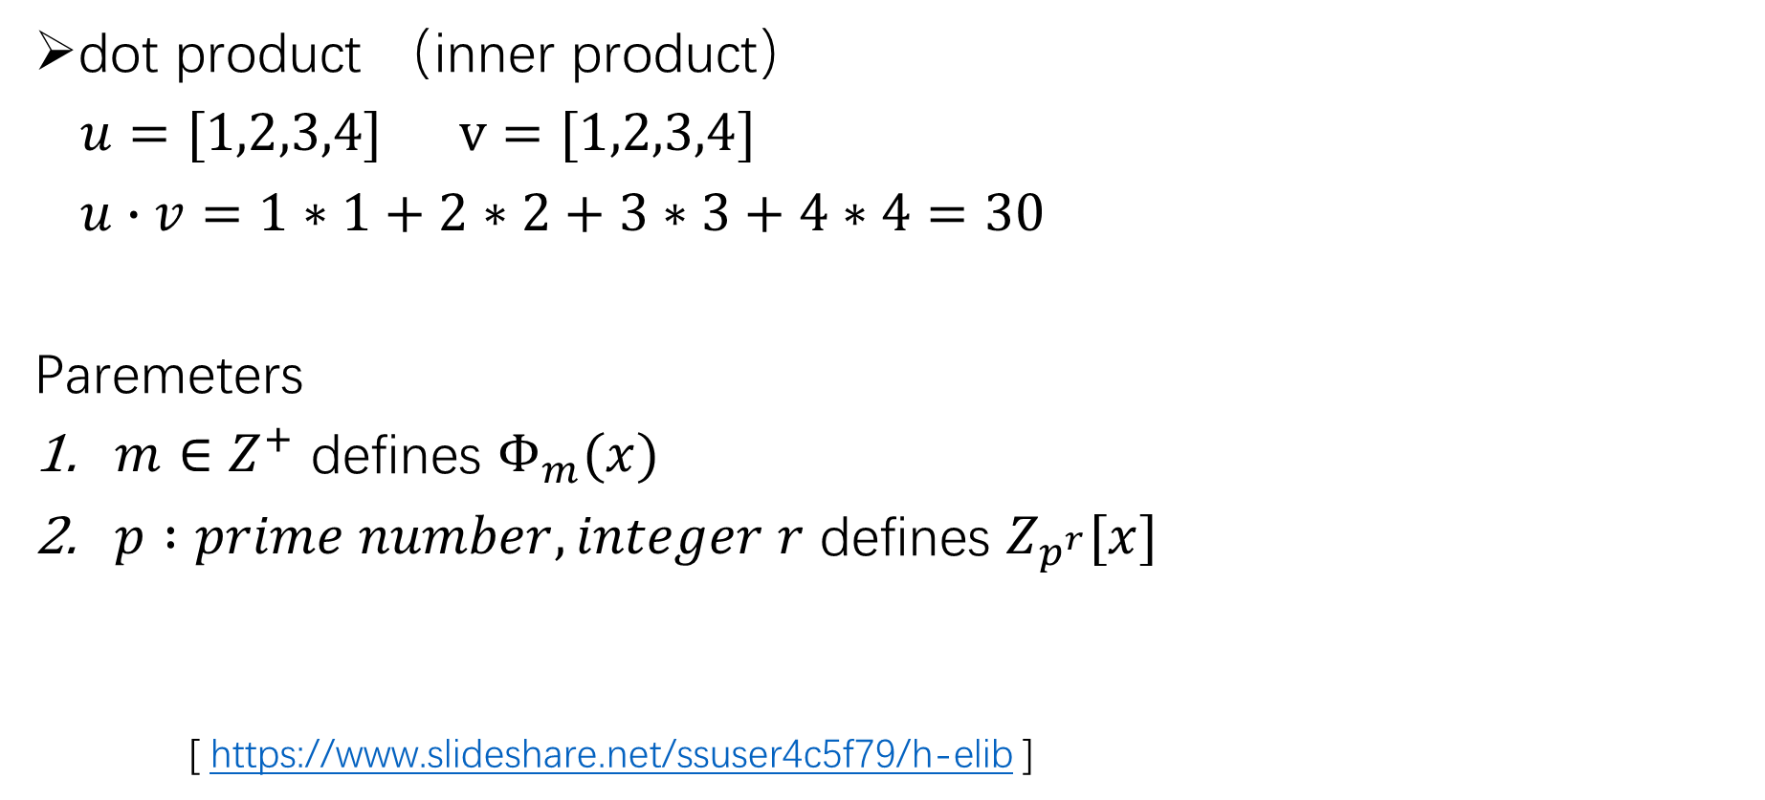
HElib
dot product （inner product）
$u=[1,2,3,4]$ $v=[1,2,3,4]$
$u∙v=1∗1+2∗2+3∗3+4∗4=30$
Paremeters
$m∈Z^{+}$ defines $Φ_{m}(x)$
$p :prime number, integer r$ defines $Z_{p^{r}}[x]$
[ https://www.slideshare.net/ssuser4c5f79/h-elib ]

