Slide 1
2018-10-09

Slide 2
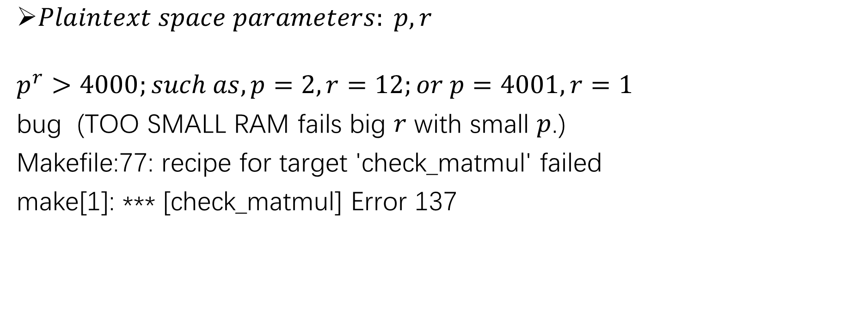
HElib
$Plaintext space parameters: p, r$
$$p^{r}>4000;such as, p=2,r=12;or p=4001, r=1$$
bug (TOO SMALL RAM fails big $r$ with small $p$.)
Makefile:77: recipe for target 'check_matmul' failed
make[1]: *** [check_matmul] Error 137

Slide 3

HElib
Levels$parameter:L$
$Plaintext parameter p^{r}!=2, better to add more levels$

Slide 4
HElib
Debian Ubuntu
CentOS
IP Address: acm.nankai.edu.cn
Port: 9034

