Slide 1
2019-02-28

Slide 2
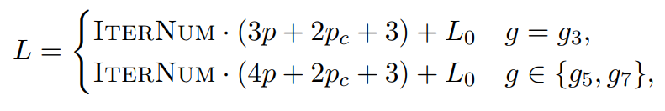
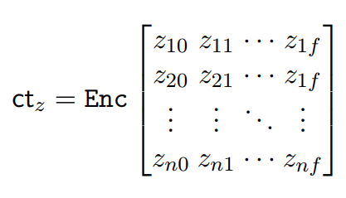
IDASH2017-master代码
Makefile C++工程项目 添加注释
Logistic Regression Model Training based on the Approximate Homomorphic Encryption
Andrey Kim, Yongsoo Song, Miran Kim, Keewoo Lee, and Jung Hee Cheon. SNU 2018

Slide 3
simplified fixed Hessian method
C++编程实现
Privacy-Preserving Logistic Regression Training
Charlotte Bonte, and Frederik Vercauteren. [KU Leuven] 2018
Fix-Hessian method : Dankmar Böhning and Bruce G Lindsay 1988
Newton method ：海森矩阵不可逆，求海森矩阵的逆计算量大
Böhning fix Hessian H≥B（where “≥” denotes the Loewner ordering）+ a lower bound
Charlotte Bonte simplify lower bound

Slide 4
在明文上实现 simplified fixed Hessian method
验证所实现算法代码的逻辑正确无误
在IDASH2017-maste的C++工程项目上
实现经过验证的算法逻辑
并在密文上实现该算法逻辑

