Slide 1
2018-12-04

Slide 2
Logistic Regression Based on Homomorphic Encryption
Doing Real Work with FHE: The Case of Logistic Regression.
Jack L.H. Crawford, Craig Gentry, Shai Halevi, Daniel Platt, and Victor Shoup.
Logistic Regression Model Training based on the Approximate Homomorphic Encryption. Andrey Kim, Yongsoo Song, Miran Kim, Keewoo Lee, and Jung Hee Cheon.
Logistic regression over encrypted data from fully homomorphic encryption. Hao Chen, Ran Gilad-Bachrach, Kyoohyung Han, Zhicong Huang, Amir Jalali, Kim Laine, and Kristin Lauter.
Privacy-Preserving Logistic Regression Training.
Charlotte Bonte and Frederik Vercauteren.

Slide 3
Logistic Regression Based on Homomorphic Encryption
Doing Real Work with FHE: The Case of Logistic Regression.
Jack L.H. Crawford, Craig Gentry, Shai Halevi, Daniel Platt, and Victor Shoup.
Craig Gentry
Shai Halevi, and Victor Shoup. (HElib)
Homomorphic binary comparisons.
Unfortunately, our solution was not ready in time for the iDASH competition deadline, so we ended up not participating in the formal competition.

Slide 4
Logistic Regression Based on Homomorphic Encryption
Gradient Descent:
Logistic Regression Model Training based on the Approximate Homomorphic Encryption. Andrey Kim, Yongsoo Song, Miran Kim, Keewoo Lee, and Jung Hee Cheon.
Logistic regression over encrypted data from fully homomorphic encryption. Hao Chen, Ran Gilad-Bachrach, Kyoohyung Han, Zhicong Huang, Amir Jalali, Kim Laine, and Kristin Lauter.

Slide 5
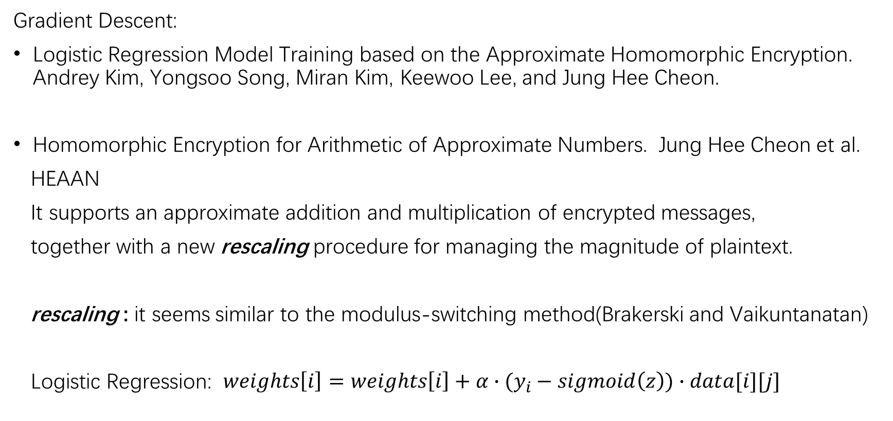
Logistic Regression Based on Homomorphic Encryption
Gradient Descent:
Logistic Regression Model Training based on the Approximate Homomorphic Encryption. Andrey Kim, Yongsoo Song, Miran Kim, Keewoo Lee, and Jung Hee Cheon.
Homomorphic Encryption for Arithmetic of Approximate Numbers. Jung Hee Cheon et al.
HEAAN
It supports an approximate addition and multiplication of encrypted messages,
together with a new rescaling procedure for managing the magnitude of plaintext.
rescaling : it seems similar to the modulus-switching method(Brakerski and Vaikuntanatan)
Logistic Regression: $weights\left[i\right]=weights\left[i\right]+α∙(y_{i}−sigmoid\left(z\right))∙data[i][j]$

Slide 6
Logistic Regression Based on Homomorphic Encryption
Gradient Descent:
Logistic Regression Model Training based on the Approximate Homomorphic Encryption. Andrey Kim, Yongsoo Song, Miran Kim, Keewoo Lee, and Jung Hee Cheon.
Homomorphic Encryption for Arithmetic of Approximate Numbers. Jung Hee Cheon et al.
HElib + Logistic Regression
HElib + rescaling 可能性 不可行

Slide 7
Logistic Regression Based on Homomorphic Encryption
Gradient Descent:
Logistic Regression Model Training based on the Approximate Homomorphic Encryption. Andrey Kim, Yongsoo Song, Miran Kim, Keewoo Lee, and Jung Hee Cheon.
We introduced HEAAN at a workshop for the standardization of HE hosted by Microsoft Research
Logistic regression over encrypted data from fully homomorphic encryption. Hao Chen, Ran Gilad-Bachrach, Kyoohyung Han, Zhicong Huang, Amir Jalali, Kim Laine, and Kristin Lauter.
We will use FHE.bscale(·,i) to denote the above bootstrapping plus scaling down by i digits in base p.

Slide 8
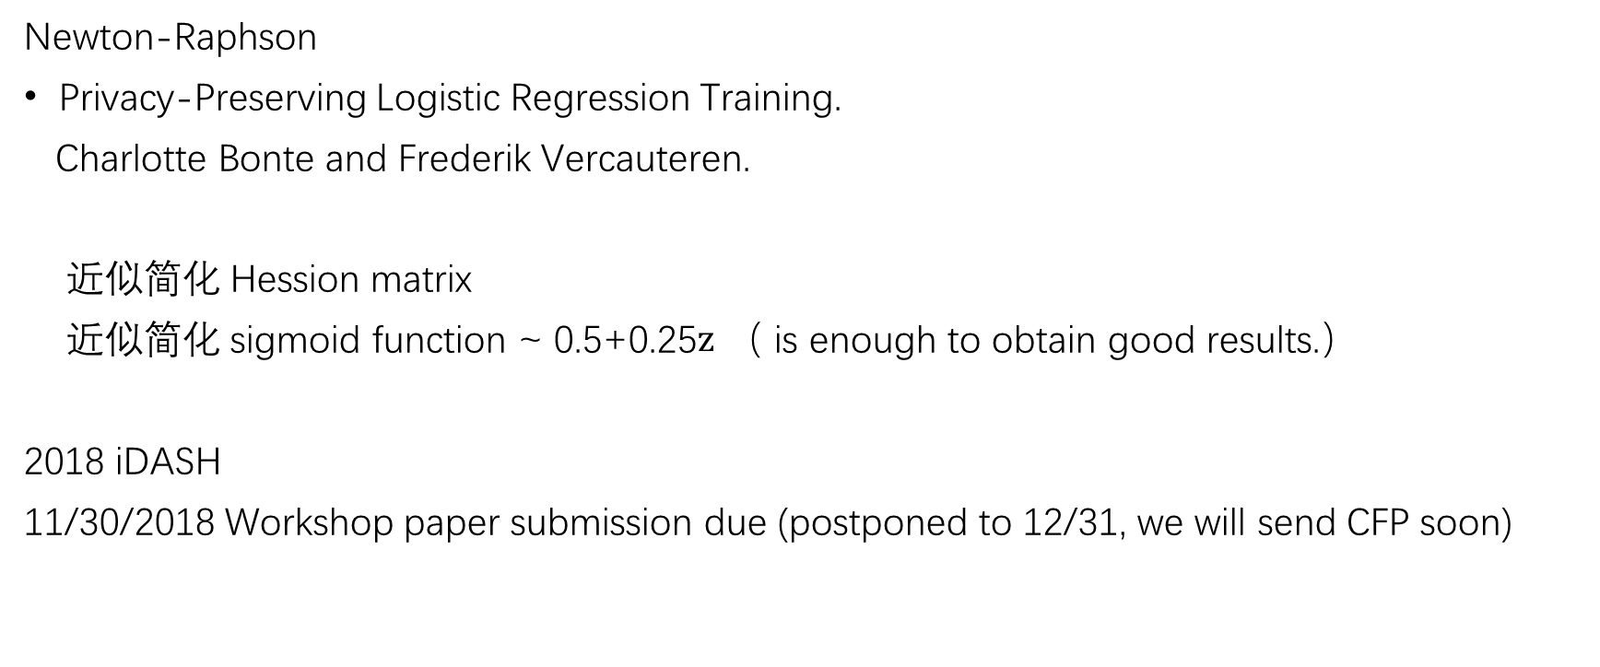
Logistic Regression Based on Homomorphic Encryption
Newton-Raphson
Privacy-Preserving Logistic Regression Training.
Charlotte Bonte and Frederik Vercauteren.
近似简化 Hession matrix
近似简化 sigmoid function ~ 0.5+0.25$z$ （ is enough to obtain good results.）
2018 iDASH
11/30/2018 Workshop paper submission due (postponed to 12/31, we will send CFP soon)

