Slide 1
Project3_Gaurav.Handa
File created on: 4/21/2020 3:09:08 PM

Slide 2
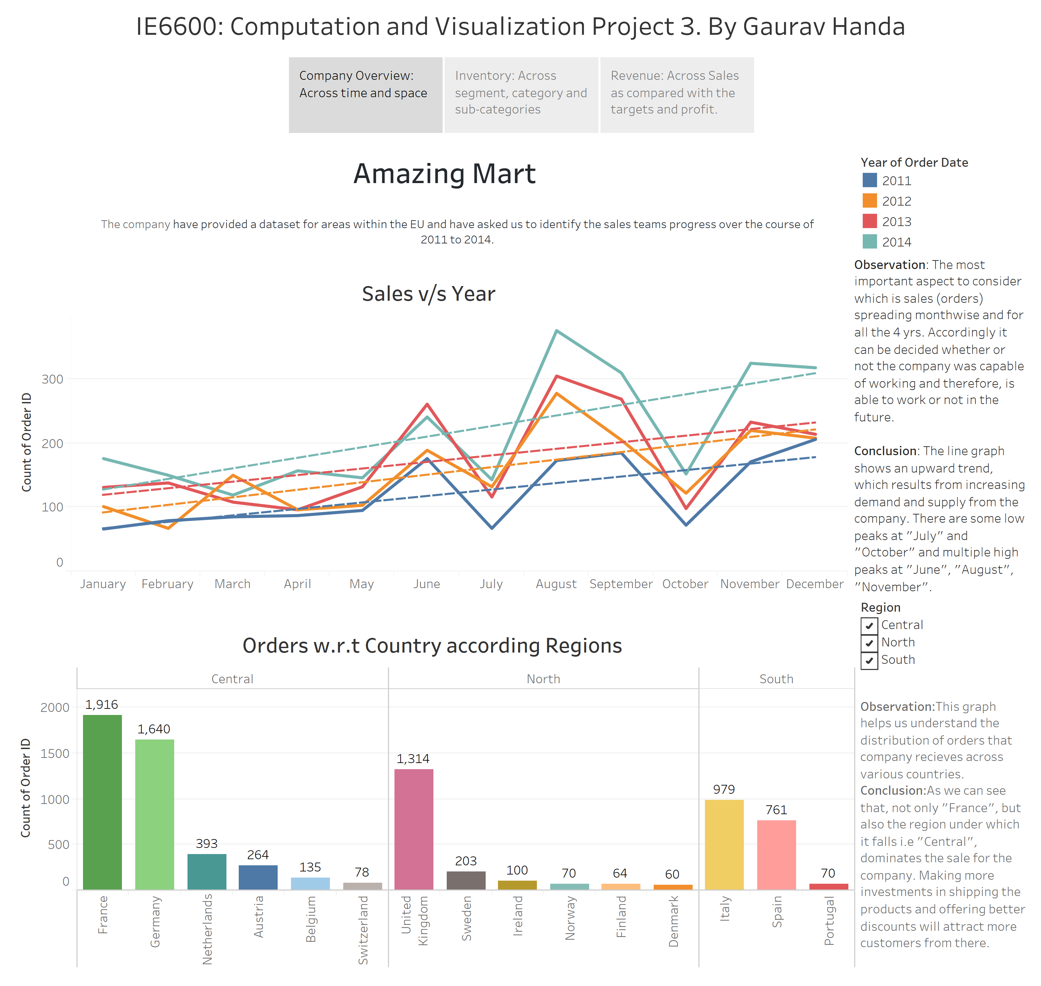

Slide 3
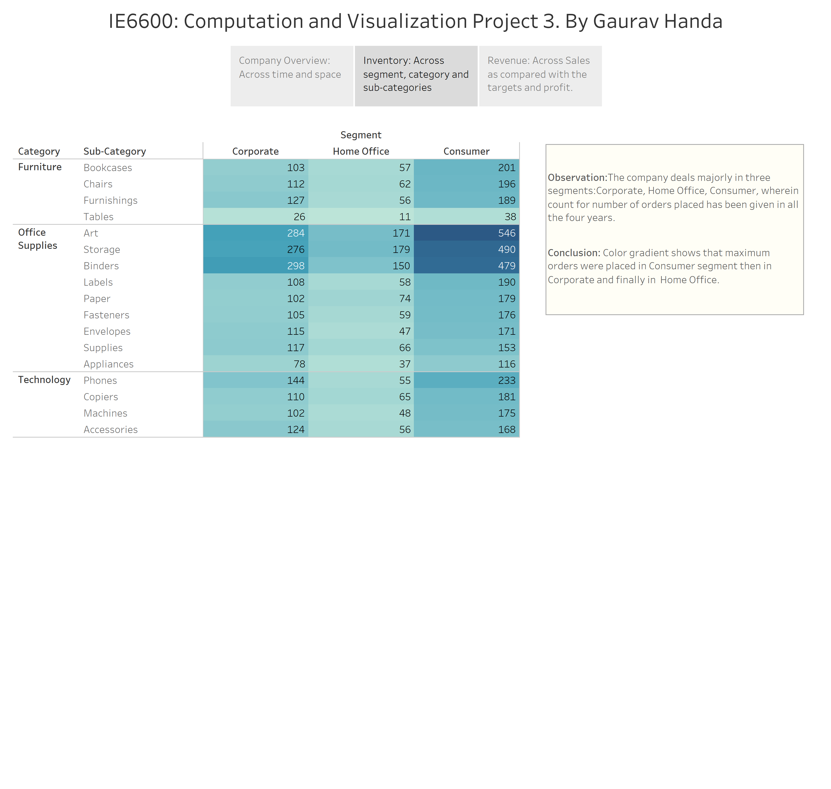

Slide 4
