Slide 1
PROBLEM STATEMENT
An ABC company has the sales data for the last 3 years and they want to analyze it now. There is a Dimension Data where there is the list of companies and their Line of Business. There are 3 years of sales data. There is also a Target Data. Based on the data set given, try to create a dashboard. Stakeholders want the following insights in the dashboard:
Include important KPIs
Sales over Time
Sales for various Products
Manager wise analysis
Customer coverage across various Locations
Target Analysis

Slide 2




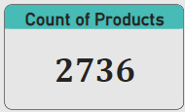


Key Insights
The total sales are 17.91M, whereas the given target was 23.83M.
The highest sales were done in October (1.96M) followed by September (1.89M) and November (1.80M).
The lowest sales months are February ( 967.72K), March (1.09M) and April (1.16M).
The KPI by team is negative by 29.18%.
Sales by Manager: Duane Frame contribution in total sales was 9.21M (51.44%) whereas Ronnie Daly contributed 8.70M(48.56%).
Sales by Sales person: Sahil Seymour sold more sales (4.71M)as compared to other sales associates.
Supermarket Lv3 is the top line of business with the sale of (3.58M).

Slide 3
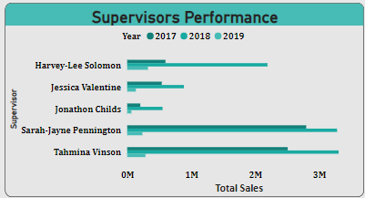
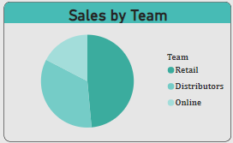
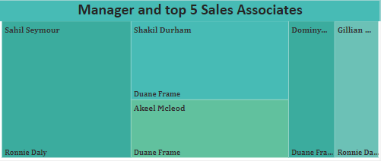
Sales Team Insights
In 2017, Sarah Pennington sold 2.80M,followed by Tahmina Vinson 2.51M.
In 2018, Tahmina did the top sales and Sarah was the second top sales supervisor.
In 2019, Harvey Solomon has the maximum sales and Tahmina has the second highest sales.
The retail team has the highest sales (8.70M) among the other teams, where Distribution team contribution has 6.10 and the Online team has 3.11M.
Sahil Seymour was the top sales associate with the Sales of 4.71M, followed by Shakil Durham 3.30M.

Slide 4
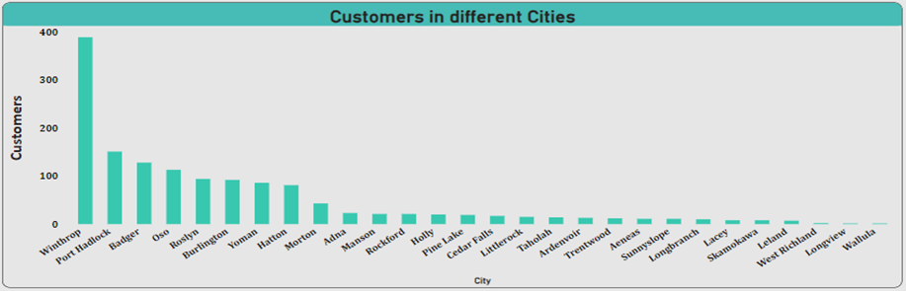
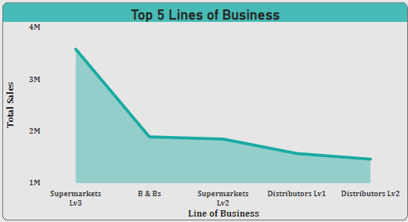
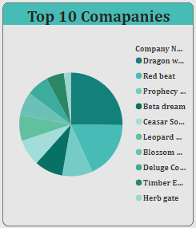
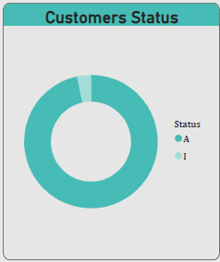
Customers Based Insights
The city Winthrop has the highest customers for the entire time period with the count of 389.
Wallula has the least customers.
The top five line of business are Supermarkets Lv3, B&B, Supermarkets, Lv2,Distribution Lv1 and Distribution Lv2
Dragon Walk is the top company with the percentage of 25.21, followed by red Beat and so on.
96.67% customers are still active, however; only 3.33% has been inactivated.

Slide 5
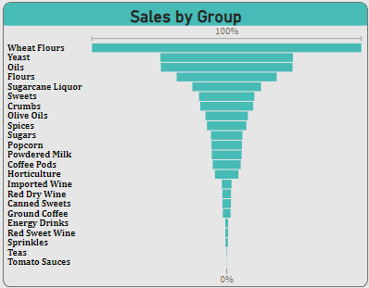
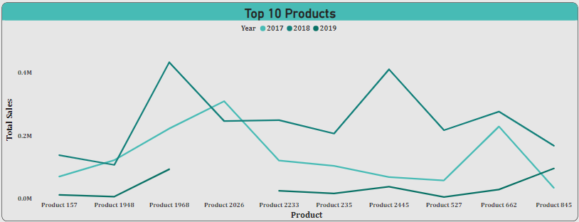
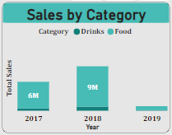
Insights based on Products
The wheat flour has the maximum sales among the other product groups. The tomato sauces has the very minimum sales throughout the entire time.
The product 1968 is on peak in three years sales.
The category wise, food has more sales as compare to drinks.

Slide 6
Thank you!

