Slide 1
Unboxing Me and Starting Your First Cut!

Slide 2
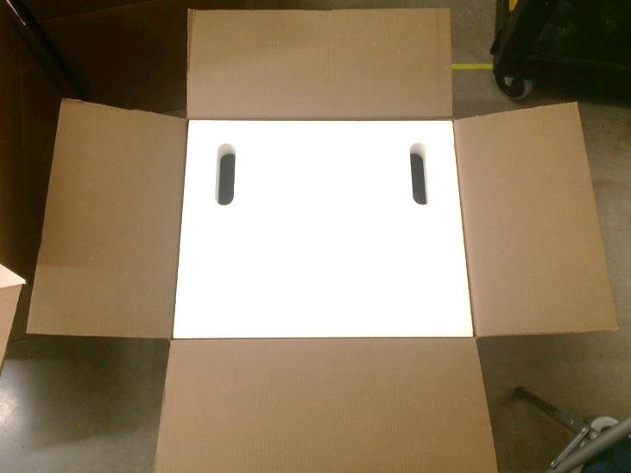
Remove the top layer of the foam packaging

Slide 3
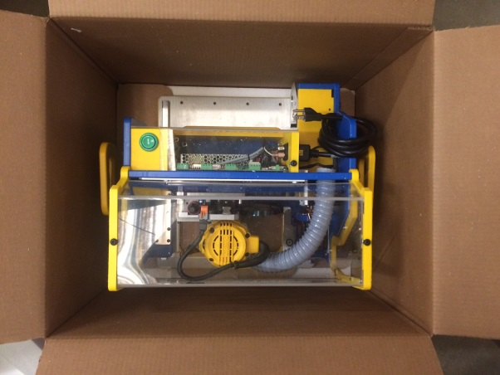
Your handibot is bolted to a piece of wood that protected it during shipping and will be used for the first test cut with your new tool! Lift the tool out of the box by the two yellow handles.

Slide 4
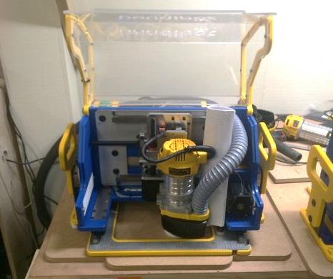
Set your tool on a flat surface. Make sure there is plenty of open space around the tool so that nothing gets knocked over when the tool moves around. Open the hood and remove the safety manual that is tucked behind the vacuum hose.

Slide 5
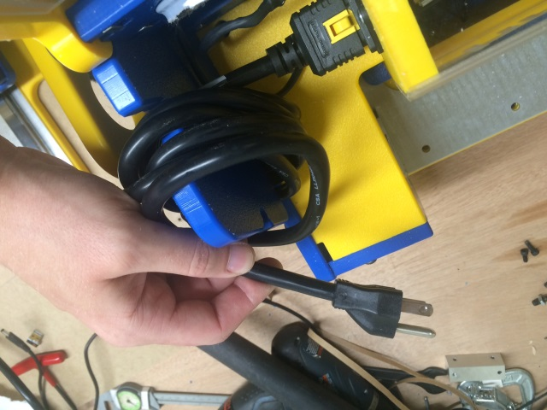
The power cord for your tool is wrapped up on the rear of the frame. Pop the cord out of its holder and plug it in.

Slide 6
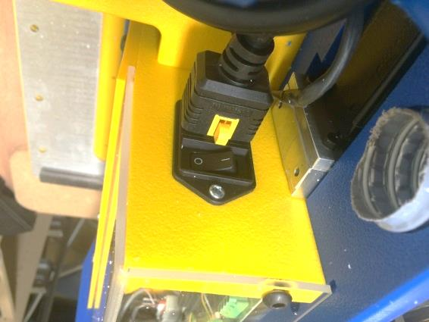
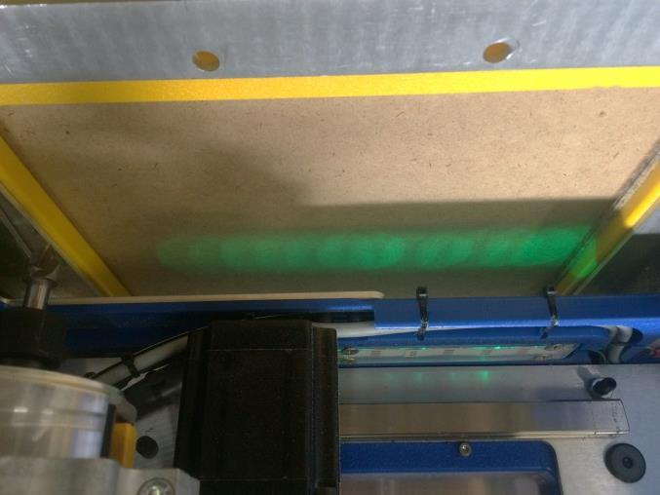
Turn on the power using switch by the cord on the back of your handibot. Green lights should come on underneath the tool.

Slide 7
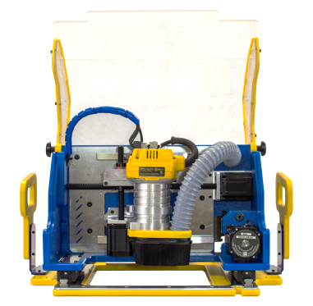
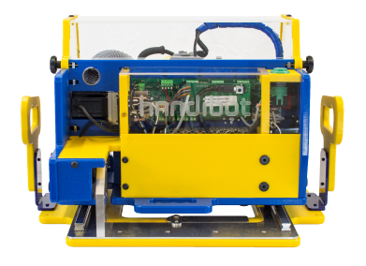
Give your software a little bit of time to boot up and while you review your Handibot’s anatomy:
Hood
Z Axis
Router
Electronics Enclosure
X Axis
Power Switch
Start Button
Y Axis
Stop Button
Exoframe
Dust Foot
Base Plate

Slide 8
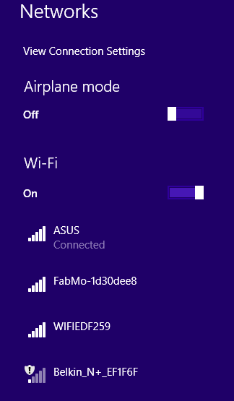
Open the WiFi or network manager on the computer or device* that you want to run your tool from.
* Your device should be a relatively recent, WiFi-enabled, Windows PC, Mac, Linux PC, iPad, iPhone, or Android smart phone or tablet.
Your Handibot will appear in the list of available networks as: FabMo-xxxxxxx
Log into your Handibot’s Access Point Mode link as you would to a network.
Use the password: go2fabmo

Slide 9

After your network manager connects to your Handibot it will say something like: Unidentified network, No Internet Acess”.
BUT you now have a direct link right into your Handibot – it’s called Access Point Mode
This is the linkage that we will use to set-up and test your tool. Your tool will be always available to you in Access Point (AP) Mode (good for job sites, etc…).
Further along, we’ll show you how to put your Handibot onto your local wireless network. Then your device can be back in touch with the internet.

Slide 10
After your network manager connects to your Handibot it will say something like: Unidentified network, No Internet Acess”.
BUT you now have a direct link right into your Handibot.
Note that at this point your device is no longer connected to the Internet. It’s relationship is exclusively with your Handibot via AP Mode. This is the linkage that we will use to set-up and test your tool. Your tool is always available to you in AP Mode and you will be able to use this linkage in enviroments where wireless networks are not present, such as jobsites or where you want to insure very restriced access.
Later, we’ll take up how to put your Handibot on your local wireless network.

Slide 11
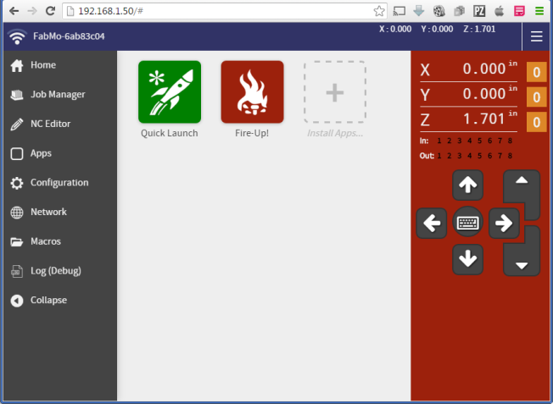
Open your internet browser and type “192.168.42.1” into the address bar. After pressing enter, your Handibot Dashboard should appear.

Slide 12

To follow a short tutorial for setting up your tool and to make your first cut, click on the green Quick Launch app and follow the in-app instructions before returning to this guide.
These instructions and other parts of the Handibot Manual are available on the web: docs.handibot.com

Slide 13
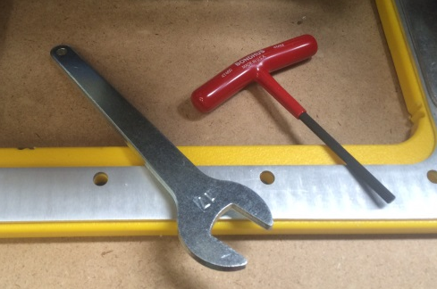
Now that you’ve finished your first cut, take a look at the rest of the contents of your Handibot box. These are your two most important tools. 17mm collet wrench for changing bits. The 4mm T-handle hex key will be used to release the router from its bracket and can turn most of the screws used to build your Handibot.

Slide 14
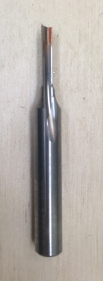
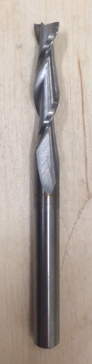
Your handibot comes with three router bits.
1/8” Straight bit. This bit is great for cutting small parts with tight corners. The straight edge on this bit will also provide a nice finish in wood.
1/4” Up-cut bit. This long bit will be great for pocketing out larger areas and cutting through wood quickly. The up-spiral of the cutter clears chips better than the straight bit but also tends to lift your material

Slide 15
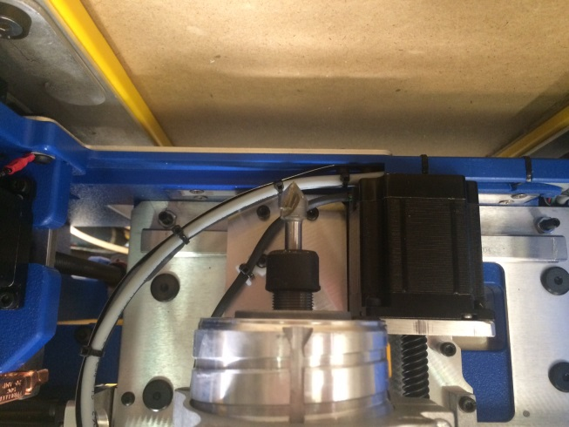
The bit held in your router is called a “v-bit”. It has a sharp point that is great for engraving lettering and other detailed shapes.

Slide 16
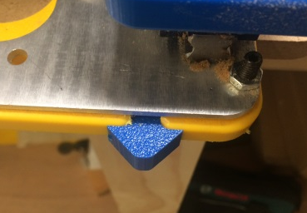
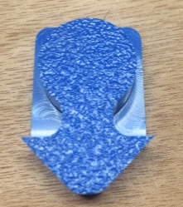
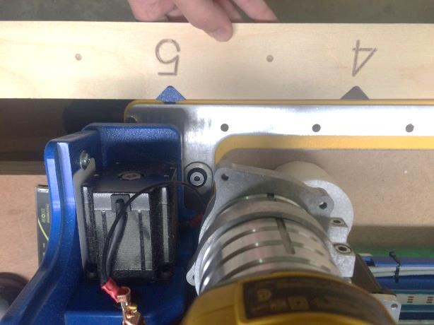
Your blue pointer can be inserted into the front of your tool to accurately position the tool using a jig like our large material indexing jig.

Slide 17
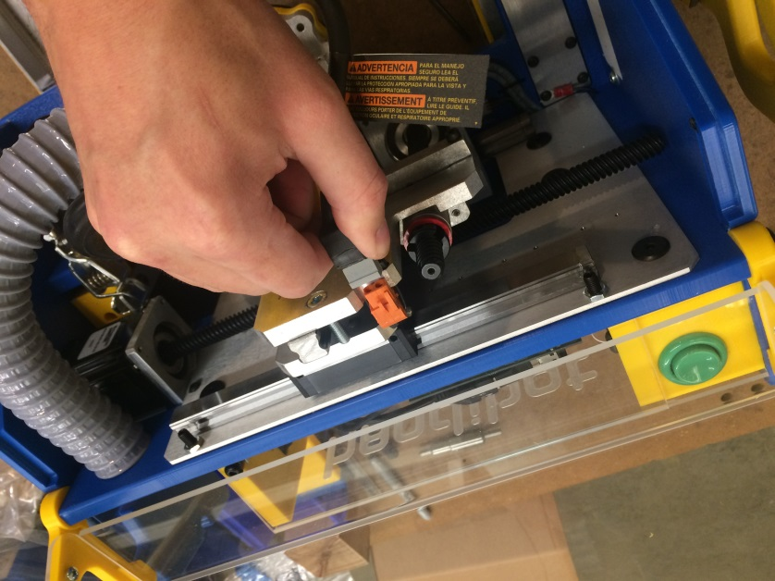
Here’s how to change your router bit out for your next cut. First, unplug the router power from the orange plug peeking over the z-axis plate.

Slide 18
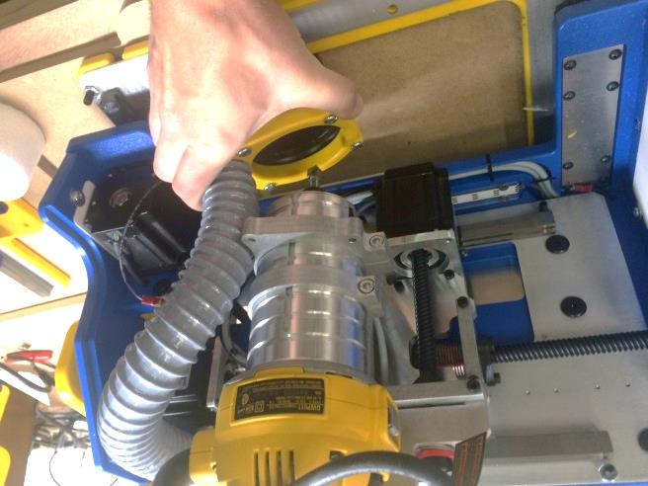
The dust foot is held in place by 4 magnets. Remove it by pulling firmly down until it disengages.

Slide 19
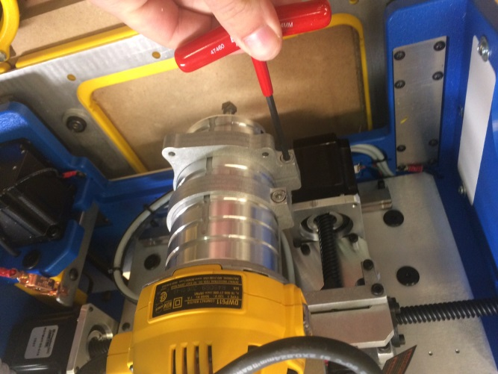
Using your 4mm wrench, loosen the two router bracket screws so that you can remove the router from the tool.

Slide 20
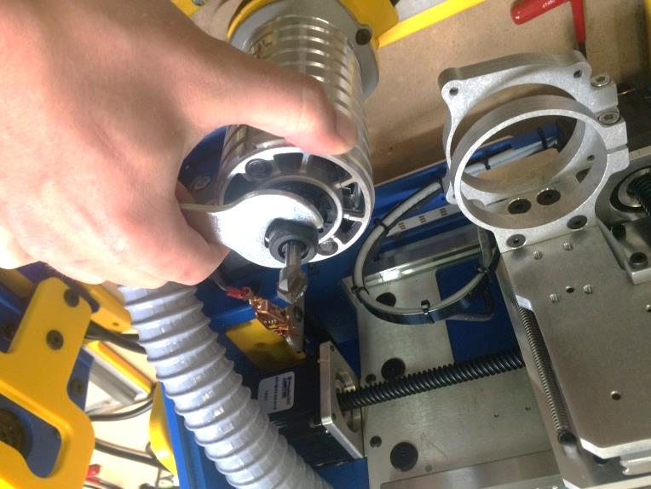
Flip the router over and, using your 17mm wrench, unscrew (counter clockwise) the collet nut while pressing the yellow button on the side of the router to lock the spindle.

Slide 21
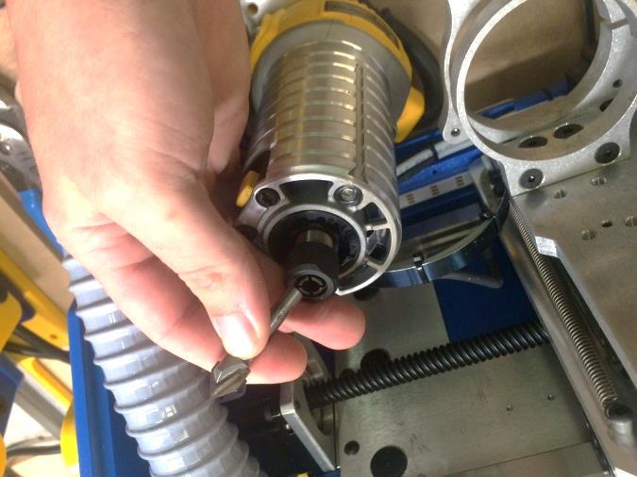
Once the collet nut is loose, you should be able to easily pull the bit out of the router.

Slide 22
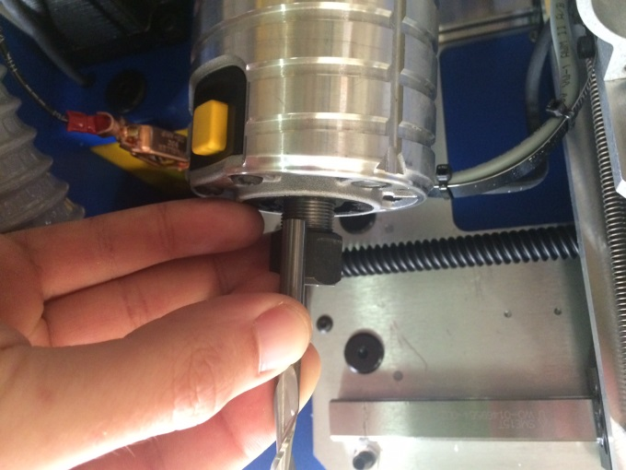
Choose the bit that you’d like to insert. It’s best to have about ¾” of the bit’s shank inserted into the collet.

Slide 23
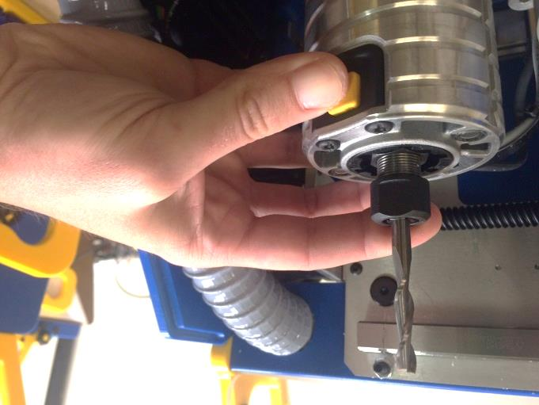
With the bit inserted, depress the yellow button and tighten the collet nut (clockwise) with your 17mm wrench.

Slide 24
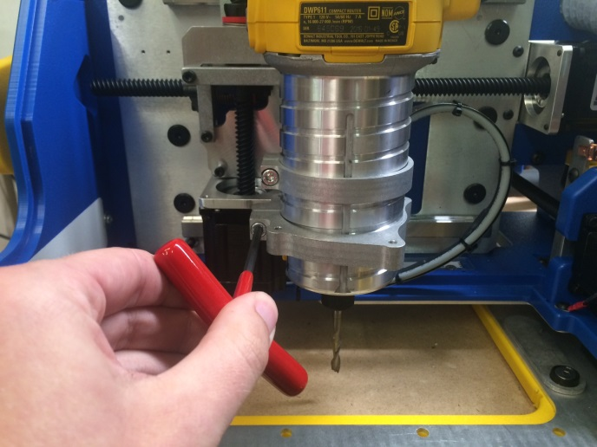
Slide the router back into its bracket and tighten the two bracket bolts with your 4mm wrench

Slide 25
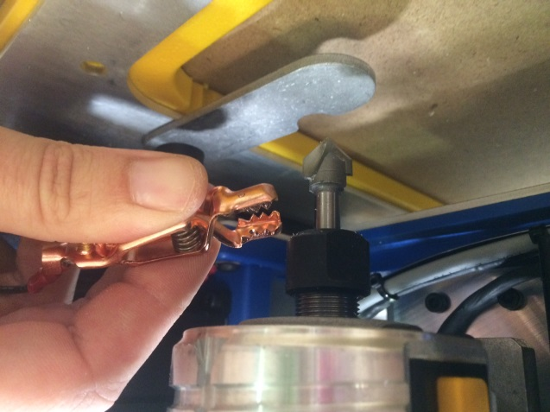
Use the commands in your quick launch app to zero your new bit before starting your next cut.

Slide 26
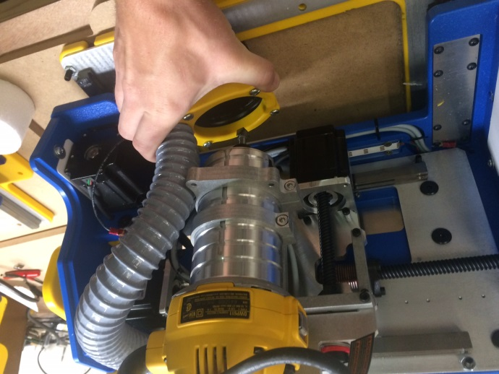
Place the vacuum foot back over your router if you’ve removed it.

Slide 27
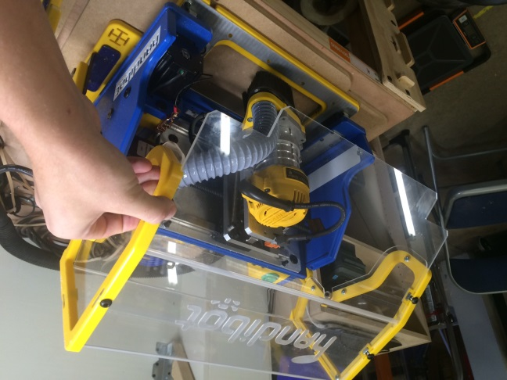
Be sure to close the hood before you begin any cuts.

Slide 28
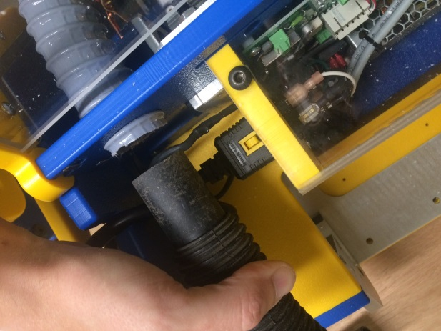
If you have a vacuum, insert a 1.25” fitting into the end of the vacuum tube at the back of your tool.

Slide 29
Don’t forget to read (and keep handy) your safety manual!

