Slide 1
APAC25: SUSTech
Haibin Lai, Benxiang Xiao, Bowen Zhang, Hemu Liu, Ziheng Wang, Zhiyu Wu, Zixu Wang

Slide 2
SUSTech

Slide 3
Running Cluster

Slide 4
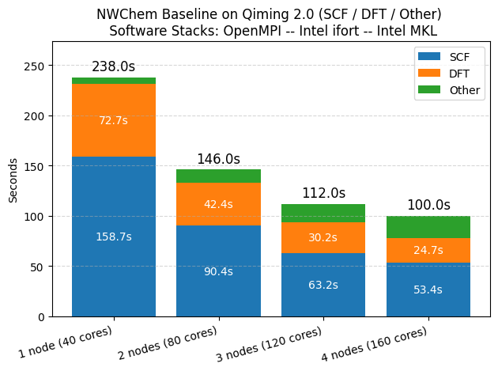
NWChem

Slide 6
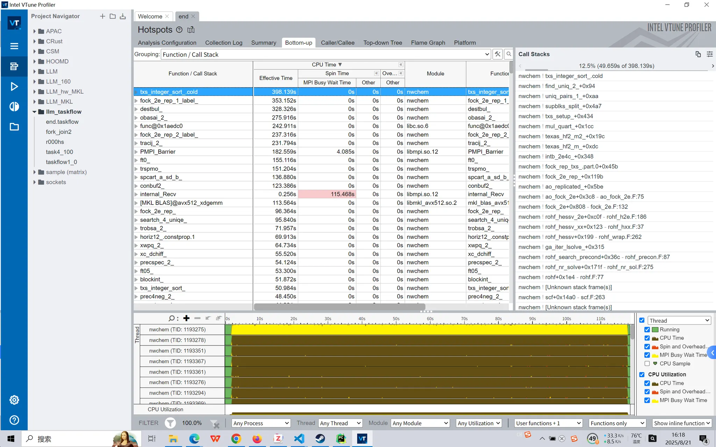
Profile

