Slide 1


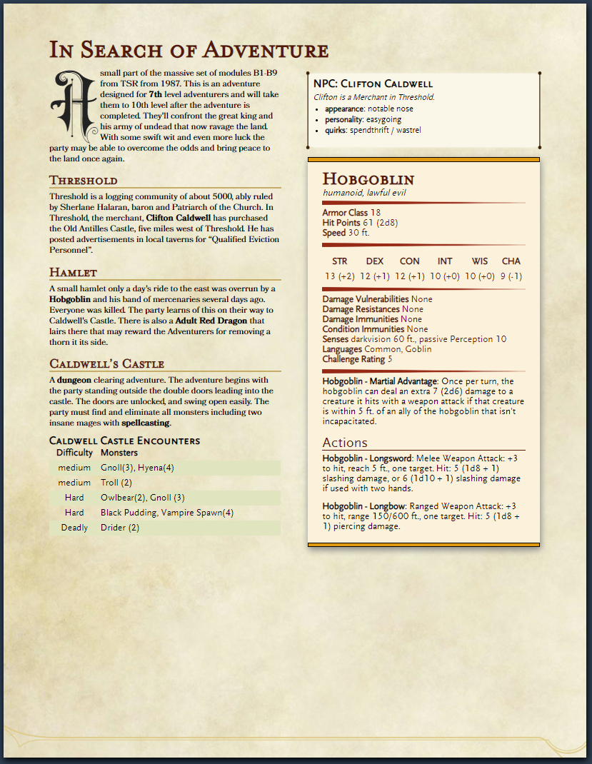
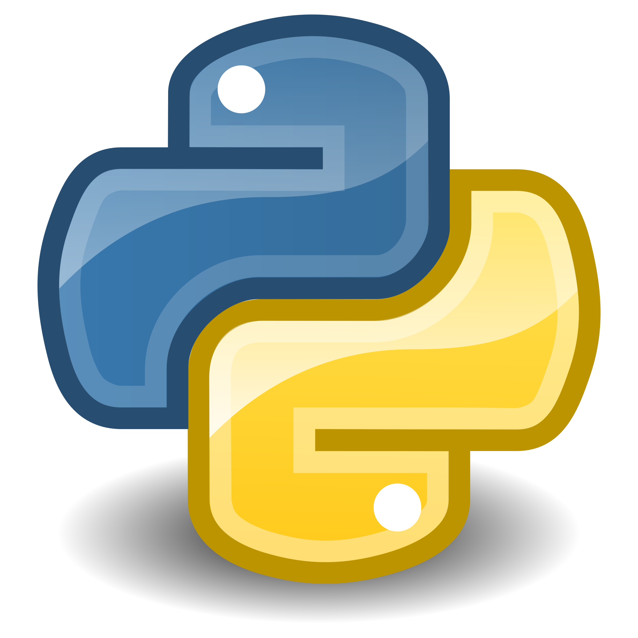
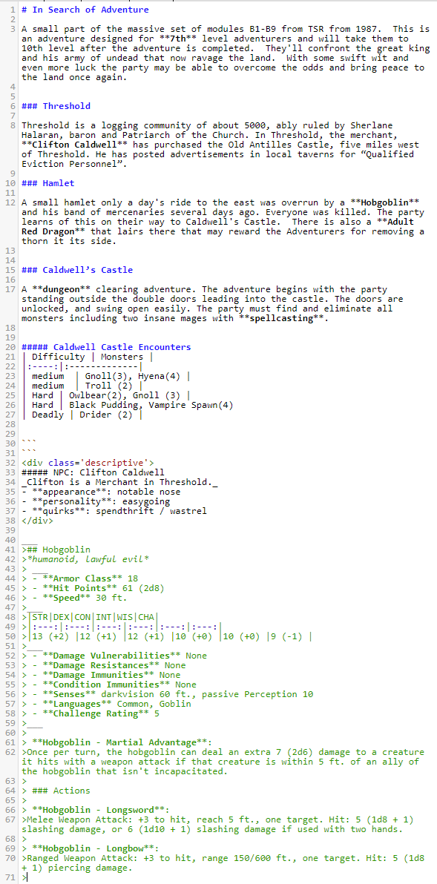
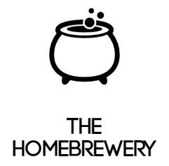
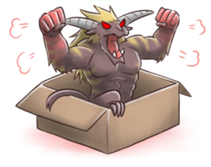
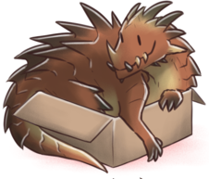
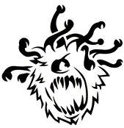
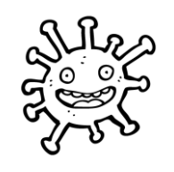


Adventure Day
Created By: Ryan Solnik
Advised By: Dr. Robert Adams
Overview
Adventure Parser
Output
Dungeons and Dragons is a role playing game where one player assumes the role of the Dungeon Master. This player is responsible for dreaming up adventures for the other players to embark upon.
Preparing games for dungeons and dragons can be a daunting task that is filled with lengthy tasks that may not yield benefit when it comes to running the game you’ve prepared.
Adventure Day is a computational solution to streamline the creation process of a D&D Adventure.
Markdown Text Parser written in Python that interprets tagged words and headings for operations requested.
Dictionary entries to trigger additional actions to be taken on important actors in the story provided. Dictionary operators can be combined
Name: The name of item highlighted in text or monster to be referenced.
Type: Queries the Monster Vault for either a Monster or an NPC characteristics
Level: The rough power level of the adventure that is being created. This informs monster selection.
Location: Creates a set of encounters for adventurers based on the Location the encounter would occur.
Race: Returns a specific type of monster (ex. “Dragon”, “Aberration”, “Goblin” etc…)
CR: Sets the challenge rating for the desired Monster up or down based on the number provided.
Ability: Returns a monster with the desired ability listed as a value to the Ability Key.
Gathers markdown text input and tagged items and compiles them into an output that can be formatted with a CSS Stylesheet provided by The Homebrewery. Monsters are provided in stat blocks that are easily readable and story scenes are separated by headings that had been provided in the text file.
{“Name":"Archmage", “Type":"monster", “Race": "human", “Ability": "spellcasting" , "CR": -2}
Solution
Monster Works
Monster Vault
### Hamlet
A small hamlet only a day's ride to the east was overrun by a **Hobgoblin** and his band of mercenaries several days ago. Everyone was killed. The party learns of this on their way to Caldwell's Castle.
{"name":"Hobgoblin","type": "monster", "CR": 5}
2
3
Monster customization
Scaling of Monster Stats to pose a challenge for Adventurers of any Level.
Addition of statistics is not directly proportional to challenge rating and needs to be evaluated.
Encounter Creation
Based on Terrain type or Monster Abilities
Had to be balanced around Adventure Level and Experience thresholds for varying difficulties.
Non Player Character (NPC) Traits
Generates character traits, quirks, and personalities for character inspiration
Postgres Database filled with Monster and NPC data that can be referenced by keywords in the Adventure Text
Important Statistics (AC, HP, Type, etc…)
Special Abilities, Actions, Reactions
Environments Monsters are encountered in
Non-player-character Quirks, personalities, and traits for inspiration.
1
4
Users supply story ideas and tag items of interest in the body of text which will be fetched and represented in the output of the application.
Highlight Headings with markdown headings
Use Bold to highlight items of importance in this case a Hobgoblin is important to the Hamlet Scene.
Define the Dictionary and what actions to be taken. In this case we want to make our Hobgoblin Five Challenge Ratings Higher than it starts at

