Slide 1
BOARDVIEW TOOLS / OCTOBER 2026
The boardview landscape
Representative options students may meet at the repair bench
CATEGORY
EXAMPLES
TYPICAL STRENGTH / ACCESS
Professional repair
FlexBV5 · ZXWSoft
Schematic and repair workflows; native software
Free proprietary
NexusBV desktop + web
Broad format support; local browser option
Open source
OpenBoardView · BoardRipper
Inspectable code; native or self-hosted web
BoardScope
Hands-On Security
One offline HTML file; tracing and probe points
Representative tools, not a feature ranking · Sources in speaker notes
01 / 02
Notes:
Presenter: Avoid claiming BoardScope is the only free or browser-based option. NexusBV offers a free web version that says files stay local. FlexBV5 offers a cross-platform free edition; Pro is a perpetual licence with PDF schematic integration and job database. ZXWSoft has repair content, Windows 10/11, and account-based paid-file access. OpenBoardView is an established open-source native viewer. BoardRipper is an open-source web-based peer.
Sources (official): https://pldaniels.com/flexbv5/ ; https://www.zxwtools.com/en/zxwsoft/zxwsoft4.0.html ; https://nexusbv.net/ ; https://github.com/OpenBoardView/OpenBoardView ; https://github.com/AlexeyInwerp/BoardRipper
These categories describe workflow emphasis, not a quality ranking. Features and pricing may change; checked October 2026.

Slide 2
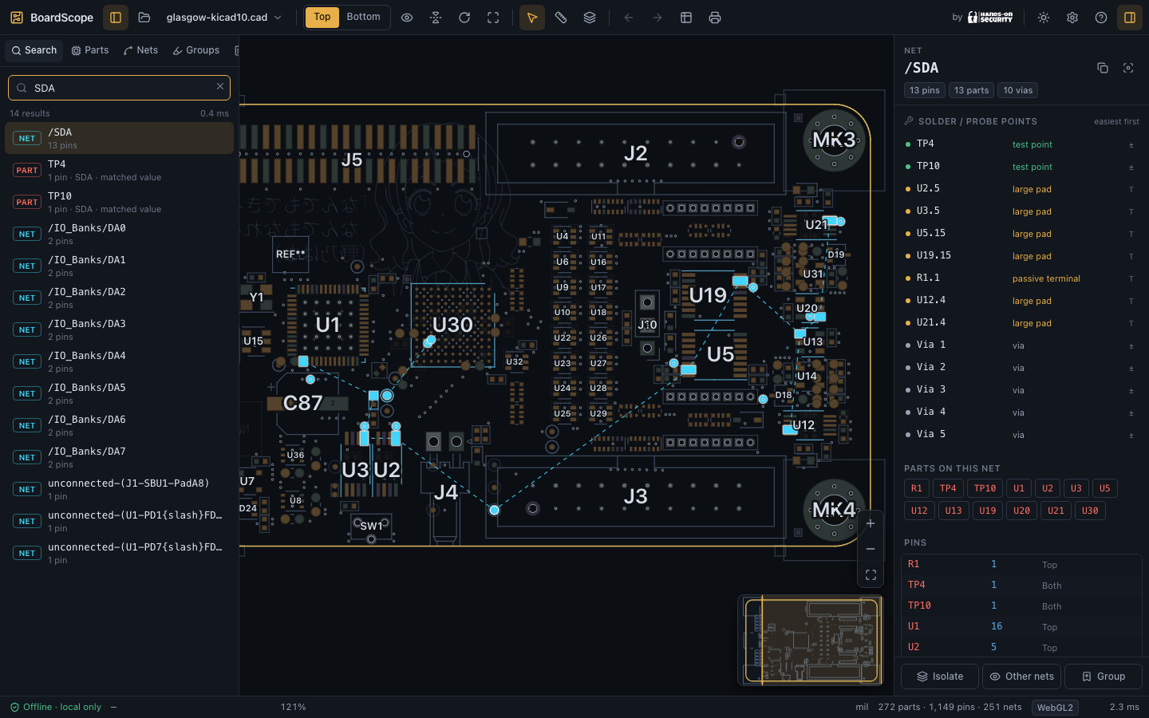
BOARDSCOPE / CLASSROOM BETA
A boardview workflow for students
Local, portable, focused on investigation at the bench
01 OPEN
Drag a boardview into one HTML file. No VM, login or installation.
02 TRACE
Follow nets through series parts and locate practical probe points.
03 TEACH
Use the same local browser workflow on students’ own machines.
Pilot scope: tested formats only · No board files or vendor keys included
02 / 02
Notes:
Presenter: For the classroom pilot, distribute only dist/boardview.html plus a supported-format list and lesson files that you have permission to share. The app works from file://, makes no network requests, and ships without board files or vendor decryption keys. A separately imported keyfile can be used locally when authorised. Students can search parts/nets, inspect either side, follow series components, and rank solder/probe access points.
Validation: project REPORT.md and FORMAT_MATRIX.md. Current local validation: 338 unit/corpus checks, 109 browser checks across Chromium, Firefox and WebKit, plus zero production dependency advisories from npm audit. The browser-engine tests ran on macOS; test the actual managed Windows/Linux machines before claiming platform-wide validation.
Known limits: Allegro 18+ is unsupported; NBV, numbered TopTest with .con, full Extracta, and multi-board GenCAM have no authentic fixtures and remain experimental. Some copper/silkscreen artwork is incomplete. Password-protected archives are unsupported. BoardScope is suitable as a classroom beta for verified formats, not a complete replacement for professional repair suites.
Screenshot source: docs/screenshots/dark-net.png from this project. Code and licence: LICENSE, THIRD_PARTY_NOTICES.md.

