Slide 1
Model Selection & Training
Problem: Multivariate Regression
Preprocessing

Slide 2
Evaluation Model with training Data set
Model
Linear Regression
Decision Tree Regression
RMSE
RMSE
Under fitting
Over fitting

Slide 3
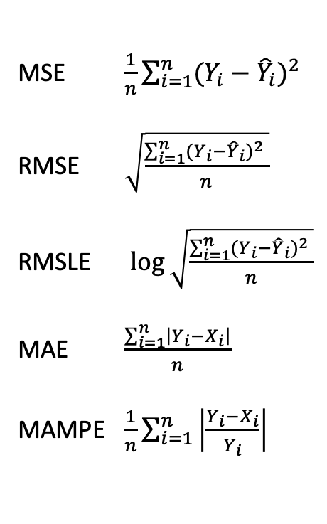
Linear Regression Goals & Evaluation Method
MSE $\frac{1}{n}\sum_{i=1}^{n}{{(Y_{i}−{\hat{Y}}_{i})}^{2}}$
RMSE $\sqrt{\frac{\sum_{i=1}^{n}{{(Y_{i}−{\hat{Y}}_{i})}^{2} }}{n}}$
RMSLE $\log{\sqrt{\frac{\sum_{i=1}^{n}{{(Y_{i}−{\hat{Y}}_{i})}^{2} }}{n}}}$
MAE $\frac{\sum_{i=1}^{n}{\left|Y_{i}−X_{i}\right|}}{n}$
MAMPE $\frac{1}{n}\sum_{i=1}^{n}{\left|\frac{Y_{i}−X_{i}}{Y_{i}}\right|}$
if data set have a lot of noise value
Which method is fit for that data set?

Slide 4
Linear Regression Goals & Evaluation Method
MSE $\frac{1}{n}\sum_{i=1}^{n}{{(Y_{i}−{\hat{Y}}_{i})}^{2}}$
RMSE $\sqrt{\frac{\sum_{i=1}^{n}{{(Y_{i}−{\hat{Y}}_{i})}^{2} }}{n}}$
RMSLE $\log{\sqrt{\frac{\sum_{i=1}^{n}{{(Y_{i}−{\hat{Y}}_{i})}^{2} }}{n}}}$
MAE $\frac{\sum_{i=1}^{n}{\left|Y_{i}−X_{i}\right|}}{n}$
MAMPE $\frac{1}{n}\sum_{i=1}^{n}{\left|\frac{Y_{i}−X_{i}}{Y_{i}}\right|}$
if data set have a lot of noise value
Which method is fit for that data set?
MAE

Slide 5
Linear Regression Goals & Evaluation Method
MSE $\frac{1}{n}\sum_{i=1}^{n}{{(Y_{i}−{\hat{Y}}_{i})}^{2}}$
RMSE $\sqrt{\frac{\sum_{i=1}^{n}{{(Y_{i}−{\hat{Y}}_{i})}^{2} }}{n}}$
RMSLE $\log{\sqrt{\frac{\sum_{i=1}^{n}{{(Y_{i}−{\hat{Y}}_{i})}^{2} }}{n}}}$
MAE $\frac{\sum_{i=1}^{n}{\left|Y_{i}−X_{i}\right|}}{n}$
MAMPE $\frac{1}{n}\sum_{i=1}^{n}{\left|\frac{Y_{i}−X_{i}}{Y_{i}}\right|}$
if data set have a lot of noise value
Which method is fit for that data set?
MAE
WHY?

Slide 6


$${(X+Y)}^{2}$$
$$\left|X+Y\right|$$
vs
What’s difference?

Slide 7
Evaluation Model with training Data set
Model
Linear Regression
Decision Tree Regression
RMSE
RMSE
Cross validation
Under fitting
Over fitting

Slide 8
Cross validation
Q. What is Goal of machine learning & statistical inference model?

Slide 9
Cross validation
Q. What is Goal of machine learning & statistical inference model?
A. Predict the future by extracting pattern from our data(present)

Slide 10
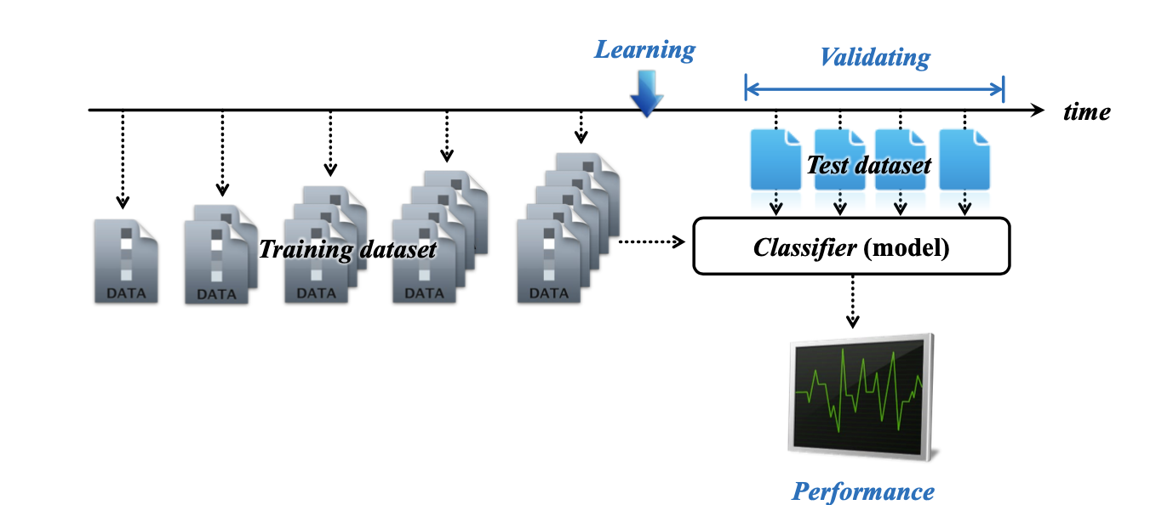
Cross validation
Q. What is Goal of machine learning & statistical inference model?
A. Predict the future by extracting pattern from our data(present)

Slide 11
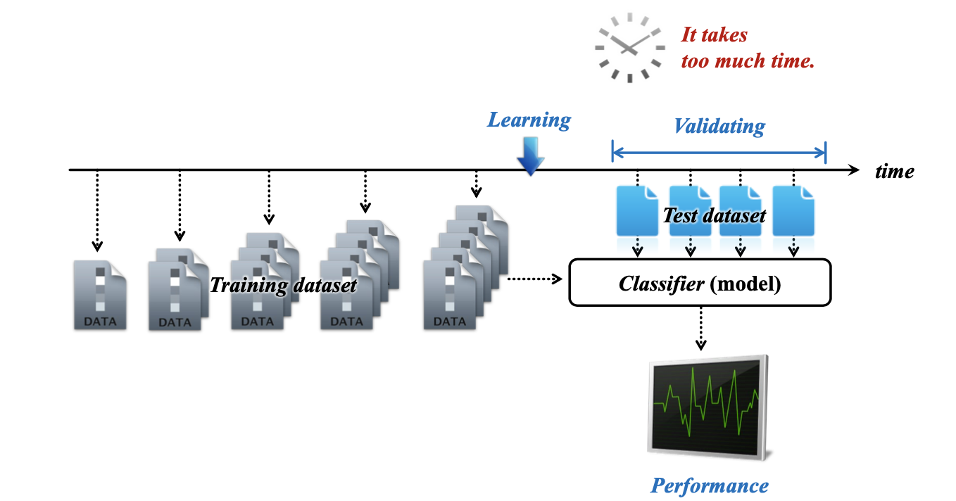
Cross validation
Q. What is Goal of machine learning & statistical inference model?

Slide 12
Cross validation
Leave-p-out
K-fold

Slide 13
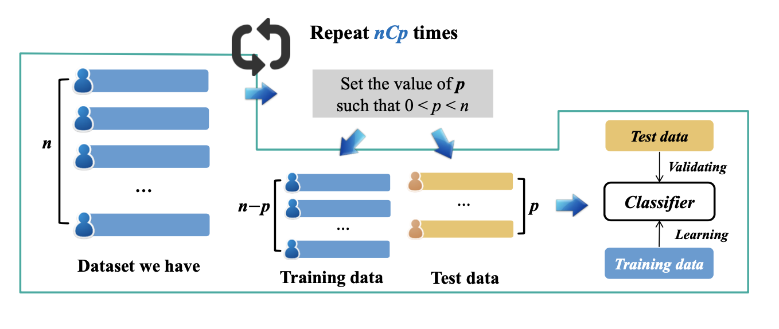
Leave – p - out
100 1

Slide 14
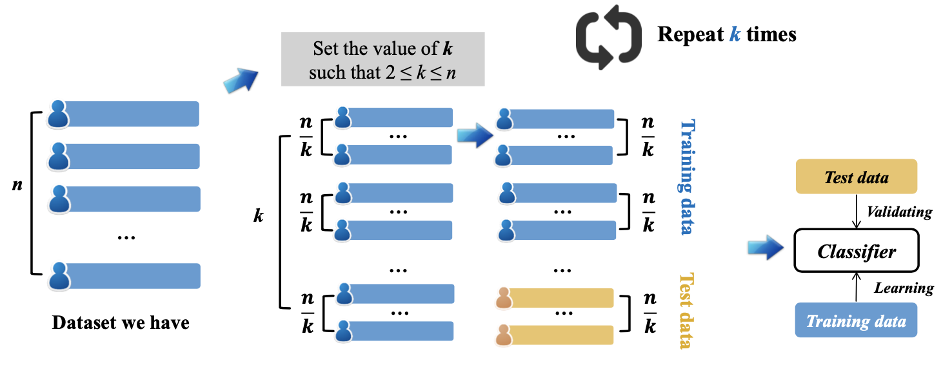
K-fold

Slide 15
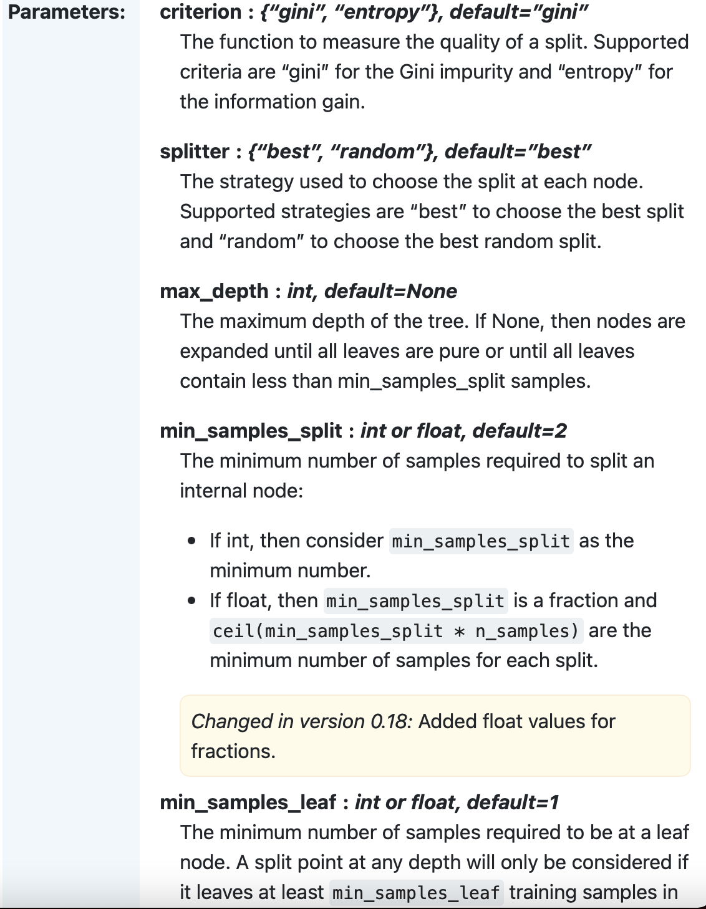
Fine Tuning
Model에게는 Hyper parameters 존재
Decision Tree hyperparameter

Slide 16
1000
2,3,5,1
3,5,6,1
.
.
.
1,1,1,1
1,1,1,2
1,1,1,3
Max,max,max,max

