Slide 1
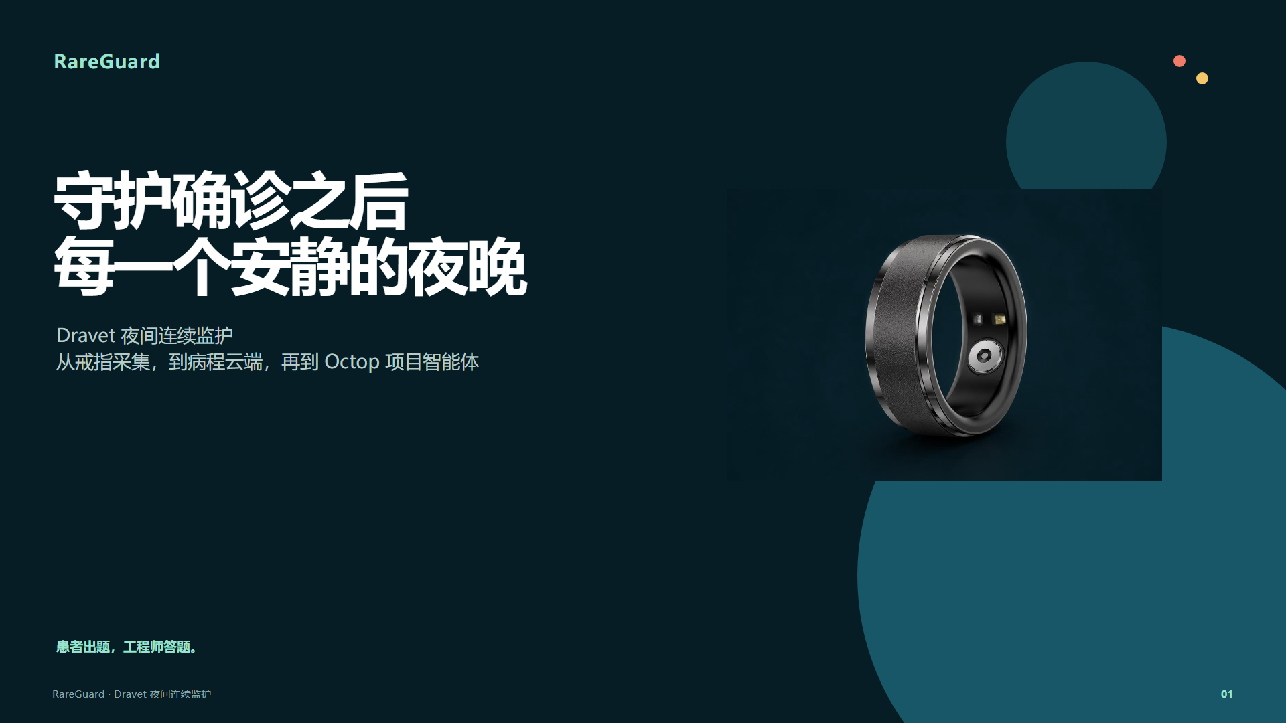
Notes:
Source: docs/presentation/index.html. App UI is a design example; cloud pages contain synthetic acceptance data. Octop image excludes the account region. Real device, overnight coverage and alarm acceptance remain pending. Edit HTML to change content; this PPTX uses rendered slide images.

Slide 2
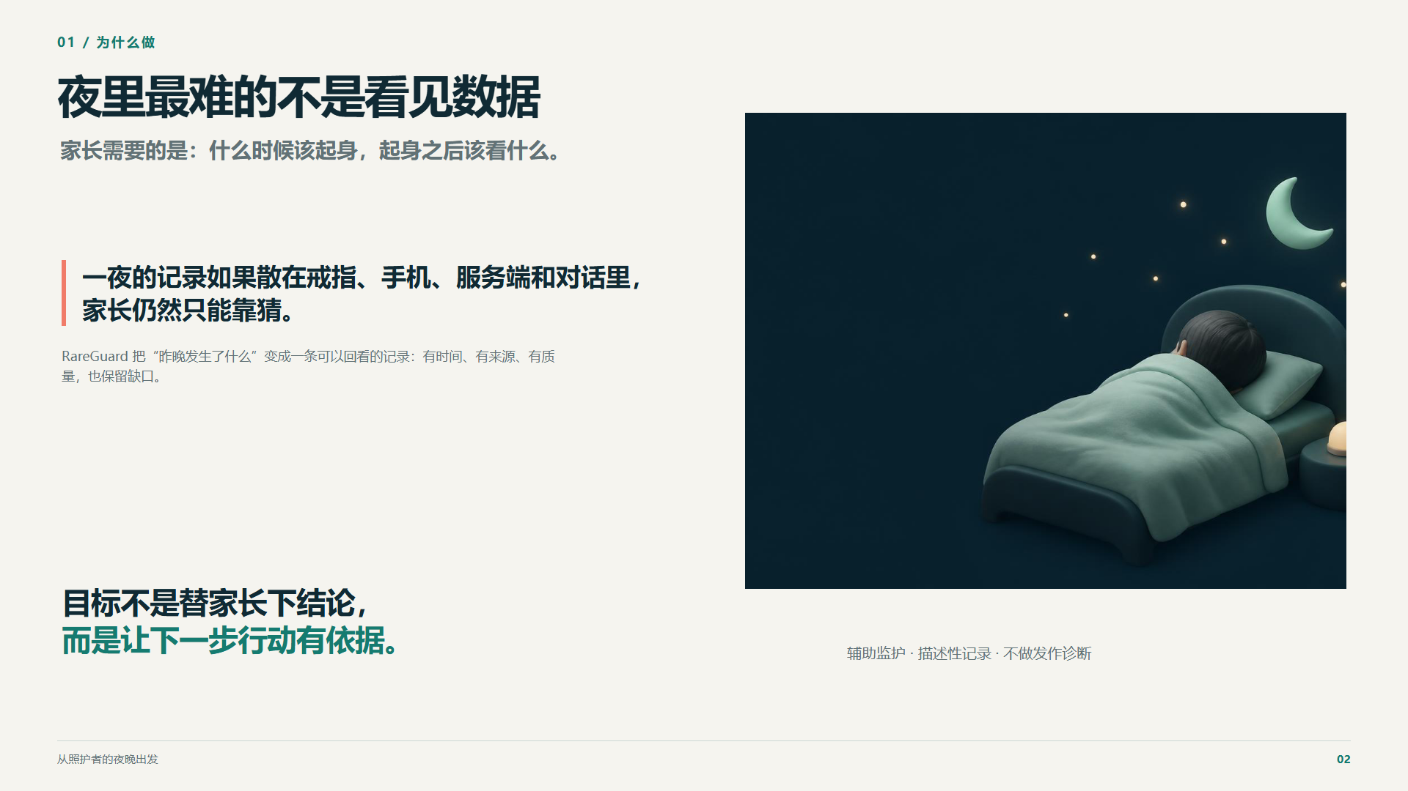
Notes:
Source: docs/presentation/index.html. App UI is a design example; cloud pages contain synthetic acceptance data. Octop image excludes the account region. Real device, overnight coverage and alarm acceptance remain pending. Edit HTML to change content; this PPTX uses rendered slide images.

Slide 3
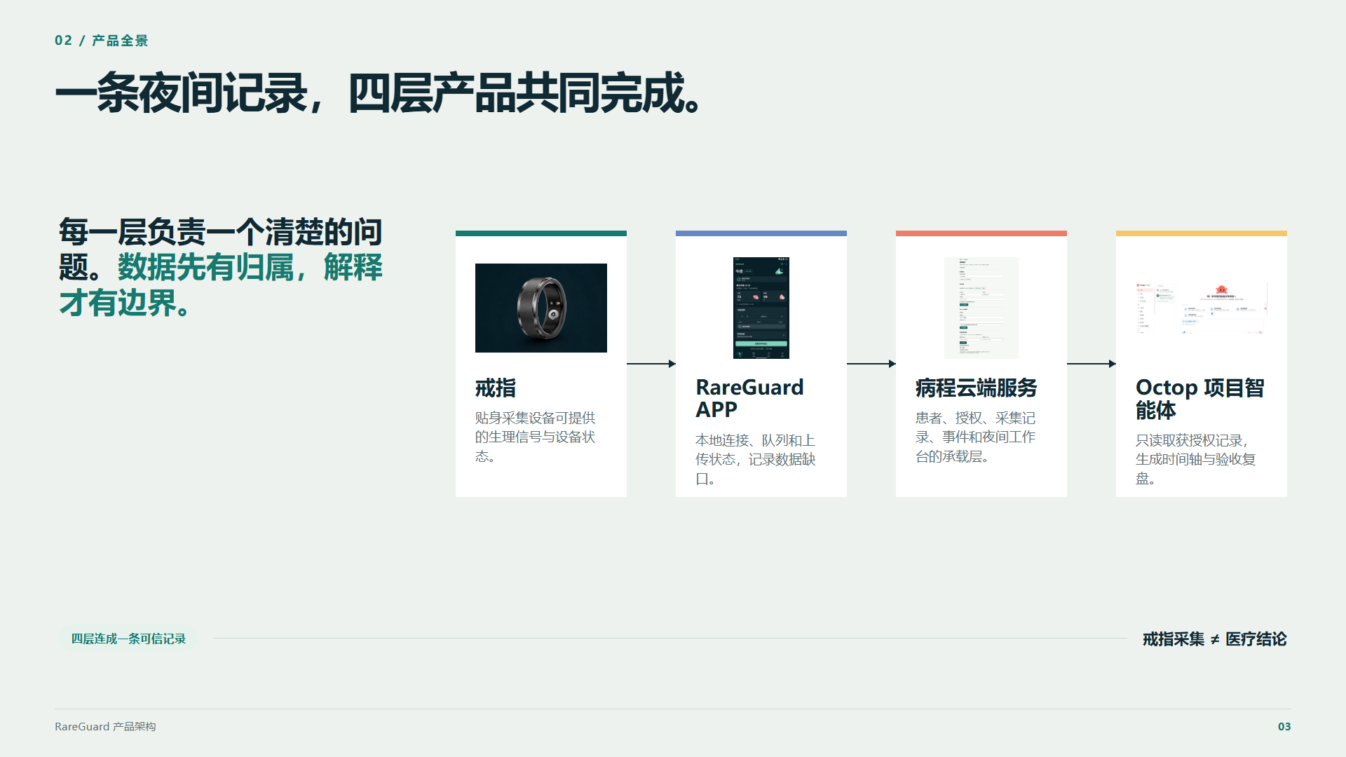
Notes:
Source: docs/presentation/index.html. App UI is a design example; cloud pages contain synthetic acceptance data. Octop image excludes the account region. Real device, overnight coverage and alarm acceptance remain pending. Edit HTML to change content; this PPTX uses rendered slide images.

Slide 4
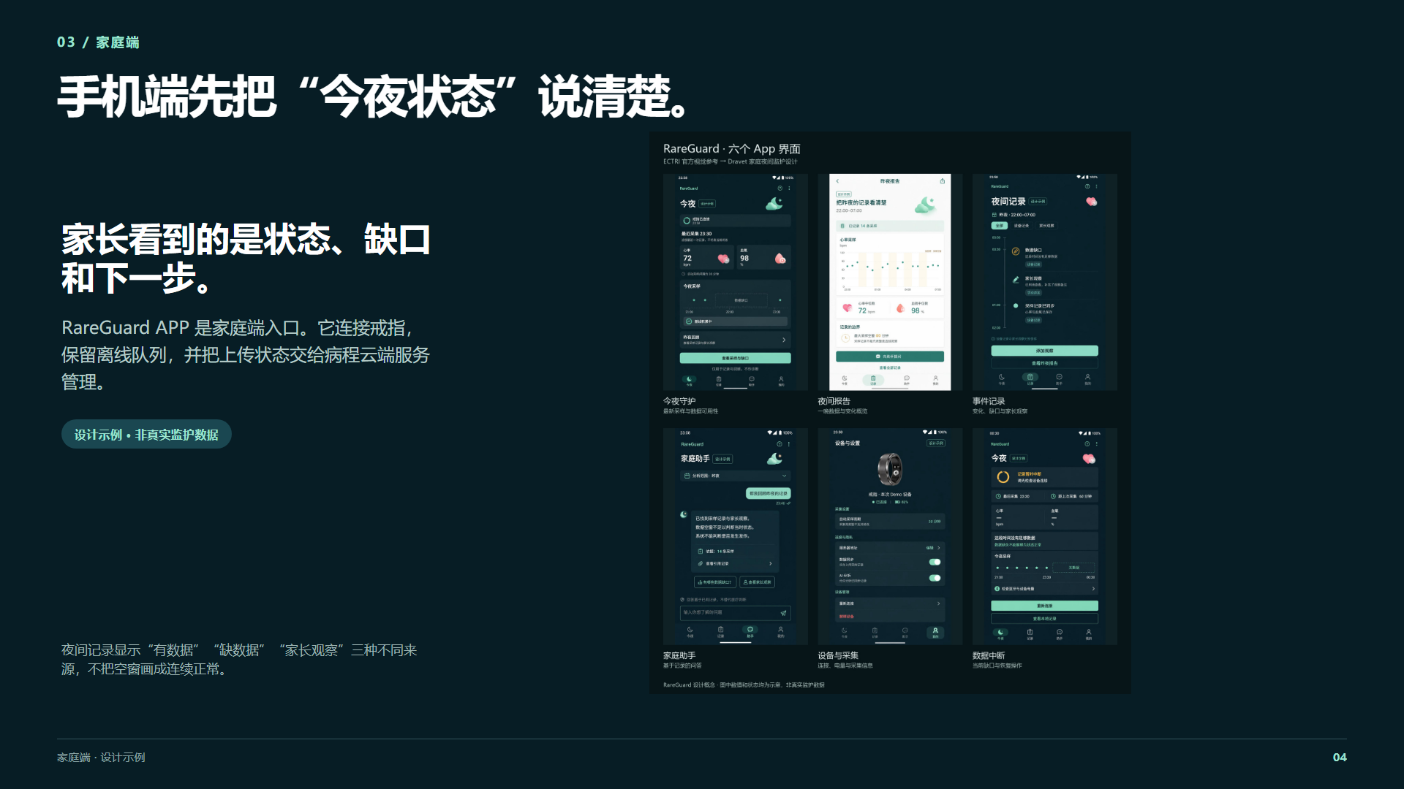
Notes:
Source: docs/presentation/index.html. App UI is a design example; cloud pages contain synthetic acceptance data. Octop image excludes the account region. Real device, overnight coverage and alarm acceptance remain pending. Edit HTML to change content; this PPTX uses rendered slide images.

Slide 5
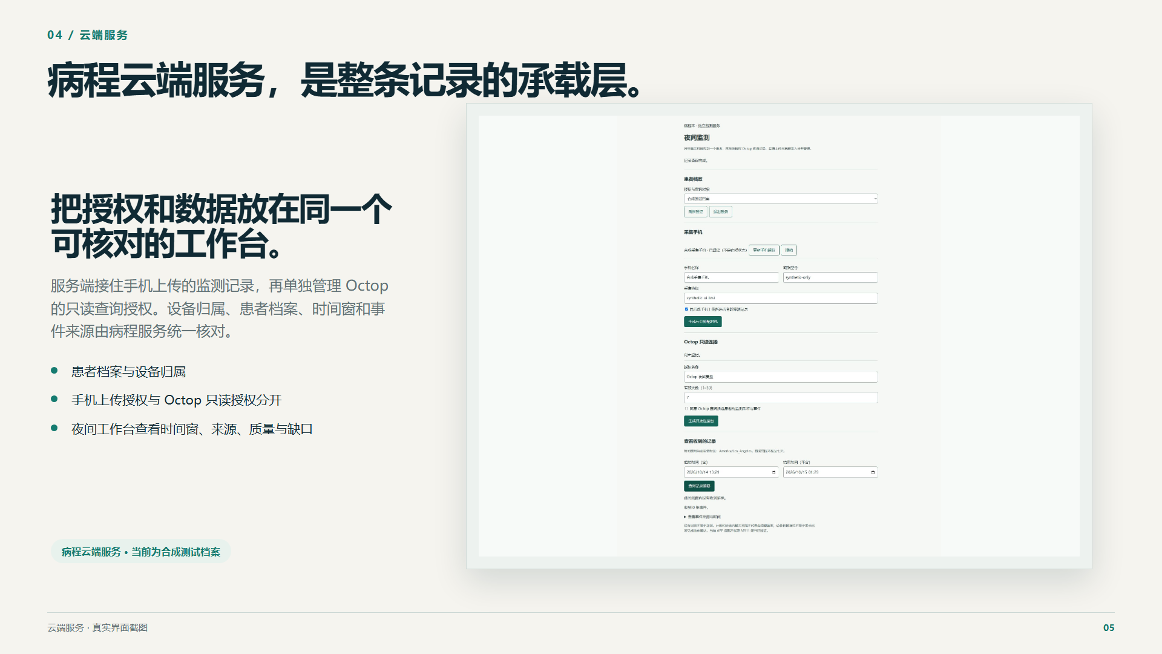
Notes:
Source: docs/presentation/index.html. App UI is a design example; cloud pages contain synthetic acceptance data. Octop image excludes the account region. Real device, overnight coverage and alarm acceptance remain pending. Edit HTML to change content; this PPTX uses rendered slide images.

Slide 6
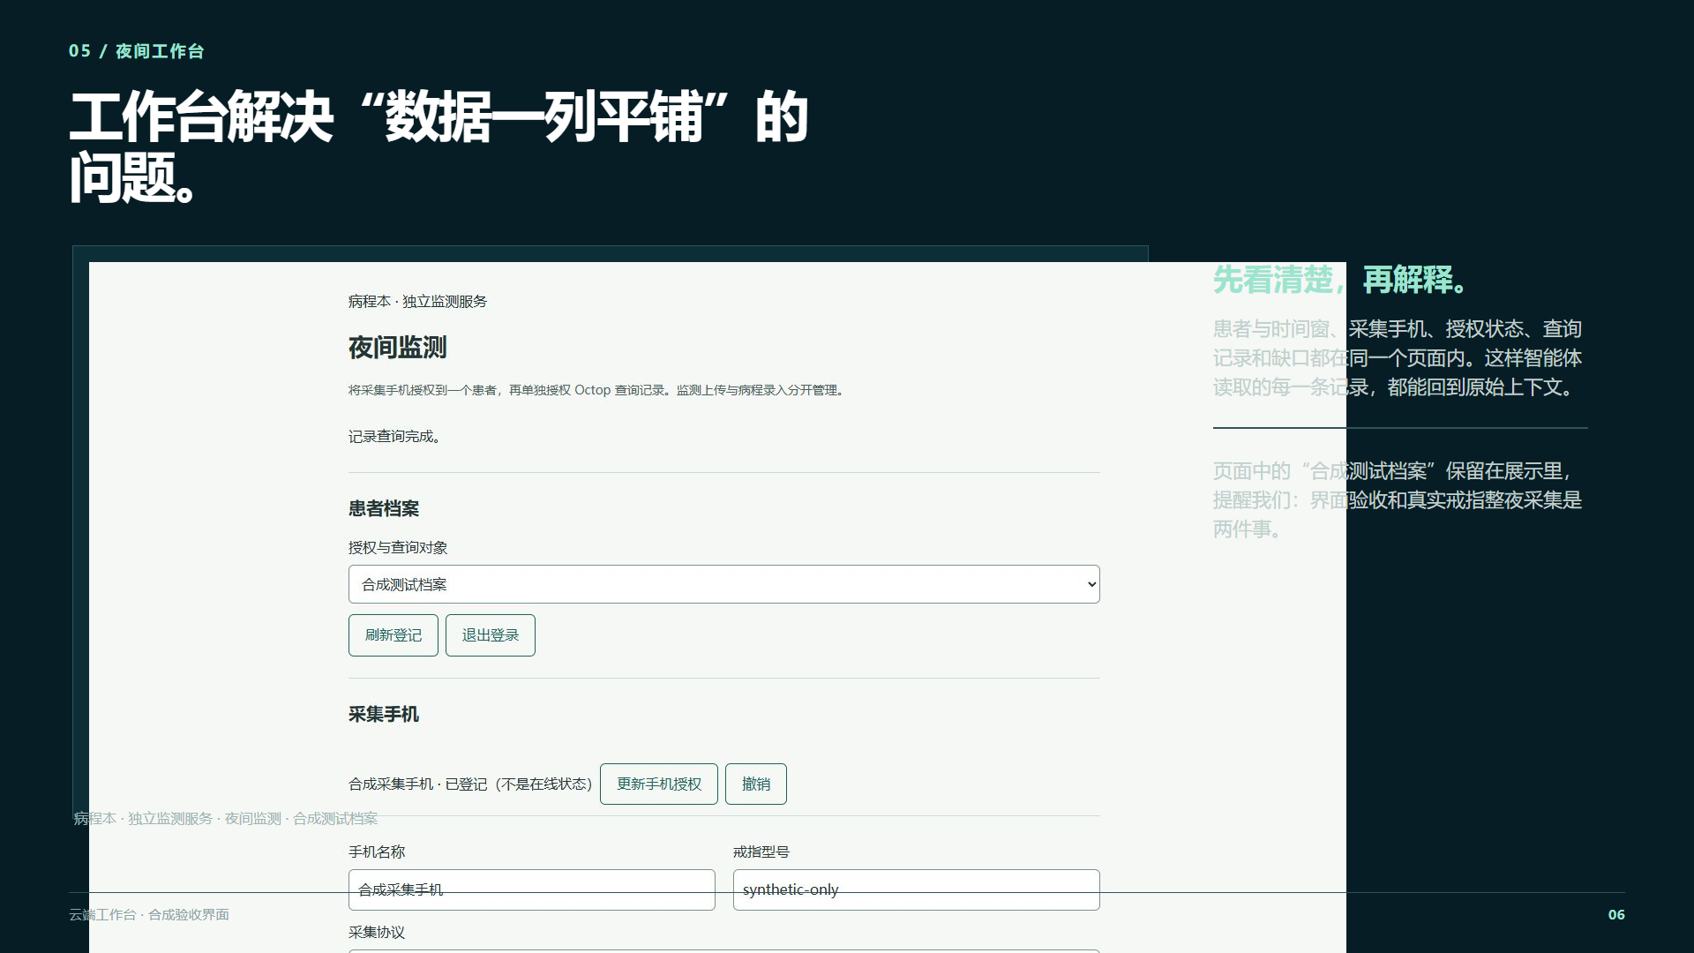
Notes:
Source: docs/presentation/index.html. App UI is a design example; cloud pages contain synthetic acceptance data. Octop image excludes the account region. Real device, overnight coverage and alarm acceptance remain pending. Edit HTML to change content; this PPTX uses rendered slide images.

Slide 7
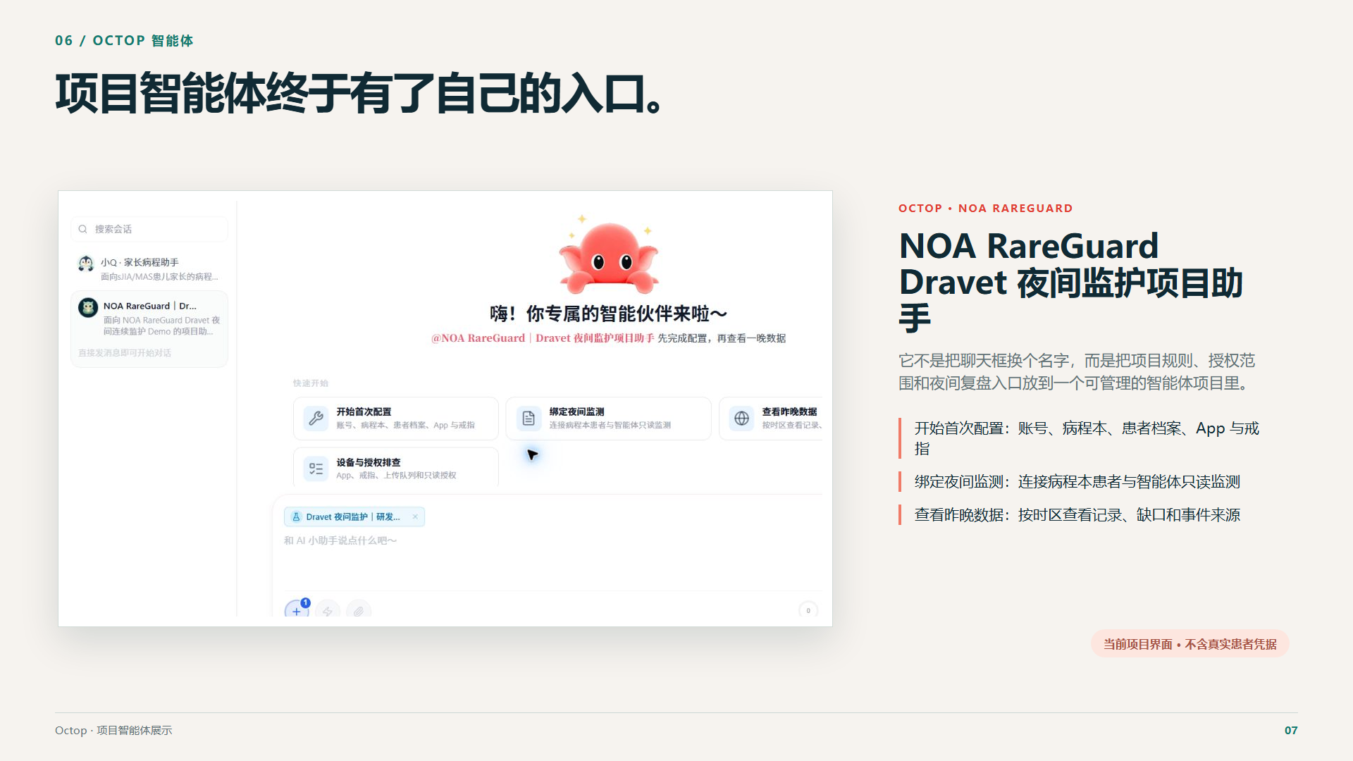
Notes:
Source: docs/presentation/index.html. App UI is a design example; cloud pages contain synthetic acceptance data. Octop image excludes the account region. Real device, overnight coverage and alarm acceptance remain pending. Edit HTML to change content; this PPTX uses rendered slide images.

Slide 8
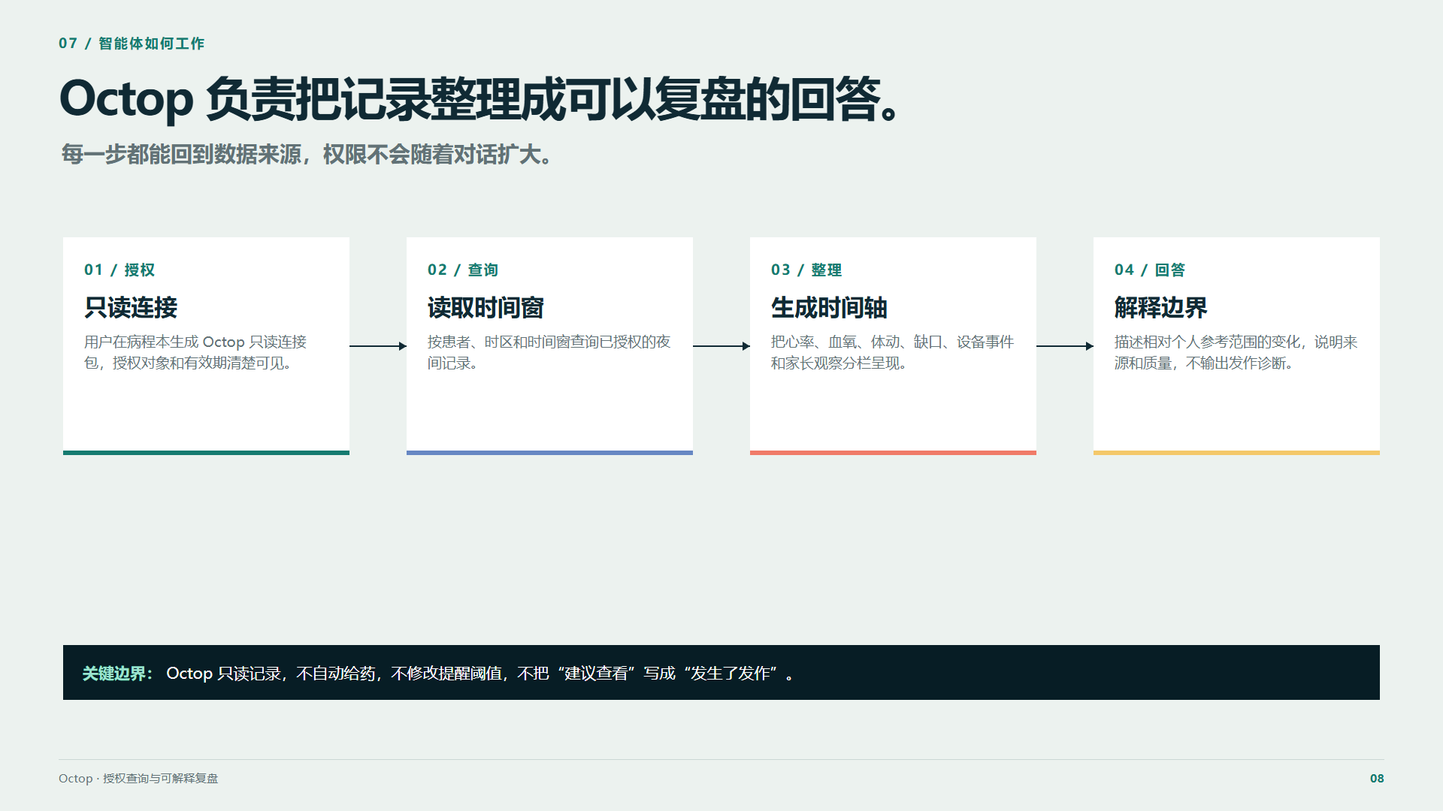
Notes:
Source: docs/presentation/index.html. App UI is a design example; cloud pages contain synthetic acceptance data. Octop image excludes the account region. Real device, overnight coverage and alarm acceptance remain pending. Edit HTML to change content; this PPTX uses rendered slide images.

Slide 9
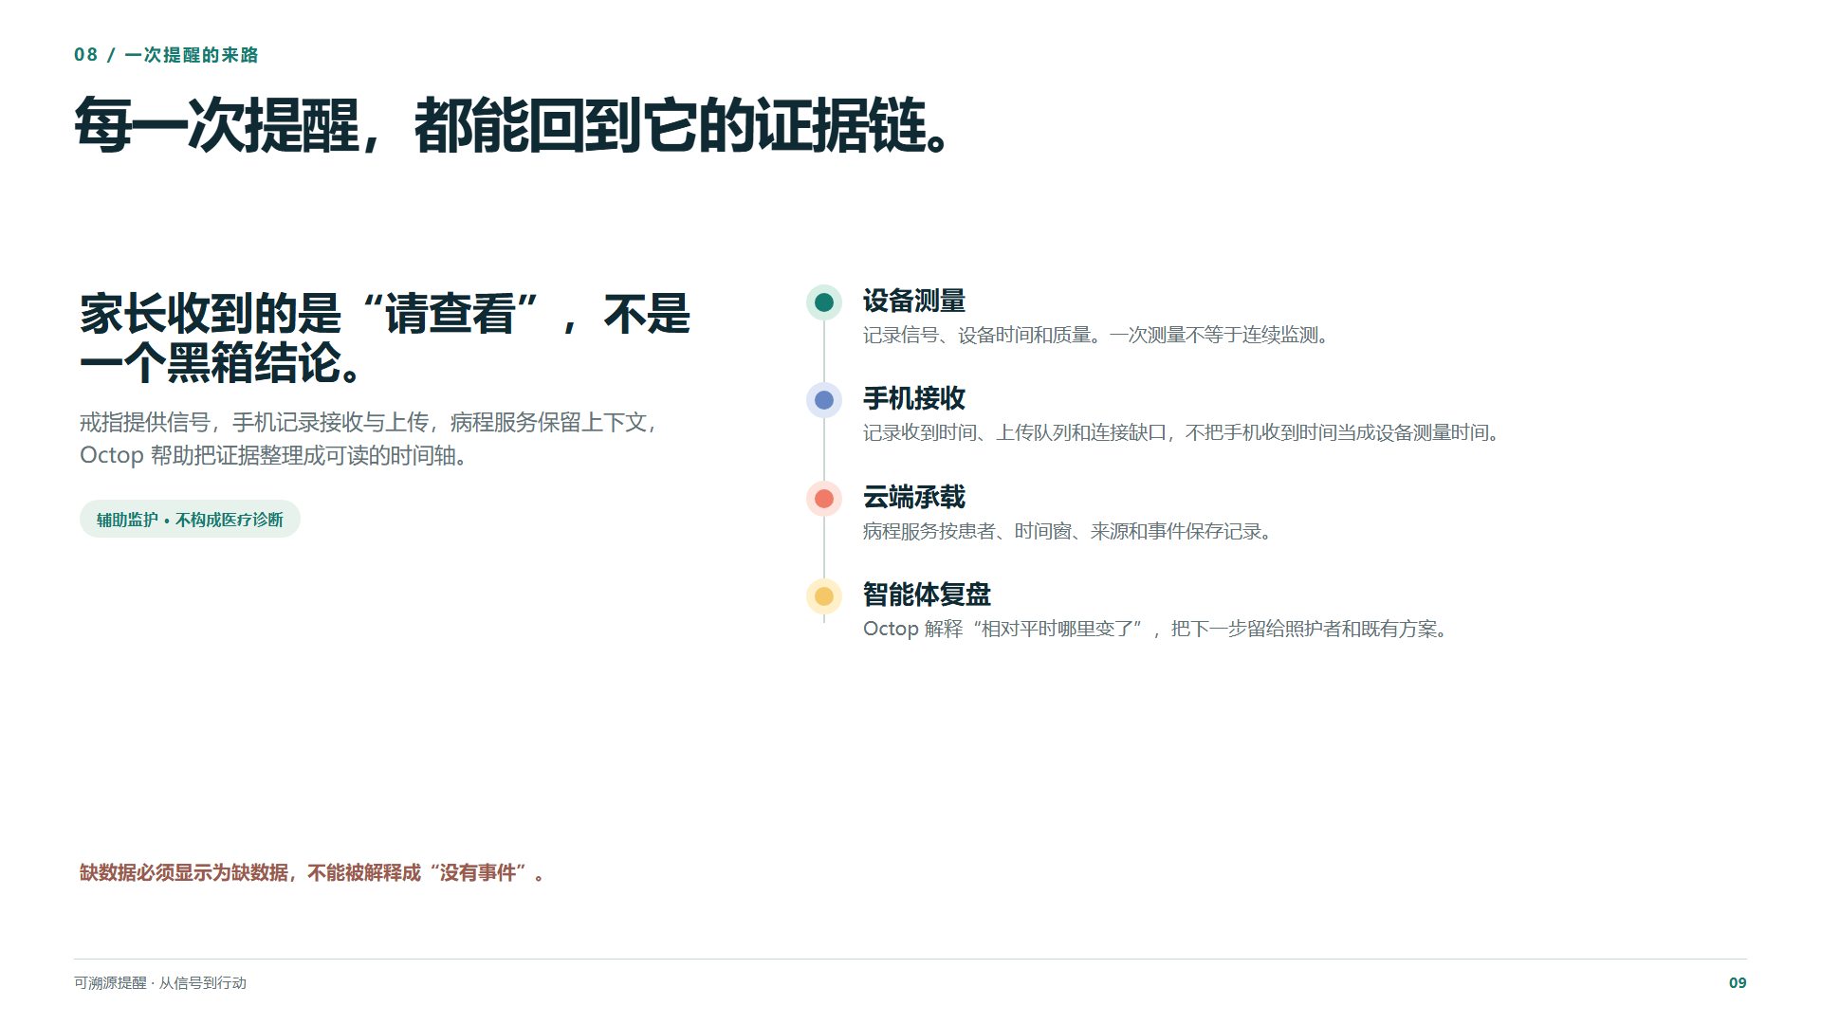
Notes:
Source: docs/presentation/index.html. App UI is a design example; cloud pages contain synthetic acceptance data. Octop image excludes the account region. Real device, overnight coverage and alarm acceptance remain pending. Edit HTML to change content; this PPTX uses rendered slide images.

Slide 10
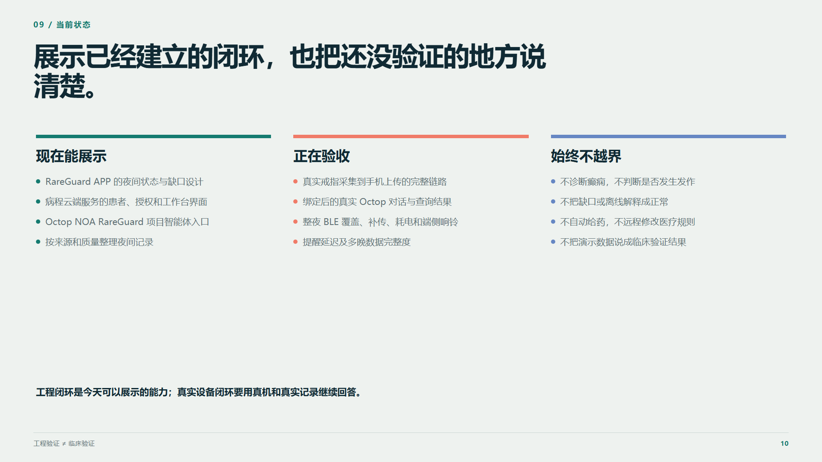
Notes:
Source: docs/presentation/index.html. App UI is a design example; cloud pages contain synthetic acceptance data. Octop image excludes the account region. Real device, overnight coverage and alarm acceptance remain pending. Edit HTML to change content; this PPTX uses rendered slide images.

Slide 11
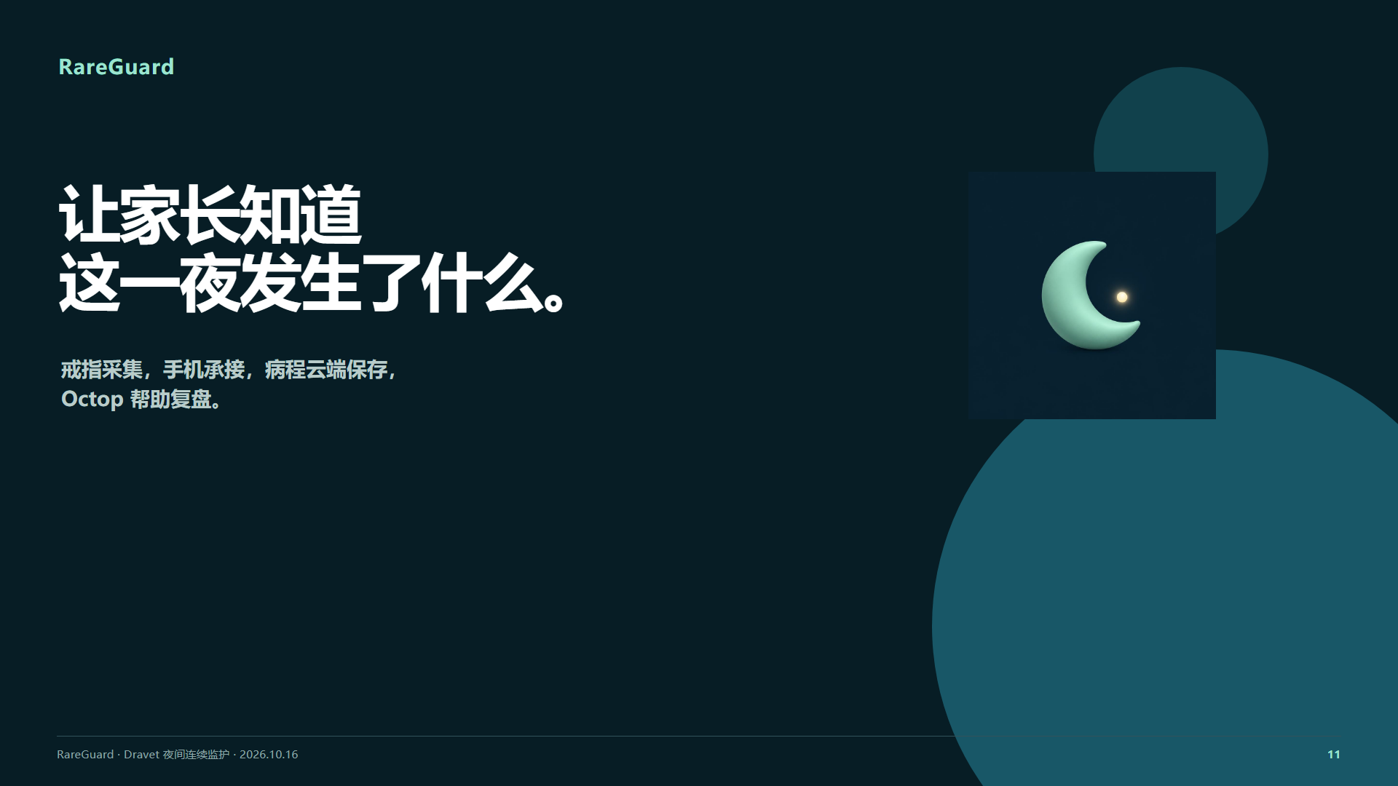
Notes:
Source: docs/presentation/index.html. App UI is a design example; cloud pages contain synthetic acceptance data. Octop image excludes the account region. Real device, overnight coverage and alarm acceptance remain pending. Edit HTML to change content; this PPTX uses rendered slide images.

