Slide 1
Chapter 4: Threads
Mar 22, 2021

Slide 2
Review

Slide 3
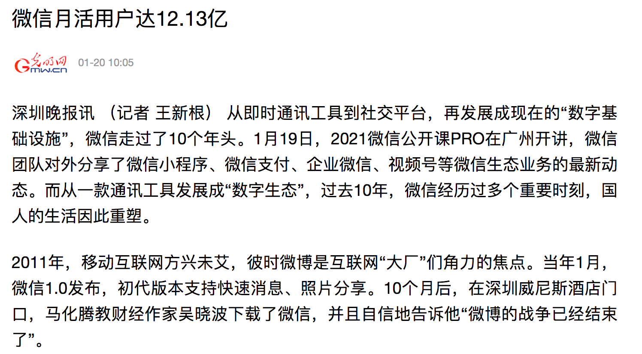
WeChat
Notes:
https://m.gmw.cn/baijia/2021-01/20/1302055242.html

Slide 4
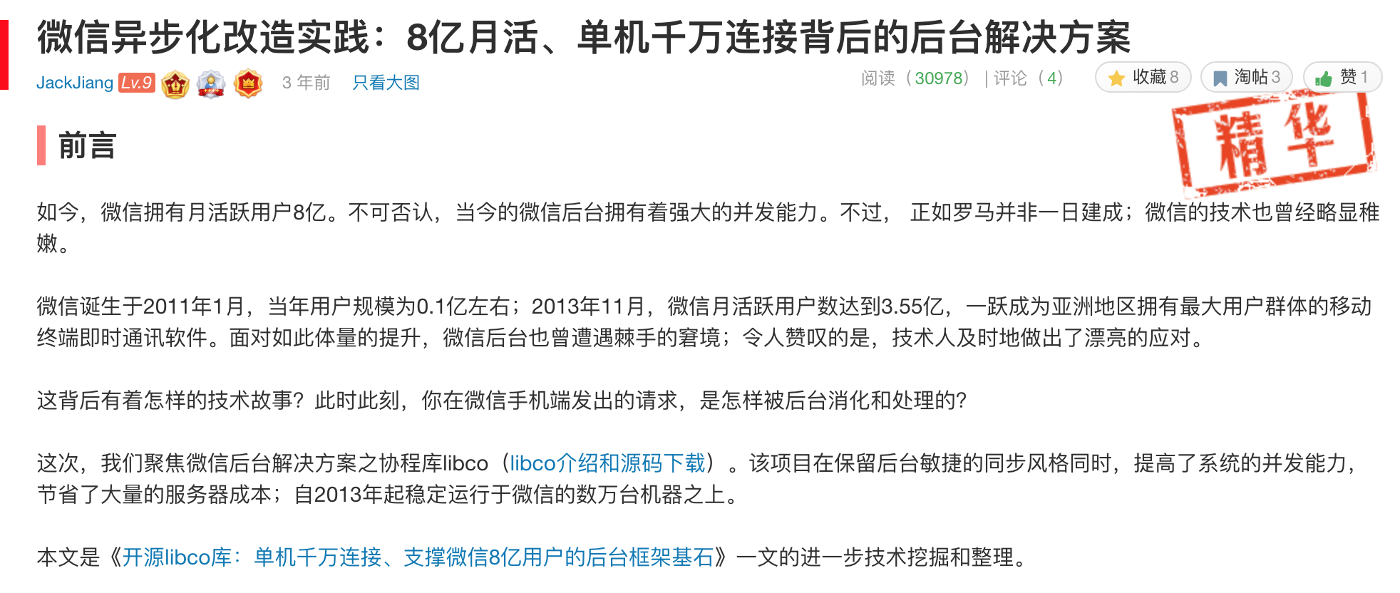
WeChat
http://www.52im.net/thread-624-1-1.html
4
Notes:
2016 Year
https://github.com/52im/libco

Slide 5
Outline
Processes vs threads
Thread models
Multi-programming
  Linux thread library

Slide 6
Objectives
To introduce the notion of a thread—a fundamental unit of CPU utilization that forms the basis of multithreaded computer systems
To discuss the different models of threads and the implementation
To cover operating system support and APIs for threads in Linux/Windows

Slide 7

Motivation
QQ

Slide 8


Motivation

Slide 9
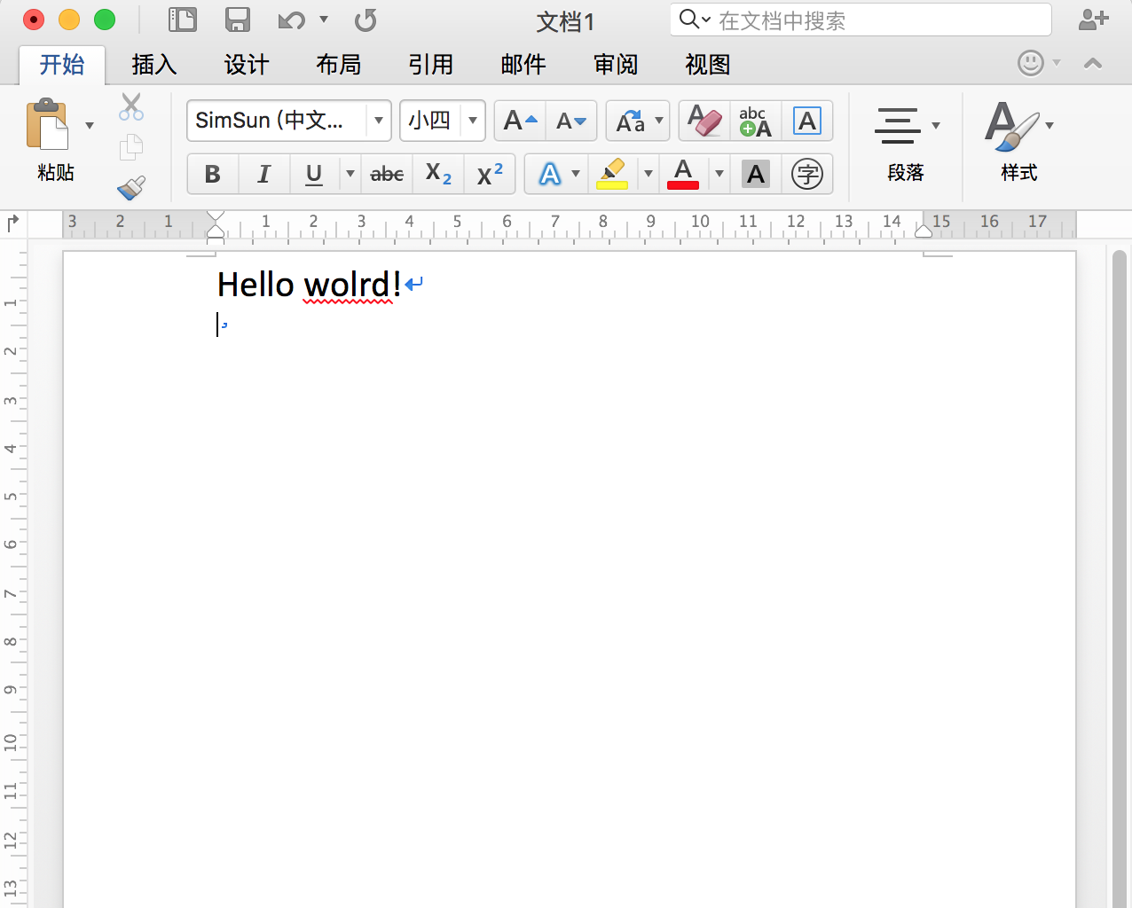
Motivation

Slide 10
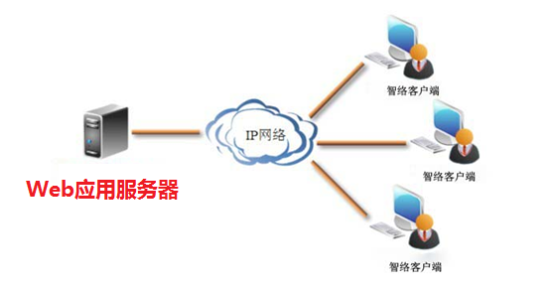

Motivation
Multithreaded Server Architecture

Slide 11

Why not process
Single process
Multiple process

Slide 12
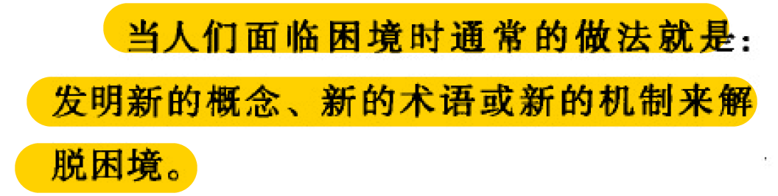
Threads

Slide 13
Threads
A thread is a basic unit of CPU utilization
It comprises a thread ID, a program counter (PC), a register set, and a stack
It shares with other threads belonging to the same process its code section, data section, and other operating-system resources, such as open files and signals

Slide 14
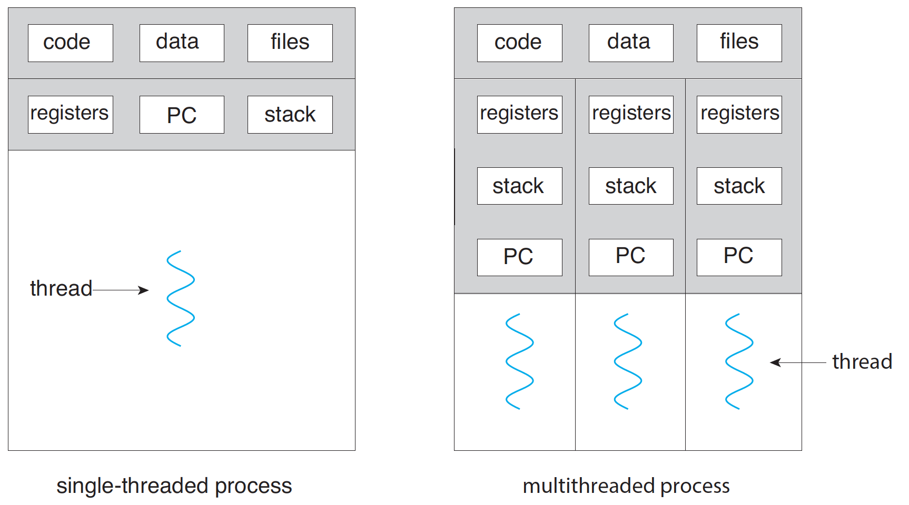
Process vs Threads

Slide 15
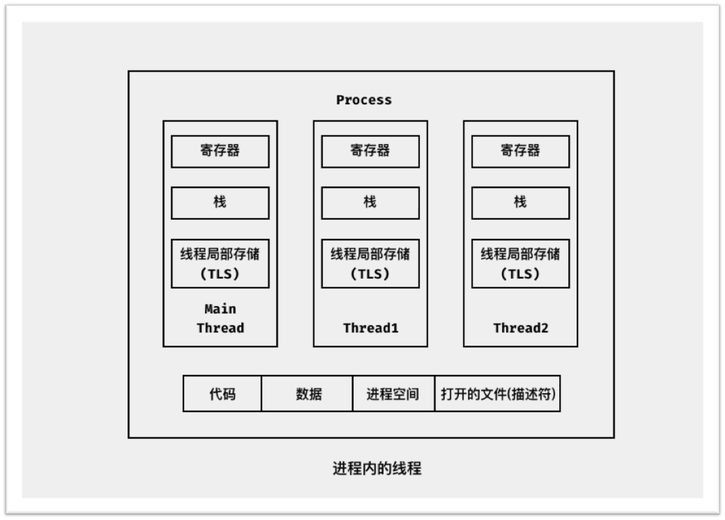
Process vs Threads

Slide 16
Benefits of Threads
Responsiveness – may allow continued execution if part of process is blocked, especially important for user interfaces
Scalability – can take advantage of multiprocessor architectures
Resource Sharing – threads share resources of process, easier than shared memory or message passing
Economy – cheaper than process creation, thread switching lower overhead than context switching (light weight process, LWP)
Notes:
webpage

Slide 17
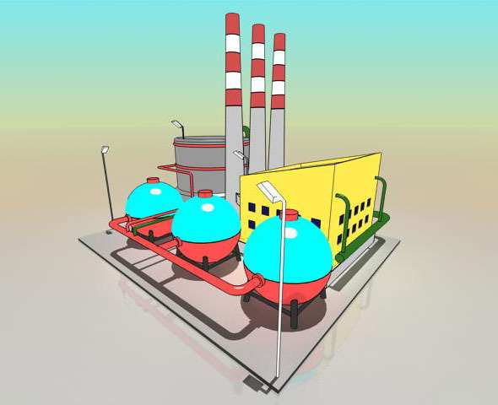
Process vs. Thread
http://www.ruanyifeng.com/blog/2013/04/processes_and_threads.html
Notes:
计算机的核心是CPU，它承担了所有的计算任务。它就像一座工厂，时刻在运行

Slide 18

Process vs. Thread
Notes:
工厂的电力有限，一次只能供给一个车间使用。也就是说，一个车间开工的时候，其他车间都必须停工。背后的含义就是，单个CPU一次只能运行一个任务

Slide 19

Process vs. Thread
Notes:
进程就好比工厂的车间，它代表CPU所能处理的单个任务。任一时刻，CPU总是运行一个进程，其他进程处于非运行状态。

Slide 20

Process vs. Thread
Notes:
线程就好比车间里的工人。一个进程可以包括多个线程。

Slide 21

Process vs. Thread
Notes:
一个车间里，可以有很多工人。他们协同完成一个任务。
车间的空间是工人们共享的，比如许多房间是每个工人都可以进出的。这象征一个进程的内存空间是共享的，每个线程都可以使用这些共享内存。

Slide 22

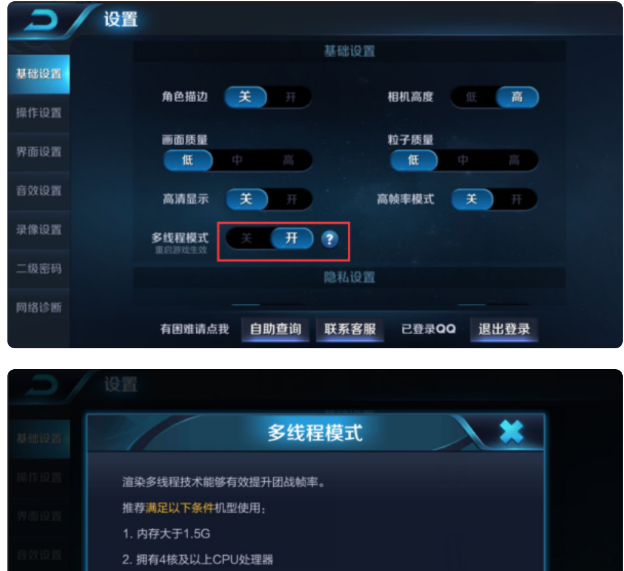
Question
Give a multi-threaded scenario?
Notes:
https://zhidao.baidu.com/question/2016192845610693108.html

Slide 23
Thread Models

Slide 24
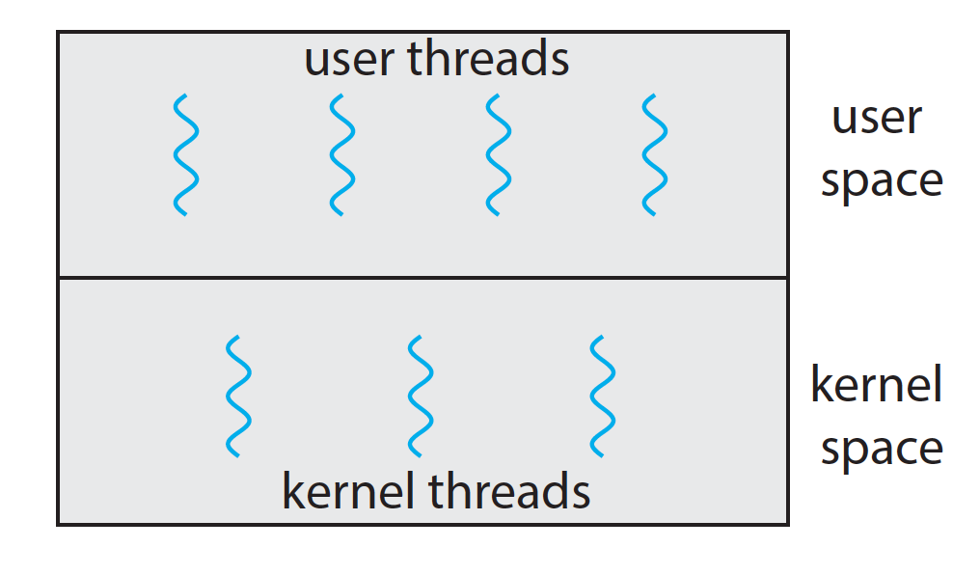
User Threads and Kernel Threads
User threads - management done by user-level threads library
Kernel threads - Supported by the Kernel
Notes:
ps -eLf: kernel threads
ps -e
ps -l
ps -L
ps -f

Slide 25
Multithreading Models
Many-to-One
One-to-One
Many-to-Many

Slide 26
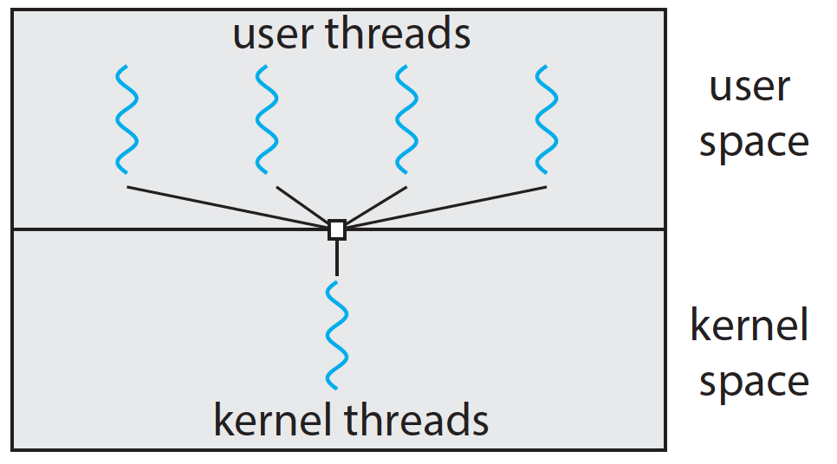
Many-to-One
Many user-level threads mapped to single kernel thread

Slide 27
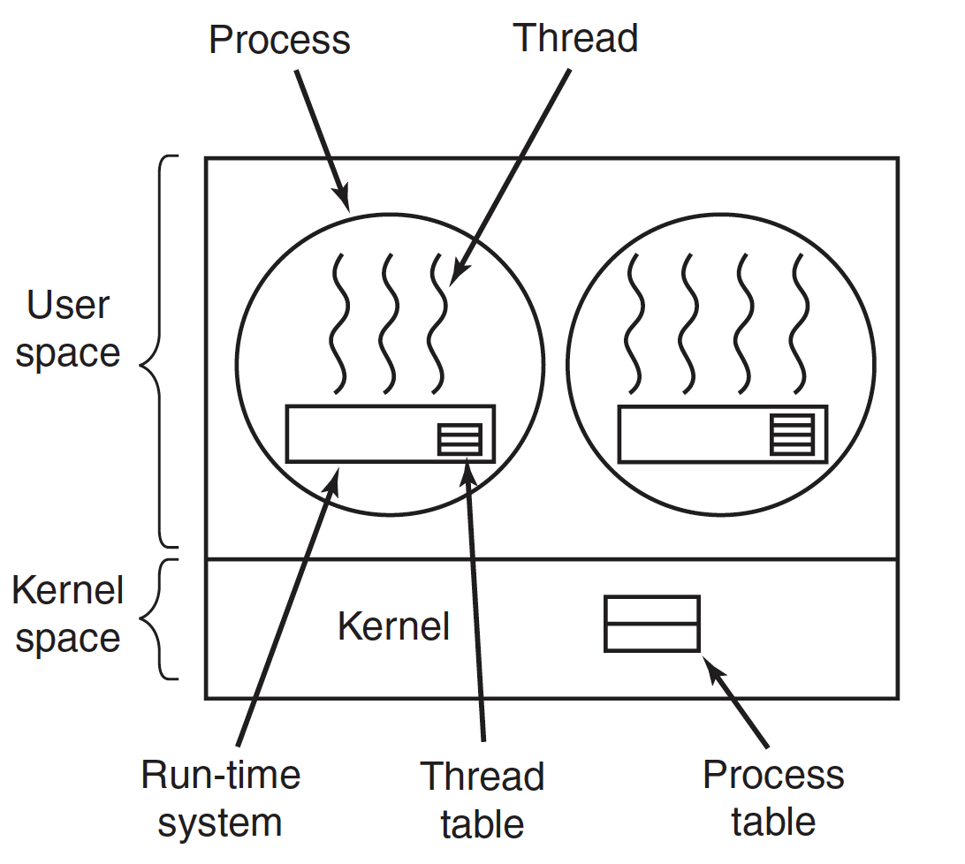
Many-to-One

Slide 28
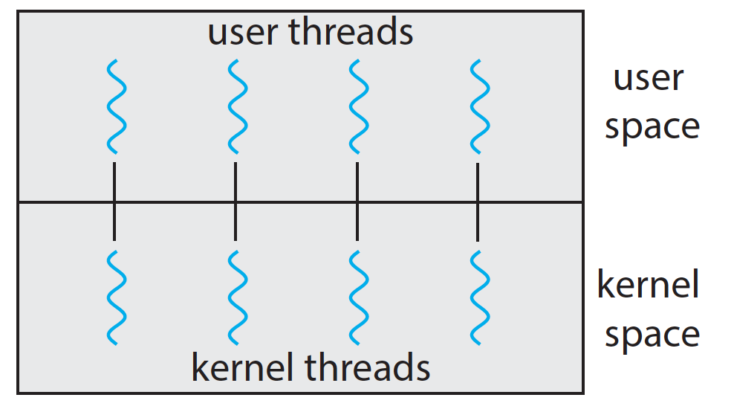
One-to-One
Each user-level thread maps to kernel thread
Examples
  Windows
  Linux

Slide 29
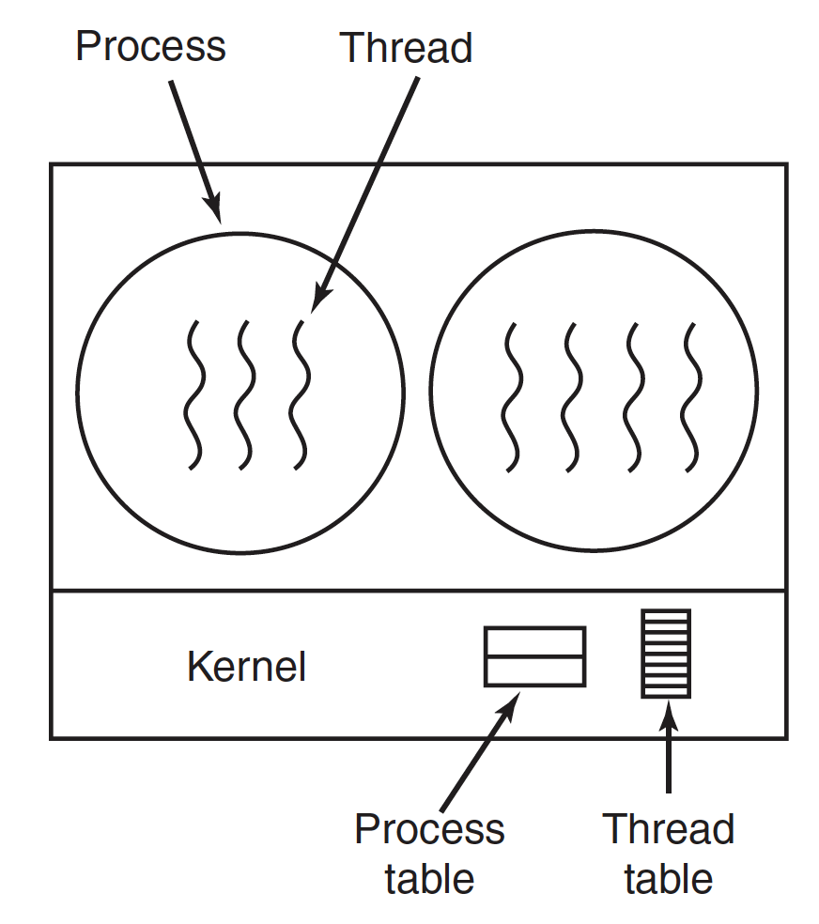
One-to-One

Slide 30
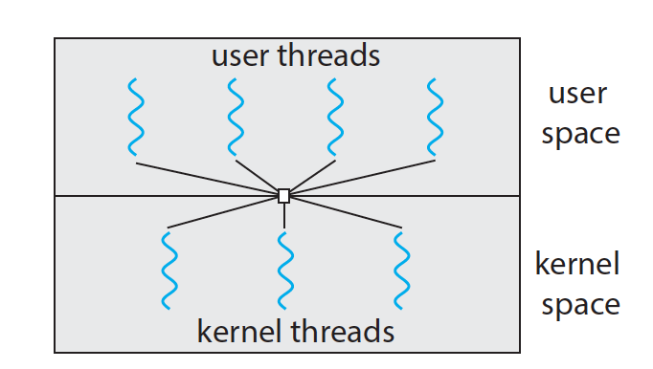
Many-to-many

Slide 31
Comparison
User threads are more efficient
On run on any system
One thread blocking causes all to block
Multiple threads may not run in parallel on muti-core system because only one may be in kernel at a time

Slide 32
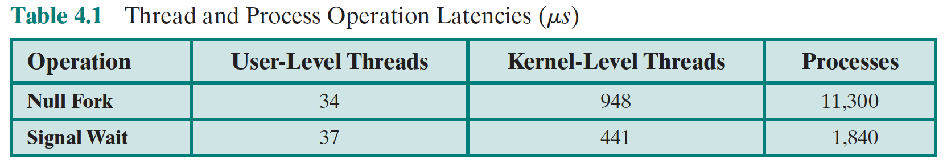
Cost
4
demo
Notes:
Demo of system call cost

Slide 33
Thread API

Slide 34
Thread Libraries
Thread library provides programmer with API for creating and managing threads
  Pthread
  Windows
  Java
Pthread
  A POSIX standard (IEEE 1003.1c) API for thread creation and synchronization
  Specification, not implementation
  API specifies behavior of the thread library, implementation is up to development of the library
  Common in UNIX operating systems (Solaris, Linux, Mac OS X)

Slide 35
API
fork pthread_create
exit pthread_exit
wait pthread_join
getpid pthread_self
abort pthread_cancel
Demo1: simple
Demo2: share global
Notes:
ps -eLf
-pthread

Slide 36
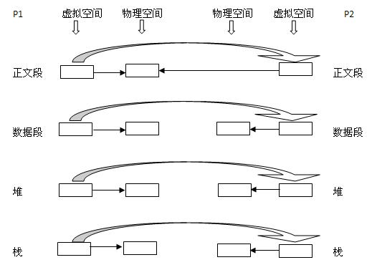
Process creation: fork()

Slide 37
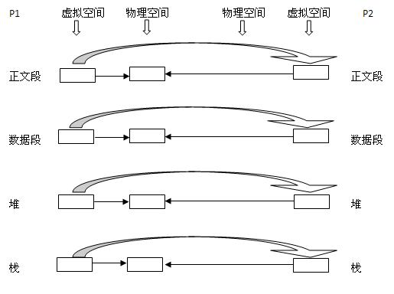
More about fork（）
Notes:
This should be fork with copy-on-write

Slide 38
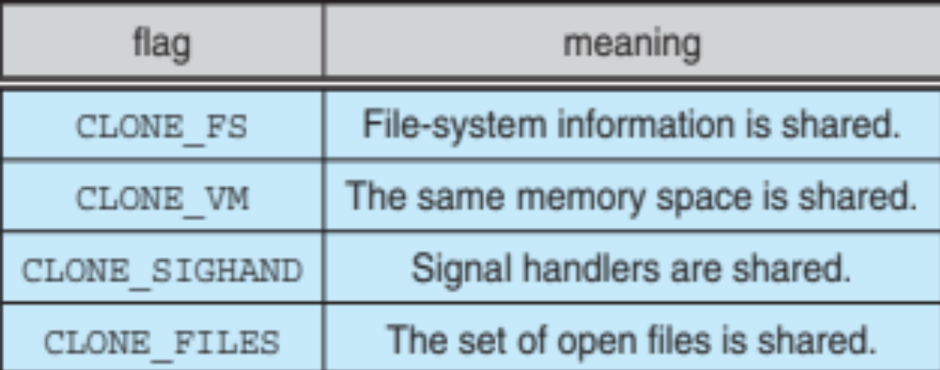
Linux Threads
Thread creation is done through clone() system call
clone() allows a child task to share the address space of the parent task (process)
  Flags control behavior

Slide 39
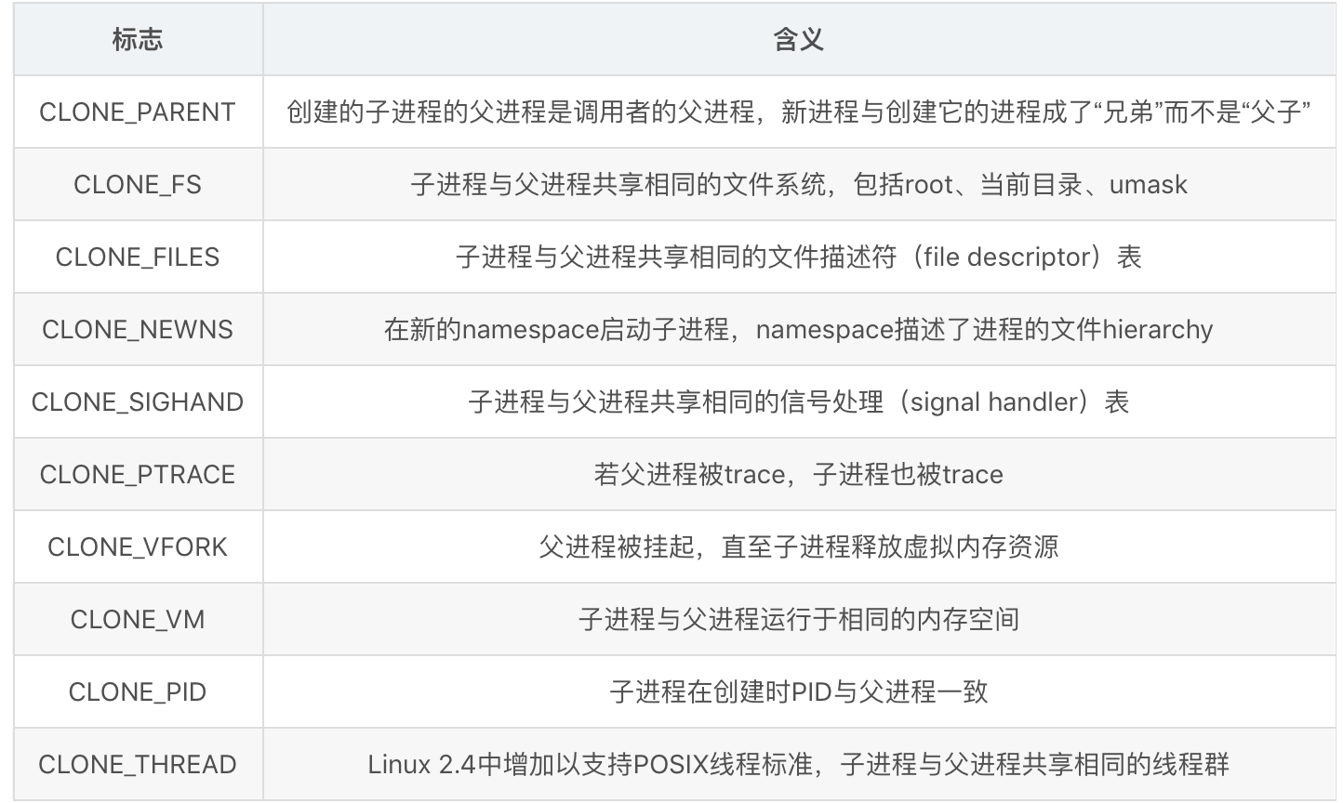
clone() flags
Notes:
strace ./a.out

Slide 40
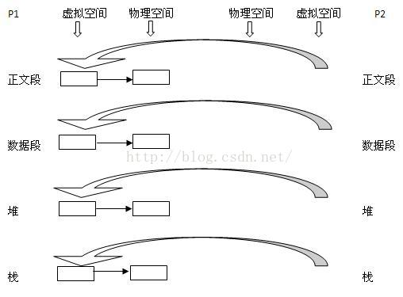
pthread_create()
Notes:
This should be clone() with clone_vm

Slide 41
How about user level threads?
pthread_create(): one-to-one model
User level threads in Linux?
  ucontext API
demo
Notes:
uncontext hello world

Slide 42
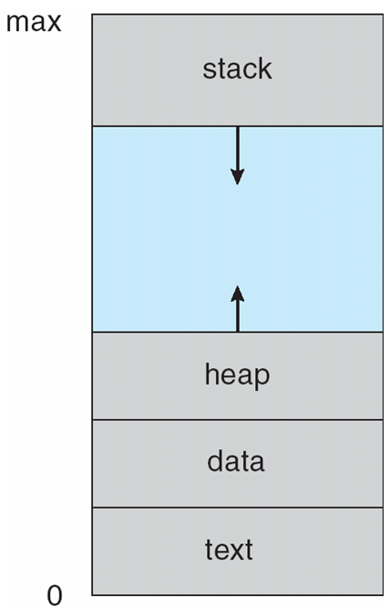
Thread Memory Allocation

Slide 43
Case: libco
http://www.52im.net/thread-624-1-1.html
Notes:
libco默认模式(stackfull) 满足大部分的业务场景，每个协程独占128k栈空间，只需1G内存就可以支持万级协程。

Slide 44
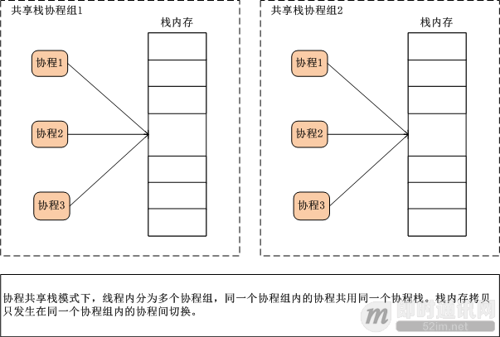
Case: libco
Notes:
我们通过libco共享栈模式创建1千万的协程（E5-2670 v3 @ 2.30GHz * 2, 128G内存），每10万个协程共享的使用128k内存，整个稳定echo服务的时候总内存消耗大概为66G。
而共享栈是libco新增的一个特性，可以支持单机千万协程，应对海量连接特殊场景。

Slide 45
Multithreaded Programming

Slide 46
Multicore Programming
Parallelism implies a system can perform more than one task simultaneously
Concurrency supports more than one task making progress
  Single processor / core, scheduler providing concurrency

Slide 47
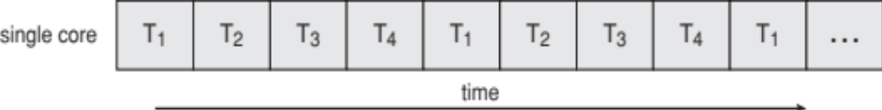
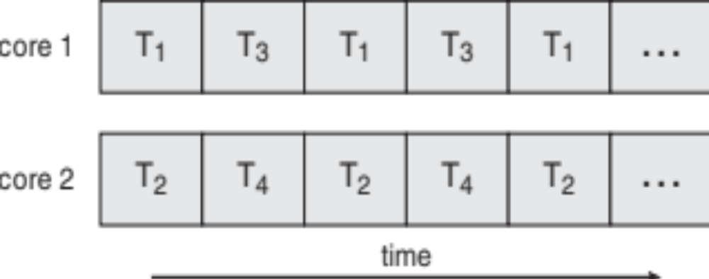
Concurrency vs. Parallelism
Concurrent execution on single-core system:
Parallelism on a multi-core system:

Slide 48
Type of parallelism
Types of parallelism
  Data parallelism – distributes subsets of the same data across multiple cores, same operation on each
  Task parallelism – distributing tasks across cores, each thread performing unique operation
  Hybrid

Slide 49
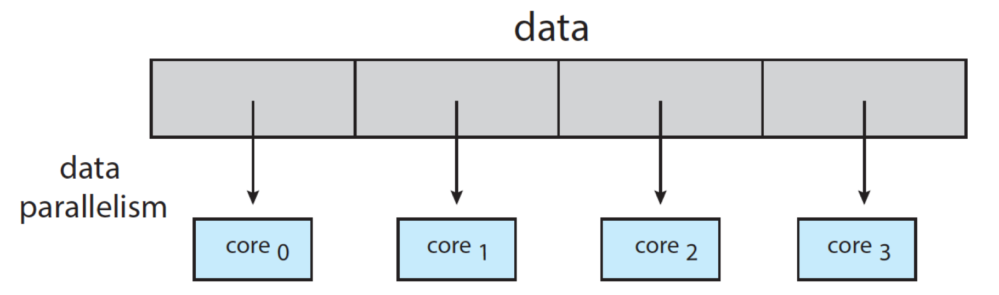
Type of parallelism

Slide 50
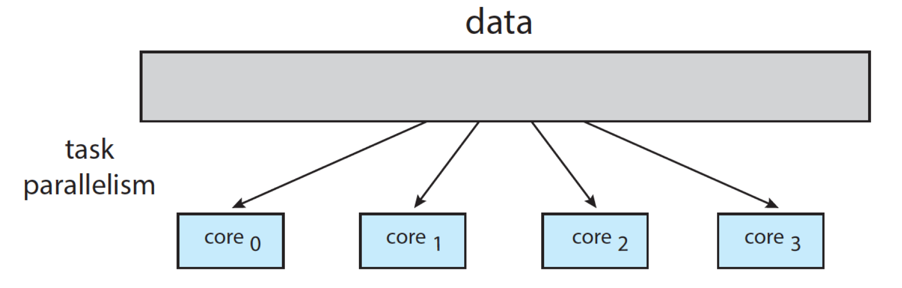
Type of parallelism

Slide 51
Challenges
Multicore or multiprocessor systems putting pressure on programmers, challenges include:
  Dividing activities
  Data splitting
  Data dependency
  Balance
  Testing and debugging

Slide 52
Thread Pool

Slide 53
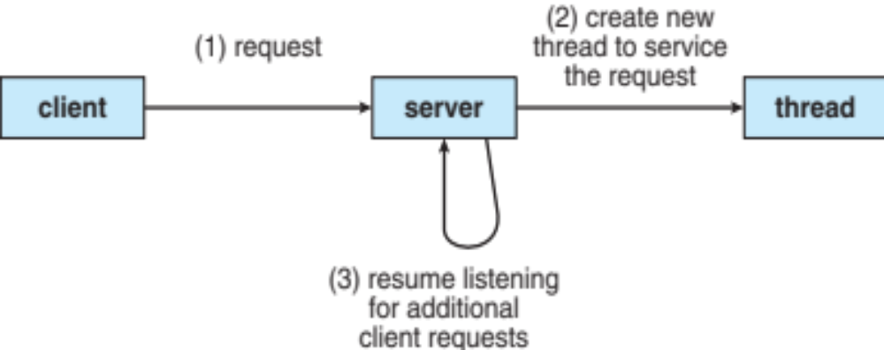
Thread Pools

Slide 54
Thread Pools
Create a number of threads in a pool where they await work
Advantages:
  Usually slightly faster to service a request with an existing thread than create a new thread
  Allows the number of threads in the application(s) to be bound to the size of the pool

Slide 55
Assignment Comments
Assignment1

Slide 56
End of Chapter 4

Slide 57


