Slide 1
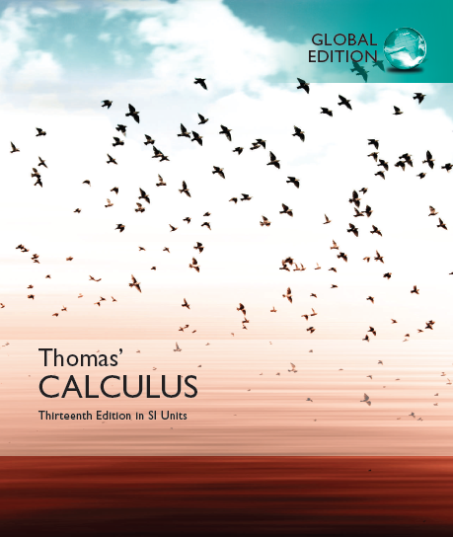

© 2017 Pearson Education, Inc. All rights reserved

Slide 2
Chapter 2
Limits and Continuity
Copyright © 2010 Pearson Education, Inc. Publishing as Pearson Addison-Wesley

Slide 3
2.1
Rates of Change and Tangents to Curves
(Why study limit?)
Other examples(Software/Hardware)?
Copyright © 2010 Pearson Education, Inc. Publishing as Pearson Addison-Wesley

Slide 4
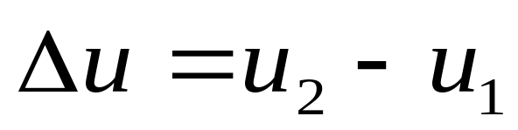
1. Increments
For any variable u, we consider its increment △u.

Slide 5
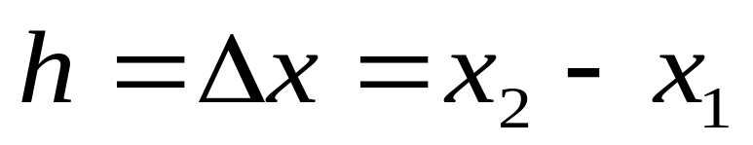
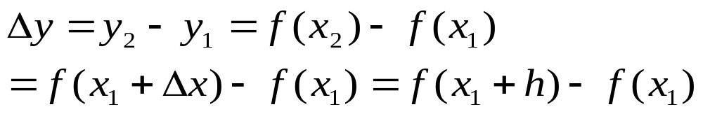
y = f(x):

Slide 6
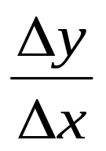
2. (Dynamic Systems) Average rate of change and Instantaneous rate of change
(1) Let y = f(x):

Slide 7
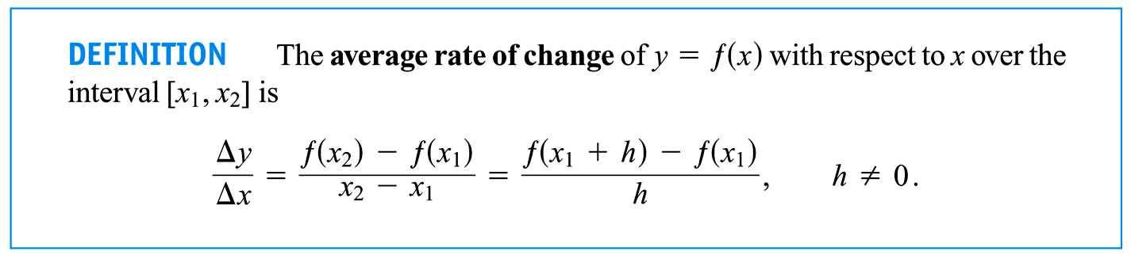

Slide 8
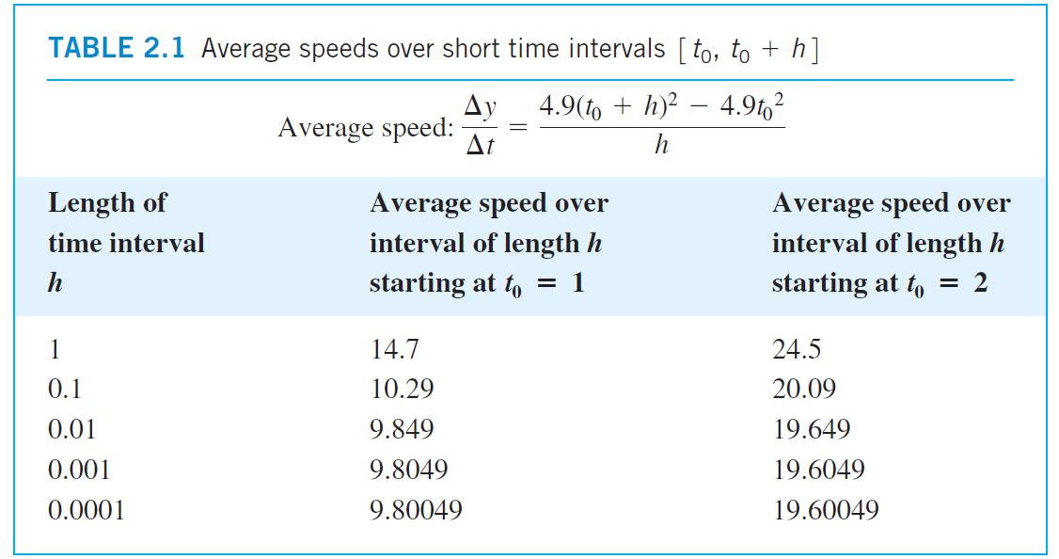

Slide 9
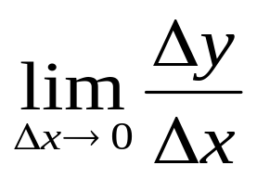
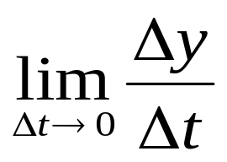
(2) Instantaneous rate of change at x₁?
Instantaneous speed at x₁?

Slide 10
3. Slopes of secant line and tangent line
(1) Secant slope
(2) Tangent slope
How to get the tangent line?

Slide 11
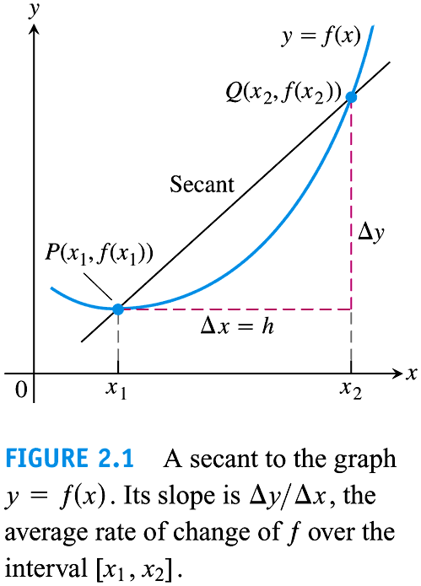

Slide 12
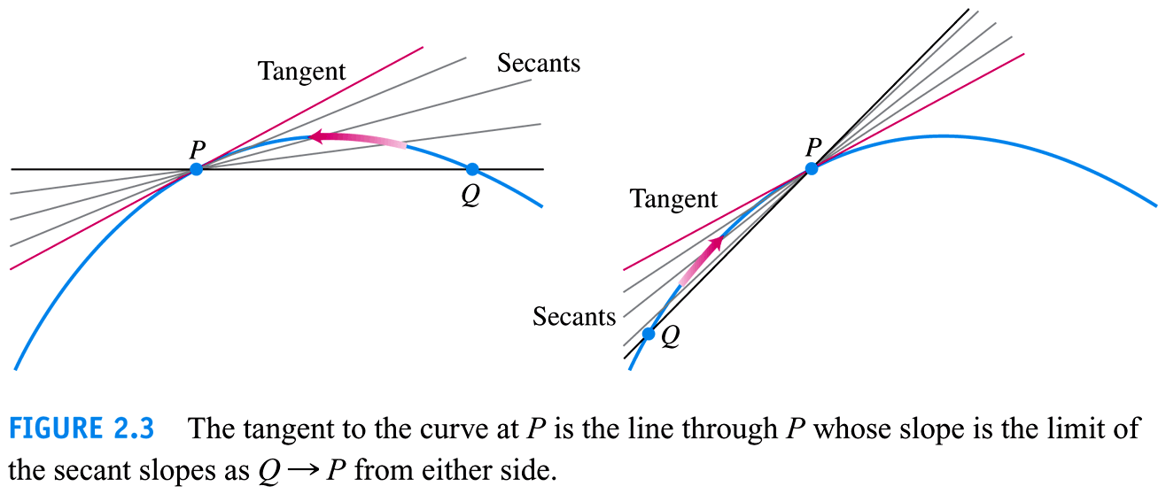

Slide 13
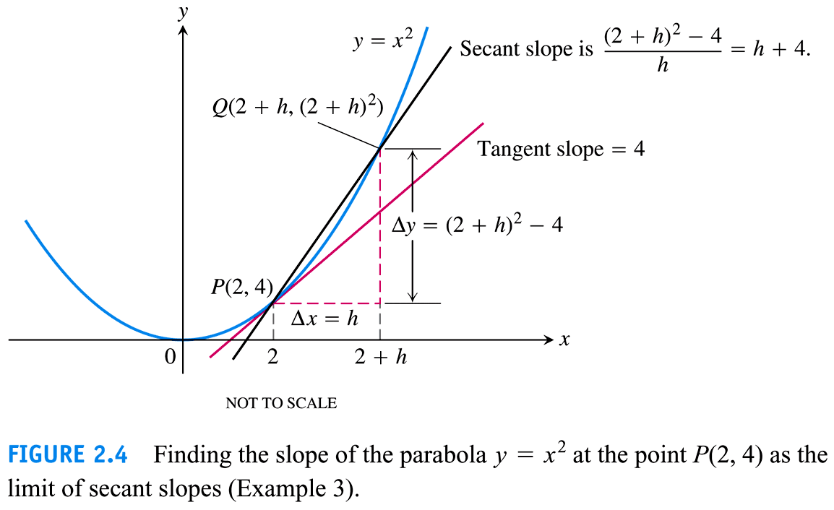

Slide 14
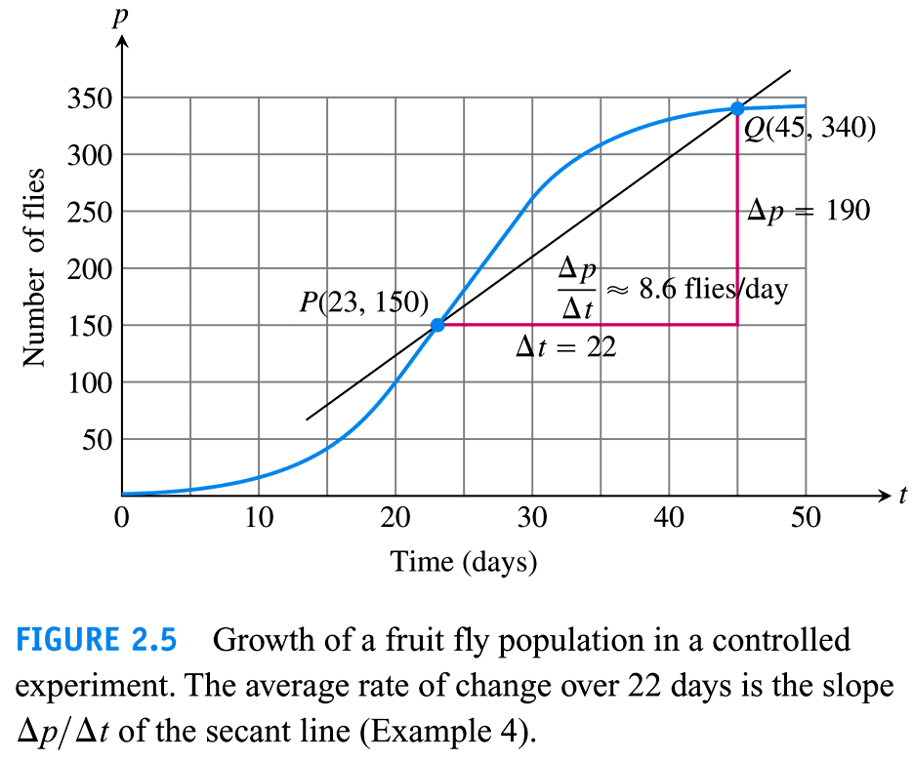

Slide 15
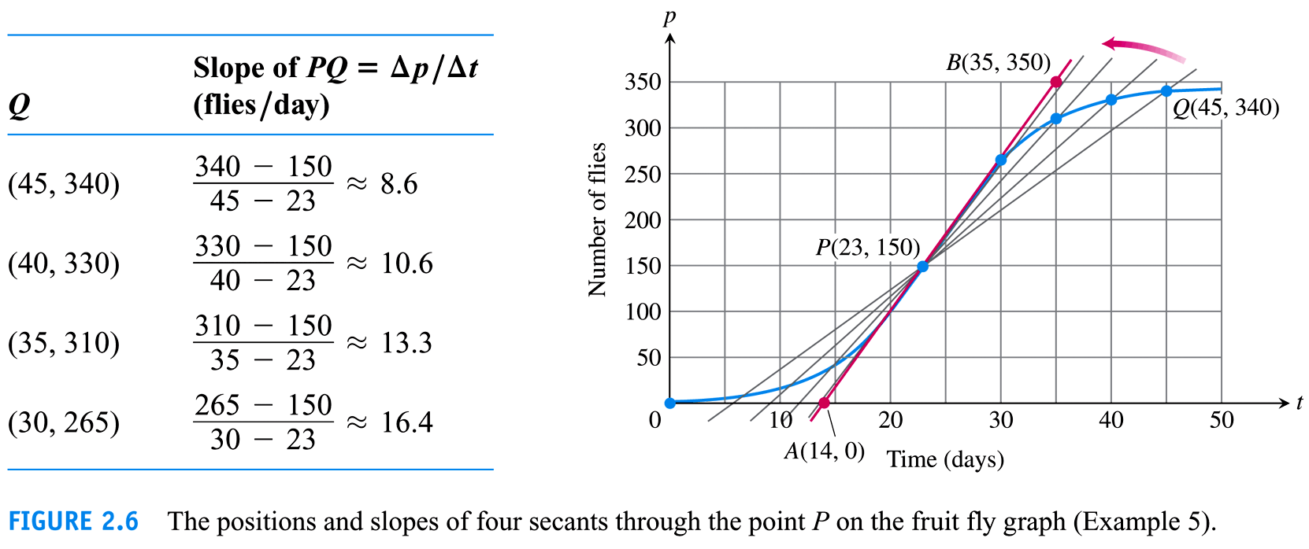

Slide 16
2.2
Limit of a Function
and Limit Laws
Copyright © 2010 Pearson Education, Inc. Publishing as Pearson Addison-Wesley

Slide 17
Contents:
1. Intuitive meaning of the limit of a function
2. The limit operation rules: (1)+, (2) -, (3) *, (4) /, (5) °.
3. The Sandwish Theorem

Slide 18
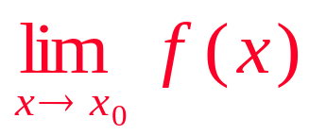
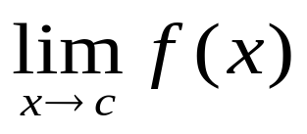
1. Intuitive meaning of the limit of a function:

Slide 19
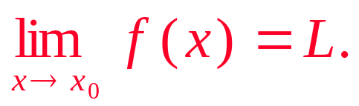
Suppose f(x) is defined on an open interval about x₀, except possibly at x₀ itself. If f(x) is arbitrarily close to L(as close to L as we wish) for all x sufficiently close to x₀, we say that f(x) approaches to the limit L as x approaches x₀, and we write

Slide 20
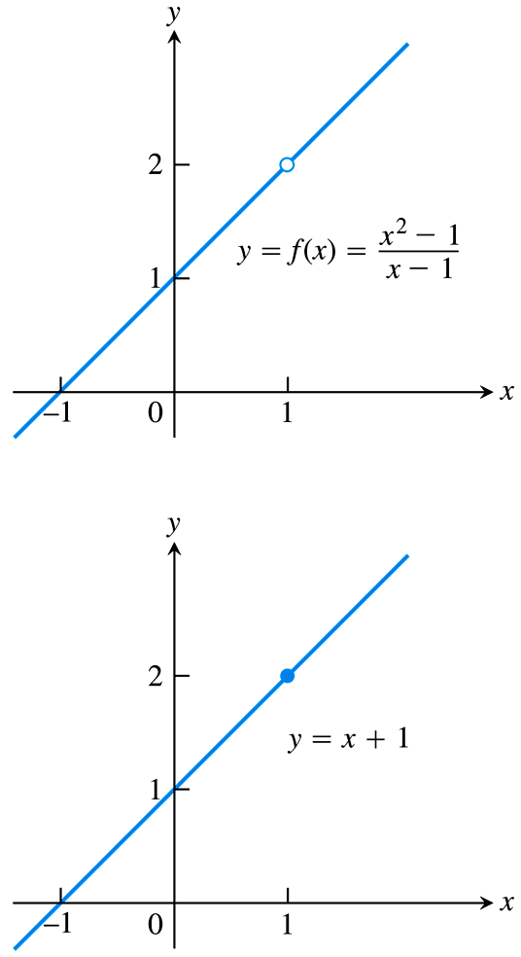
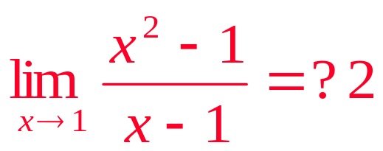
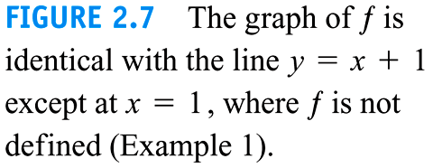

Slide 21
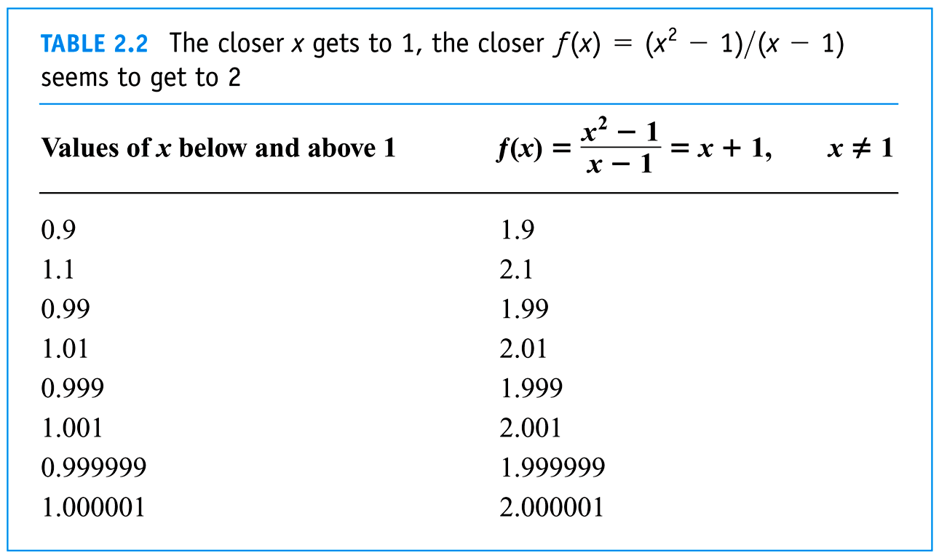

Slide 23
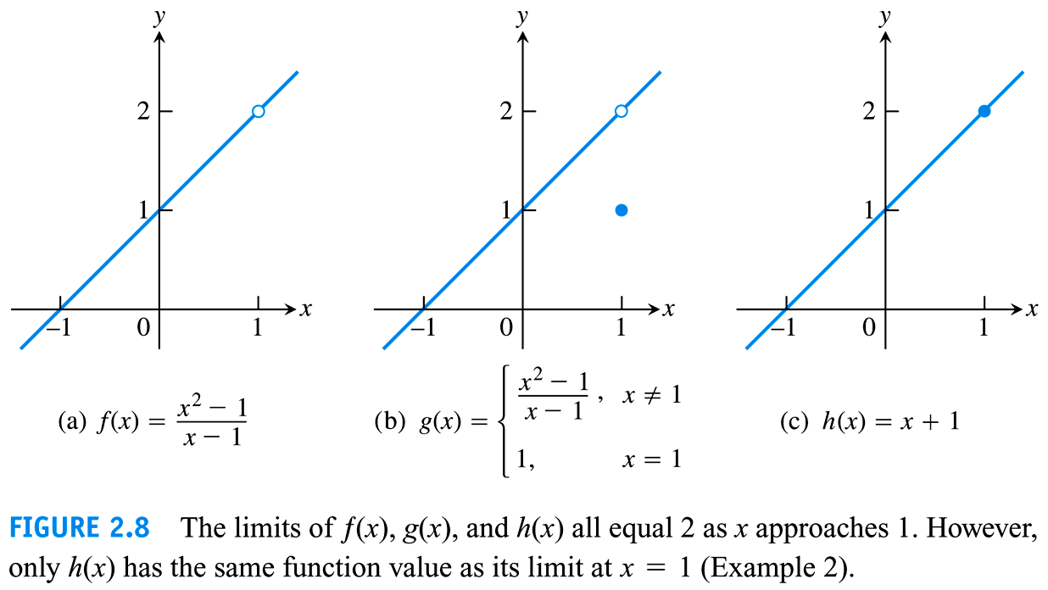

Slide 24
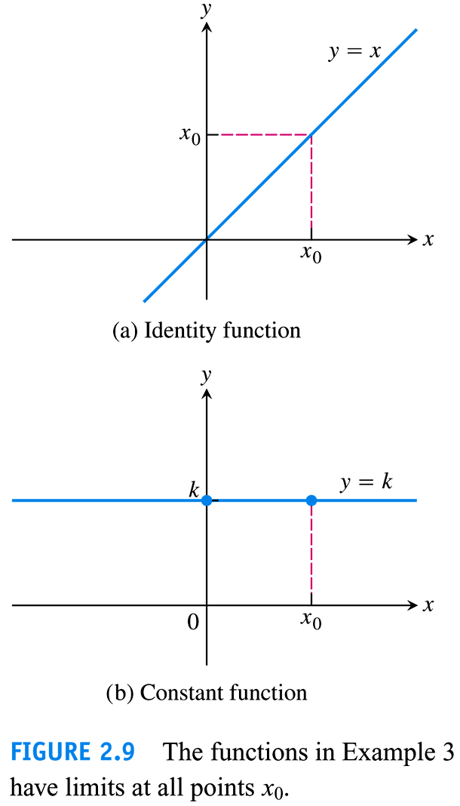

Slide 25
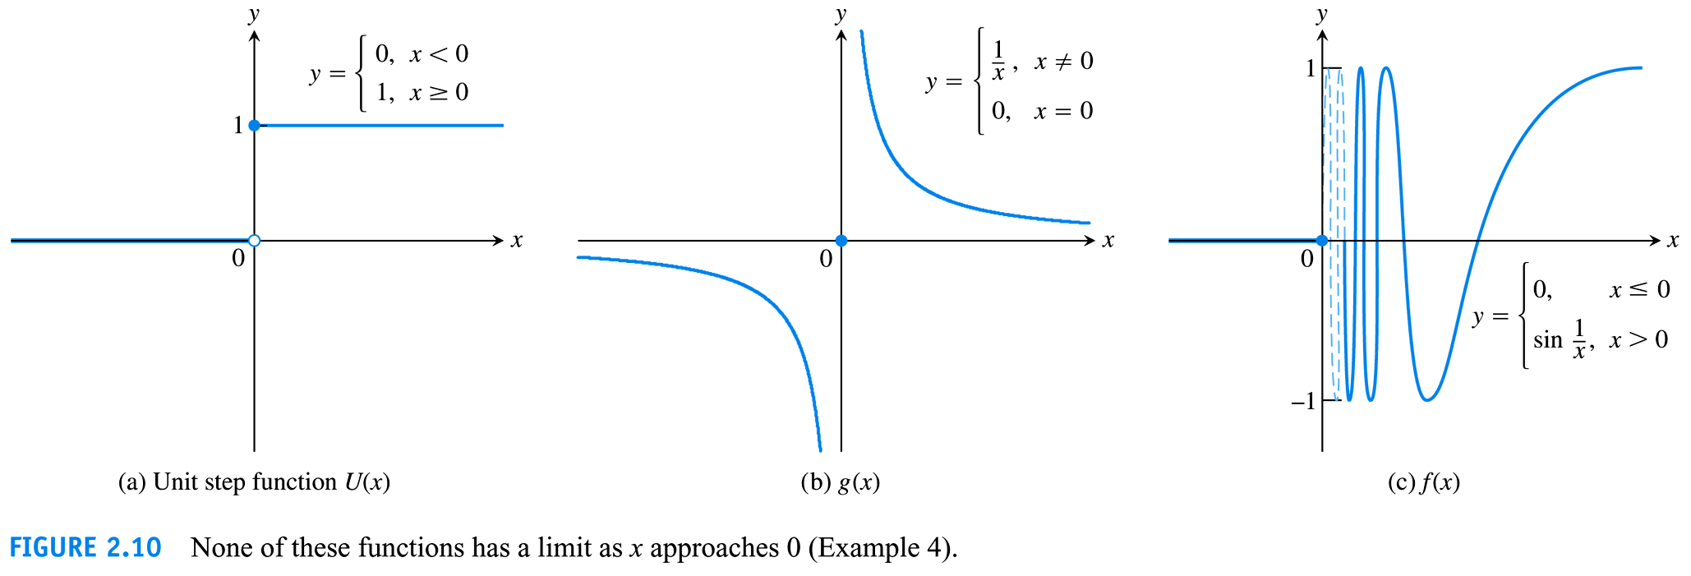

Slide 26
2. The Limit Laws
Laws: Methods, Rules
The limit operation rules: (1)+, (2) -, (3) *, (4) /, (5) °.
How to prove (See Section 2.3)?

Slide 27
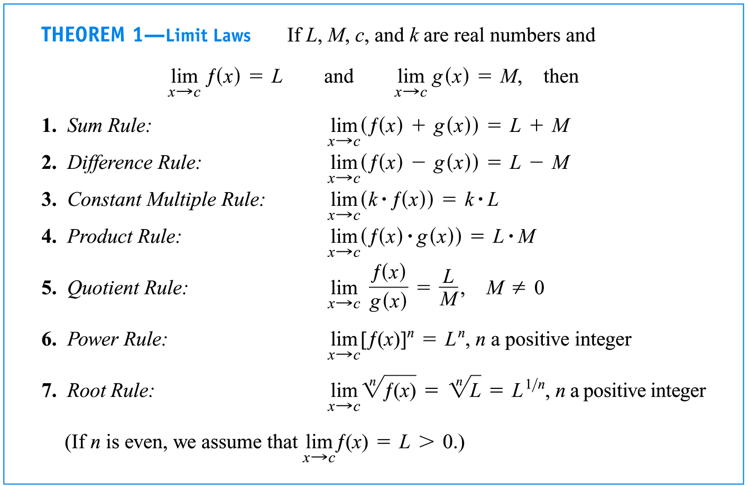

Slide 28
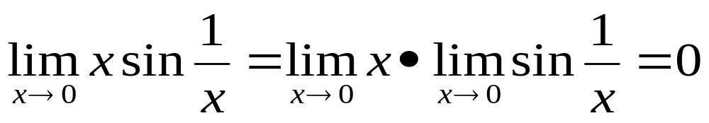
Proof (Example 6 at P78)
Cautious
P80, 49:

Slide 29
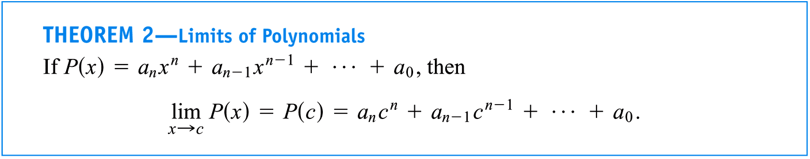

Slide 30
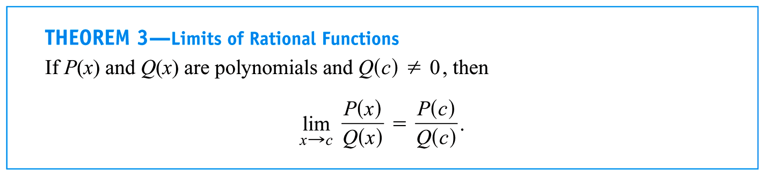

Slide 31
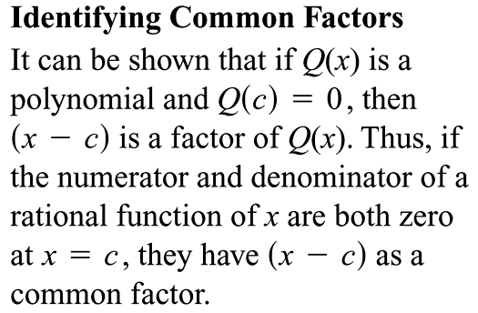

Slide 32
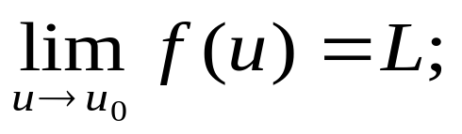
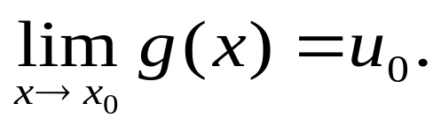
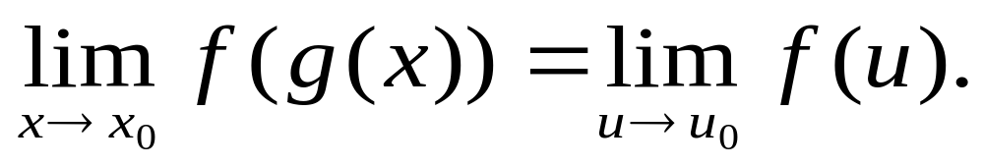
The limit Law of Composite Functions:
(A?) Suppose that y = f(u) is defined on some interval containing u₀, but not necessarily at u₀, and and u = g(x) is defined on some interval containing x₀ and g(x) ≠ u₀, but not necessarily at x₀, and
Then

Slide 33
Proof ?
Other Cases?

Slide 34
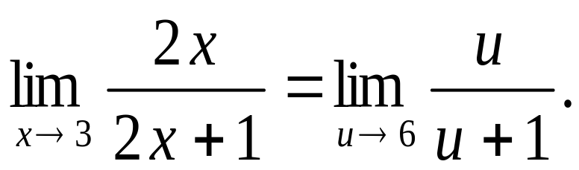
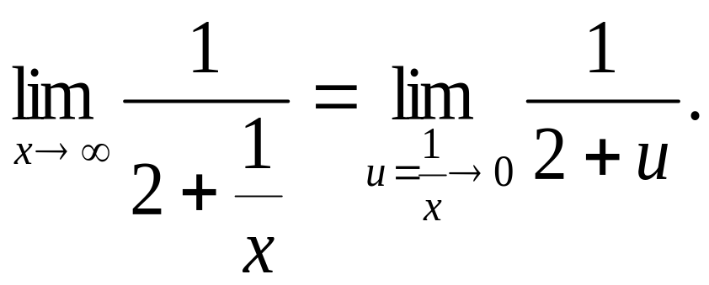

Slide 35
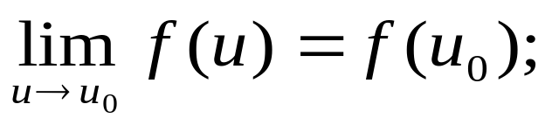
The limit Law of Composite Functions:
(B) Suppose that y = f(u) is continuous at u₀, and and u = g(x) is defined on some interval containing x₀ but not necessarily at x₀, and
Then
(See P94)

Slide 36
Proof ?

Slide 38
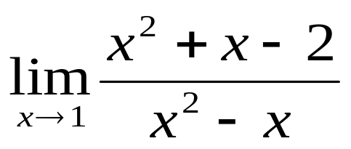
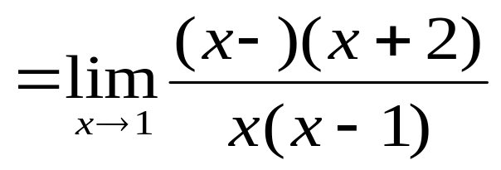
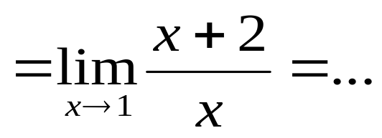
Some techniques:
(1)

Slide 39
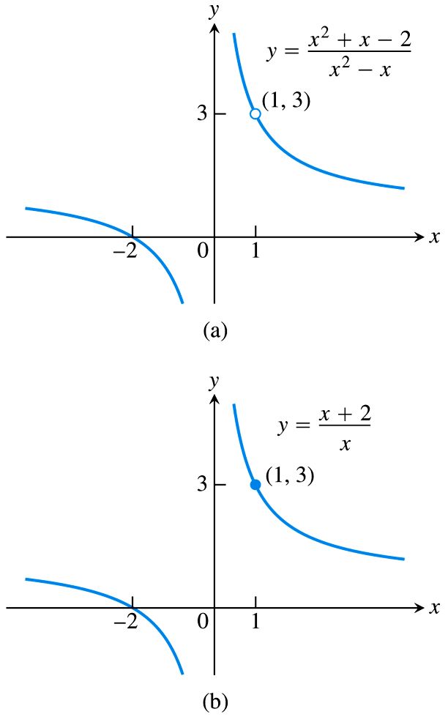
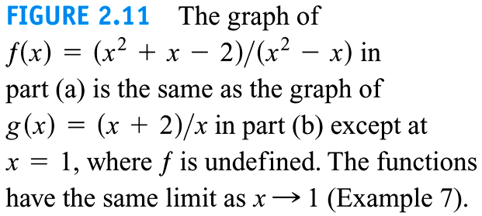

Slide 40
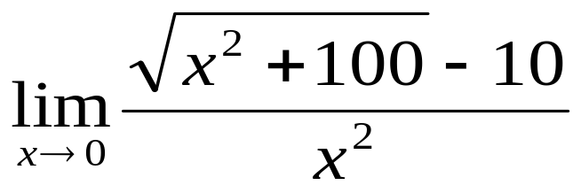
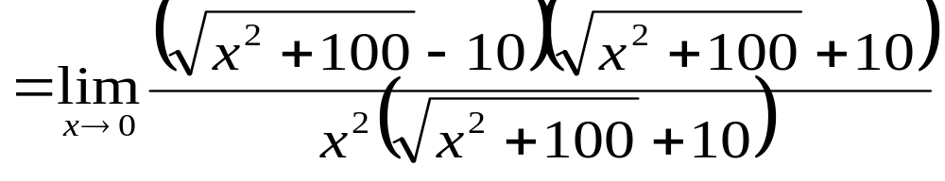
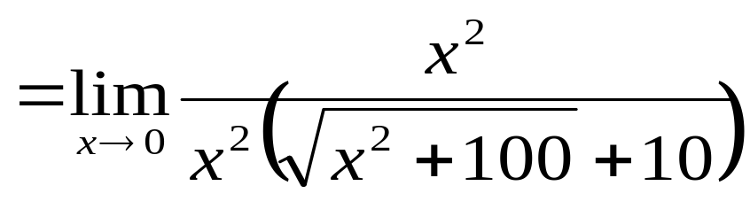
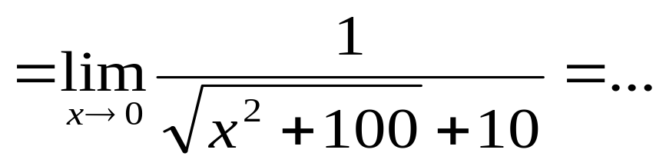
(2)

Slide 41
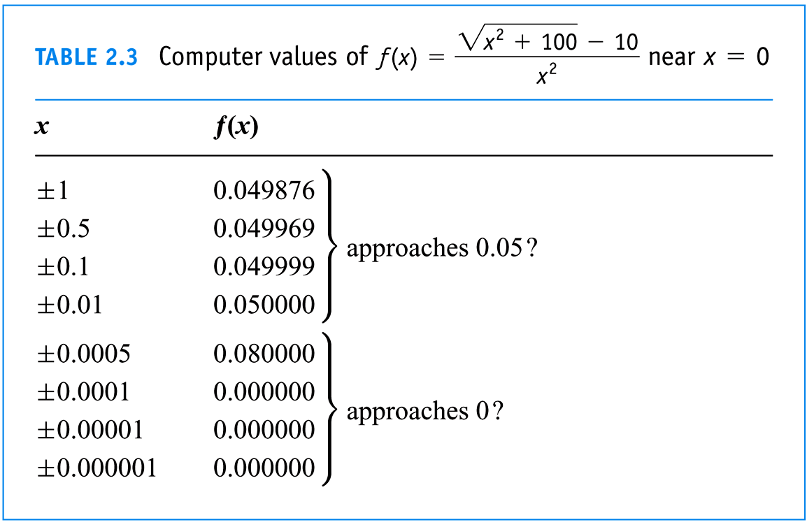

Slide 42
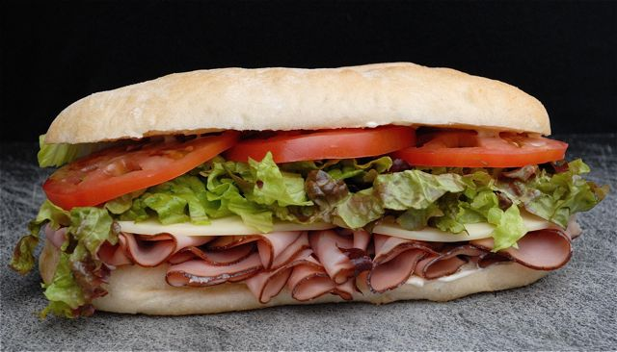
3. The Sandwish Theorem
Squeeze Theorem
Pinching Theorem

Slide 43
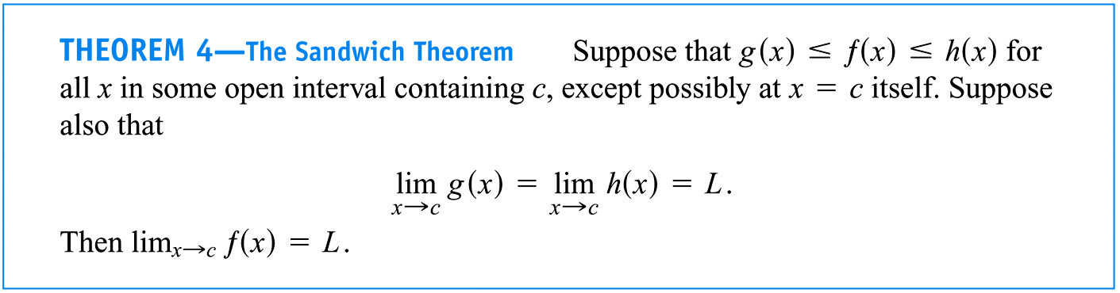

Slide 44
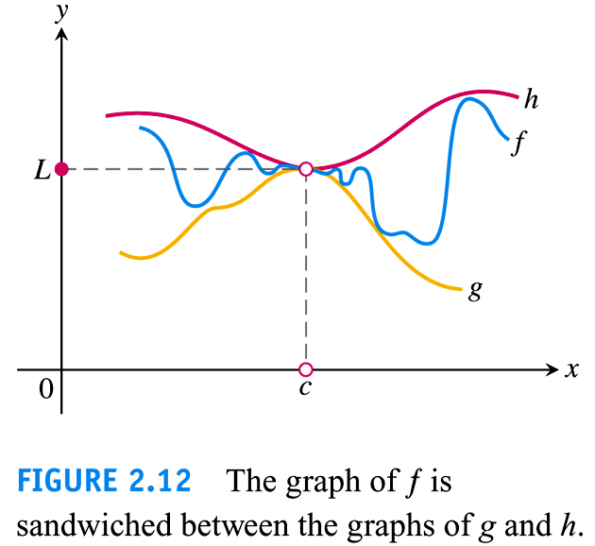

Slide 45
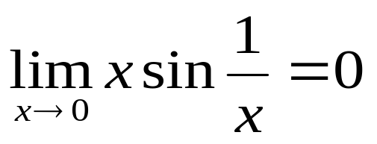
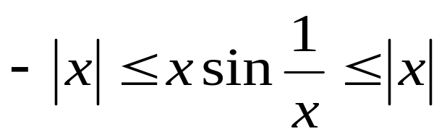

(P80, 49)Apply the Sandwish Theorem:
(1)
(2)

Slide 46



How to prove the Sandwish Theorem (cf. Section 2.3)?
Proof of the Sandwish Theorem Let ε > 0 be given.
Since we must find δ₁ > 0 such that for all x

Slide 47





Similarly, since we must find δ₂ > 0 such that for all x
Let δ =min{δ₁, δ₂}> 0. We have
This prove that

Slide 48


Slide 49


Slide 50


Slide 51
2.3
The Precise Definition of a Limit
Copyright © 2017 Pearson Education, Inc. Publishing as Pearson Addison-Wesley

Slide 52
Contents:
1. The definition of a limit
2.Proofs of Operation Rules and Examples
3. Proof of Sandwish Theorem

Slide 53

1. The mathematical definition of a limit
Why do we need it?
For Proving?
From Newton-Leibniz to Cauchy?
(P62)Example 1

Slide 54


Slide 56

Two things must considered:
(I) What does “f(x) is arbitrarily close to L” when x changes(to x₀ closely) to some extent?
(II) How to represent “when x changes to some extent”?

Slide 57


Slide 58


Slide 59


Slide 60


Slide 61

Example 2 Show that

Slide 62


Slide 63

Proof For any given ε >0, we choose δ =ε/5 >0 .
If 0 < |x – 1| < δ , then
which prove that

Slide 64

Example (Exercises 49, P80)Show that

Slide 65


Proof For any given ε >0, we choose δ =ε >0 .
For all x satisfying 0 < |x – 0| = |x| < δ , we have
This prove that

Slide 66
Cautious
P80, 49:

Slide 67


(More simple examples)Show that
(1)
(2)

Slide 68


Slide 69


Slide 70


Slide 71


Slide 72


Slide 73


Slide 74


Slide 75


Slide 76


Slide 77

(2) Examples

Slide 78

Some techniques:
(1)

Slide 80
(2)

Slide 82
3. Proof of Sandwish Theorem

Slide 83


Proof Let ε >0 be given. Since there exists δ₁ > 0 such that
whenever 0< |x – c| < δ₁.
Similarly, Since there exists δ₂ > 0 such that
whenever 0< |x – c| < δ₂.

Slide 84
Let δ = min{δ₁, δ₂}.
If 0 < |x – c| < δ, then 0< |x – c| < δ₁and 0< |x – c| < δ₂. Therefore
That is |f(x) – L| < ε.
This prove that

Slide 85
(P80, 49)Apply the Sandwish Theorem:
(1)
(2)

Slide 86

One more example:

Slide 87
2.4
One-Sided Limits
Copyright © 2010 Pearson Education, Inc. Publishing as Pearson Addison-Wesley

Slide 88

Contents:
1. The intuitive meaning of one-sided limits
2. One important limit

Slide 89

1. The intuitive meaning of one-sided limits
The case that the limit fails to exist

Slide 90


Left-hand limit
Right-hand limit

Slide 91



Slide 92


Slide 93
Left-hand limit/right-hand limit does not exist possibly.

Slide 94


Slide 95


Slide 96
The precise definitions of one-sided limit(to be omitted)
For proving?

Slide 97


Slide 98


Slide 99


Slide 100

2. Show that

Slide 101


Slide 102


(1)
(2)

Slide 103


Slide 104




Area ΔOAP<area sector OAP<Area ΔOAT
θ > 0:

Slide 105


Supple. Examples
(1) Evaluate
(2) Compute

Slide 106
2.5
Continuity
Copyright © 2010 Pearson Education, Inc. Publishing as Pearson Addison-Wesley

Slide 107
Contents:
1. Definition of continuity at a point
2. Common Discontinuity Types
3. Continuity of elementary functions
4. Properties of continuous functions on closed interval

Slide 108
1. Definition of continuity at a point
(1) Intuitive meaning:
with an unbroken curve at (x₀, f(x₀))
without lifting the pencil at (x₀, f(x₀))

Slide 109


Slide 110

(2) Precise definition (P90)

Slide 111

Two more examples:
Temperature?
Stature Height?

Slide 112


Slide 113


Slide 114


Slide 115


Slide 116




Slide 117


2. Common Discontinuity Types
(1) removable discontinuity points
Figure 2.40 (b)(c):
(2) jump discontinuity points
Figure 2.40(d):

Slide 118
(3) infinite discontinuity points
Figure 2.40 (e)
(4) oscillating discontinuity points
Figure 2.40 (f)
Others?

Slide 119


Slide 120


Slide 121
3. Continuity of elementary functions
Every elementary function is continuous at every point in its defined interval.

Slide 122







(1) Any common function is continuous in its defined interval.

Slide 123




Slide 124


Slide 125

(2)

Slide 126


Slide 127


Slide 128


Slide 129


Slide 130


Slide 131


Slide 132
Continuous Functions on an interval?
(a, b)
[a, b)
(a, b]
[a, b]
(a, +∞)
[a, +∞)
(- ∞ , b)
(- ∞ , b]
(- ∞ , +∞)

Slide 133


(A) Interior points
(B) Endpoint?
Right-continuous at c
Left-continuous at c

Slide 134

Remark Continuous at endpoint of interval:
Right-continuous at left endpoint; Left-continuous at right endpoint.

Slide 135



Method of computing limits for continuous functions:
For examples:

Slide 136
4. Properties of continuous functions on closed interval
(1) The Maximum/Minimum Value Theorem (on P200)
(2) The Intermediate Value Theorem
The Zero Point Theorem

Slide 137


Slide 138


Slide 139
Example 10 Show that there is a root of equation x³ – x -1 = 0 between 1 and 2.

Slide 140


Slide 141

Example 11

Slide 142
2.6
Limits Involving Infinity; Asymptotes of Graphs
Copyright © 2010 Pearson Education, Inc. Publishing as Pearson Addison-Wesley

Slide 143
Contents:
1. Finding Limits as x→±∞ and Horizontal Asymptotes
2. Infinite Limits and Vertical asymptotes

Slide 144



1. Finding Limits as x→±∞

Slide 145



Slide 146







Slide 148


Slide 149


Slide 150


Slide 151


Example 2
(a)
(b)

Slide 152


Example 3
(a)
(b)

Slide 153


Slide 154


Slide 155

Horizontal Asymptotes

Slide 156


Slide 157


Slide 158


Slide 159


Slide 160



2. Infinite Limits

Slide 161


Slide 162


Slide 163





Slide 164


Slide 166


Slide 167


Slide 168


Slide 169


Slide 170

Vertical asymptote

Slide 171


Slide 172


Slide 173


Slide 174



