Slide 1

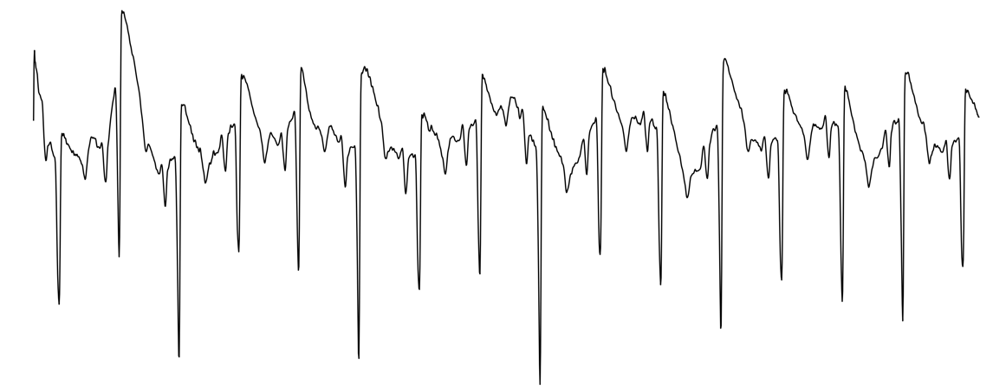
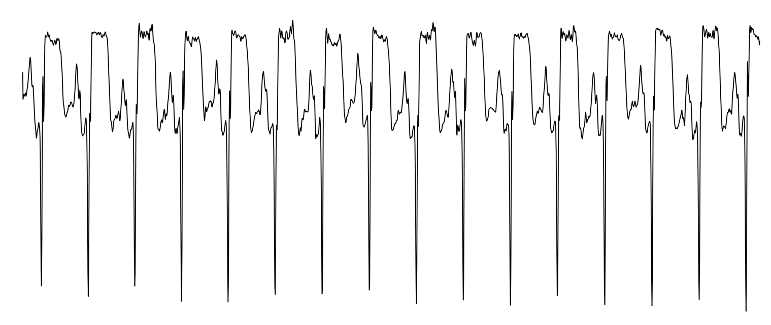
Time Encoder
Global Token
Transformer Block
Transformer Block
Transformer Block
Patch
Embedding
…
12 x L
Shared Encoder
Image Encoder
Transformer Block
Transformer Block
Transformer Block
Transformer Block
Transformer Block
Transformer Block
Patch
Embedding
…
…
(Lead: C)
Linear
Softmax
(Length: L)
Label Encoder
Transformer Block
Transformer Block
Transformer Block
label
label
…
label
Patch
Embedding
…

Slide 2
Time Encoder
Global Token
Transformer Block
Transformer Block
Transformer Block
Patch
Embedding
…
12 x L
Shared Encoder
Image Encoder
Transformer Block
Transformer Block
Transformer Block
Transformer Block
Transformer Block
Transformer Block
Patch
Embedding
…
…
(Lead: C)
Linear
Softmax
(Length: L)
lab
lab
…
lab
MLP

Slide 3
Time Encoder
Global Token
Transformer Block
Transformer Block
Transformer Block
Patch
Embedding
…
12 x L
Shared Encoder
Image Encoder
Transformer Block
Transformer Block
Transformer Block
Transformer Block
Transformer Block
Transformer Block
Patch
Embedding
…
…
(Lead: C)
Linear
Softmax
(Length: L)
label
label
…
label
MLP

