Slide 1
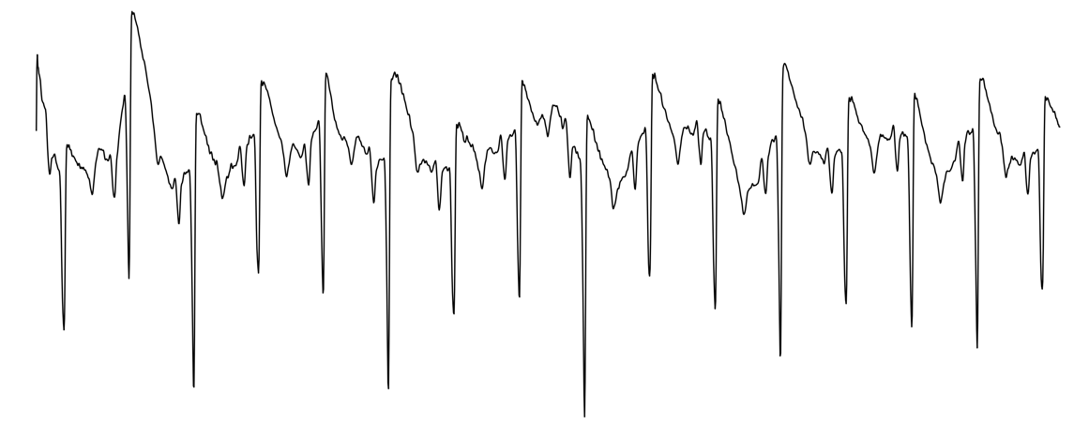
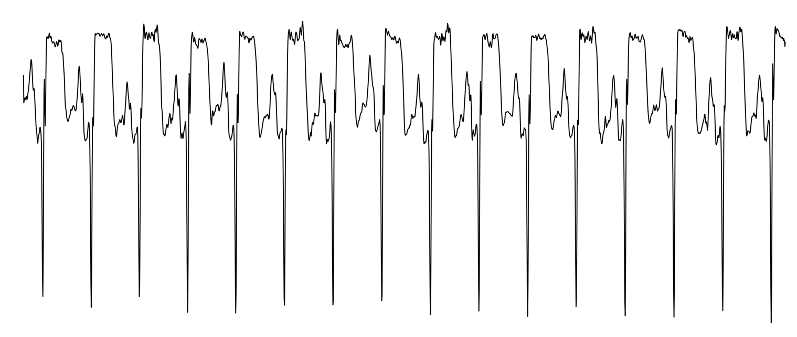

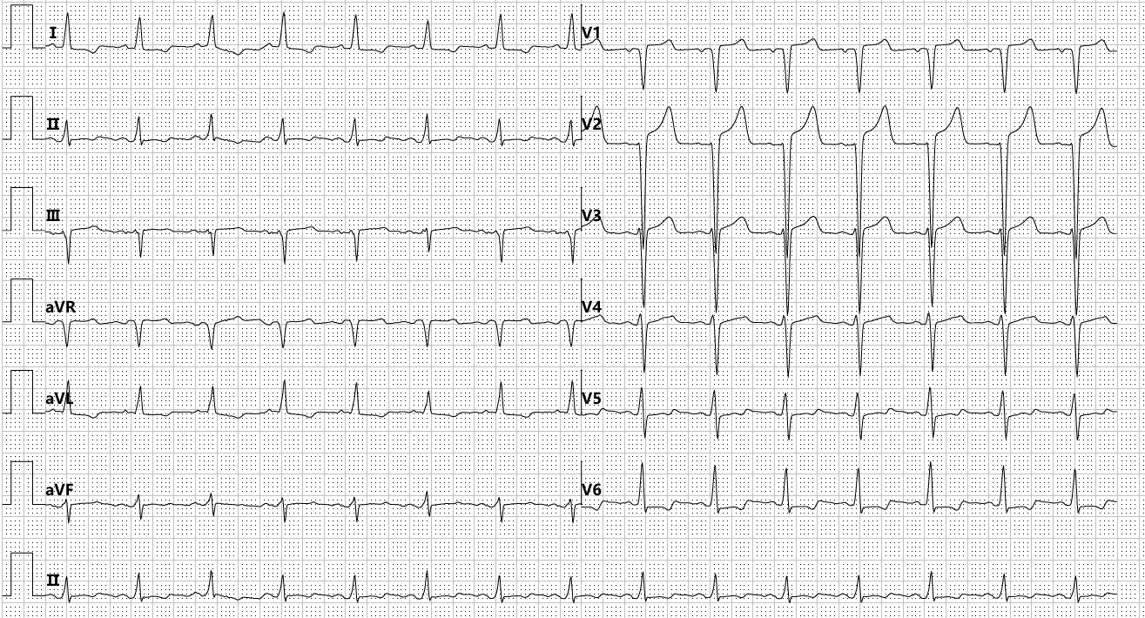
ECG
Time Series
Time Encoder
Global Token
Graphorm
MLP
Inter-lead
Dependencies
(Lead: 12)
(Length: L)
Transformer Block
Transformer Block
Transformer Block
FiLM
…
Linear
Softmax
Laboratory Biomarkers
Image Encoder
ViT Block
ViT Block
ViT Block
Patch
Embedding
…
ECG Image

