Slide 1
工作进展汇报
Presented by Xiantong Xiang
2024.10.21

Slide 2
ECG-Based Deep Learning and Clinical Risk Factors to Predict Atrial Fibrillation
通过阅读Going Where, by Whom, and at What Time: Next Location Prediction Considering User Preference and Temporal Regularity（KDD’24）这篇论文，学习其对于到达时间进行预测的做法。
原文：we aim to estimate a user’s next arrival time based on its activity sequence 𝑆 ^{𝑢𝑖} _{𝑛} and build the arrival time embedding as the context feature.
估计到达时间->时间嵌入
Circulation，Q1，B1，IF35.5，2022
DOI: 10.1161/CIRCULATIONAHA.121.057480, PMID: 34743566

Slide 3
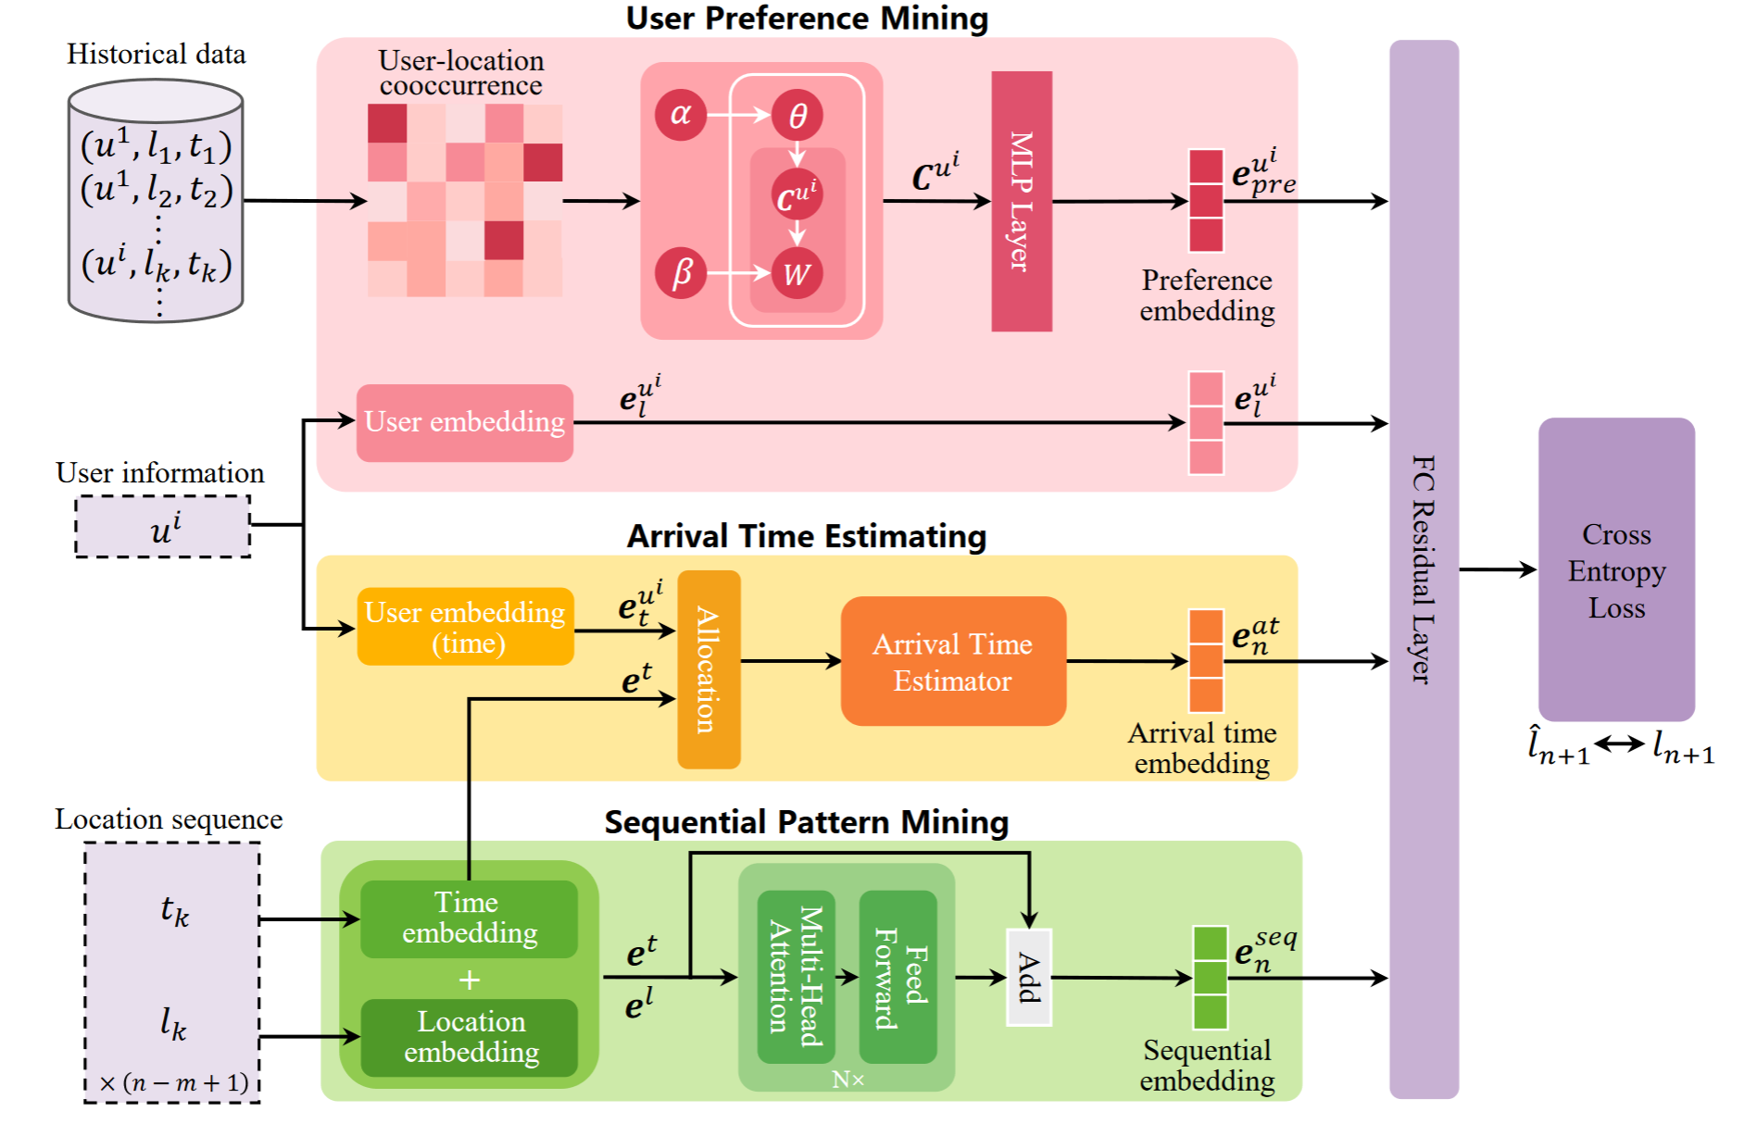

Slide 4
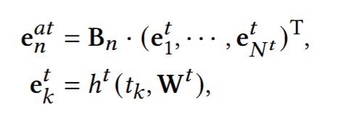

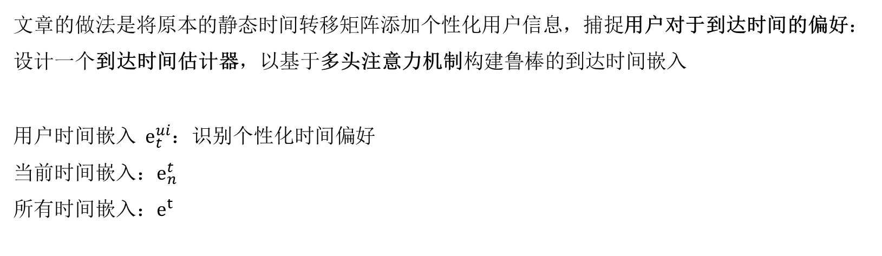
文章的做法是将原本的静态时间转移矩阵添加个性化用户信息，捕捉用户对于到达时间的偏好：
设计一个到达时间估计器，以基于多头注意力机制构建鲁棒的到达时间嵌入
用户时间嵌入 $e_{t}^{ui}$：识别个性化时间偏好
当前时间嵌入：$e_{n}^{t}$
所有时间嵌入：$e^{t}$

Slide 5
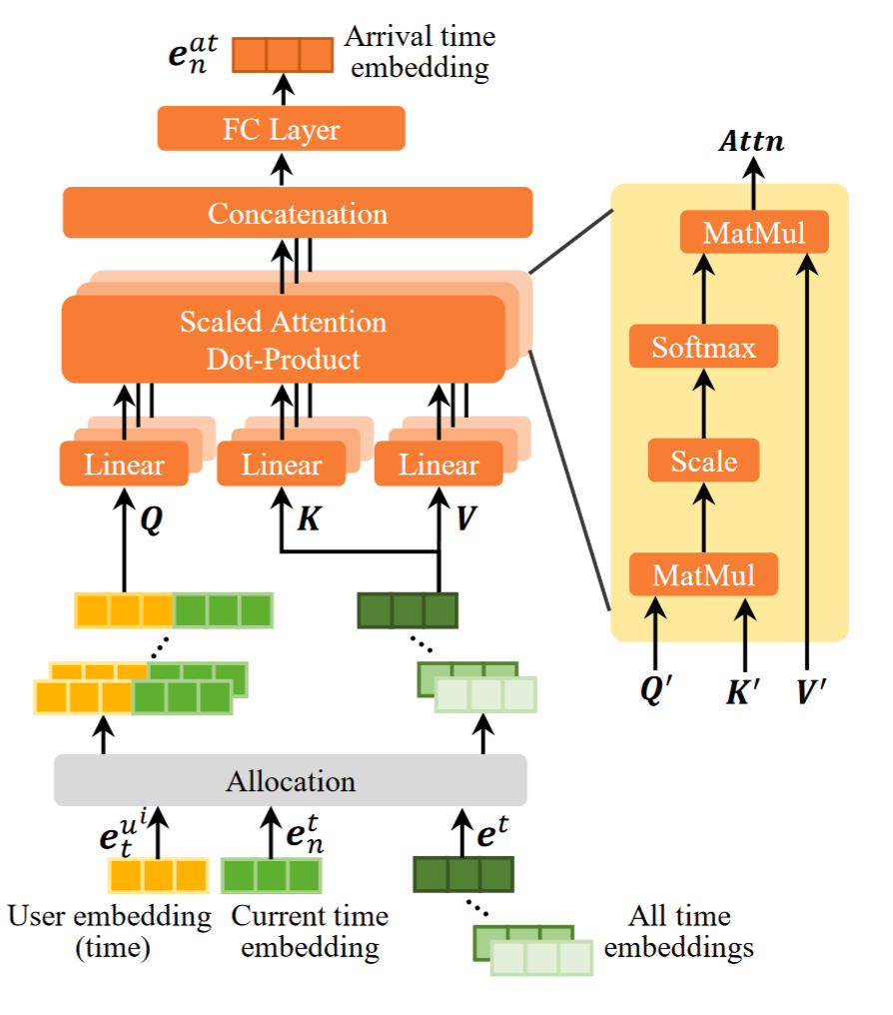
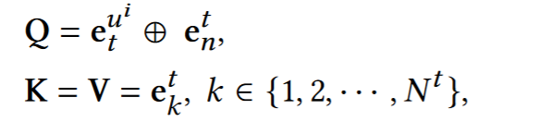
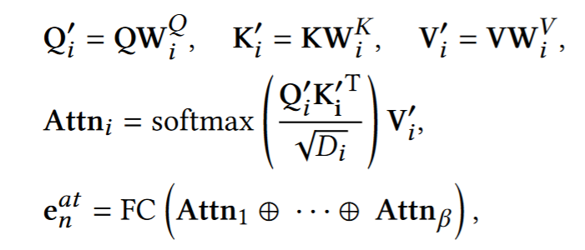

Slide 6
所有实验结果
 | acc@1 | acc@5 | acc@10 | acc@20 | mrr
pe*0.1 | 0.2605 | 0.5381 | 0.6329 | 0.6876 | 0.3847
pe*0.2 | 0.2568 | 05396 | 0.6306 | 0.6899 | 0.3825
pe*0.3 | 0.2576 | 0.5389 | 0.6269 | 0.6854 | 0.3845
pe*0.4 | 0.2576 | 0.5366 | 0.6321 | 0.6839 | 0.3829
pe*0.5(baseline） | 0.2561 | 0.5396 | 0.6255 | 0.6854 | 0.3838
time_embed=4 | 0.2613 | 0.5396 | 0.6321 | 0.6847 | 0.3856
time_embed=8 | 0.2628 | 0.5285 | 0.6262 | 0.6743 | 0.3825
time_embed=16 | 0.2628 | 0.5322 | 0.6269 | 0.6862 | 0.3830
time_embed=32 | 0.2628 | 0.5433 | 0.6321 | 0.6921 | 0.3877
time_embed=64 | 0.2576 | 0.5418 | 0.6321 | 0.6913 | 0.3827
LSTM_cat+Transformer_time | 0.2605 | 0.5455 | 0.6366 | 0.6913 | 0.3849
LSTM_cat | 0.2687 | 0.5433 | 0.6358 | 0.6928 | 0.3893
origin
Transformer_time
LSTM_cat

Slide 7
下一步准备构建复杂的时间/类别估计器

Slide 8
Q & A
Thanks!

