Slide 1

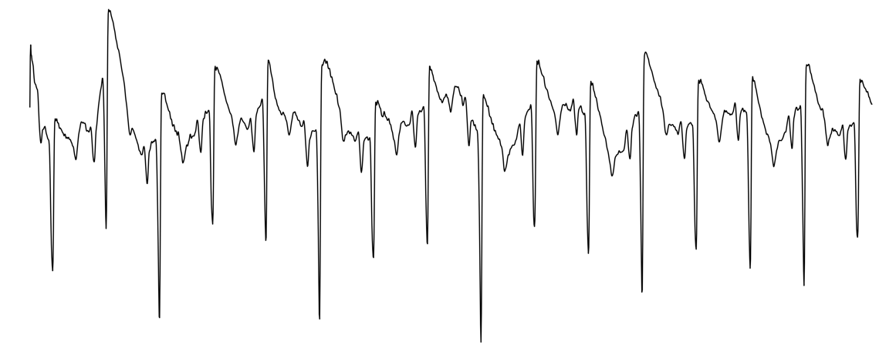
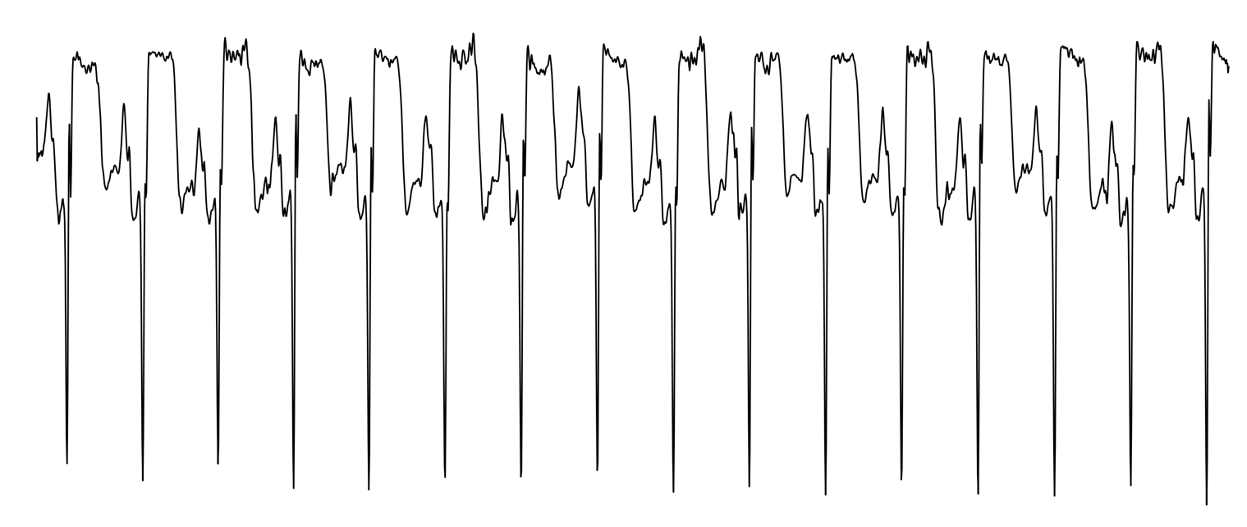
Time Encoder
Global Token
Transformer Block
Transformer Block
Transformer Block
Patch
Embedding
…
12 x L
Shared Encoder
Image Encoder
Transformer Block
Transformer Block
Transformer Block
Transformer Block
Transformer Block
Transformer Block
Patch
Embedding
…
…
(Lead: C)
Linear
Softmax
(Length: L)
Label Encoder
Transformer Block
Transformer Block
Transformer Block
label
label
…
label
Patch
Embedding
…

Slide 2
Time Encoder
Global Token
Transformer Block
Transformer Block
Transformer Block
Patch
Embedding
…
12 x L
Shared Encoder
Image Encoder
Transformer Block
Transformer Block
Transformer Block
Transformer Block
Transformer Block
Transformer Block
Patch
Embedding
…
…
(Lead: C)
Linear
Softmax
(Length: L)
lab
lab
…
lab
MLP

Slide 3
Time Encoder
Global Token
Transformer Block
Transformer Block
Transformer Block
Patch
Embedding
…
12 x L
Shared Encoder
Image Encoder
Transformer Block
Transformer Block
Transformer Block
Transformer Block
Transformer Block
Transformer Block
Patch
Embedding
…
…
(Lead: C)
Linear
Softmax
(Length: L)
label
label
…
label
MLP

Slide 4
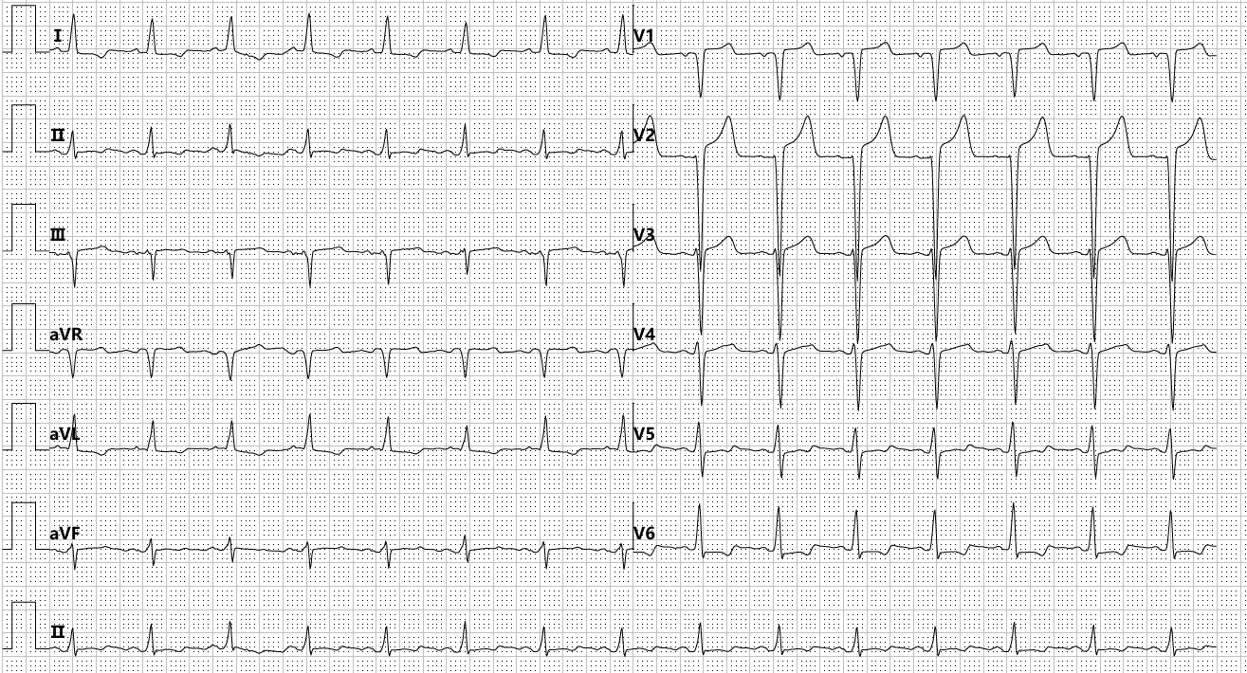
ECG
Time Series
Time Encoder
Global Token
Graphorm
MLP
Inter-lead
Dependencies
(Lead: 12)
(Length: L)
Transformer Block
Transformer Block
Transformer Block
FiLM
…
Linear
Softmax
Laboratory Biomarkers
Image Encoder
ViT Block
ViT Block
ViT Block
Patch
Embedding
…
ECG Image

Slide 5
Time-Series Branch
GFM-MIP Framework
Time Encoder
500Hz
…
Graphormer
FFN
Downsampling
Inter-lead
Dependencies
Multi-Head
Attention
Structural Encodings
FiLM
FiLM
100Hz
Time-Series Branch
Image Branch
MLP
…
InfoNCE
…
…
Image Branch
…
…
Global Token
Transformer Block
Transformer Block
Transformer Block
Image Encoder
Time Token
Contrastive Loss
…
Image Token
LN
$$λ_{con}$$
Patch
Embedding
$$λ_{cls}$$
Classification Loss
Laboratory Biomarkers
MHSA
…
…
…
$$𝓛_{total}$$
12 Lead
ECG
LN
Vision Transformer
Classifier
FFN
ECG Image
…

