Slide 1
INFSCI 2595 Machine Learning Final project
By: Haneef Ahamed Mohammad Pitt Id: ham149

Slide 2
Most important inputs
From our models, we were able to find the importance of X-variable and V-variable on our best performing model.(written in order of importance)
For Regression
X- variable: x11 and x09
V- variable: v10, v12, v06 and v08
For Classification
X- variable: x11 and x09
V- variable: v10, v04, v02 and v06

Slide 3
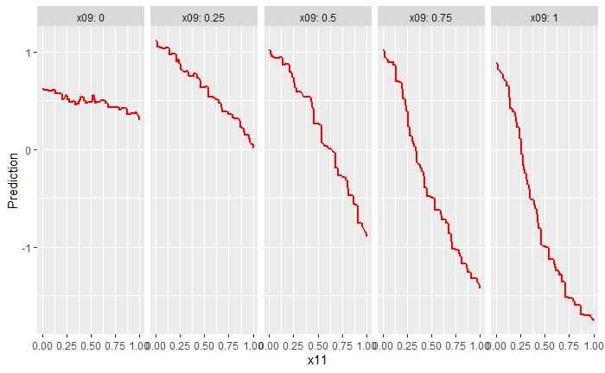
Trends of the continuous response with respect to the most important inputs (X- variable)

Slide 4
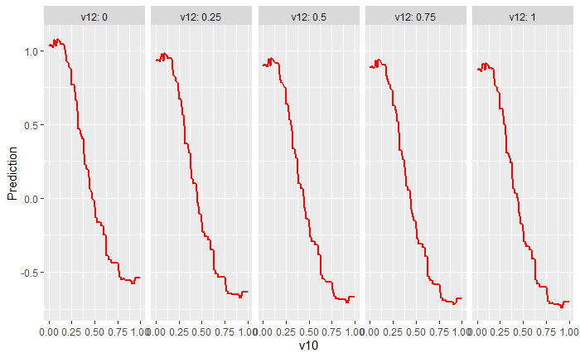
Trends of the continuous response with respect to the most important inputs (V- variable)

Slide 5
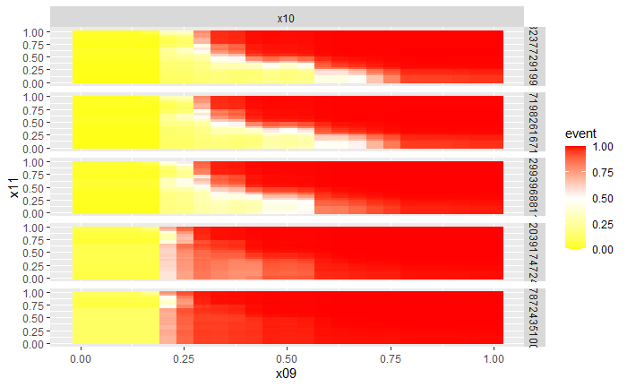
Trends of the event probability with respect to the most important inputs (X – variable)

Slide 6
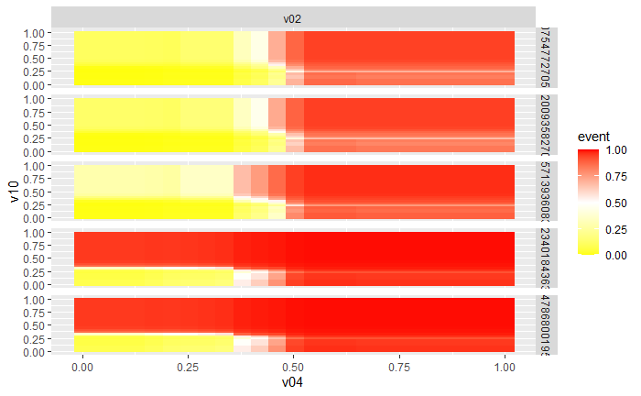
Trends of the event probability with respect to the most important inputs (V - variable)

Slide 7
Minimizing
I recommend x11 = 1 and v10 = 1, for input values to minimize the continuous response for the Regression.
I recommend x11 = 0.04 and v = 0.01 input values do you recommend to minimize the event probability for Classification

