Slide 1
AN-NAJAH NATIONAL UNIVERSITY | NETWORKS PROGRAMMING
Remote Infrastructure
Management with Termix
From a single remote host to a segmented network protected by a real router
Haneen Baradia
Student ID: 12429915
Instructor: Dr. Jehad Hamamreh
1

Slide 2
OVERVIEW
What This Project Covers
01
Proxmox & Termix
The virtualization platform and the remote-access tool built on top of it
02
Basic Remote Access
Connecting Termix to a single host over SSH, VNC, and Telnet
03
Building a Router
Creating a real boundary between an outside and an internal network
04
Protecting a Host
Placing a second machine behind the router and reaching it on purpose
05
Real Screen Control
Confirming Termix drives the machine's actual screen, not a separate one
2

Slide 3
THE FOUNDATION
Proxmox and Termix
P
Proxmox VE
T
Termix
An open-source Type-1 hypervisor: it runs directly on the physical server and turns it into several independent virtual machines and containers.
A self-hosted, open-source dashboard for managing remote machines from a browser — one interface instead of a separate app per protocol.
KVM – full virtual machines with their own kernel
SSH, VNC, RDP, and Telnet in one dashboard
LXC – lightweight containers sharing the host kernel
File management, tunneling, Docker control
One web interface for VMs, storage, and networking
Self-hosted: credentials and logs stay local
3

Slide 4
OBJECTIVES & SCOPE
Two Stages, One Goal
STAGE 1
STAGE 2
Prove the Basics
Build a Real Network
Deploy Termix and connect it to a single host. Configure and test SSH, VNC, and Telnet to confirm reliable remote management through one dashboard.
Introduce network segmentation through a dedicated router, add a second, protected host, and reach it from Termix only through a controlled path.
4

Slide 5
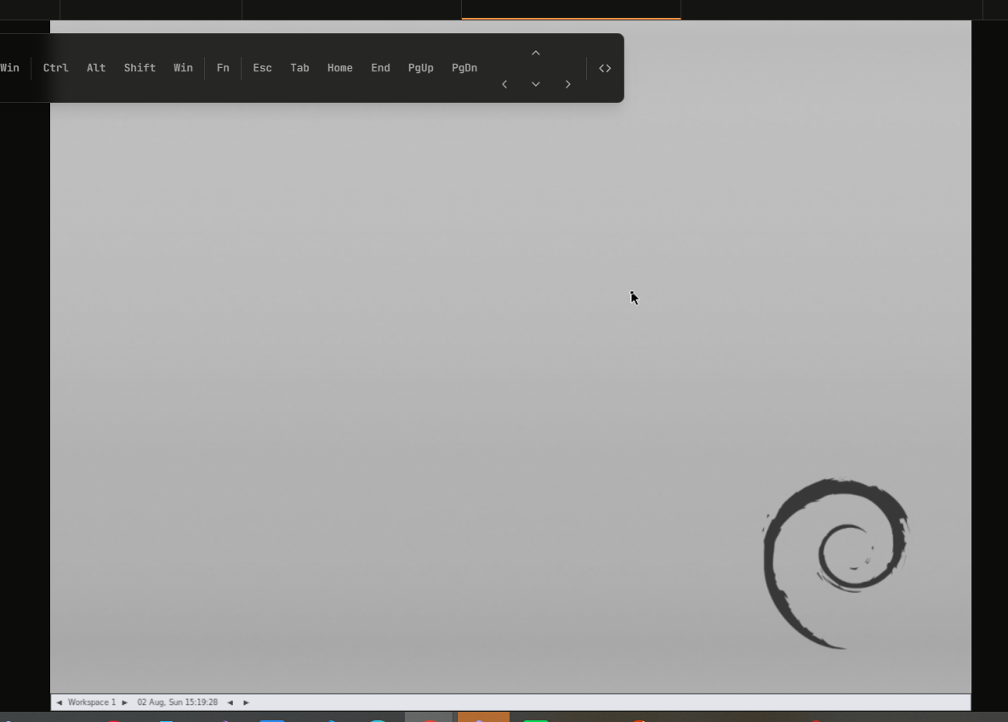
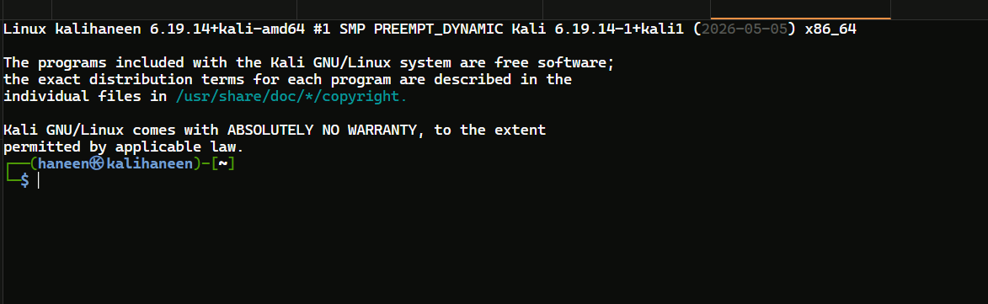
STAGE 1 RESULT
Three Protocols, One Dashboard
SSH
VNC
Telnet
Each protocol was enabled per host inside Termix. All three produced a fully working session inside the browser — confirming Termix as a reliable single point of remote access.
Secure terminal session
Full graphical desktop
Legacy, unencrypted access
5

Slide 6
TURNING POINT
From a Single Host to a Segmented Network
Termix could already manage one open host. The next goal was to prove it could do the same inside a network that behaves like a real one — where not every host is reachable, and reaching a protected machine takes a deliberate, controlled path.
1
2
3
Build a Router
Add a Protected Host
Open a Controlled Path
Create a real boundary between the outside network and an internal one
Place a second machine behind the router instead of beside it
Let Termix still reach that host on purpose, without removing the protection
6

Slide 7
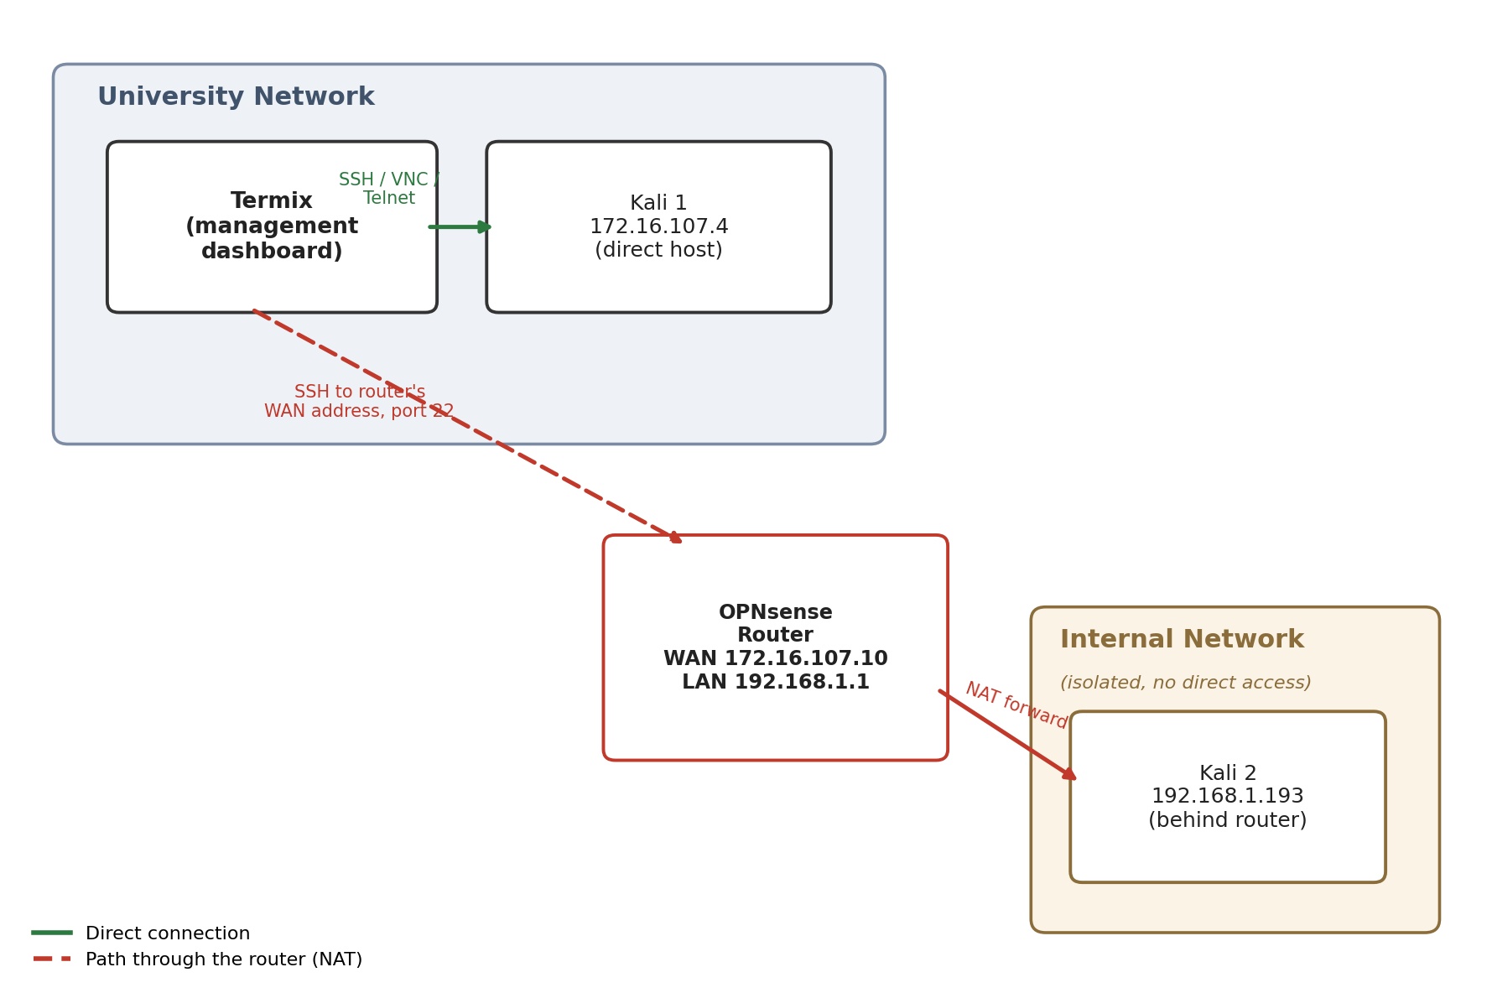
THE BLUEPRINT
Network Topology
Termix and the first host stay on the university network and reach each other directly. The router sits between that network and a new, isolated internal network. The second host lives only inside that internal network — reachable from Termix only through the router.
7

Slide 8
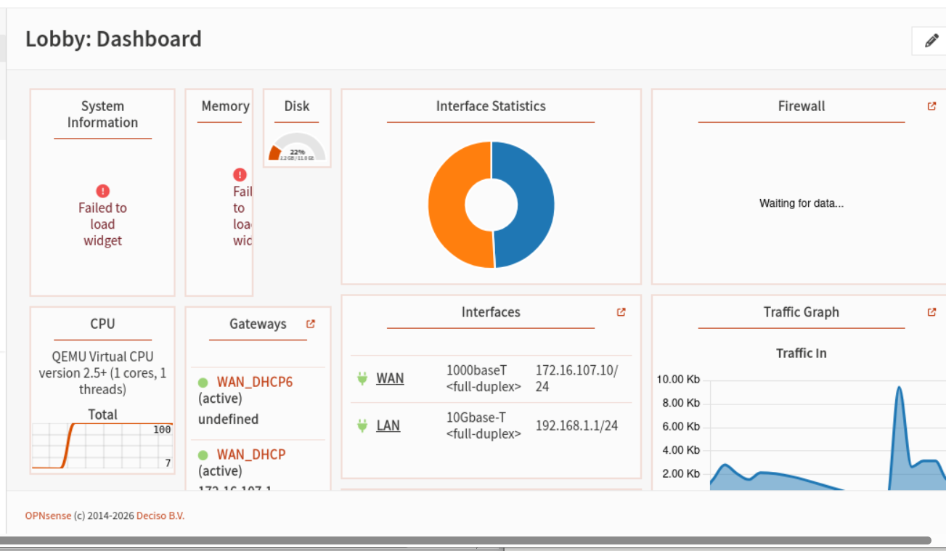
STEP ONE
Building a Router with OPNsense
OPNsense is an open-source router and firewall operating system. A new virtual machine was built for it with two interfaces: one facing the university network (WAN) and one facing a new, isolated internal network (LAN).
WAN
172.16.107.10
Faces the university network
LAN
192.168.1.1
Serves the new internal network
8

Slide 9
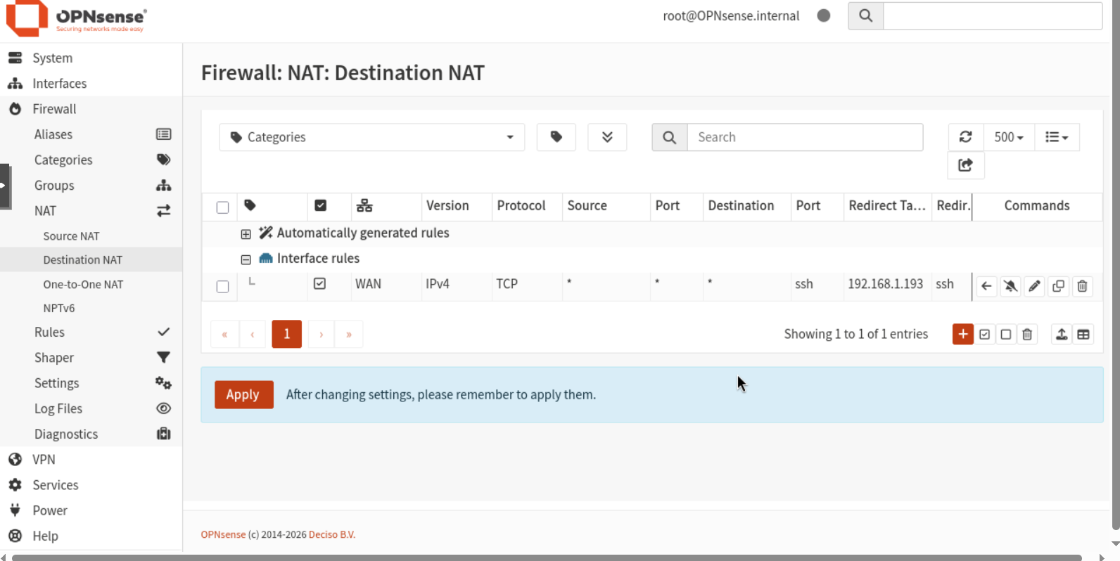
STEP TWO & THREE
A Protected Host, Reached on Purpose
A second Kali host was placed on the internal network and is no longer directly reachable from the outside. A NAT rule on the router forwards SSH traffic arriving at the router's own address to that host — a controlled path instead of open exposure.
Result
Termix connected to the protected host using the router's address instead of the host's own address — a full terminal session, through the router, to a machine otherwise isolated from the outside network.
9

Slide 10
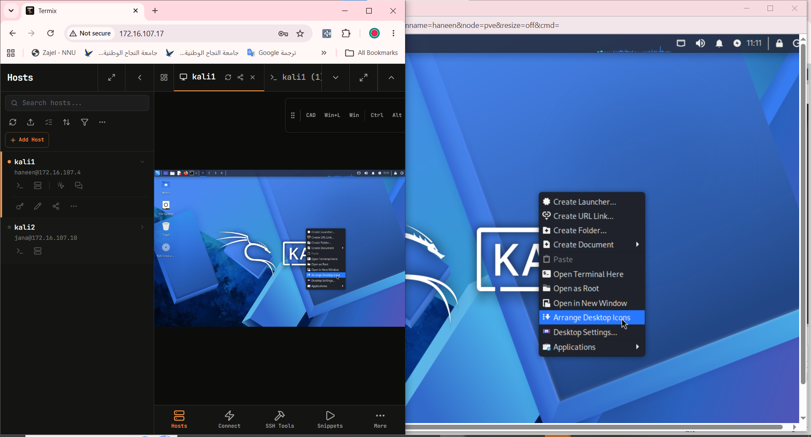
FINAL PROOF
Controlling the Real Screen
The graphical session Termix opens is normally a separate virtual display. A full desktop was configured to run on the machine's actual display instead, proving Termix drives the same live screen shown by the machine's own console — not an independent one.
10

Slide 11
CONCLUSION
A Lightweight Tool, a Real Network
Termix went from managing one open host to operating inside a segmented network with a real router, a protected host, and controlled access — bridging the gap between a simple lab exercise and genuine infrastructure management.
Virtualization
Network Segmentation
Firewall & NAT
Remote Management
Proxmox VMs & containers
WAN / LAN separation
Controlled, deliberate access
SSH, VNC, Telnet in one tool
11

