Slide 1
BugLens AI
average.py
1 def calculate_average(numbers)
2 total = sum(numbers)
3 return total / len(numbers)
AI-Powered Code Bug Detection and Explanation
Missing colon in function declaration
HIGH
Python requires a colon after a function declaration.
Find bugs. Understand code. Build better.
def calculate_average(numbers):
Notes:
Introduce BugLens AI: an AI-powered tool that detects and explains bugs in source code.

Slide 2
Problem
Developers and students often spend significant time identifying and understanding coding errors.
File "app.py", line 1
def calculate_average(numbers)
SyntaxError: invalid syntax
Traditional error messages can be difficult for beginners to understand.
It says what failed, but not why or how to fix it.
Notes:
Debugging is slow and confusing, especially for beginners. Error messages state what failed, not why or how to fix it.

Slide 3
Solution
BugLens AI turns confusing errors into clear, actionable explanations.
Bug detection
1
Error explanation
2
Possible cause
3
Paste code. Get answers.
Suggested fix
4
Code improvement suggestions
5
Notes:
BugLens AI turns confusing errors into clear, actionable explanations.

Slide 4
Target Users
Software Engineering students
Beginner developers
01
02
Learn from every explanation
Understand errors in plain language
Programming learners
Developers
03
04
Practice and self-check code
Get a fast second opinion
Notes:
Who benefits: students, beginners, learners and professional developers.

Slide 5
How It Works
1
2
3
4
5
User enters code
Backend validates the request
AI analyzes the code
Structured results are returned
User reviews the explanation and suggested fix
Simple architecture
Web Interface
Backend API
AI Service
Structured JSON
Results
Notes:
Five steps from pasted code to an explained fix, with a simple architecture underneath.

Slide 6
Main Features
1
2
3
4
AI Bug Detection
Error Explanation
Suggested Fixes
Multiple Languages
Syntax, logic and runtime issues
Plain-language reasons
Corrected code, ready to copy
Python, JS, TS, Java, C++, C#
5
6
7
Code Quality Suggestions
Demo Mode
Recent Analyses
Readability and maintainability tips
Works without an API key
History saved in your browser
Notes:
Seven core capabilities, including Demo Mode so anyone can try the app without an API key.

Slide 7
Technology Stack
FRONTEND
BACKEND
AI
React
TypeScript
Tailwind CSS
Node.js
API Routes
AI API
CODE EDITOR
DEPLOYMENT
VERSION CONTROL
Monaco Editor
Vercel
GitHub
Notes:
React, TypeScript and Tailwind on the front end; Node.js API routes on the back end; Monaco Editor; Vercel; GitHub.

Slide 8
System Architecture
User
Pastes code and reads the results.
Web Interface
React and Monaco Editor: input, loading and error states.
Backend API
Validates input, applies limits, keeps the API key secret.
AI Service
Analyzes the code as text. It never executes it.
Structured Analysis
JSON is checked and normalised before display.
Results Interface
Severity, location, cause, fix and improvement tips.
Notes:
Each component has one job: the interface collects code, the backend guards the key and validates, the AI analyzes, results are validated before display.

Slide 9
Security
1
2
3
API keys stored in environment variables
API keys never exposed to users
User code is not executed
Configured on the server only
Never sent to the browser
Analyzed as plain text only
4
5
6
Input validation
Request limits
Secure backend API
Type, language and size checks
Size cap and per-IP rate limit
All AI calls go through /api/analyze
Notes:
Security is designed in: keys stay on the server, code is never executed, and every request and response is validated.

Slide 10
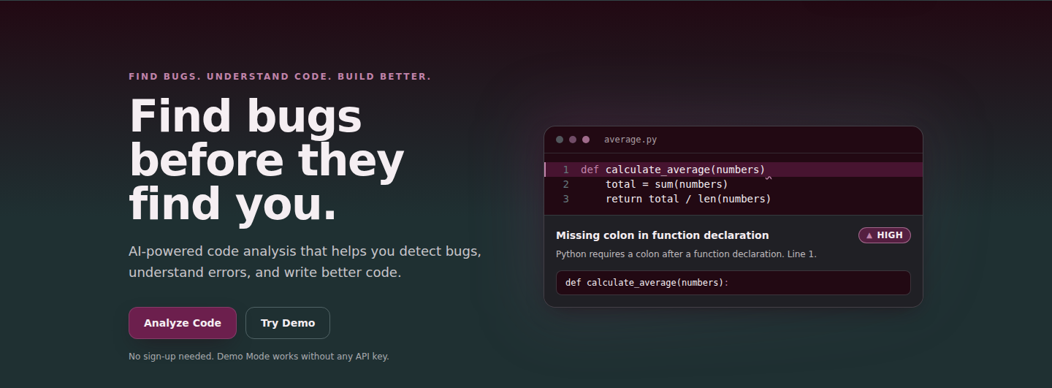
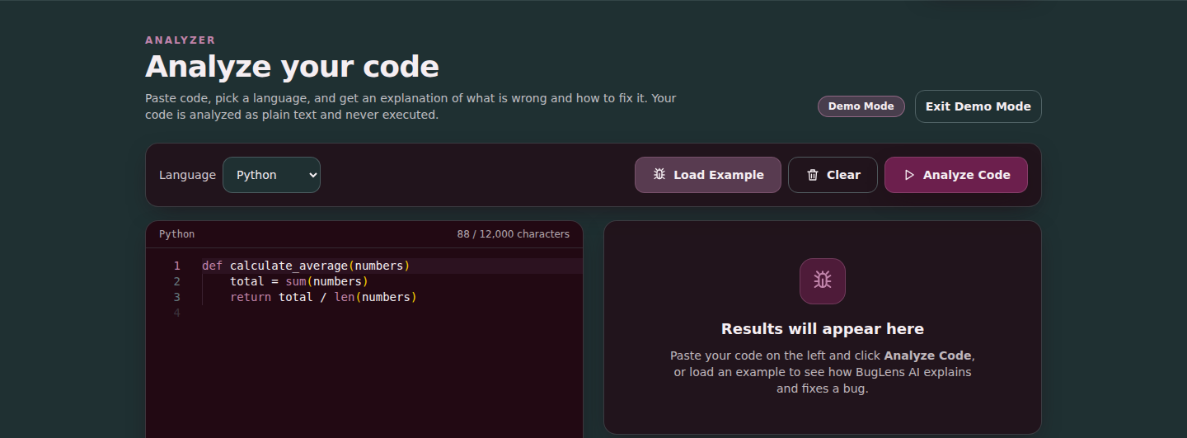
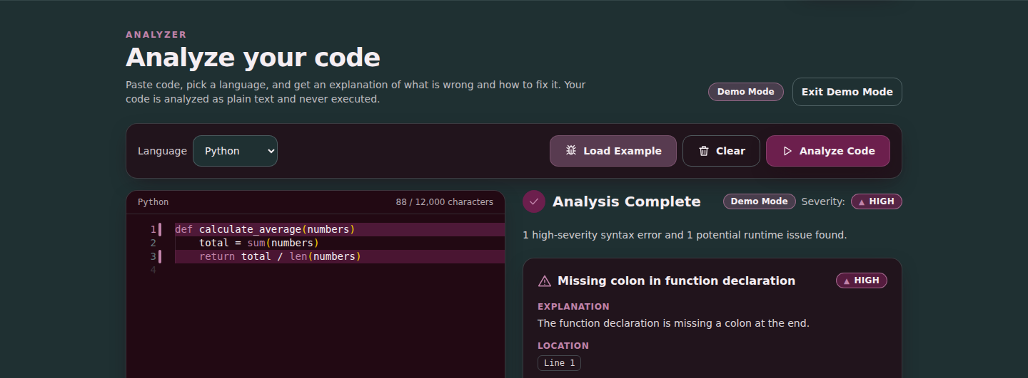
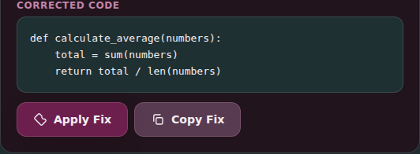
Demo
Home page
Code editor
Analysis result
Suggested fix
Notes:
Screenshots captured from the running application in Demo Mode.

Slide 11
Future Improvements
1
2
3
More programming languages
GitHub repository integration
Pull Request analysis
4
5
6
Advanced static analysis
Team collaboration
Personalized learning recommendations
Notes:
Possible next steps for the project.

Slide 12
“
BugLens AI combines artificial intelligence and software engineering to make debugging more understandable, accessible, and efficient.
Thank You
Questions?
Notes:
Close with the conclusion, then thank the audience and invite questions.

