Slide 1

ML-GUARD: ADVANCED LOG ANALYSIS WITH SURICATA
Presented by:
Haneen Almassri
Saja Sehweil
Mona Al-Talli
Supervised by:
Eng. Alaaeddin AlQazzaz

Slide 2


Is a high performance Network IDS, IPS and Network Security Monitoring engine. It is open source and owned by a community-run non-profit foundation
Suricata System

Slide 3

Suricata
While Suricata is a powerful tool for detecting various types of cyber attacks, there are several ways in which its detection methods can fail
1.Evasion Techniques
2.Zero-Day Attacks
3.Encrypted Traffic
4.Resource Limitations: Suricata's performance is affected by high traffic volumes and complex rules. Heavy traffic may cause packet loss or missed detections, while complex or unoptimized rules can slow processing, reducing detection accuracy.
5.Anomaly Detection Limitations: Defining a baseline for normal behavior is challenging, especially in dynamic environments. Inaccurate baselines may lead to false positives or missed anomalies.

Slide 4
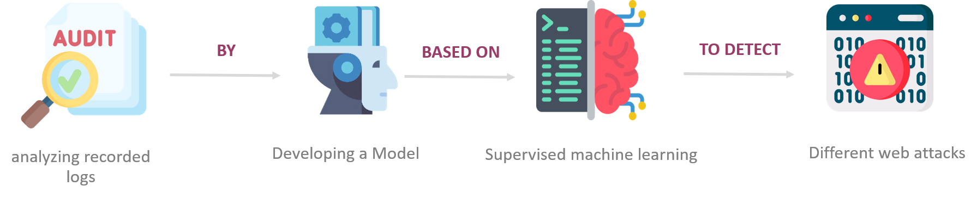
Main objective of the project
Automated Threat Detection by developing a models based on Machine Learning technology to detect web attacks through analyzing recorded logs

Slide 5

Machine learning

Slide 6
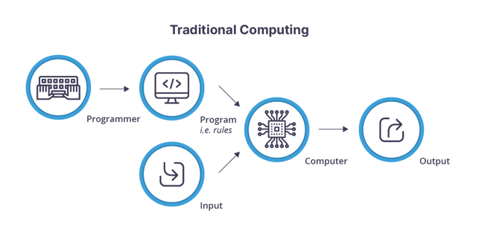
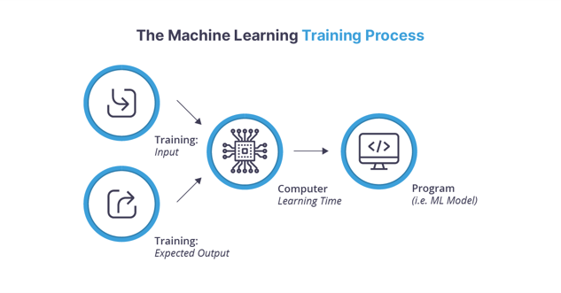
What is machine learning?
Machine learning (ML) is defined as a discipline of artificial intelligence (AI) that provides machines the ability to automatically learn from data and past experiences to identify patterns and make predictions with minimal human intervention.

Slide 7


Machine learning types
 | Supervised ML | Unsupervised ML
Input data | Input data is labelled | Input data is unlabelled
Purpose | Used for prediction | Used for analysis
Examples | Classification and regression | Clustering and density estimation

Slide 8

Defined attacks in our project
•SQL Injection.
•Cross-Site Scripting (XSS).
•DDOS attack.

Slide 9
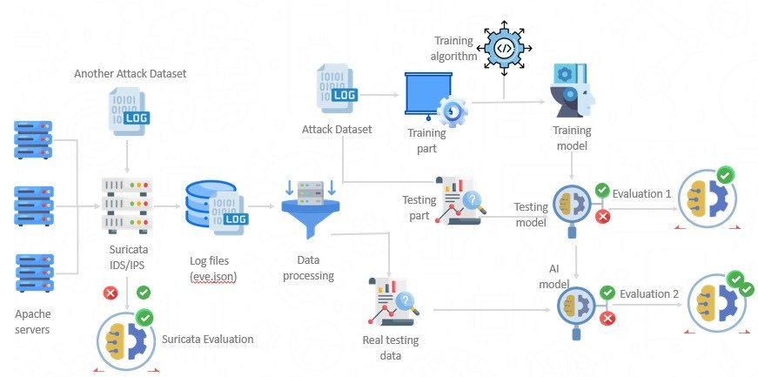
Proposed system overview

Slide 10




Dataset Criteria
1
2
3
Large Dataset Size
Raw, Unprocessed Data
Separate Datasets for Different Web Attacks

Slide 11



Dataset Searching
1
2
3
Manually collection
Using prepared virtual infrastructure—comprising web servers and
clients
Find open source tool for generating.
Search in Online Repositories
Payloads were not genuine
Strange symbols in logs disrupted training and detection
All generated logs were malicious

Slide 12
Dataset Searching
•SQLI dataset consists of 30,919 payloads
•XSS dataset consists of 13686 payloads
•DDOS dataset consists of 104345 payloads

Slide 13

Data processing
•Feature Extraction
•Data labeling

Slide 14
Feature Extraction
Features are the independent variables in the data that can be divided into columns in a structured dataset, which is an input to the learning model, and it’s measurable so it can be analyzed.

Slide 15
Data labeling
•Data labeling annotates data for supervised machine learning, helping models learn to map inputs to outputs.
•Types of labeling: Manual (individual labels) vs. Programmatic (automated functions for large datasets, reducing effort and time).
•Project approach: Supervised learning with pre-labeled datasets using "1" for attacks and "0" for normal behavior, requiring no additional labeling.

Slide 16
Training & Testing

Slide 17
The datasets are split using python Sklearn library into 80% for the training dataset and 20% for the testing dataset. Then, they are used as an input for the training phase.
The learning classification algorithms on that we use to training dataset:
Convolutional Neural Networks (CNNs)
Decision Tree Classifier
Deep Learning
K-Means
K-Neighbors Classifier
LightGBM
Random Forest
Support Vector Machine(SVM)
Logistic Regression
XGBoost

Slide 18
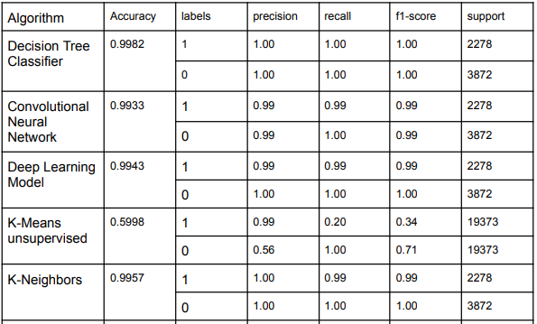
Evaluation

Slide 19
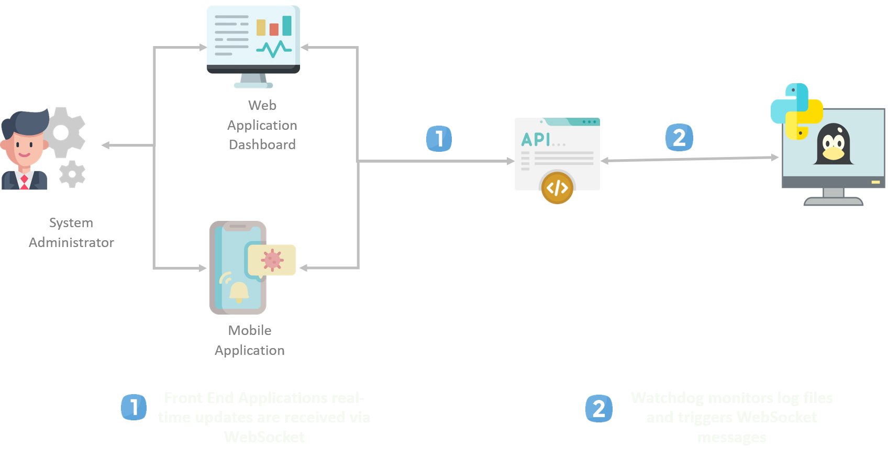
Proposed system architecture

Slide 20
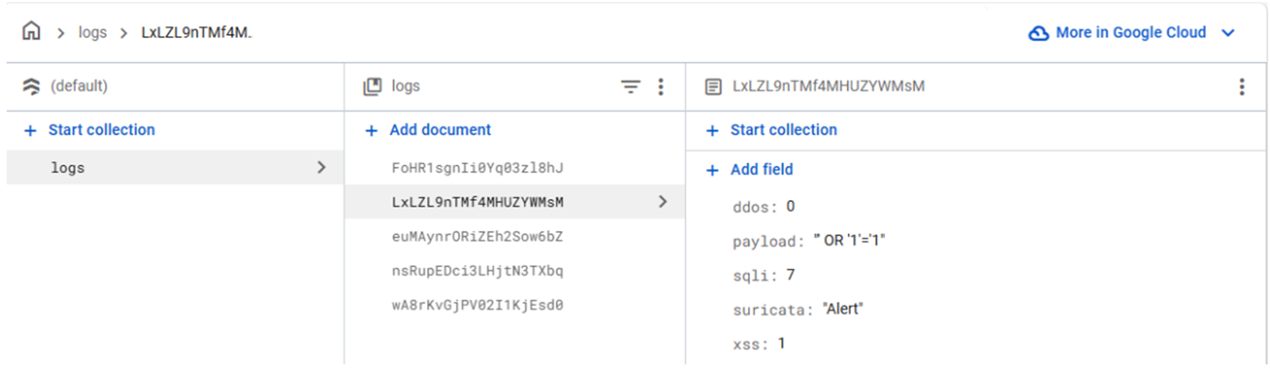
logs on Firebase

Slide 21
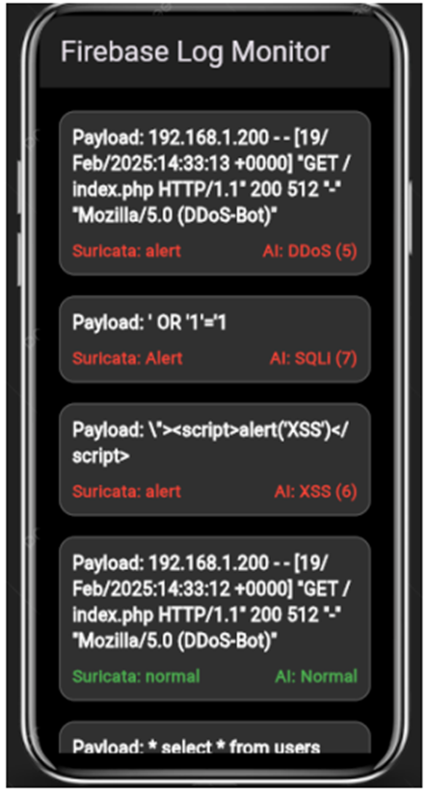
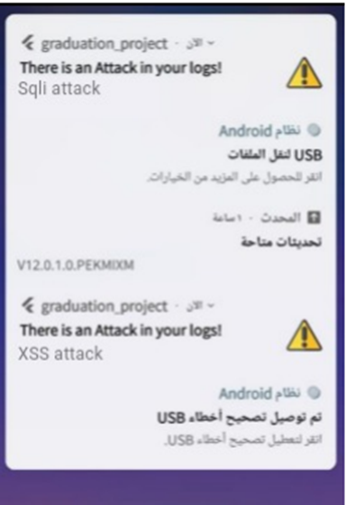
Our Mobile Application

Slide 22
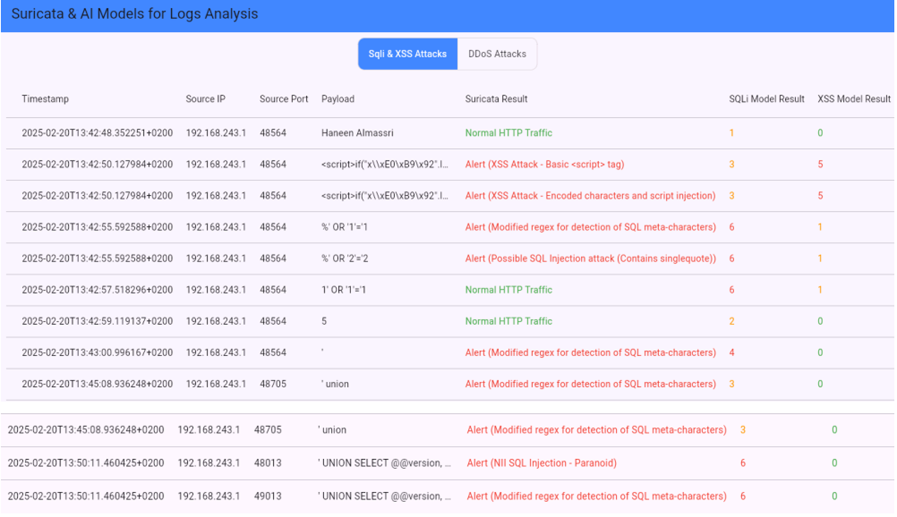
SQLi & XSS attacks on web dashboard

Slide 23
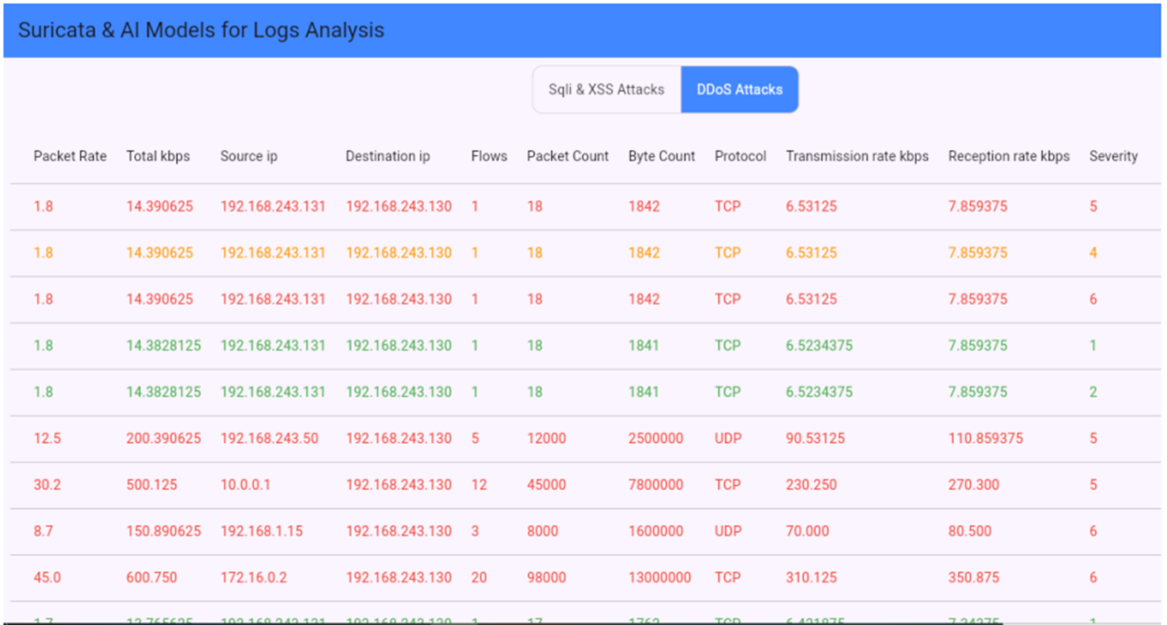
DDOS attacks on web dashboard.

Slide 24
Literature Survey
Project | ML Algorithms | Dataset | result
A Suricata and Machine Learning Based Hybrid Network Intrusion Detection System | Decision Tree (DT) | CICIDS2017 dataset | The proposed model is capable of detecting any type of computer attack including zero-day intrusions and exploits.
Webhawk - The New Version | Decision Tree Classifier , Random Forest Classifier , extra Tree Classifier , MLP Classifier , K-Neighbors Classifier | Apache Malicious Log Generator tool | detect SQL injection , Cross Site Scripting(XSS) and Directory Traversal Attacks on apache web server
ntrusion Detection System with Machine Learning and Multiple Datasets | Gradient Boosting Machines (XGBoost) ,. Logistic Regression , Random Forest Classifier | UNSW-NB15 | Certain models perform better than other models. Specifically, the XGBoost and random forest classifiers perform better than the logistic regression model.

Slide 25


THANK YOU!

