Slide 1
DATA BASE PROJECT
Database of a school system

Slide 2
Our project
Our project talks about a database for the school. Many data are stored, such as personal information about employees in general, which appeared from the principal to the security guard, and about students, such as their grades, level, days of attendance and absence, in addition to it includes the tools that exist within the school ... etc.

Slide 3
Business rules :-
1-each student located in one and only one address
2-Each address has one or more students
3-each student study and recored one or more subject
4-each subject studied and recorded by one or more students
5-each student must be belong to one and only one AcademicDivision
6-each AcademicDivision must be contain one or more students
7-each student must be attend one or more times in Attendance
8-each Attendance must be attended by one and only one student
9-each student recored his marks one ore more time in scorerecored //
10-each scorerecored recoreded by one ore more student //
11-each student may be contain one and only corona_student // 1 -- 1
12- each corona_student is a student // 1 -- 1

Slide 4
Business rules :-
each staff must be located in one and only one address
each address may be has one or more staff
each staff must be belong to one and only one stafftybe
each stafftybe may be contain one or more staff
each staff must be contain one or more teacher
each teacher must be belong to one and only one staff
each staff may be contain one and only corona_staff// 1 – 1
each teacher may be manage one and only one club
each club must be managed by one and only one teacher
each teacher must be teach one or more subject
each subject must be teaching by one or more teacher

Slide 5
Business rules :-
each school must be located in one and only one address
each address must be contain one or more schools
each level must be contain one or more AcademicDivision
each AcademicDivision must be belong to one only one level
each floor must be contain one or more room
each room must belong to one and only one floor
each room must be contain one or more item
each item must be belong to one or more room

Slide 6
Tables in the database
Staff
StaffType
Teacher
Student
School
Subject
Club
Member
Address
Stu_Level
AcademicDivision
Attendance
ScoreRecord
Floor
Room
item

Slide 7
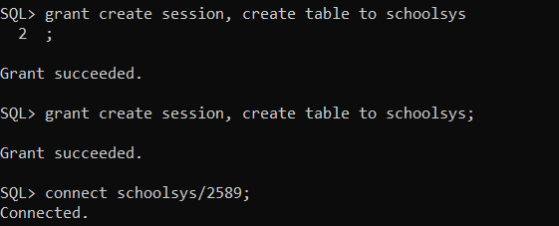
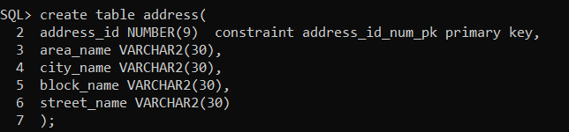
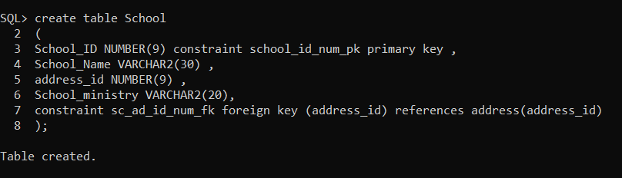

Slide 8
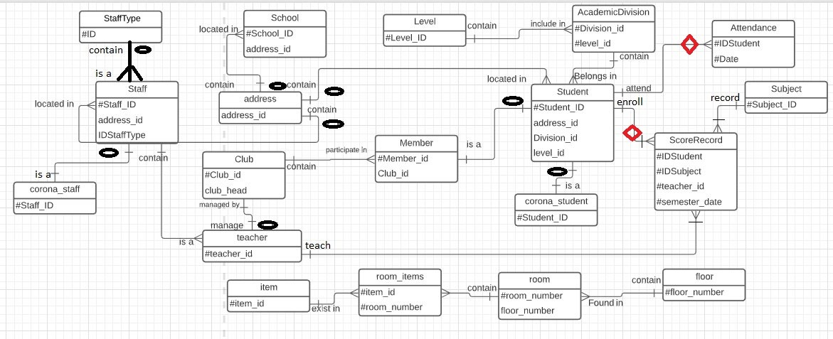
ERD

Slide 9

GROUP MEMBER **
SAJA JAMAL SEHWEL
HANEEN ALMASRY

