Slide 1
Web Application Threats, Web Application Hacking, Countermeasures,
Cross Site Scripting / XSS Flaws [Detailed in the 3rd unit]
By
Dr. M. Senthilkumar
Associate Professor, CSE Dept,
ASC, CBE

Slide 2
Web applications are programs that reside on a web server to give the user functionality beyond just a website.
Database queries, webmail, discussion groups, and blogs are all examples of web applications.
A web application uses a client/server architecture, with a web browser as the client and the web server acting as the application server.
JavaScript is a popular way to implement web applications.

Slide 3
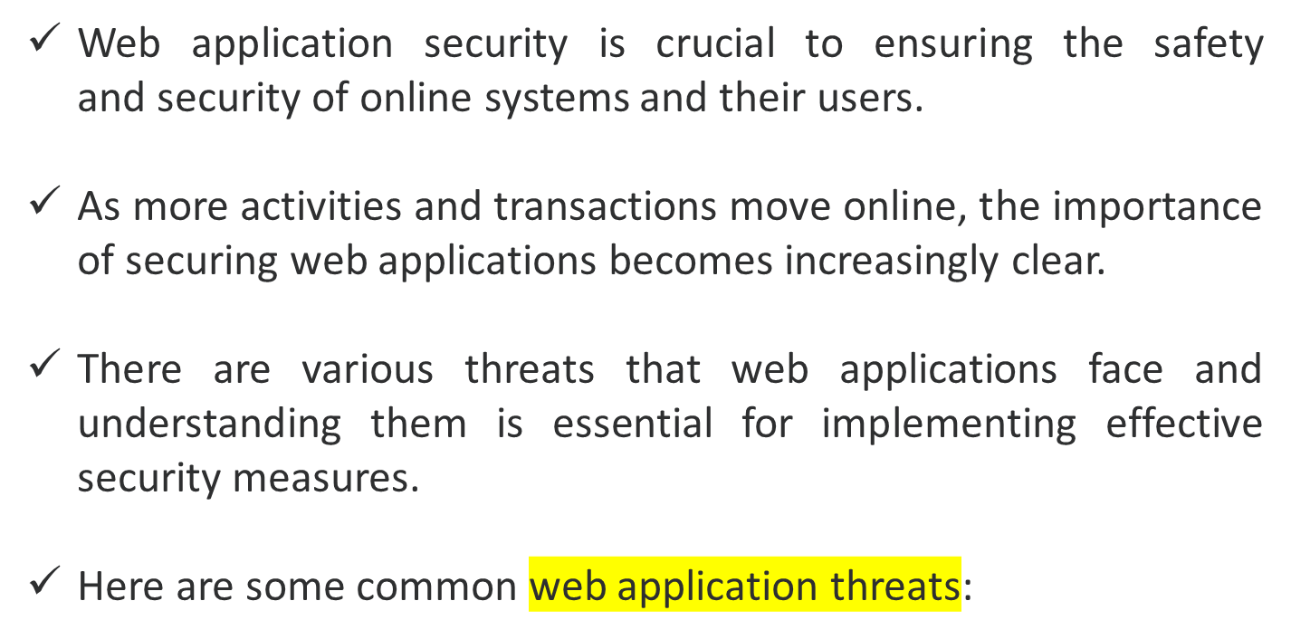

Slide 4
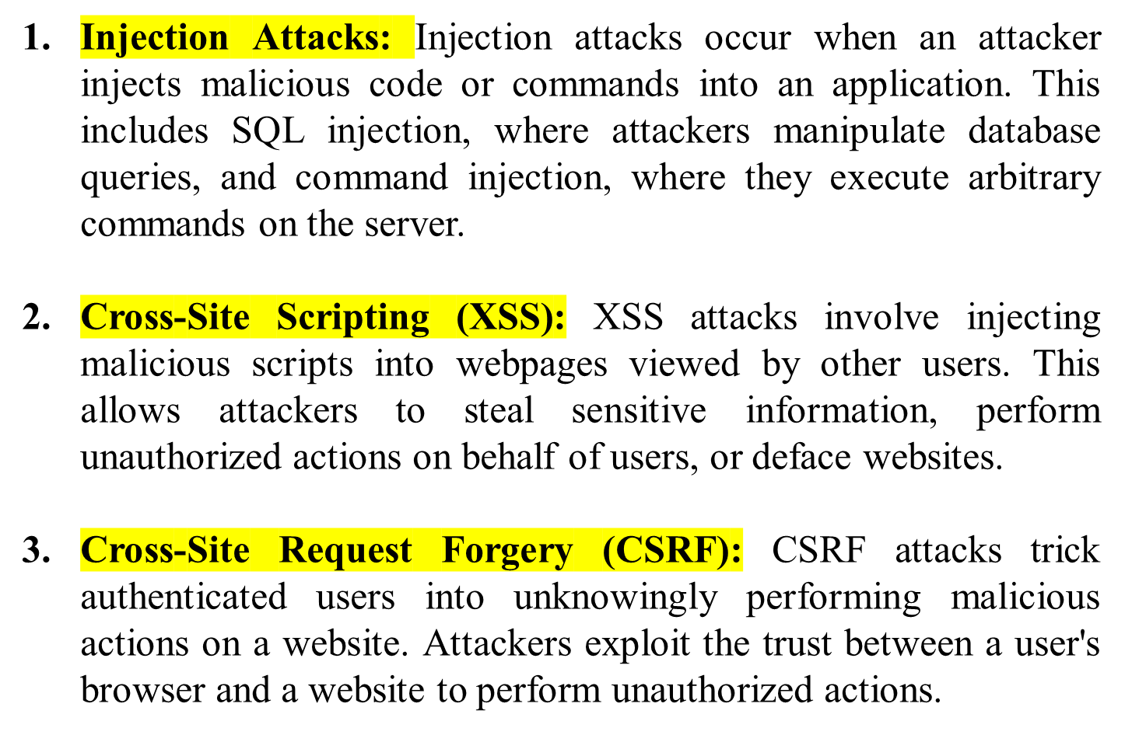

Slide 5
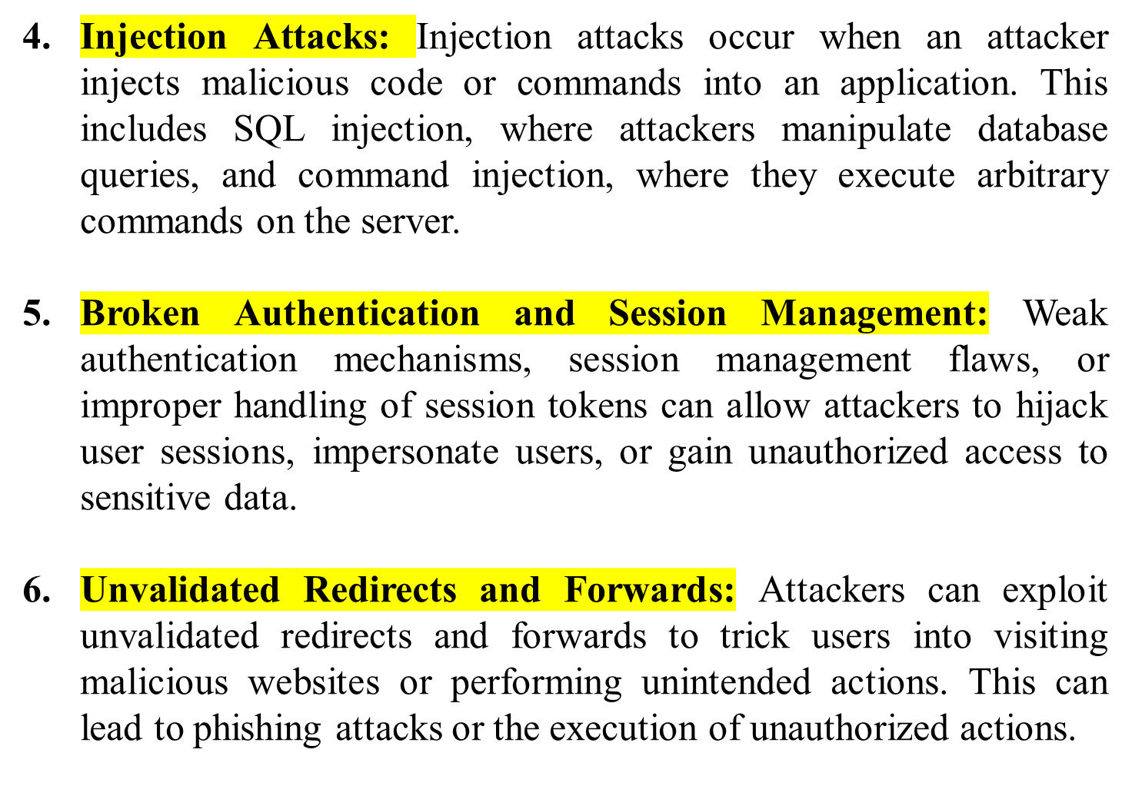

Slide 6
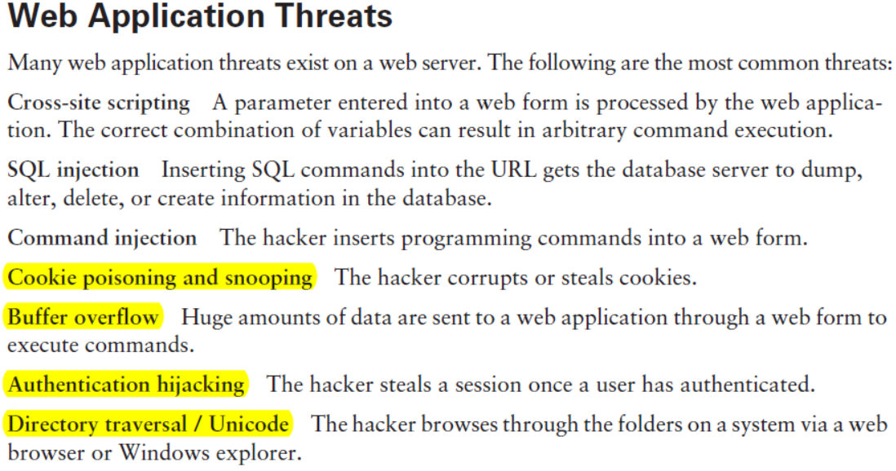

Slide 7
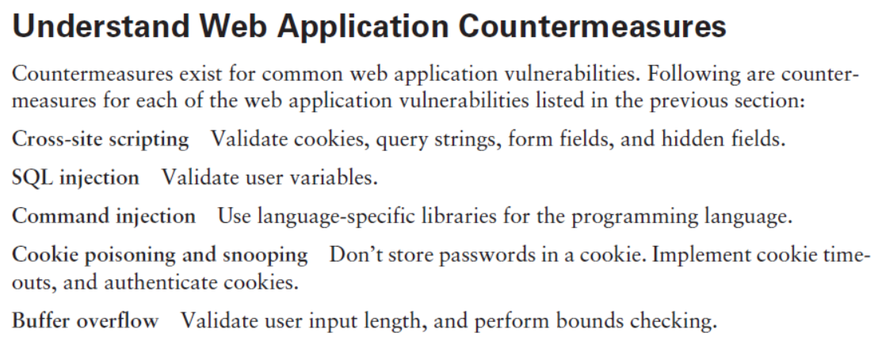
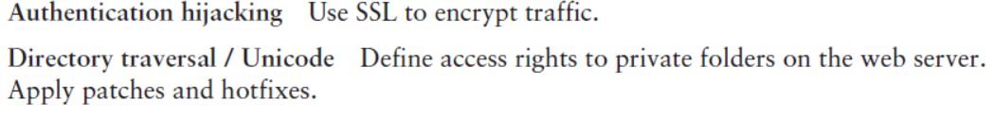

Slide 8
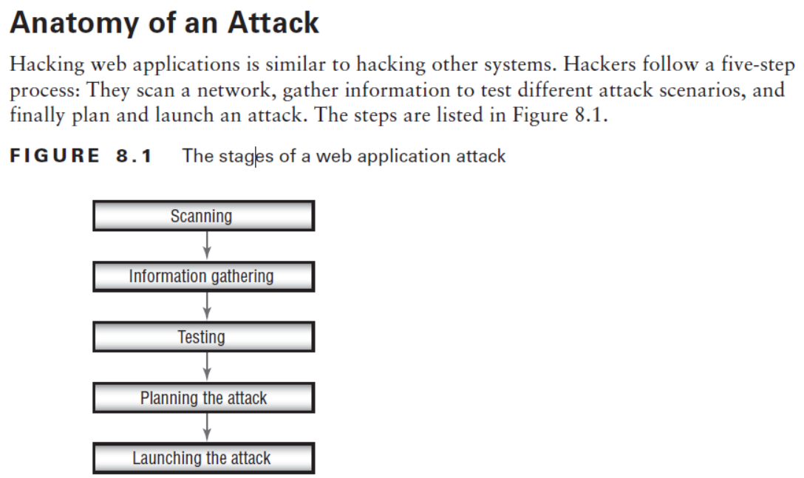
Web Application Hacking Methodology

Slide 9
Preventive Measures for Web Application Threats:
Input Validation and Sanitization
Secure Authentication and Session Management
Regular Security Patching and Updates - Keep web servers, frameworks, and application components up to date with the latest security patches and updates.
Security Testing and Code Reviews: Conduct regular security testing, including penetration testing and vulnerability assessments.
Secure Configuration: Follow secure configuration practices for web servers, frameworks, and application components. Disable unnecessary services, use secure default configurations, and apply access controls to limit exposure.
Web Application Firewalls (WAF): Implement a WAF to monitor and filter incoming web traffic, blocking known attack patterns
User Education and Awareness: Educate users about common web application threats, such as phishing attacks and the importance of strong passwords.

Slide 10
Web Application Hacking
Web application hacking or web app hacking is the act of exploiting vulnerabilities and weaknesses in web applications to gain unauthorized access, manipulate data, or perform malicious activities.
It involves identifying security flaws in web apps and leveraging them to compromise their integrity, confidentiality, or availability.
Web applications are software programs that run on web servers and are accessed through web browsers.
They are used for various purposes, such as online banking, e-commerce, social media, and more.
However, these applications often have security vulnerabilities that can be exploited by hackers.

Slide 11
Common Web App Attacks
There are several common web application attacks that hackers often exploit to compromise the security of web applications. Here are some of the most prevalent ones:
Cross-Site Scripting (XSS)
SQL Injection
Cross-Site Request Forgery (CSRF)
Remote File Inclusion (RFI) and Local File Inclusion (LFI) in a web application
XML External Entity (XXE) Attacks → XXE attacks target applications that parse XML input insecurely. By exploiting this vulnerability, attackers can retrieve sensitive information, execute remote code, or perform denial-of-service attacks.
Server-Side Request Forgery (SSRF) → occur when an attacker tricks a web application into making requests to other internal or external resources on behalf of the application server.

Slide 12
Cross Site Scripting / XSS Flaws
Detailed in the 3rd unit…..

Slide 13


Slide 14
Thank You to All My Dear Students

