Slide 1

Risk Game Build I
Notes:
<number>

Slide 2
The Goal of Build I
Phases implementation
Domination View
Phase View
Card View
MVC Architecture
Refactoring

Slide 3

Architecture design

Slide 4
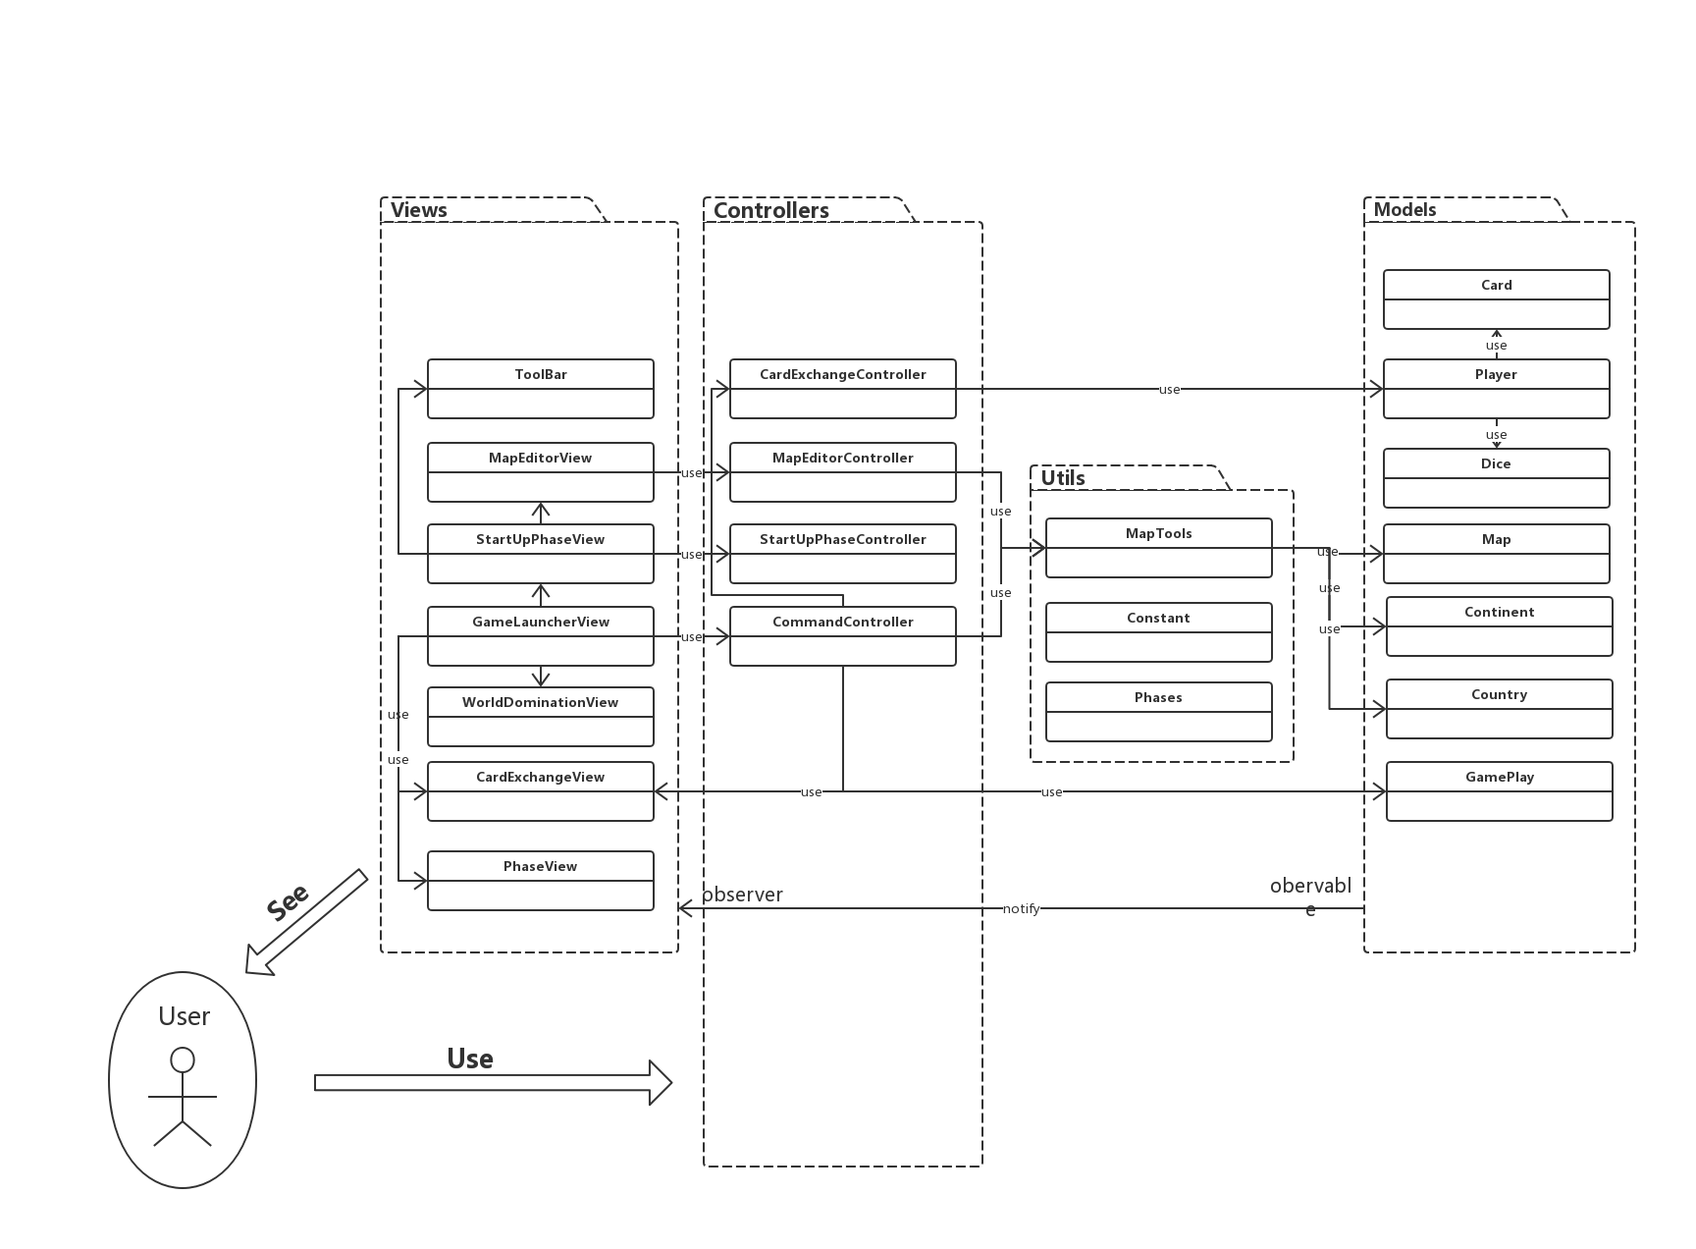
Architecture design

