Slide 1

Risk Game Build I
Notes:
<number>

Slide 2
The Goal of Build I
Set up the architecture
Basic models
Map editor
Command prompt controller
Abstract function of
game phases design

Slide 3

Architecture design

Slide 4
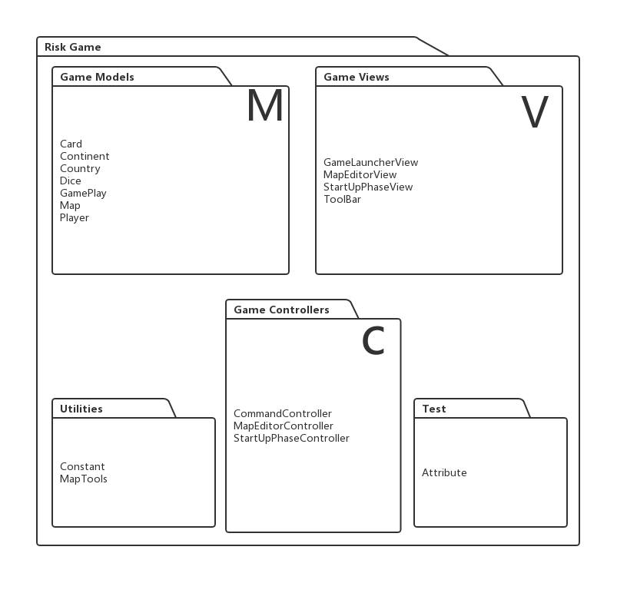
Architecture design

Slide 5
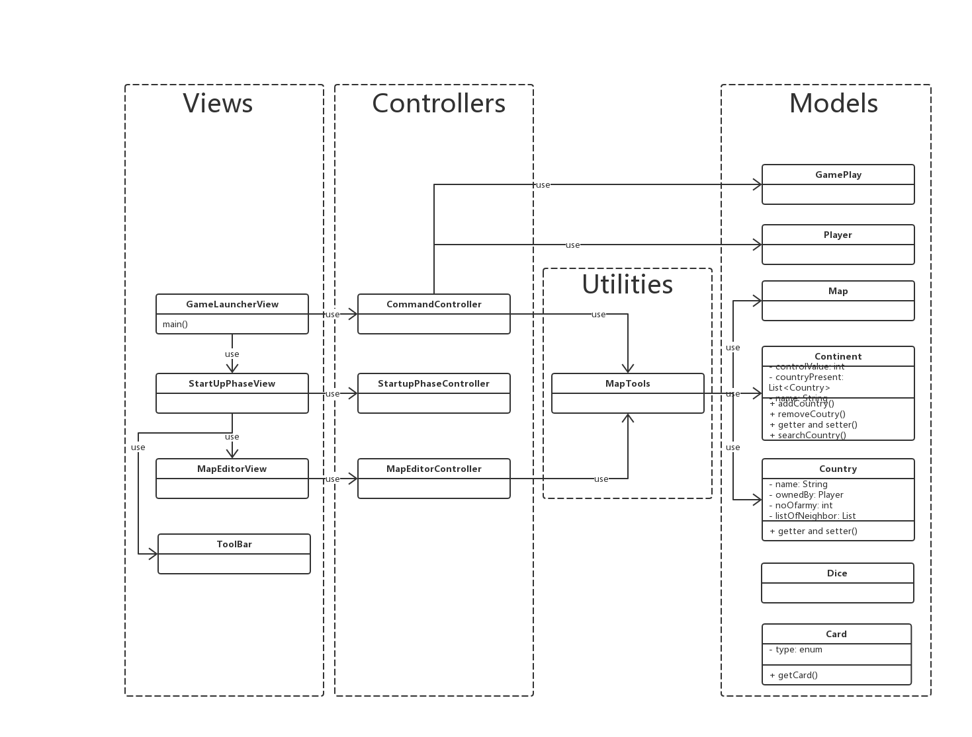
Architecture design

Slide 6
Project Folder Structure/Modules
/controller :
/models :
/utilities :
/view :

Slide 7
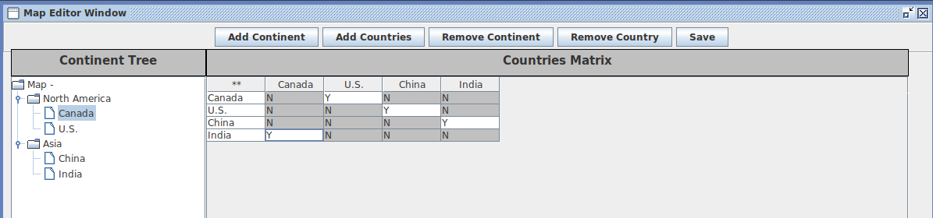
Map editor

