Slide 1
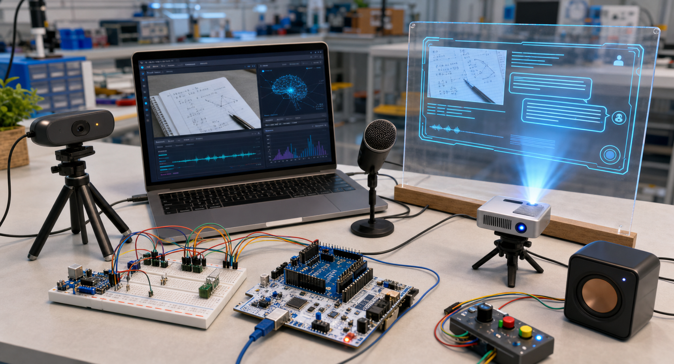
AI Reality Bridge
AI Reality Perception & Feedback System Based on C++ and STM32
C++ Course Project Final Defense
Group 5 | C++ Programming | 2025.06
Notes:
<!--pageType:cover-->

Slide 2
01
Background & Overview
CONTENTS
Background & Overview
CONTENTS
02
Architecture & C++ Design
Architecture & C++ Design
03
Testing & Validation
Testing & Validation
04
Conclusion & Team
Conclusion & Team
Notes:
<!--pageType:table_of_contents-->

Slide 3
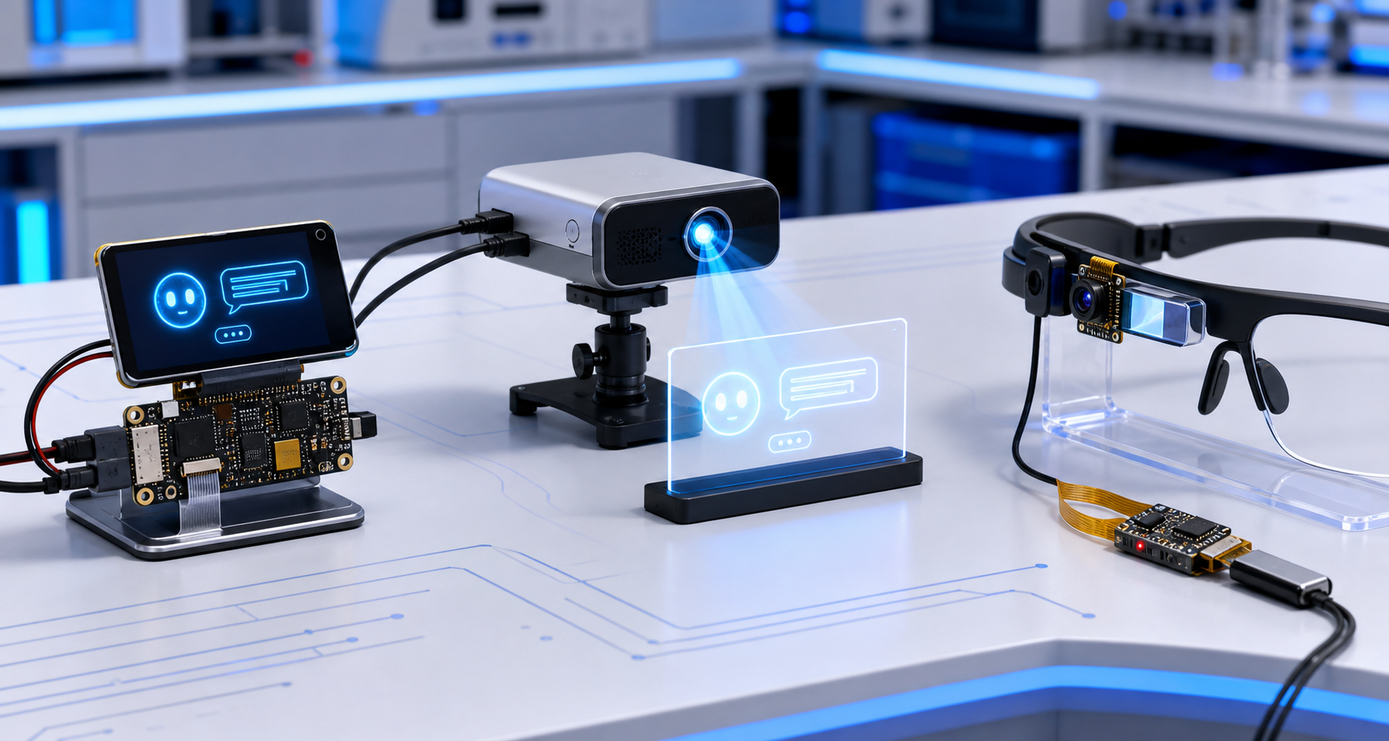
01
Background & Overview
Background & Overview
Notes:
<!--pageType:chapter-->

Slide 4
01 Background & Overview
Project Background & Motivation / Project Background & Motivation
1. Industry Status
Mainstream AI tools rely on touchscreens, creating fragmented perception-interaction-feedback pipelines that are unsuitable for hands-free scenarios.
2. Four Core Defects of Traditional Interaction
3. Shortcomings of Existing Smart Hardware
①
Passive Human-Machine Interaction
②
Long and Fragmented Operation Chain
Commercial smart glasses face bottlenecks:
• Limited power and computing make it difficult to build a complete perception-reasoning-hardware feedback loop at low cost.
• The long development cycle is unsuitable for quickly validating the underlying interaction chain in course projects.
• The lack of a reusable desktop prototype platform makes iteration within the course timeframe difficult.
AI cannot actively perceive the environment and can only wait for manual user input. Without visual or gesture-based sensing, scenario-driven responses are impossible.
Image analysis requires unlocking the device, opening software, capturing, uploading, and waiting for a response. Multiple manual steps interrupt the flow with poor real-time performance.
③
Limited Single-Modality Feedback
④
Hands-Free Interaction Blind Spots
Results are only text on screen. Hardware audio-visual, OLED, and status indicators are missing, resulting in poor environmental adaptability.
Cooking, debugging, and inspection occupy both hands, making touchscreen operation impossible. Pure voice is vulnerable to noise with poor recognition stability.
4. Project Motivation
Build a Raspberry Pi + NUCLEO dual-mainboard prototype to simulate smart glasses' core functions. Camera/microphone capture → C++ multimodal AI inference → hardware audio-visual feedback. A single button triggers a complete interaction loop, validating the full hands-free embedded AI interaction pipeline.
04
Notes:
<!--pageType:content-->

Slide 5

01 Background & Overview
System Goals & Objectives / System Goals & Objectives
Image Acquisition
Voice Input
AI Analysis
USB Camera + OpenCV Real-time Capture
1280×720 Frame, JPEG Encoding
→ Course: UI / Data
Microphone + ASR Speech-to-Text
5-Second Recording, WAV Format
→ Course: Audio / I/O
Qwen-VL Vision-Language Model
Image + Text Prompt → JSON Result
→ Course: API / Logic
Embedded Feedback
Qt Visualization
Logging
OLED, LED, Buzzer, Vibration Motor
Multi-Channel Physical Feedback
→ Course: STM32 / GPIO
Qt 6 Windows Control Center
Real-time Chat, History, Camera
→ Course: UI / Widgets
Random File Read/Write Audit Log
Append, Query, Update-by-ID
→ Course: File I/O
05
Notes:
<!--pageType:content-->

Slide 6
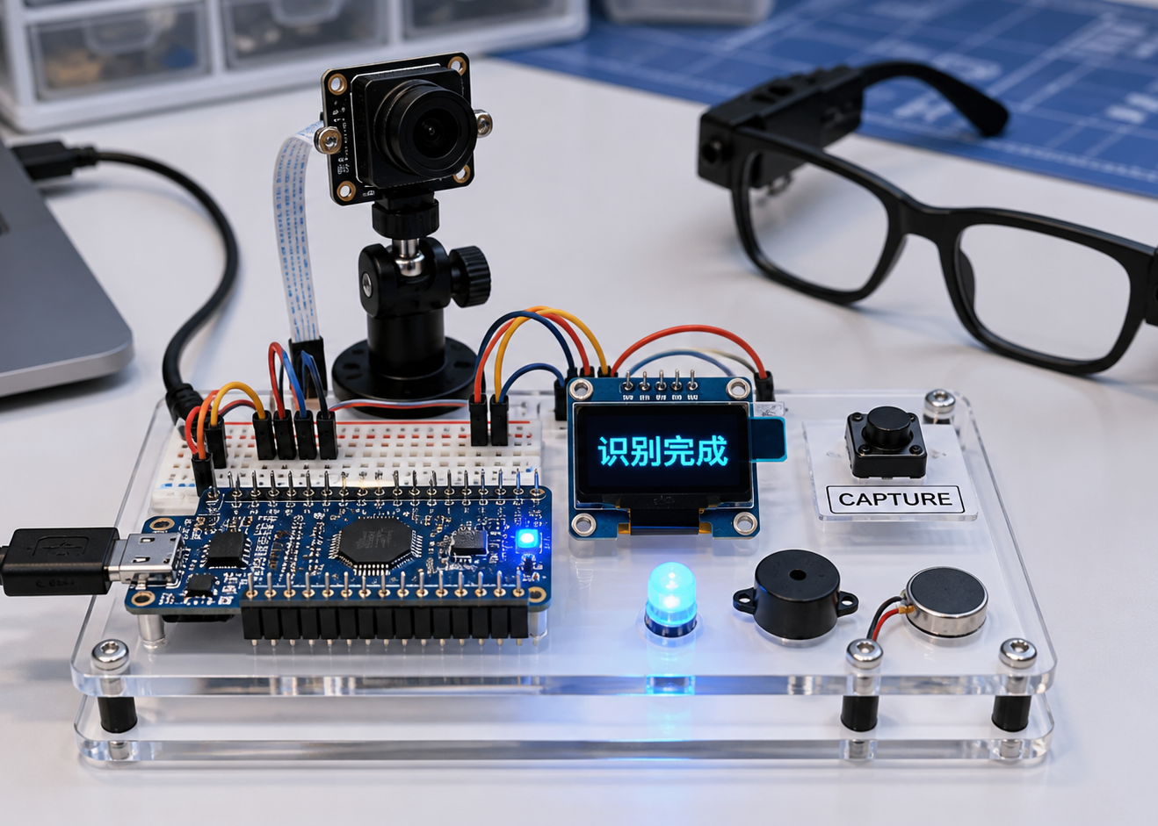
01 Background & Overview
Hardware Composition / Hardware Composition
Raspberry Pi 5 — Linux Host, Camera, Mic, Network, AI API
NUCLEO-F446RE — MCU Controller, GPIO, UART, I2C
C270 USB Camera — 1280×720 Image Capture
OLED Display — Local Status Output (128×64)
Three-Key Keyboard — Trigger Buttons
LED + Buzzer + Vibration — Multi-Modal Feedback
Windows PC — Qt 6 Control Center
06
Notes:
<!--pageType:content-->

Slide 7
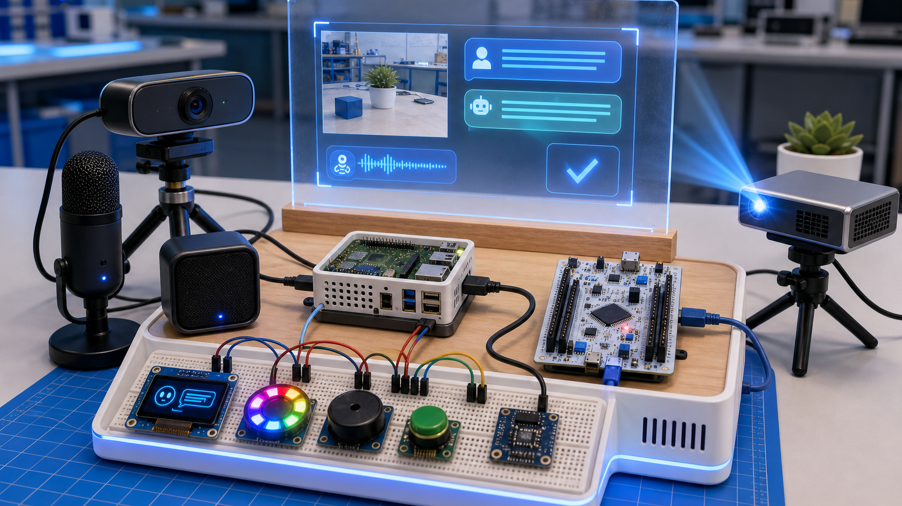
02
Architecture & C++ Design
Architecture & C++ Design
Notes:
<!--pageType:chapter-->

Slide 8
02 Architecture & C++ Design
Five-Layer System Architecture / Five-Layer System Architecture
A five-layer decoupling design isolates UI, business logic, AI services, communication, and hardware. Each layer is implemented by corresponding C++ classes, reducing module coupling — a core C++ engineering practice.
Presentation
Presentation Layer
C++ Qt Widgets — ChatPage, HistoryPage, DiagnosePage, LogWidget
Qt Desktop Control: Real-time Chat, History Log, Connection Diagnosis, Camera Preview, Raw Log Output
Course Exam Point
Qt GUI, Widget Encapsulation, Signal-Slot
Application
Application Layer
C++ AppCore — AppCore, WorkflowManager
Global Business Scheduling: Button Trigger, Voice Capture, AI Image Analysis, Exception Fault Tolerance
Course Exam Point
Class Encapsulation, State Machine, Workflow Management
Service
Service Layer
Abstract Base + Polymorphism — CameraService, AiVisionService, AudioRecorder
Image Capture, Speech Recognition, Multimodal AI Inference Services; Seamless Real/Mock Service Switching
Course Exam Point
Abstract Class, Inheritance, Polymorphism (Core)
Communication
Communication Layer
C++ IO / Network — SerialPort, HardwareBridge, HttpNetworkClient, SshChecker
Serial Port STM32 Driver, HTTP Large Model API, SSH Device Status Inspection
Course Exam Point
File I/O, Network Requests, Serial Read/Write
Hardware
Hardware Layer
RPi Linux C++ + STM32 — Raspberry Pi 5, NUCLEO-F446RE, C270, OLED, Three-Key, LED/Buzzer/Vibration
Audio/Video Capture, Button Trigger, OLED Local Output, Audio-Visual-Vibration Hardware Feedback
Course Exam Point
Linux Embedded, Serial Peripheral Communication
08
Notes:
<!--pageType:content-->

Slide 9
02 Architecture & C++ Design
Layer Code Mapping / Layer Code Mapping
The five-layer architecture maps to independent code directories. Each layer encapsulates dedicated C++ classes with header/source decoupling, strictly following OOP encapsulation, inheritance, and polymorphism principles.
Layer | Directory | Core C++ Classes | Key Coding Capabilities
Presentation Presentation Layer | ui/ | ChatPage, HistoryPage, DiagnoseWidget, LogViewer | Qt6 Custom Widgets, Signal-Slot, Window Paging, Real-time Image Rendering
Application Application Layer | app/ | AppCore, WorkflowManager, FaultHandler | Business State Machine, Fault Tolerance, Multi-module Coordination, Lifecycle Management
Service Service Layer | service/ | CameraService, AiVisionService, AudioRecorder (abstract) OpenCvCameraService, QwenVisionService, MockAiVisionService | Abstract Interface, Inheritance Override, Runtime Polymorphism, Module Hot-Swap
Communication Communication Layer | comm/ | SerialPort, HardwareBridge, HttpClient | Binary Serial Read/Write, libcurl Network Requests, Data Pack/Unpack, IO Exception Capture
Hardware Hardware Layer | rpi_capture/ + stm32/ | RpiCapture, Stm32Driver | Linux Low-level Device Access, Cross-device Serial Communication, Peripheral GPIO Control
Engineering Code Standards
• Header (.h) declares classes/interfaces, Source (.cpp) implements logic, compilation decoupled. • All services depend on abstract base classes, not concrete implementations, conforming to the Open-Closed Principle.
• Unified exception capture mechanism, custom exception classes per layer, hierarchical fault reporting. • AuditLogStore independently encapsulated, globally called, fulfilling the course random file I/O requirement.
09
Notes:
<!--pageType:content-->

Slide 10
02 Architecture & C++ Design
Closed-Loop Data Flow / Closed-Loop Data Flow
The five-layer architecture supports bidirectional data flow. Upper layers send control commands to lower-layer hardware; hardware collects data and device status, feeding back up to the Qt interface, forming a complete hands-free AI interaction closed loop.
Flow 1: Downward Command / Downward Command Flow
Qt Interface
Issue Start Command
AppCore
Schedule Workflow
Service Layer
Recording/Capture/Inference
Communication
Serial/HTTP Dispatch
Hardware
Button/OLED/Audio-Visual
Flow 2: Upward Data / Upward Data Reflow
Hardware
Image/Voice/Status
Communication
Data Encapsulation Upload
Service Layer
ASR / Qwen-VL
AppCore
Integrate Results/Faults
Qt Interface
Real-time Interface Refresh
Fault Tolerance / Exception Data Flow
When devices are offline, network times out, or AI recognition fails, lower-layer hardware reports fault codes, passed upward layer by layer. Qt interface pops up alerts and OLED synchronously reports errors, fully demonstrating system robustness.
This bidirectional logic relies on C++ SerialPort and HttpClient, covering course File I/O and Network Programming requirements.
10
Notes:
<!--pageType:content-->

Slide 11
02 Architecture & C++ Design
Complete Interaction Flow / Complete Interaction Flow
The entire interaction is triggered by a single physical button press, no touchscreen needed. A three-level fault fallback strategy ensures stable operation in noisy, disconnected, or peripheral-offline scenarios, solving the pain points of cumbersome traditional AI interaction with poor fault tolerance.
Three-Key Trigger
Physical Button Trigger
5s Voice Recording
Audio Recording
ASR Speech-to-Text
Speech-to-Text
Camera Snapshot
Real-time Image Capture
Qwen-VL Analysis
Multimodal AI Understanding
OLED + Qt Sync
Synchronize Hardware and Interface
Fallback Fault Tolerance Strategy / Fault Tolerance Fallback Mechanism
Speech Recognition Failure
Switch to manual text input channel to avoid no-input freeze and ensure interaction chain continuity.
Camera Offline
Load locally cached historical images to ensure AI analysis chain continuity and support continuous use.
Network Connection Interrupted
Hardware audio-visual alarm + OLED fault code printing for quick fault-level localization and troubleshooting.
11
Notes:
<!--pageType:content-->

Slide 12
02 Architecture & C++ Design
C++ Object-Oriented Design / C++ Object-Oriented Design
This project strictly follows C++ OOP standards. Pure virtual abstract interface classes define unified service standards, with different business implementations completed through inheritance and polymorphism, fully covering the core OOP assessment content.
Abstract Interface / Abstract Base Class
CameraService
Pure Virtual Interface capture()
AiVisionService
Pure Virtual Interface analyze()
AudioRecorder
Pure Virtual Interface record()
Derived Implementation / Derived Implementation Classes
OpenCvCameraService
OpenCV Real Camera Capture
QwenVisionService
Call Qwen API
MockAiVisionService
Offline Simulated AI Return
ShellAudioRecorder
System Interface Audio Recording
Design Benefits / Design Benefits
① Satisfies Course Polymorphism Assessment
Relies on C++ abstract classes, inheritance, and dynamic binding to achieve polymorphism — the core project practice.
② Decoupling and Parallel Development
Upper layers only depend on abstract interfaces, not binding to hardware/API. Teams can develop in parallel without interference.
③ Supports Offline Unit Testing
MockAiVision requires no network or keys, enabling full business process debugging without hardware.
④ Modules Can Be Quickly Replaced
Only new derived classes need to be added when replacing cameras or models, without modifying upper-layer code.
12
Notes:
<!--pageType:content-->

Slide 13
02 Architecture & C++ Design
File I/O & Qt UI / File I/O & Qt UI
Relying on C++ standard file streams for binary random log storage, and developing a visual control console based on Qt6, completing data persistence and visual interaction, covering the two module requirements of 'File I/O' and 'Graphical Interface' in the course.
AuditLogStore / Binary Audit Log
Qt 6 Control Center / Visual Console
Course Requirement: C++ Random File I/O
Course Requirement: C++ Graphical User Interface (Qt GUI)
• Binary storage format supporting high-speed append of interaction records
• Randomly read by unique record ID, tracing back historical conversations
• Update log status fields in place without rewriting the entire file
Engineering Value:Complete retention of interaction data facilitates fault tracing and effect review.
Compared to txt, binary read/write is faster and easier for random retrieval by ID.
• Real-time Interaction Page: Camera View + AI Reply Synchronous Rendering
• History Page: Read local logs, display past interactions
• Device Diagnosis Page: Monitor serial port, network, microcontroller status
• System Settings Page: Parameter configuration, raw log debug window
Engineering Value:Unified visual debugging terminal reduces embedded hardware debugging difficulty.
Peripheral Local Status Output:The Raspberry Pi OLED screen relies on systemd user service to auto-start on boot, independent of the PC host. It can independently display hardware local status such as device operation, recognition completion, and fault alarms.
The Pi OLED auto-starts via systemd, providing independent local status display.
13
Notes:
<!--pageType:content-->

Slide 14
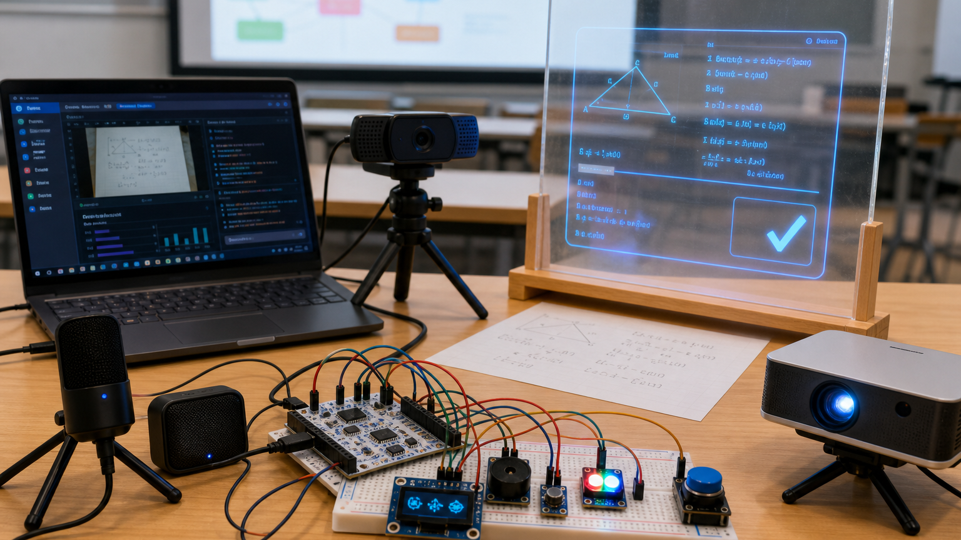
03
Testing & Validation
Testing & Validation
Notes:
<!--pageType:chapter-->

Slide 15
03 Testing & Validation
Testing Matrix & Exception Handling / Testing & Exception Handling
Functional Testing Matrix / Functional Testing Matrix
Test Item | Input | Expected | Result | C++ Class | Testing Purpose
Serial Port | /dev/ttyACM0 | Bi-directional data | ✓ Pass | SerialPort / HardwareBridge | Verify serial port encapsulation class, implementing command interaction between MCU and host computer
Camera | C270 USB | 1280×720 JPEG | ✓ Pass | OpenCvCameraService | Verify OpenCV image capture encapsulation, meeting real-time capture requirements
Voice Recording | 5s trigger | WAV file | ✓ Pass | ShellAudioRecorder | Verify audio I/O encapsulation, implementing hands-free voice input
ASR | WAV upload | Chinese text | ✓ Pass | QwenAsrService | Verify speech recognition, replacing manual text input
Qwen-VL | Image + text | JSON result | ✓ Pass | QwenVisionService | Verify large model API calls, implementing image-text joint analysis
Exception Handling / Exception Handling
• Serial port device change → Auto-scan /dev/ttyACM* and reconnect
• Camera unreadable → Capture exception, use the last cached frame
• ASR service failure → Degrade to text prompt input without interrupting the main process
• Network disconnection → Red LED flashing + OLED error code + Qt status bar prompt
• API timeout → Exponential backoff retry, up to 3 times
• Chinese encoding → Force UTF-8 end-to-end processing
16
Notes:
<!--pageType:content-->

Slide 16
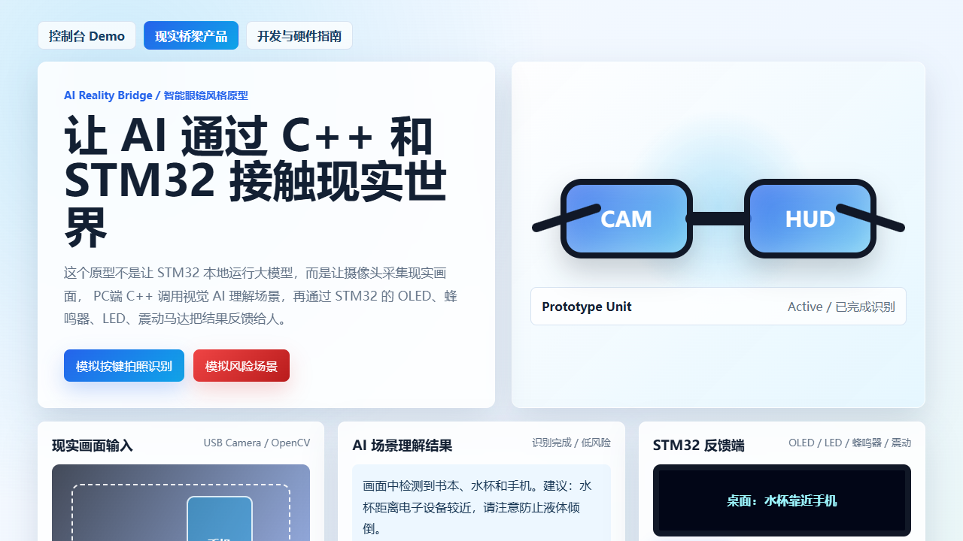
04
Conclusion & Team
Conclusion & Team
Notes:
<!--pageType:chapter-->

Slide 17
04 Conclusion & Team
Course Requirements & Team Mapping / Course Requirements & Team Mapping
Course Requirements Mapping / Course Requirements Mapping
Requirement | Implementation | Evidence
UI Interface | Qt 6 Windows Control Center + Raspberry Pi LCD local display | Screenshots + LCD photos
Classes & Objects | App, HardwareBridge, SerialPort, QwenVisionService, etc. | Class diagram + code
Inheritance & Polymorphism | CameraService/OpenCvCameraService, AiVisionService/QwenVisionService/MockAiVisionService | Inheritance graph
Random File I/O | AuditLogStore binary log: append, read, update-by-ID | Log file + history page
Code Scale | Bridge + NUCLEO firmware + Qt center, >2000 lines | Code statistics
Team Task Completion / Team Task Completion Table
Member | Backend | Qt UI | Embedded | AI API | Document
Member A | ✓ Completed | ✓ Completed | — | — | ✓ Completed
Member B | — | — | ✓ Completed | ✓ Completed | —
Member C | ✓ Completed | ✓ Completed | ✓ Completed | — | —
Member D | — | — | ✓ Completed | ✓ Completed | ✓ Completed
15
Notes:
<!--pageType:content-->

Slide 18
Thank You / Thank You For Listening
We built a closed-loop hardware-software-AI system that perceives, understands, and feeds back through multiple physical channels.
We built a hardware-software-AI closed-loop system: perceiving the environment, understanding content, and feeding back through multiple physical channels.
Future: Ditoo pixel screen · OCR enhancement · Packaged installer · Continuous conversation
Outlook: Ditoo Pixel Screen · OCR Text Recognition Enhancement · Packaged Installer · Continuous Conversation Support
Group 5 | C++ Programming | 2025.06
Notes:
<!--pageType:final-->

