Slide 1


Git-GitHub
1

Slide 2
Git
version control system (DVCS)
GitHub
repository site

Slide 3
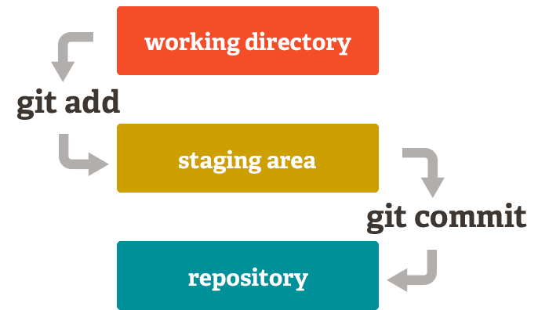
The Git-GitHub flow

Slide 4
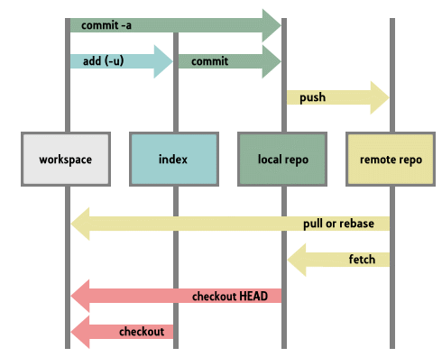
The Git-GitHub flow Cont’d ..

Slide 5
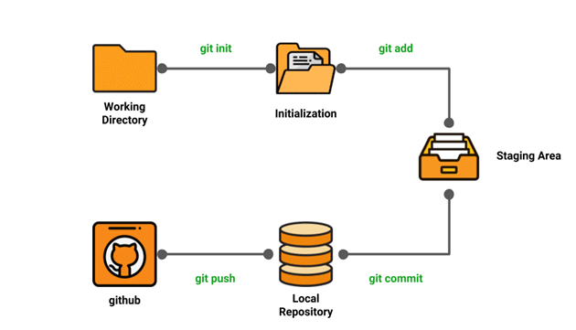
The Git-GitHub flow Cont’d ..

Slide 6

Installing Git & GitHub
1) Environment Setup
Create a GitHub account
Configure Git
Create a local repository
2) Creating a GitHub account
Go to https://Github.com
Create a GitHub account

Slide 7

--fast-version-control
https://git-scm.com/

Slide 8
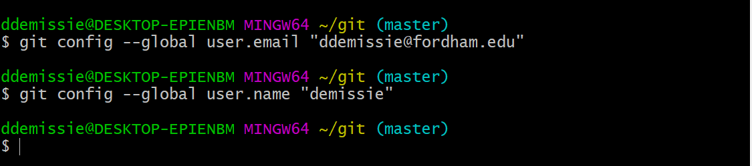
Configuring Git:
To tell Git who we are, run the following two commands:

Slide 9
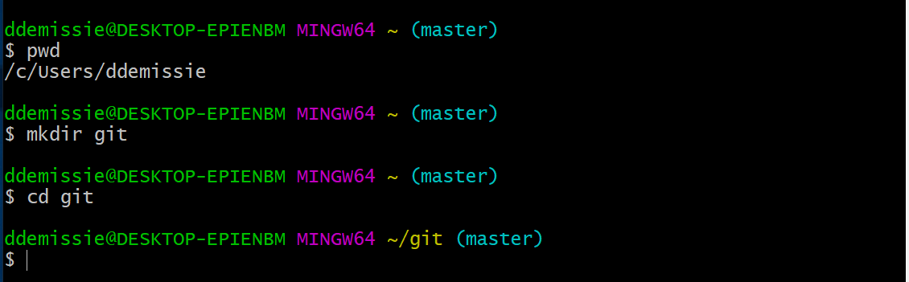
Creating a local repository

Slide 10

Common Git Commands
1) Local:
git init, git touch,
git status, git add,
git commit, and git rm
2) Remote:
git remote, git pull, and git push

Slide 11
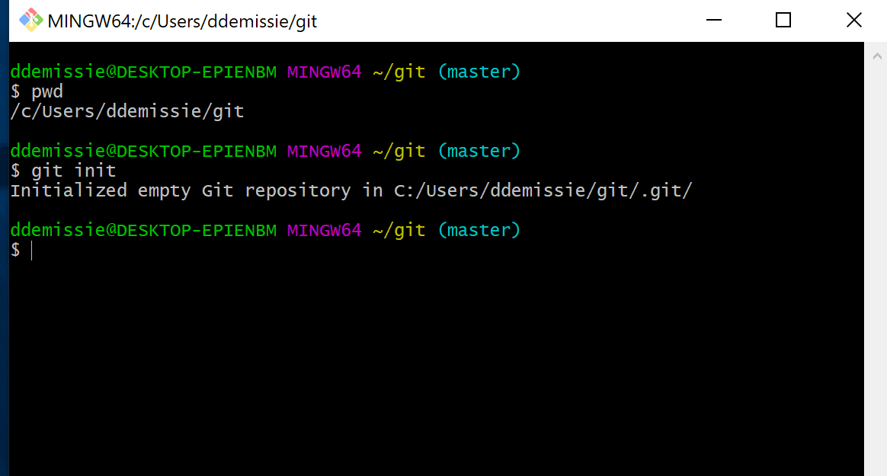
git init
We use the git init command to initialize a Git repository in the root of a folder.

Slide 12
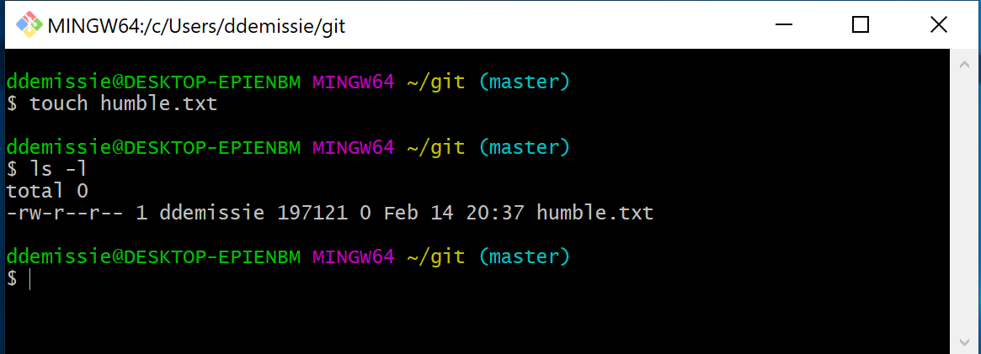
git touch

Slide 13
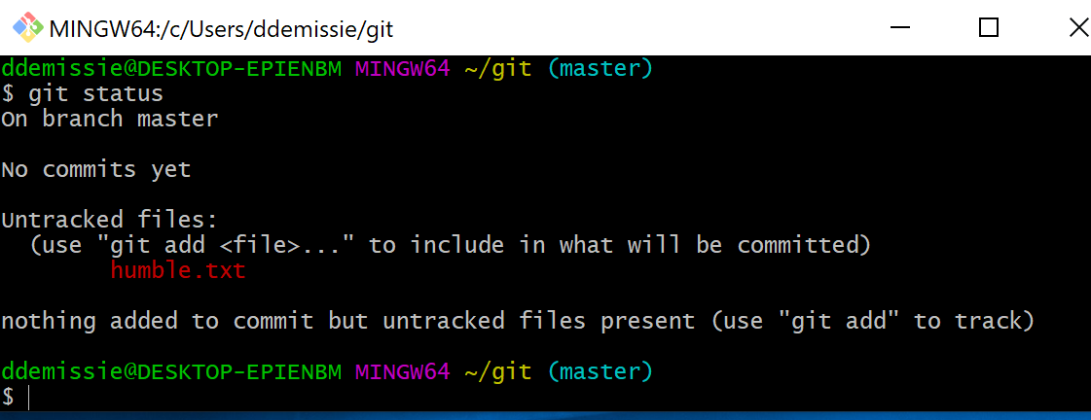
git status

Slide 14
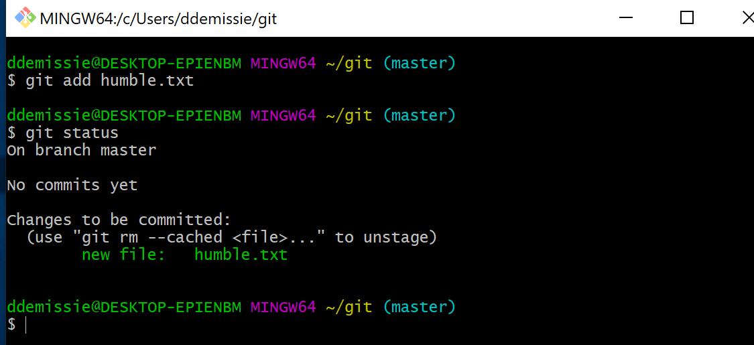
git add

Slide 15
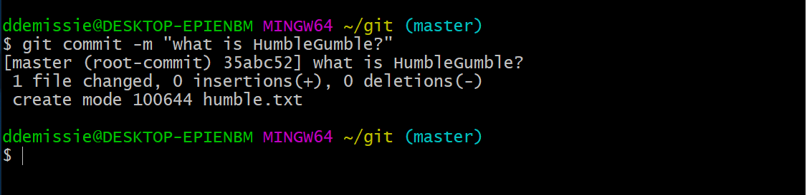
git commit

Slide 16
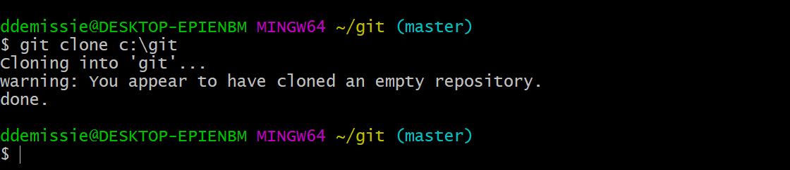
git clone

Slide 17

https://github.com/

Slide 18
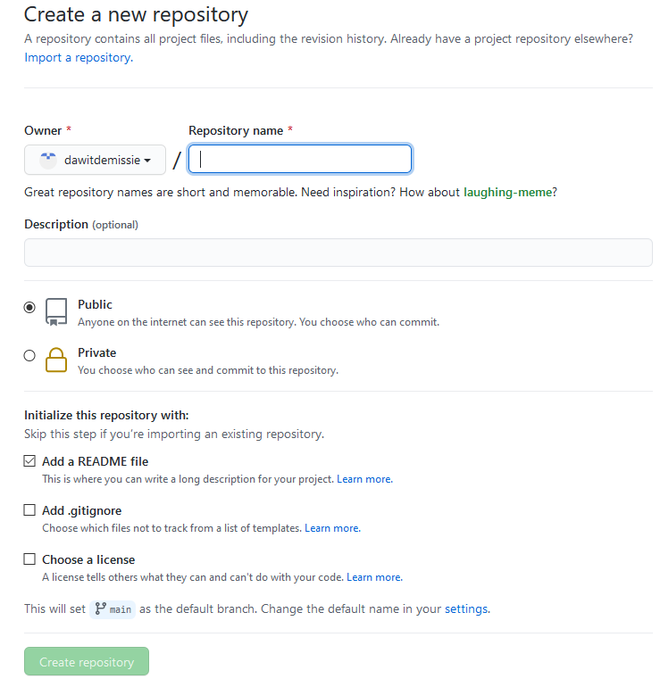
Remote Commands

Slide 19
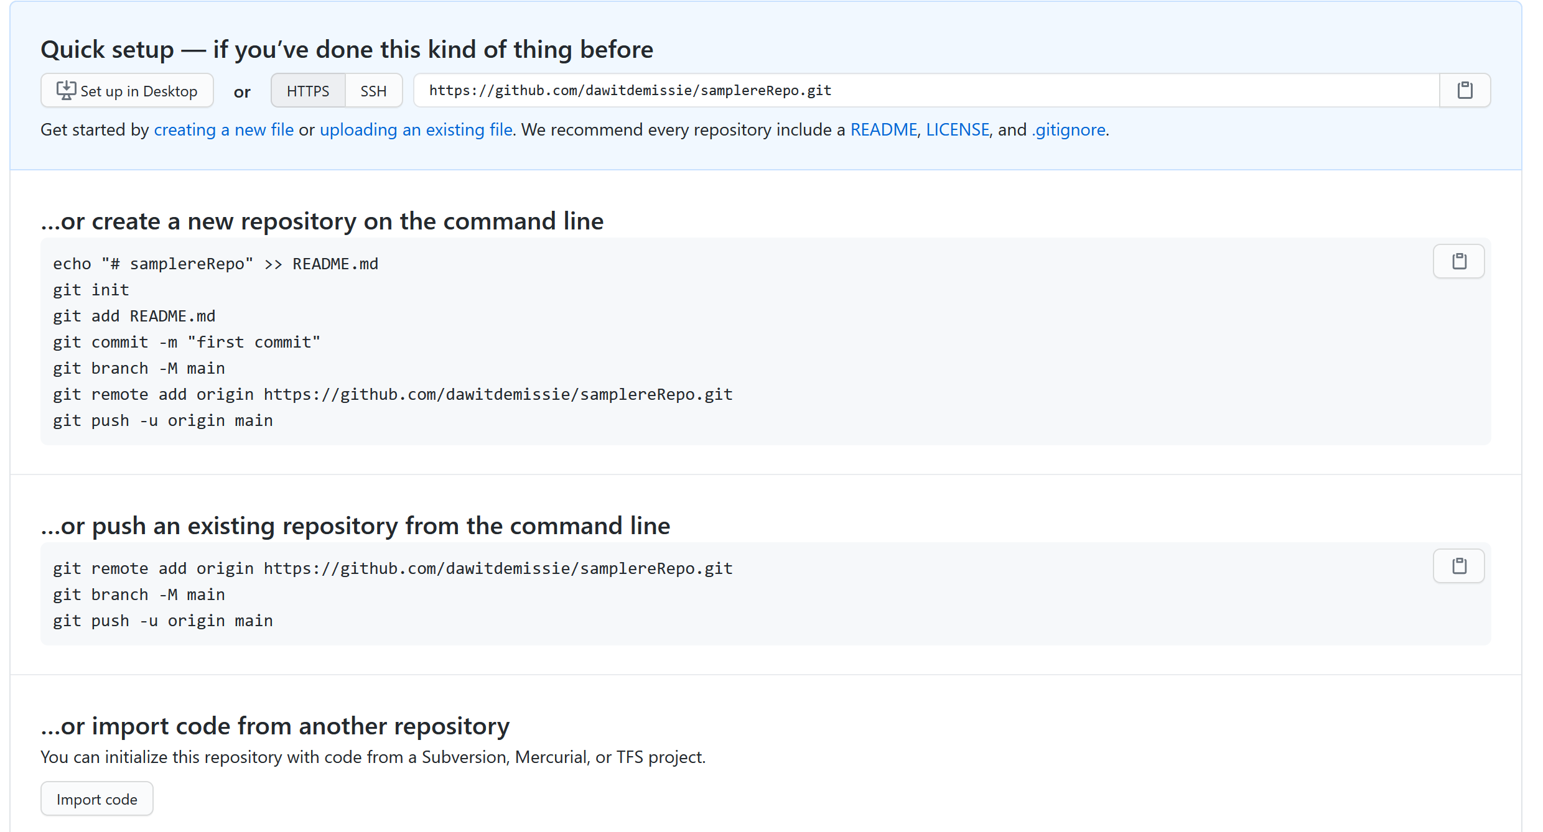
Remote Commands cont’d

Slide 20
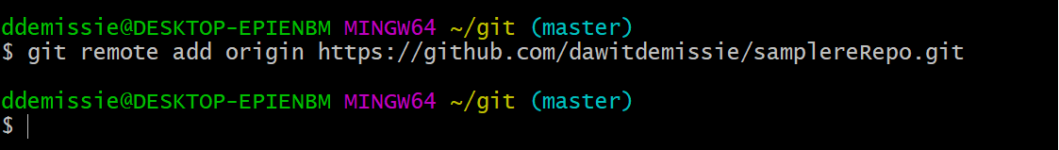
git remote

Slide 21
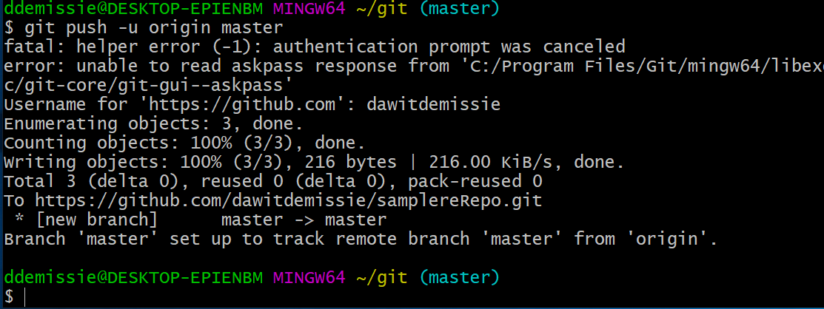
git push

Slide 22
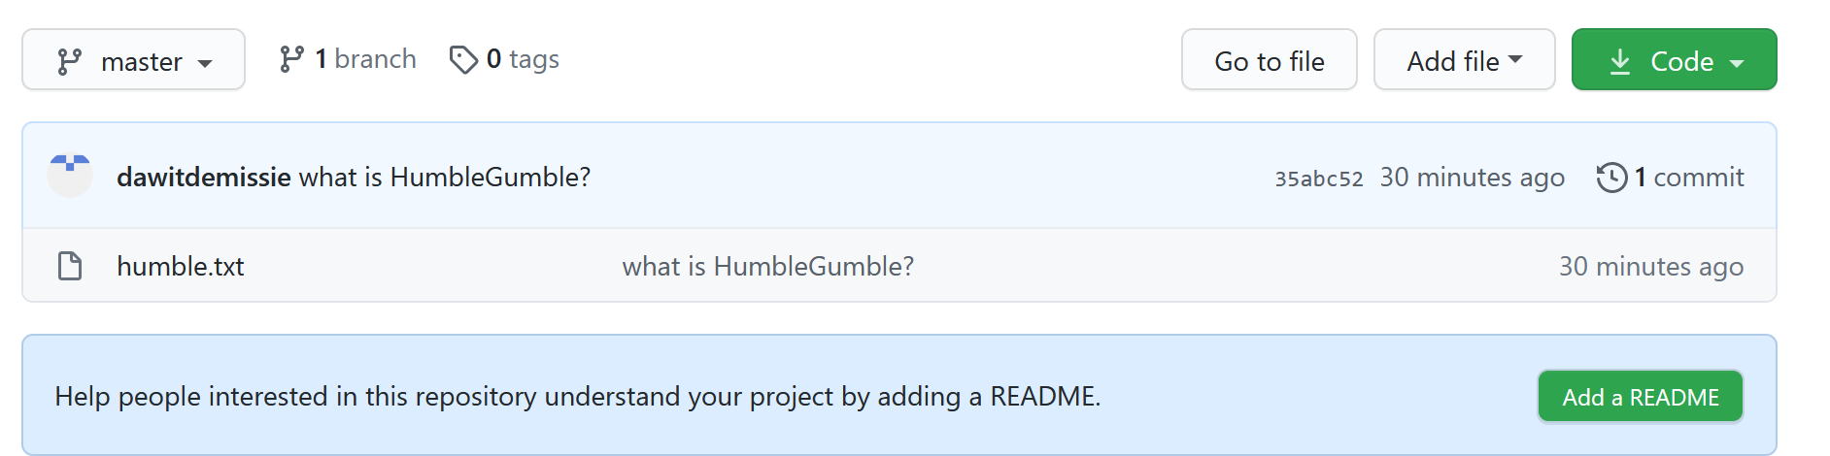
Now, let us look at our repository:

Slide 23
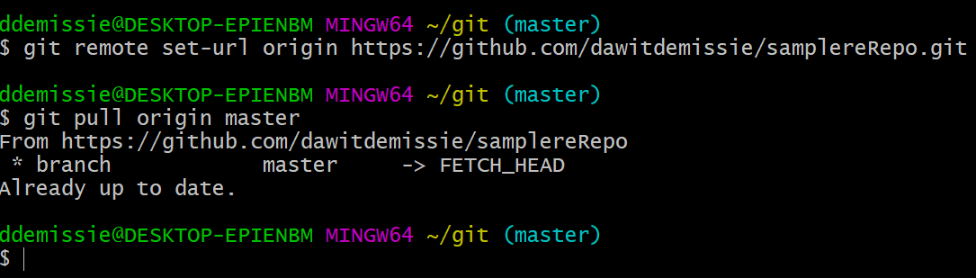
git pull

Slide 24
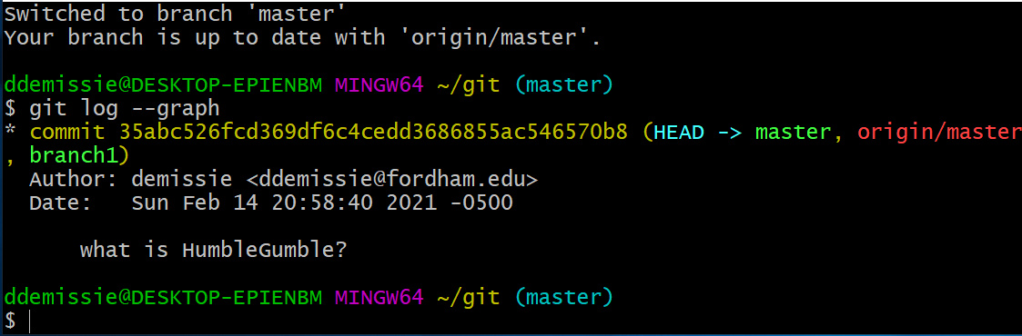
git log --graph

