Slide 1
Big Data Analytics
Lecture 1
1

Slide 2
pre-course survey
https://fordham.co1.qualtrics.com/jfe/form/SV_5suh0NZpQkzp0LY

Slide 3
About this class
This class is covers
introduction to the Big Data problem, current challenges, trends, and applications.
algorithms for Big Data analysis mining and learning algorithms that have been developed specifically to deal with large datasets.
technologies for Big Data management.
Big Data technology and tools, special consideration made to the Map-Reduce paradigm and the Hadoop ecosystem.
3

Slide 4
About this class
This class is NOT
a machine learning or data mining course.
a programming course (however, you need to know basic programming with Python and some basic commands in Linux.
4

Slide 5
Class Overview
Introduction to Hadoop and MapReduce programming
Hadoop overview
Framework / architecture
Cloud computing (Amazon AWS)
Data management
Hbase, hive, pig, sqoop, kafka
5

Slide 6
Class Overview –cont’d
Data analytics
Association rule mining
Clustering
Recommender system
Topic modeling
Social network analysis
Algorithm level
(not just the terminology)
6

Slide 7




Textbooks
Recommend you read the following books:
7

Slide 8
Labs
Configuration and installation of Hadoop
Data management (HQL)
Spark practice
ML practices (multiple!)

Slide 9
Assignments
4 assignments (all of them require programming)
Basic MapReduce programming
Data management
Frequent Itemset Mining
k-means clustering
Recommendation System
Social network analysis
Two of these topics

Slide 10
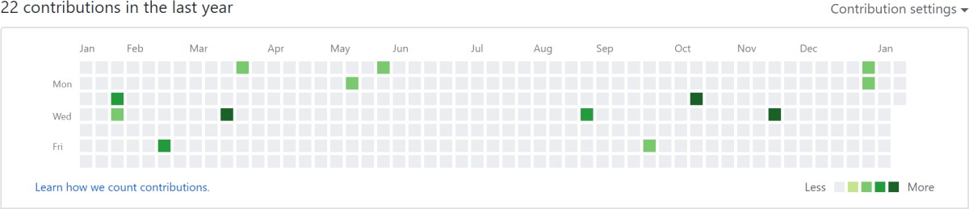
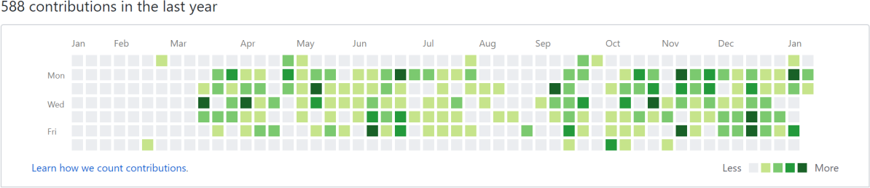
Start to use GitHub
Goal: to have at least 4 commits by the end of the semester
For MSBA: use it as your extended resume

Slide 11
Project
Proposal presentation. Maximum 6 PPT pages of project proposal, dataset, business problem, data processing, models and (optional) expected outcomes.
Final Presentation. There will be 1 presentation during the last class in the semester, major results are expected during the presentation.
Report. Maximum 15-page report (double-space, 12-point font) highlighting consisting on the traditional sections of introduction, motivation, method, results, and conclusion.
Confidential peer-evaluation form. You will evaluate the contribution of each of your group members.
Assigning students to groups (randomly pre-assigned groups)

Slide 12
Big Data Overview

Slide 13
Learning Outcomes
Identify Big Data and its Business Implications.
Understand the Big Data Platform and its Use cases

Slide 14
Why Big Data?
The U.S. could face a shortage by 2018 of 140,000 to 190,000 people with "deep analytical talent" and of 1.5 million people capable of analyzing data in ways that enable business decisions. (McKinsey & Co)
Science
Engineering
Business
In 2012, the Obama administration announced the Big Data Research and
Development Initiative 84 different big data programs spread across six departments.
Walmart handles more than 1 million customer transactions every hour, which is imported into databases estimated to contain more than 2.5 petabytes of data.
Facebook handles 40 billion photos from its user base.
Falcon Credit Card Fraud Detection System protects 2.1 billion active accounts world- wide.
Healthcare
…

Slide 15

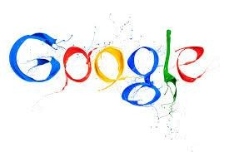





Big data is everywhere…
processed about 24 petabytes of
data per day in 2009.
transfers about 30 petabytes of data through its networks each day.
By 2012, LHC collision data was being produced at approximately 25 petabytes per year.
Twitter now sends and receives as many as 200 million “tweets” every day.
As of January 2013, Facebook users had uploaded over 240 billion photos, with 350 million new photos every day.
S3: 449B objects, peak 290k
request/second (7/2011) 1T objects (6/2012)
150 PB on 50k+ servers running 15k apps (6/2011)

Slide 16
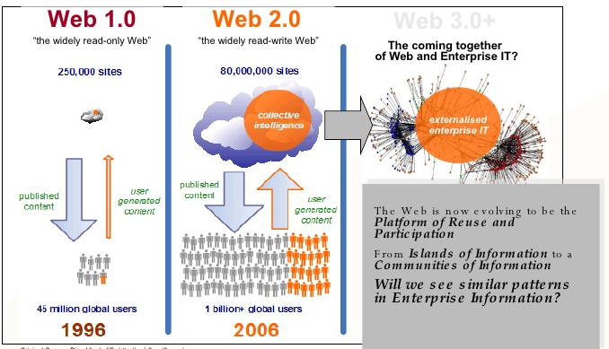
Big data is everywhere cont’d

Slide 17

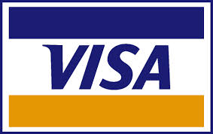















A Single View to the Customer
Social Media
Banking
Finance
Gaming
Our
Known
History
Customer
Entertain
Purchase

Slide 18

5 Vs of Big Data
To get better understanding of what big data is, it is often described using 5 Vs.
Variety
Volume
Veracity
Velocity
Value

Slide 19








We see increasing volume of data, that grow at exponential rates
Volume refers to the vast amount of data generated every second.We are not talking about Terabytes but Zettabytes or Brontobytes. If we take all the data generated in the world between the beginning of time and 2008, the
Variety
Volume
same amount of data will soon be generated every minute.This makes most data sets too large to store and analyze using traditional database technology. New big data tools use distributed systems so we can store and analyze data across databases that are dotted around everywhere in the world.
Veracity
Velocity
Value

Slide 20
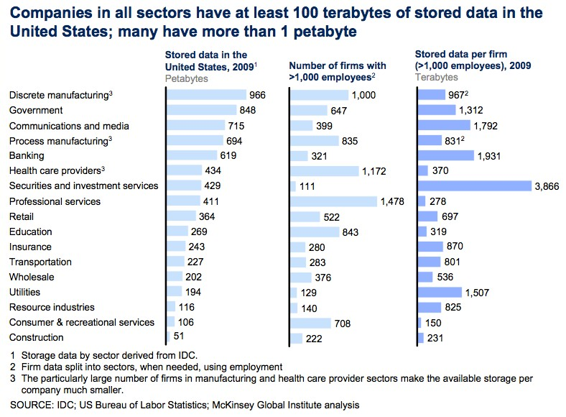
Big data is more prevalent than you think

Slide 21








We see increasing velocity (or speed)
at which data changes, travels, or increases
Velocity refers to the speed at which new data is generated and the speed at which data moves around.
Variety
Volume
Just think of social media messages going viral in seconds.Technology now allows us to analyze the data while it is being generated (sometimes referred to as it in- memory analytics), without ever putting into databases.
Veracity
Velocity
Value

Slide 22
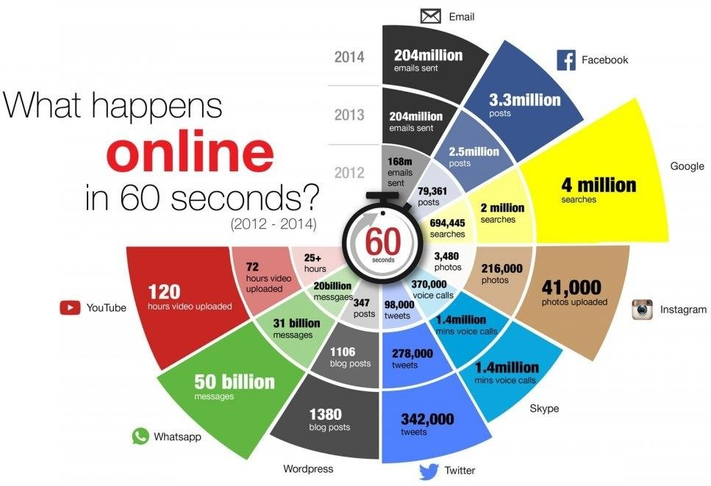
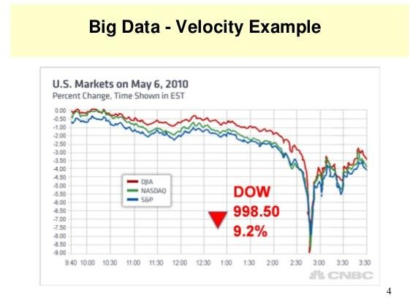
Stream Data and Real Time Data

Slide 23








We see increasing variety of data types
Variety refers to the different types of data we can now use. In the past we only focused on structured data that neatly
fitted into tables or relational databases, such as financial data. In fact, 80% of world’s data is unstructured (text, images, video, voice, etc.).With big data technology we can now analyze and bring together data of different types such as messages, social media conversations, photos, sensor data, video or voice recordings.
Variety
Volume
Veracity
Velocity
Value
BUDT 758
21

Slide 24
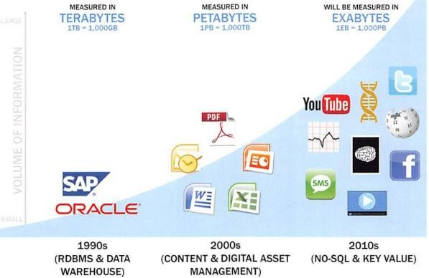
Data Evolution & Rise of Big Data Sources

Slide 25
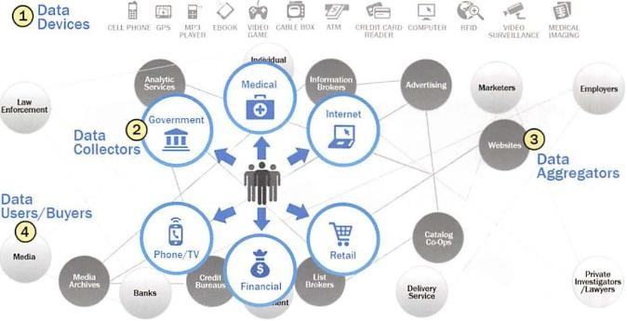
Emerging Big Data Ecosystem

Slide 26








We see increasing veracity (or accuracy) of data
Veracity refers to messiness or trustworthiness of data.With many forms of big data quality and
Variety
Volume
accuracy are less controllable (just think Twitter posts with hash tags, abbreviations, typos and colloquial speech as well as the reliability and accuracy of content) but technology now allows us to work with this type of data.
Veracity
Velocity
Value

Slide 27







Value – the most important V of all
There is another V to take into account when looking at big data: Value.
Having access to big data is no good unless we can turn it into value.
Companies are starting to generate amazing value from their big data.
Variety
Volume
Veracity
Velocity
Value

Slide 28
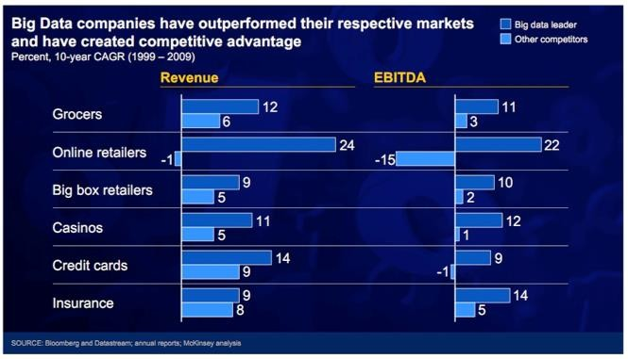
Competitive advantages gained through big data

Slide 29
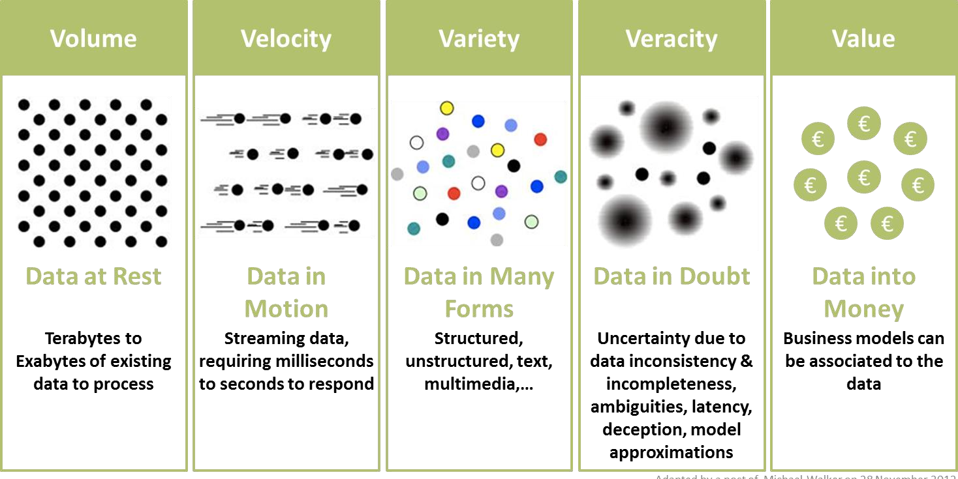
To Summarize

Slide 30
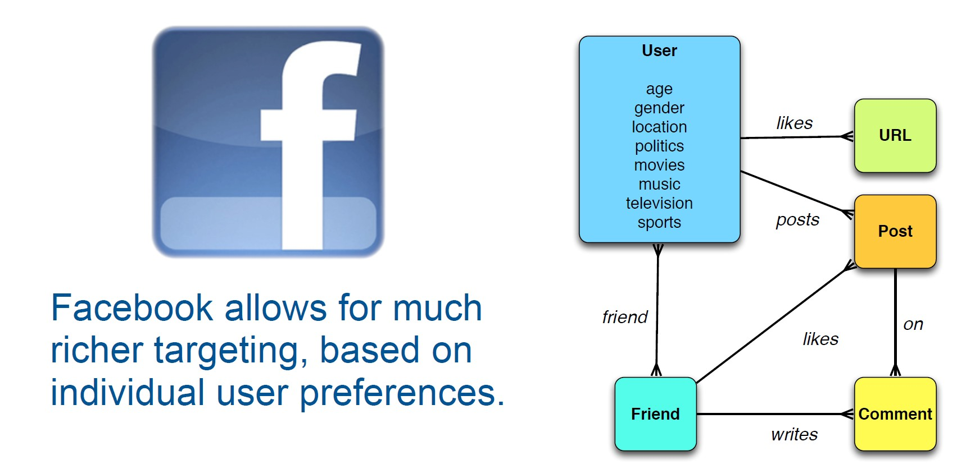


Facebook
Source:
What you like tells me who you are

Slide 31
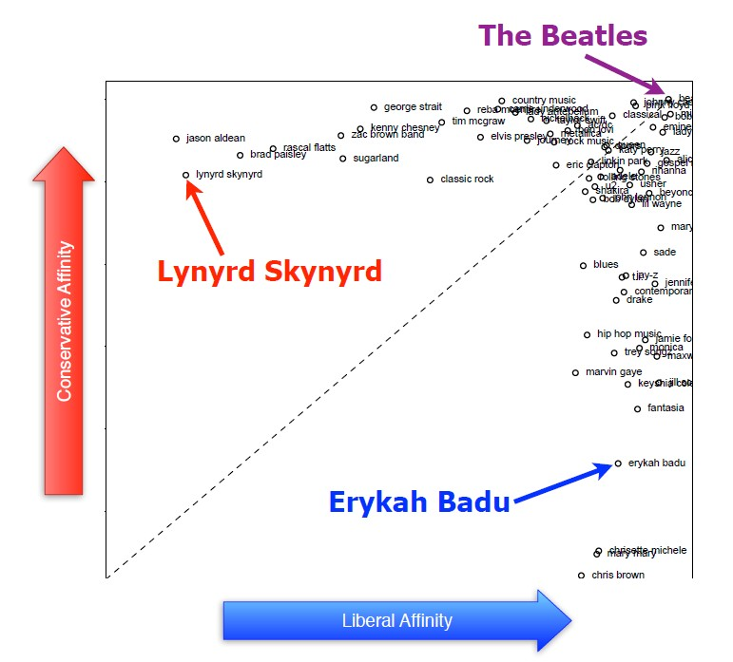
What music you like tells me who you are
Source:

Slide 32

Facebook 'likes' serve as personality test

Slide 33
Applications, data, and corresponding commonly used analytical techniques

Slide 34

1. E-Commerce and marketing intelligence
Applications
Recommender systems
Social media monitoring and analysis
Crowd-sourcing systems
Data
Search and user logs
Customer transaction records
Customer generated content
34

Slide 35
2. E-Government and Politics 2.0
Applications
Ubiquitous government services
Equal access and public services
Citizen engagement and participation
Political campaign and e-polling
Data
Government information and services
Rules and regulations
Citizen feedback and comments
35

Slide 36


Applications
3. Science & Technology
S&T innovation
Hypothesis testing
Knowledge discovery
Data
S&T instruments and system generated data
Sensor and network content
36

Slide 37


4. Smart Health and Wellbeing
Applications
Human and plant genomics
Healthcare decision support
Patient community analysis
Data
Genomics and sequence data
Electronic medical records (EMR)
Health and patient social media
37

Slide 38
5. Security and Public Safety
Applications
Crime analysis
Computational criminology
Terrorism informatics
Open-source intelligence
Cyber security
Data
Criminal records
Crime maps
Criminal networks
News and web contents
Terrorism incident databases
Viruses, cyber attacks, and botnets
38

Slide 39
Typical applications in big data

Slide 40
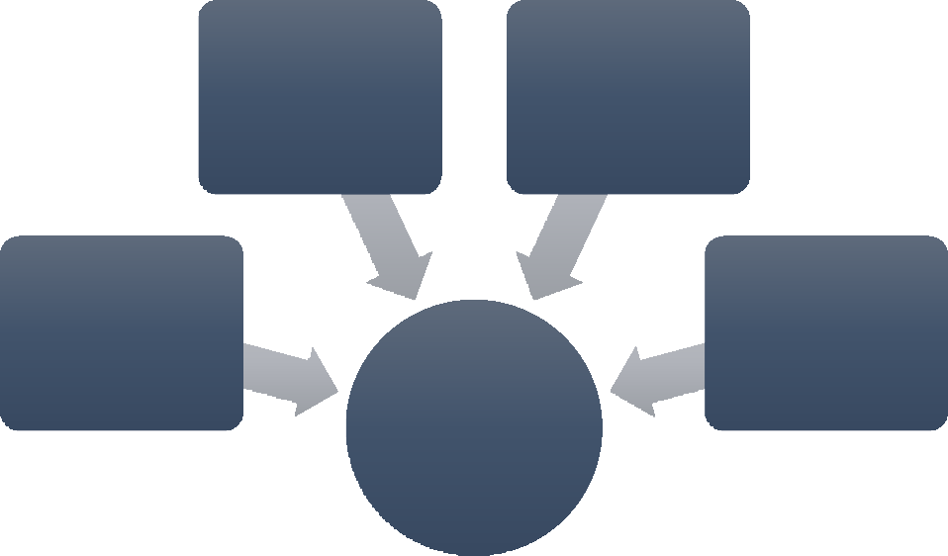
1. Understanding and targeting customers
Big data is used to better understand customers and their behaviors and preferences.
Target: very accurately predict when one of their customers will expect a baby
Wal-Mart can predict what products will sell
Car insurance companies understand how well their customers actually drive
Obama use big data analytics to win 2012
presidential election campaign
Browser logs
Sensor data
Social media data
Text analytics
Predictive models

Slide 41
2. Understanding and optimizing business processes
Retailers are able to optimize their stock based on predictions generated from social media data, web search trends, and weather forecasts;
Geographic positioning and radio frequency identification sensors are used to track goods or delivery vehicles and optimize routes by integrating live traffic data, etc.

Slide 42
3. Personal quantification and performance optimization
The Jawbone armband collects data on our calorie consumption, activity levels, and our sleep patterns and analyze such volumes of data to bring entirely new insights that it can feed back to individual users;
Most online dating sites apply big data tools and algorithms to find us the most appropriate matches.

Slide 43
4. Improving healthcare and public health
Big data techniques are already being used to monitor babies in a specialist premature and sick baby unit;
Big data analytics allow us to monitor and predict the developments of epidemics and disease outbreaks;
By recording and analyzing every heart beat and breathing pattern of every baby, infections can be predicted 24 hours before any physical symptoms appear.

Slide 44
5. Improving sports performance
Use video analytics to track the performance of every player;
Use sensor technology in sports equipment to allow us to get feedback on games;
Use smart technology to track athletes outside of the sporting environment: nutrition, sleep, and social media conversation.

Slide 45

6. Improving science and research
CERN, the Swiss nuclear physics lab with its Large Hadron Collider, the world’s largest and most powerful particle accelerator is using thousands of computers distributed across 150 data centers worldwide to unlock the secrets of our universe by analyzing its 30 petabytes of data.

Slide 46
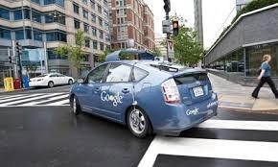
7. Optimizing machine and device performance
Google self-driving car: the Toyota Prius is fitted with cameras, GPS, powerful computers and sensors to safely drive without the intervention of human beings;
Big data tools are also used to optimize energy grids using data from smart meters.

Slide 47
8. Improving security and law enforcement
National Security Agency (NSA) in the U.S. uses big data analytics to foil terrorist plots (and maybe spy on us);
Police forces use big data tools to catch criminals and even predict criminal activity;
Credit card companies use big data to detect fraudulent transactions.

Slide 48
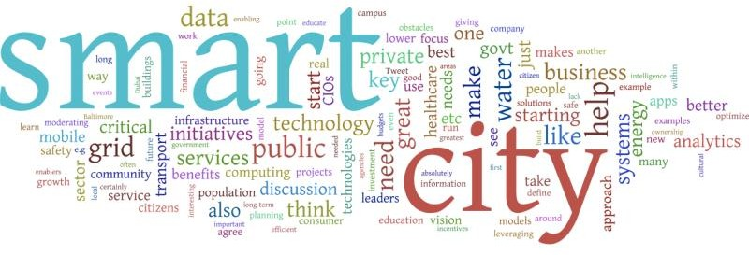
9. Improving and optimizing cities and countries
Smart cities optimize traffic flows based on real time traffic information as well as social media and weather data.

Slide 49
10. Financial trading
The majority of equity trading now takes place via data algorithms that increasingly take into account signals from social media networks and news websites to make, buy and sell decisions in split seconds (High-Frequency Trading, HFT).

Slide 50
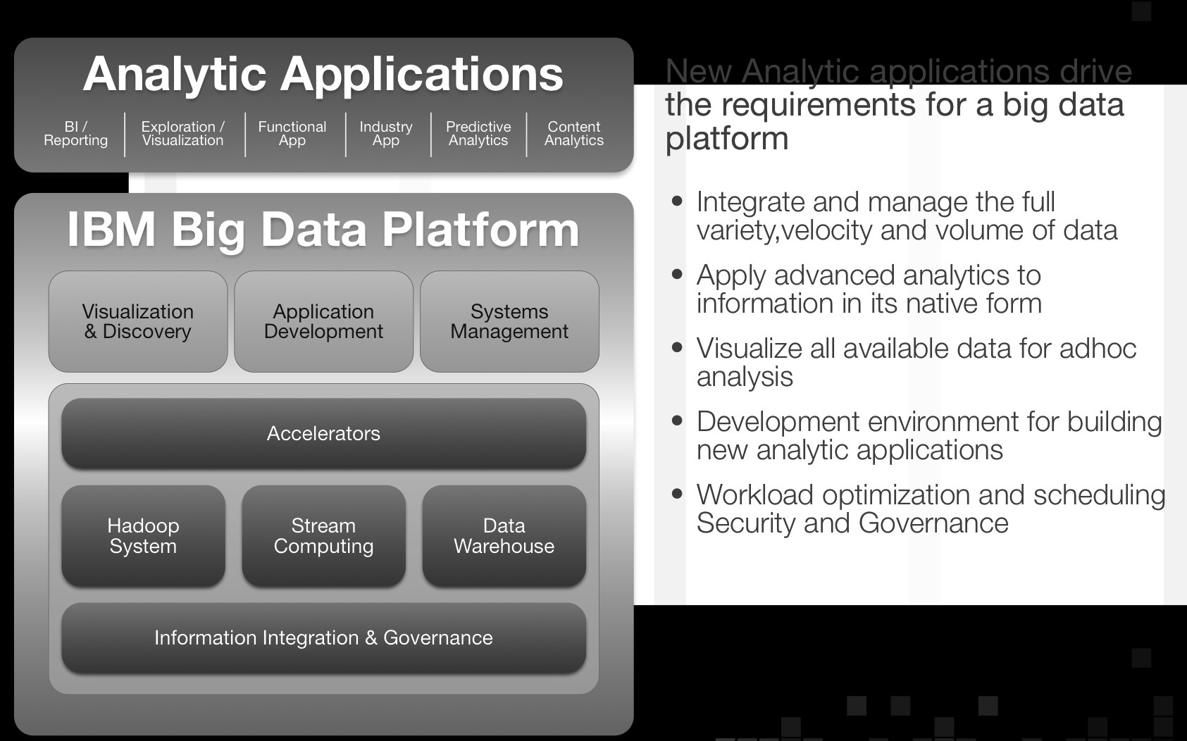
Big Data Platforms
56

Slide 51

Amazon EC2
Elastic MapReduce
DynamoDB

Slide 52
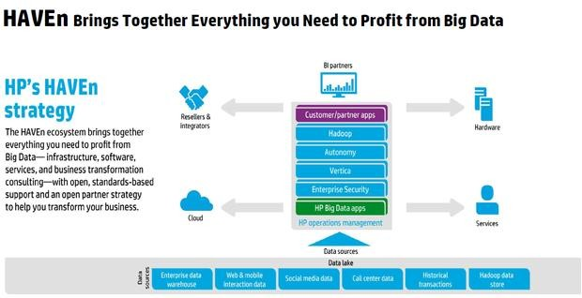
HP HAVEn

Slide 53
Using Hadoop
Java language
High-level languages on top of Hadoop
Hive (Facebook)
A data warehouse system for Hadoop that facilitates easy data summarization, ad-hoc queries, and the analysis of large datasets stored in Hadoop compatible file systems
Provides a mechanism to project structure onto this data and query the data using a
SQL-like language called HiveQL
It also allows traditional map/reduce programmers to plug in their custom mappers and reducers when it is inconvenient or inefficient to express this logic in HiveQL

Slide 54
Pig (Yahoo)
A platform for analyzing large data sets that consists of a high-level language for expressing data analysis programs, coupled with infrastructure for evaluating these programs
Jaql (IBM)
Primarily a query language for JavaScript Object Notation (JSON), but supports more than just JSON. It allows you to process both structured and nontraditional data
60

Slide 55
Big data analysis pipelines

Slide 56
Phase #1
Data acquisition and recording
Filters: not discard useful data and not store irrelevant data
Metadata: describe what data is recorded and how it is recorded and measured
Data provenance: data quality

Slide 57
Phase #2
Information extraction and cleaning
Raw data in different formats
Inaccurate data due to many reasons

Slide 58
Phase #3
Data integration, aggregation, and representation
Database techniques: NoSQL DB

Slide 59
Phase #4
Query processing, data modeling, and analysis
Data mining techniques
Statistical modeling
Query, indexing, searching techniques

Slide 60
Phase #5
Interpretation
Report
Visualization

Slide 61
Questions?

