Slide 1

Big Data Analytics
Lecture 2
Hadoop
1

Slide 2
What we’ll cover…
Hadoop history and advantages
Architecture
Hadoop distributed file system (HDFS)
Hands-on Preparation for Cloudera environment
Installation of GitHub – Lab 2
2

Slide 3

Brief History of Hadoop
Designed to answer the question:
“How to process big data with reasonable cost and time?”

Slide 4

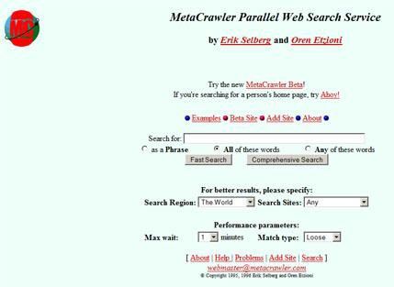



Search engines in 1990s
1996
1996
1996

Slide 5
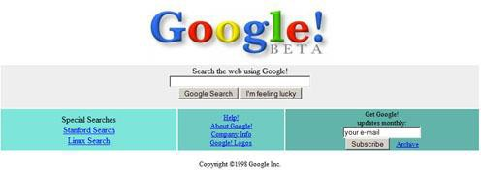

Google search engines
1998
2013

Slide 6
Early Large Scale Computing
Historically computation was processor-bound
Data volume has been relatively small
Complicated computations are performed on that data
Advances in computer technology has historically centered around improving the power of a single machine

Slide 7
Distributed System: Problems
“You know you have a distributed system when the crash of a computer you’ve never heard of stops you from getting any work done.” –Leslie Lamport
Distributed systems must be designed with the expectation of failure

Slide 8
Component Recovery
If a component fails, it should be able to recover without restarting the entire system
Component failure or recovery during a job must not affect the final output

Slide 9
Hadoop
Based on work done by Google in the early 2000s
“The Google File System” in 2003
“MapReduce: Simplified Data Processing on Large Clusters” in 2004
The core idea was to distribute the data as it is initially stored
Each node can then perform computation on the data it stores without moving the data for the initial processing

Slide 10



Hadoop’s Developers
2005: Doug Cutting and Michael J. Cafarella developed Hadoop to support distribution for the Nutch search engine project.
The project was funded by Yahoo.
2006: Yahoo gave the project to Apache Software Foundation.

Slide 11


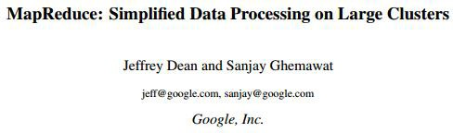

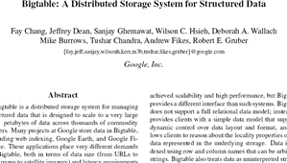

Google Origins
2003
2004
2006

Slide 12
Some Hadoop Milestones
2008 - Hadoop Wins Terabyte Sort Benchmark (sorted 1 terabyte of data in 209 seconds,
compared to previous record of 297 seconds)
2009 - Avro and Chukwa became new members of Hadoop Framework family
2010 - Hadoop's Hbase, Hive and Pig subprojects completed, adding more computational power to Hadoop framework
2011 - ZooKeeper Completed
2013 - Hadoop 1.1.2 and Hadoop 2.0.3 alpha.
- Ambari, Cassandra, Mahout have been added

Slide 13
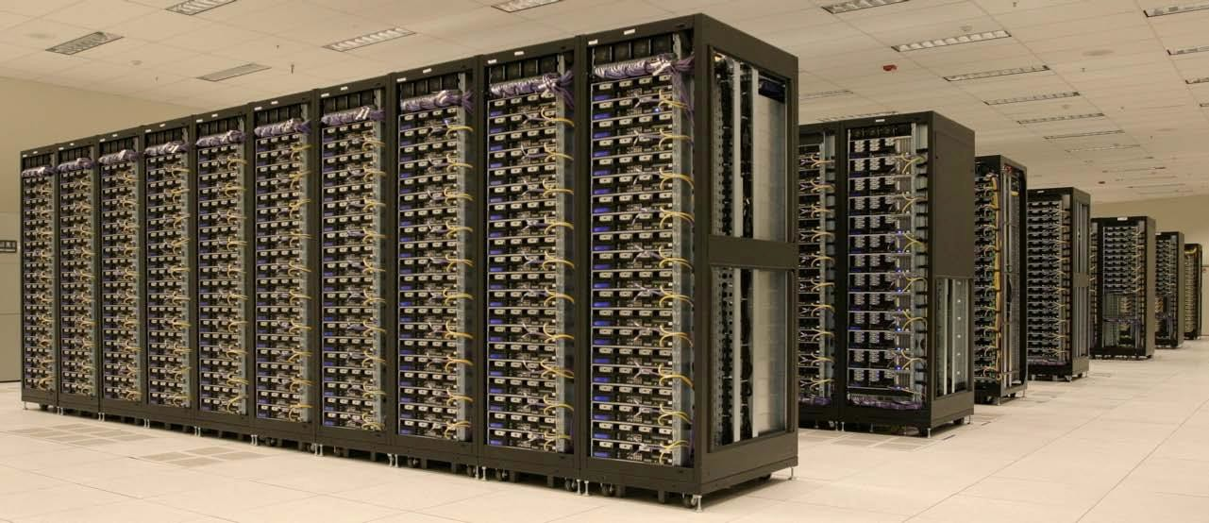
One popular solution: Hadoop
Hadoop Cluster at Yahoo!
13

Slide 14

Hadoop in the Wild
Hadoop is in use at most organizations that handle big data:
Yahoo!
Facebook
Amazon
Netflix
Etc…
Some examples of scale:
Yahoo!’s Search Webmap runs on 10,000 core Linux cluster and powers Yahoo! Web search
FB’s Hadoop cluster hosts 100+ PB of data (July, 2012) & growing at ½ PB/day (Nov,
2012)

Slide 15
Three main applications of Hadoop
Advertisement (Mining user behavior to generate recommendations)
Searches (group related documents)
Security (search for uncommon patterns)

Slide 16
Big data storage is challenging
Data volumes are massive
Reliability of storing PBs of data is challenging
All kinds of failures: Disk/Hardware/Network Failures
Probability of failures simply increase with the number of machines …
16

Slide 17
How much data?
Facebook
500 TB per day
Yahoo
Over 170 PB
eBay
Over 6 PB
Getting the data to the processors becomes the bottleneck

Slide 18

Hadoop offers
Redundant, Fault-tolerant data storage
Parallel computation framework
Job coordination
18

Slide 19



Hadoop offers
Redundant, Fault-tolerant data storage
Parallel computation framework
Job coordination
Q: Where file is
located?
No longer need to worry about
Q: How to handle failures & data lost?
Q: How to divide computation?
Programmers
Q: How to program for scaling?
19

Slide 20














Who uses Hadoop?
Social
User Tracking &
Engagement
Homeland Security
eCommerce
Financial Services
Real Time Search
20

Slide 21
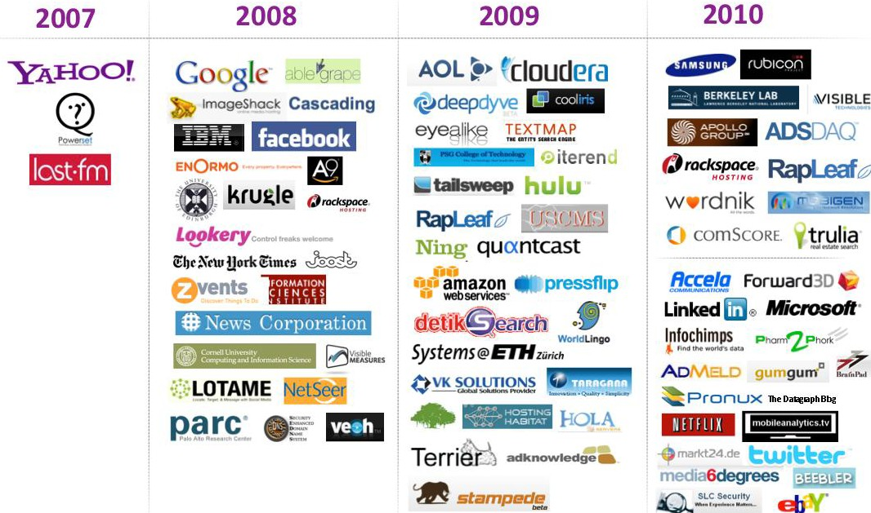

Who uses Hadoop?
21

Slide 22
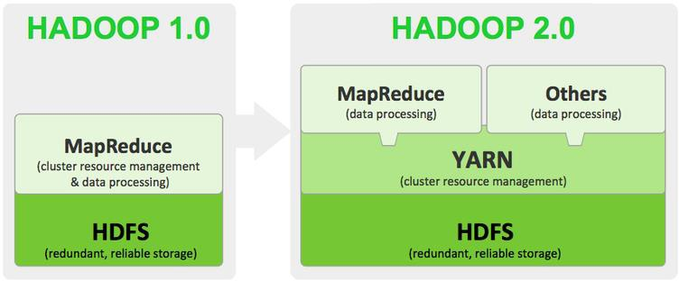
Hadoop big picture
MapReduce: Programming YARN: Resource Scheduling Hadoop: Data Management
HDFS + MapReduce is core to get work done
22

Slide 23
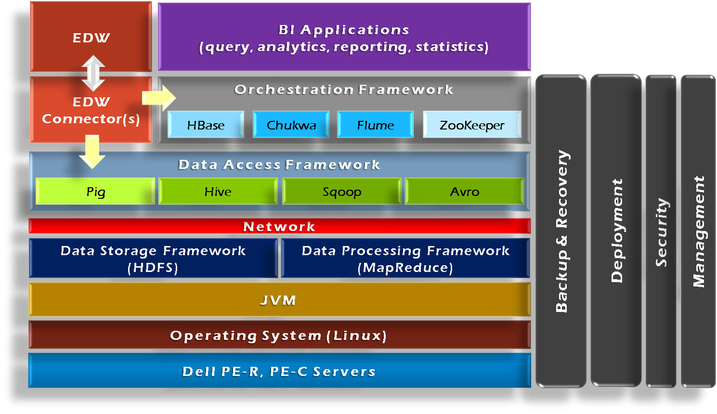
Hadoop Framework Tools

Slide 24
Hadoop goals
Scalable: Petabytes (10¹⁵ Bytes) of data on thousands on nodes
Economical: Commodity components only
Reliable: fault tolerance
24

Slide 25
Hadoop Distributed File System (HDFS)

Slide 26
Overview
Responsible for storing data on the cluster
Data files are split into blocks and distributed across the nodes in the cluster
Each block is replicated multiple times

Slide 27
HDFS Basic Concepts
HDFS is a file system written in Java based on the Google’s GFS
Provides redundant storage for massive amounts of data

Slide 28
HDFS
Master-Slave architecture
Single NameNode
Sometimes a backup: secondary NameNode
Many (Thousands) DataNodes
Files are split into fixed sized blocks and stored on data nodes (default: 64MB)
Data blocks are replicated for fault tolerance and fast access (default: 3)
28

Slide 29
HDFS Basic Concepts
HDFS works best with a smaller number of large files
Millions as opposed to billions of files
Typically 100MB or more per file
Files in HDFS are write once
Optimized for streaming reads of large files and not random reads

Slide 30
How are Files Stored
Files are split into blocks
Blocks are split across many machines at load time
Different blocks from the same file will be stored on different machines
Blocks are replicated across multiple machines
The NameNode keeps track of which blocks make up a file and where they are stored

Slide 31
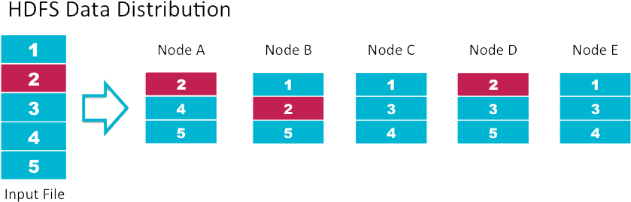
Data Replication
Default replication is 3-fold

Slide 32
Hadoop’s Architecture
NameNode:
Stores metadata for the files, like the directory structure of a typical FS.
The server holding the NameNode instance is quite crucial, as there is only one.
Transaction log for file deletes/adds, etc. Does not use transactions for whole blocks or file-streams, only metadata.
Handles creation of more replica blocks when necessary after a DataNode failure

Slide 33
Hadoop’s Architecture
DataNode:
Stores the actual data in HDFS
Can run on any underlying filesystem (ext3/4, NTFS, etc)
Notifies NameNode of what blocks it has
NameNode replicates blocks 2x in local rack, 1x elsewhere

Slide 34
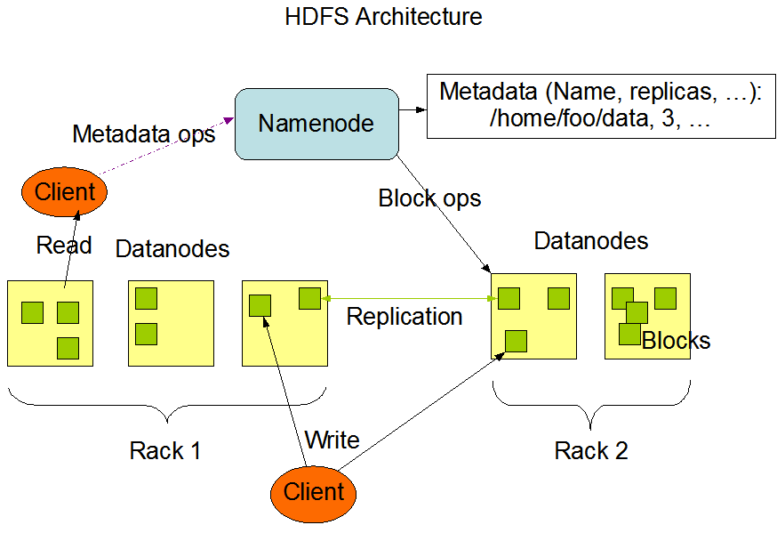
Hadoop architecture
34

Slide 35
Data Retrieval
When a client wants to retrieve data
Communicates with the NameNode to determine which blocks make up a file and on which data nodes those blocks are stored
Then communicated directly with the data nodes to read the data

Slide 36
MapReduce
Distributing computation across nodes

Slide 37
MapReduce Overview
A method for distributing computation across multiple nodes
Each node processes the data that is stored at that node
Consists of two main phases
Map
Reduce

Slide 38
MapReduce Features
Automatic parallelization and distribution
Fault-Tolerance
Provides a clean abstraction for programmers to use

Slide 39
The Mapper
Reads data as key/value pairs
The key is often discarded
Outputs zero or more key/value pairs

Slide 40
Shuffle and Sort
Output from the mapper is sorted by key
All values with the same key are guaranteed to go to the same machine

Slide 41
The Reducer
Called once for each unique key
Gets a list of all values associated with a key as input
The reducer outputs zero or more final key/value pairs
Usually just one output per input key

Slide 42
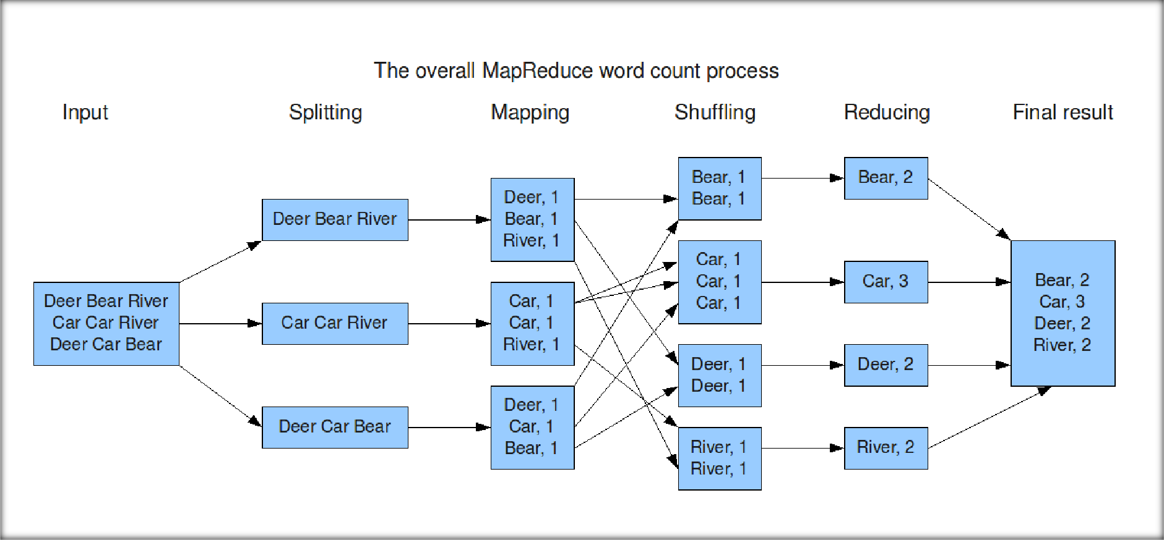
MapReduce: Word Count

Slide 43
Hadoop Architecture

Slide 44
What parts actually make up a Hadoop cluster
NameNode
Holds the metadata for the HDFS
Secondary NameNode
Performs housekeeping functions for the NameNode
DataNode
Stores the actual HDFS data blocks
JobTracker
Manages MapReduce jobs
TaskTracker
Monitors individual Map and Reduce tasks

Slide 45
JobTracker and TaskTracker
JobTracker
Determines the execution plan for the job
Assigns individual tasks
TaskTracker
Keeps track of the performance of an individual mapper or reducer

Slide 46
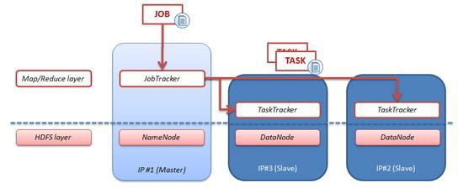
High-level architecture of Hadoop
47

Slide 47
Hadoop’s Architecture
Hadoop Distributed Filesystem
Tailored to needs of MapReduce
Targeted towards many reads of filestreams
Writes are more costly
High degree of data replication (3x by default)
No need for RAID on normal nodes
Large blocksize (64MB)
Location awareness of DataNodes in network

Slide 48
Hadoop’s Architecture
Distributed, with some centralization
Main nodes of cluster are where most of the computational power and storage of the system lies
Main nodes run TaskTracker to accept and reply to MapReduce tasks, and also DataNode to store needed blocks closely as possible
Central control node runs NameNode to keep track of HDFS directories & files, and JobTracker to dispatch compute tasks to TaskTracker
Written in Java, also supports Python and Ruby

Slide 49




HDFS network topology
HDFS takes a simple approach:
See the network as a tree
Distance between two nodes is the sum of their distances to their closest common
ancestor
Rack 1
Rack 2
Rack 3
Rack 4
n1
n3
n5
n7
n2
n4
n6
n8
Data center 1
Data center 2
50

Slide 50
HDFS filesystem commands
List the contents of a directory
hadoop fs -ls
Create a directory in HDFS at given path(s)
hadoop fs -mkdir <directory name>
Upload and download a file in HDFS
Upload: hadoop fs -put <local file> <remote path>
Download: hadoop fs -get <file in HDFS> <local path>
See contents of a file
hadoop fs -cat <filename>
Delete a file/directory in HDFS
hadoop fs -rm/rmr <file or directory>
51

Slide 51
HDFS filesystem commands
Move file from source to destination
hadoop fs -mv <src> <dst>
Report the amount of space used and availability
hadoop fs -df hdfs:/
How much space a directory occupies
hadoop fs -du -s -h <dir name>
Change permission of files
sudo hadoop fs -chmod 600 <file>
Change owner and group of files
sudo hadoop fs -chown root:root <file>
52

Slide 52
*HDFS admin commands
DFSAdmin command
-report: reports basic statistics of HDFS
-safemode: though usually not required, an administrator can manually enter or
leave safemode
o enter, leave, get, wait
-refreshNodes: updates the set of hosts allowed to connect to namenode
Usage: hadoop dfsadmin [-report] [-safemode enter | leave | get | wait] [-refreshNodes] [-
finalizeUpgrade] [-upgradeProgress status | details | force] [-metasave filename] [-setQuota
<quota> <dirname>...<dirname>] [-clrQuota <dirname>...<dirname>] [-help [cmd]]
53

Slide 53
Questions?

