Slide 1
Big Data Analytics
Lecture 3
MapReduce
Distributing computation across nodes
1

Slide 2
MapReduce Overview
A method for distributing computation across multiple nodes
Each node processes the data that is stored at that node
Consists of two main phases
Map
Reduce

Slide 3
MapReduce Features
Automatic parallelization and distribution
Fault-Tolerance
Provides a clean abstraction for programmers to use

Slide 4
The Mapper
Reads data as key/value pairs
The key is often discarded
Outputs zero or more key/value pairs

Slide 5
Shuffle and Sort
Output from the mapper is sorted by key
All values with the same key are guaranteed to go to the same machine

Slide 6
The Reducer
Called once for each unique key
Gets a list of all values associated with a key as input
The reducer outputs zero or more final key/value pairs
Usually just one output per input key

Slide 7
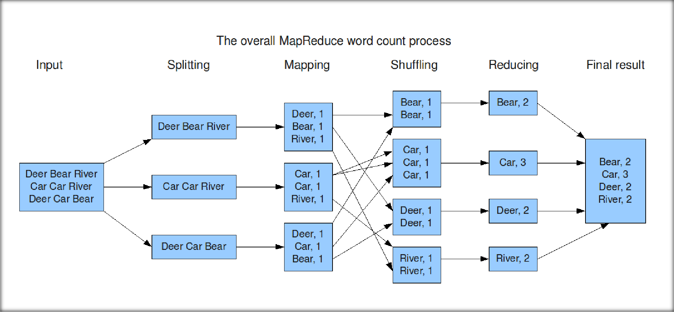
MapReduce: Word Count

Slide 8
Hadoop Architecture

Slide 9
What parts actually make up a Hadoop cluster
NameNode
Holds the metadata for the HDFS
Secondary NameNode
Performs housekeeping functions for the NameNode
DataNode
Stores the actual HDFS data blocks
JobTracker
Manages MapReduce jobs
TaskTracker
Monitors individual Map and Reduce tasks

Slide 10
JobTracker and TaskTracker
JobTracker
Determines the execution plan for the job
Assigns individual tasks
TaskTracker
Keeps track of the performance of an individual mapper or reducer

Slide 11
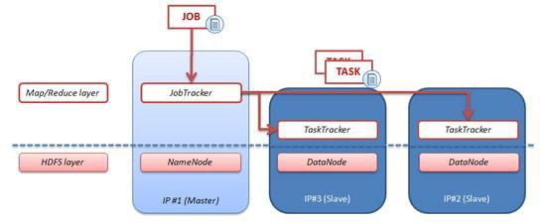
High-level architecture of Hadoop
47

Slide 12

Hadoop’s Architecture
Hadoop Distributed Filesystem
Tailored to needs of MapReduce
Targeted towards many reads of filestreams
Writes are more costly
High degree of data replication (3x by default)
No need for RAID on normal nodes
Large blocksize (64MB)
Location awareness of DataNodes in network

Slide 13

Hadoop’s Architecture
Distributed, with some centralization
Main nodes of cluster are where most of the computational power and storage of the system lies
Main nodes run TaskTracker to accept and reply to MapReduce tasks, and also DataNode to store needed blocks closely as possible
Central control node runs NameNode to keep track of HDFS directories & files, and JobTracker to dispatch compute tasks to TaskTracker
Written in Java, also supports Python and Ruby

Slide 14




HDFS network topology
HDFS takes a simple approach:
See the network as a tree
Distance between two nodes is the sum of their distances to their closest common
ancestor
Rack 1
Rack 2
Rack 3
Rack 4
n1
n3
n5
n7
n2
n4
n6
n8
Data center 1
Data center 2
50

Slide 15
HDFS filesystem commands
List the contents of a directory
hadoop fs -ls
Create a directory in HDFS at given path(s)
hadoop fs -mkdir <directory name>
Upload and download a file in HDFS
Upload: hadoop fs -put <local file> <remote path>
Download: hadoop fs -get <file in HDFS> <local path>
See contents of a file
hadoop fs -cat <filename>
Delete a file/directory in HDFS
hadoop fs -rm/rmr <file or directory>
51

Slide 16
HDFS filesystem commands
Move file from source to destination
hadoop fs -mv <src> <dst>
Report the amount of space used and availability
hadoop fs -df hdfs:/
How much space a directory occupies
hadoop fs -du -s -h <dir name>
Change permission of files
sudo hadoop fs -chmod 600 <file>
Change owner and group of files
sudo hadoop fs -chown root:root <file>
52

Slide 17
*HDFS admin commands
DFSAdmin command
-report: reports basic statistics of HDFS
-safemode: though usually not required, an administrator can manually enter or
leave safemode
o enter, leave, get, wait
-refreshNodes: updates the set of hosts allowed to connect to namenode
Usage: hadoop dfsadmin [-report] [-safemode enter | leave | get | wait] [-refreshNodes] [-
finalizeUpgrade] [-upgradeProgress status | details | force] [-metasave filename] [-setQuota
<quota> <dirname>...<dirname>] [-clrQuota <dirname>...<dirname>] [-help [cmd]]
53

Slide 18
Questions?

