Slide 1
Review of Data Mining Concepts

Slide 2
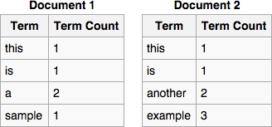


Terminologies
Dataset
Training set
Testing set
Validating set
Data representation
Feature vector
TF/IDF

Slide 3
Supervised Learning
Regression
Linear regression
Logistic regression
Naïve Bayes
Strong independence assumption
K-nearest neighboring (KNN)
Decision Tree
C4.5
Can handle both numerical and categorical features
Missing values

Slide 4
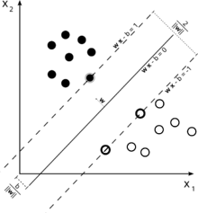
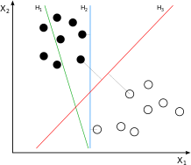
Support Vector Machine
Find a hyper-plane to maximize the functional margin.

Slide 5
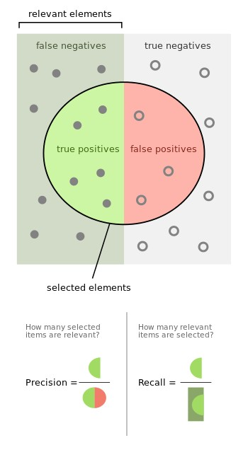

Evaluation
Accuracy
Precision-recall
F1 score
Over fitting
Cross-validation
Regularization: L1/L2-norm
Early stopping
Pruning

Slide 6
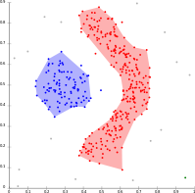
Unsupervised Learning
Clustering
K-means
Spectral clustering
Hierarchical clustering
Density-based clustering (DBSCAN)
Distance metric
Euclidean
Manhanttan
Cosine
…

Slide 7

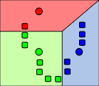

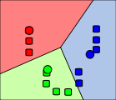
K-Means
1) k initial "means” (in this case k=3) are randomly generated within the data domain (shown in color).
2) k clusters are created by associating every observation with the nearest mean.The partitions here represent the Voronoi diagram generated by the means.
3) The centroid of each of the k clusters becomes the new mean.
4) Steps 2 and 3 are repeated until convergence has been reached.

Slide 8
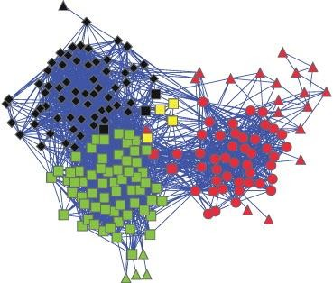
Association rule mining (market basket analysis)
{x,y} =>{z}
{x,y,z}=>{u,v}
…
Graph-based community detection
Modularity maximization-based
Networks with high modularity have dense connections between the nodes within modules but sparse connections between nodes in different modules.

Slide 9




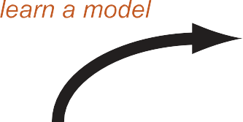
Semi-supervised learning
Active learning

Slide 10
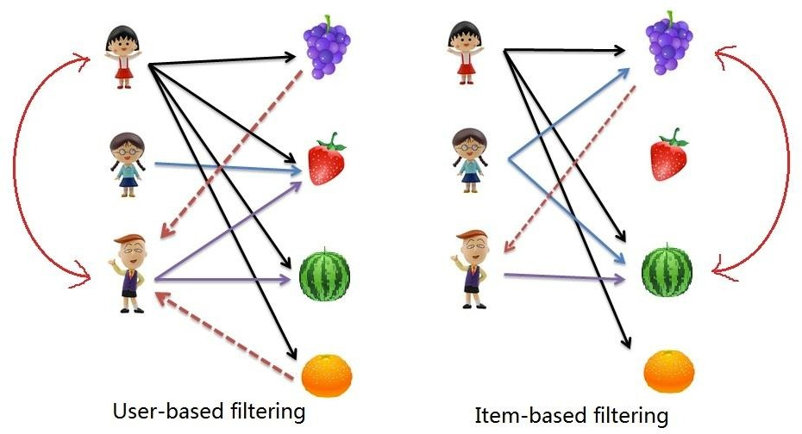
Recommender Systems
User-based collaborative filtering
Item-based collaborative filtering
Sparse matrix completion
Netflix problem

Slide 11
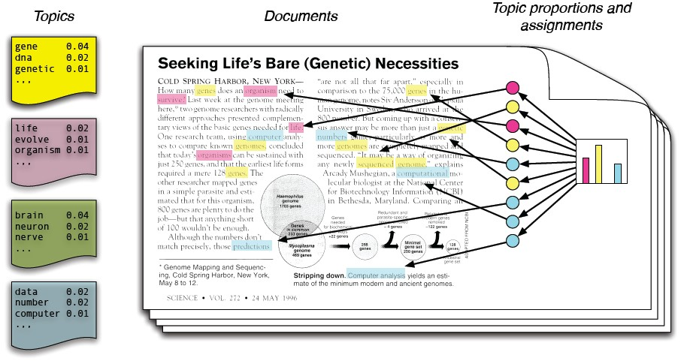
Graphical Models: Topic Modeling

