Slide 1
ECE6217 Neural Network and Hardware Implementation Lab 1
TA: You Zhou
08/29/2022

Slide 2
About this course…
Theory of neural network and their models. Representation of neural cells;
Memristor and phase change (PCM) materials;
General concept of the multilayer of the neural networks; Deep neural networks (DNN);
Spiking neural networks.
Prerequisites: ECE 4140 or ECE 6240; and knowledge of analog circuits design. (Fall, Every Year)

Slide 3
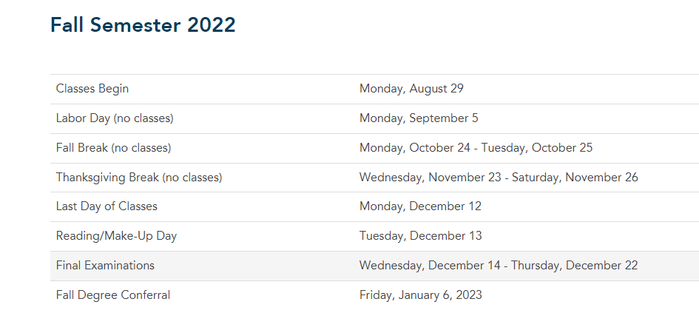
About the lab
Simulating the Neural Network using Cadence
From GW Calendar
12:45 p.m. – 3:15 p.m. Monday

Slide 4
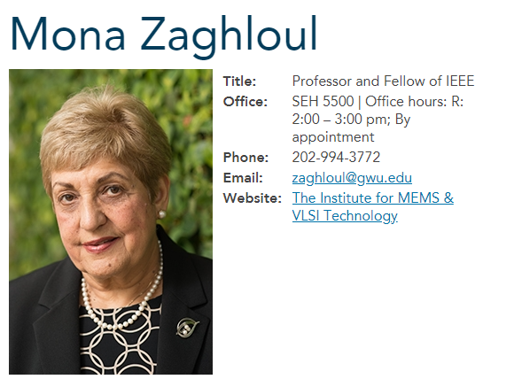
About the instructor…
For graduate students
Digital VLSI design ECE6240
Analog VLSI design ECE6218
RF VLSI design ECE6216
Neural Network and Hardware Implementation ECE6217
Introduction to MEMS ECE6215 etc.
VLSI: Very Large-Scale Integration
MEMS: Micro-electromechanical systems

Slide 5
About the TA…
You Zhou
Ph. D student, advisor: Mona Zaghloul
Email: yzhou57@gwu.edu
Office hour: 3:15 p.m. – 6:00 p.m. Monday; by appointment
Location: SEH 5th floor, Institute of VLSI and MEMS

Slide 6
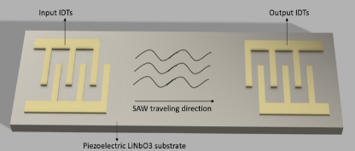
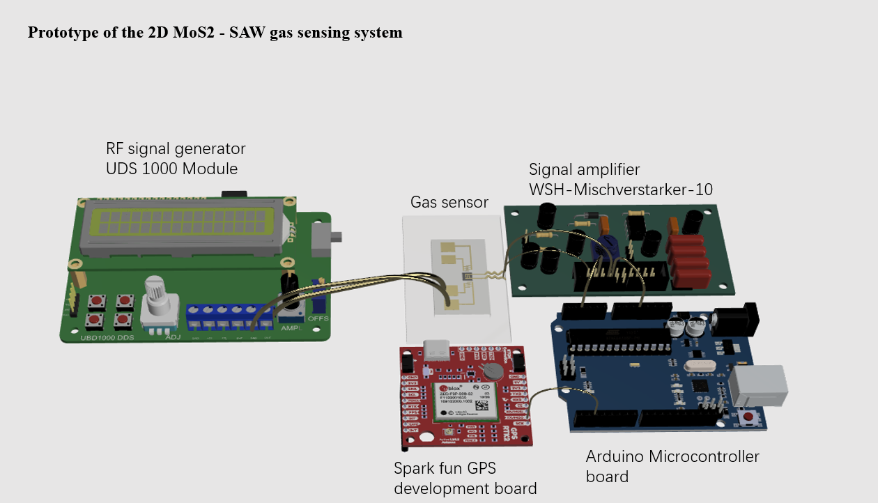
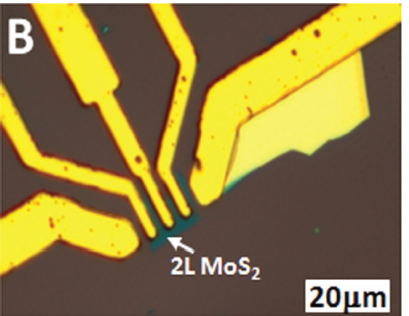
About my research
Surface Acoustic Wave(SAW) Device
Gas sensing system
Two-dimensional (2D) Material

Slide 7
About your background…
Name:
Major and focus area:
Research area:
Research advisor:
Have you ever studied ECE6240 or ECE6218?
If yes, please briefly introduce your final project

Slide 8
Thank you
Enjoy the rest of this week.

