Slide 1
ECE6217 Lab 2: Current Mirror Circuit
09/12/2022
TA: You Zhou
E-mail: yzhou57@gwu.edu

Slide 2
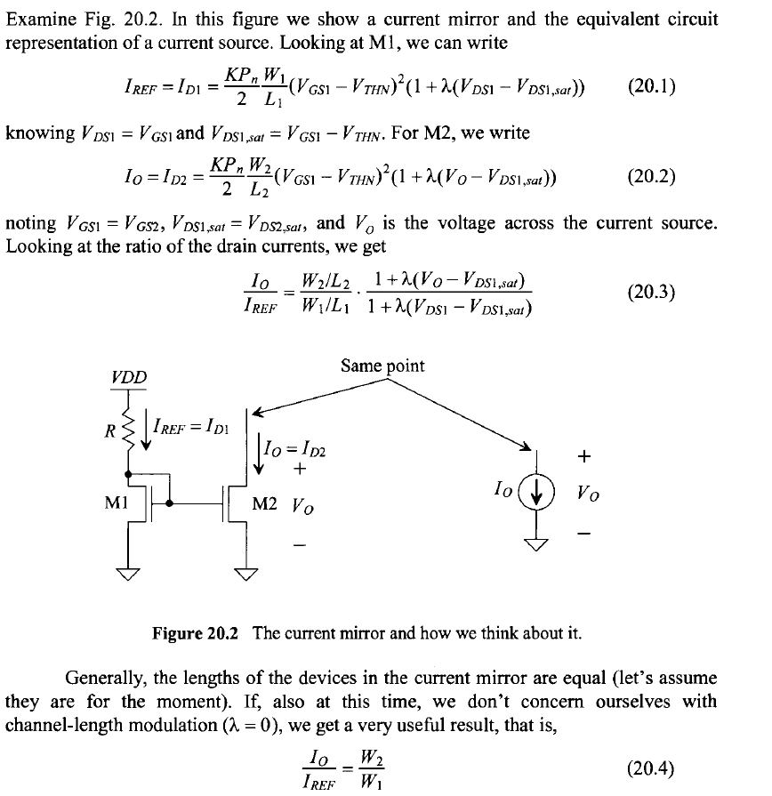
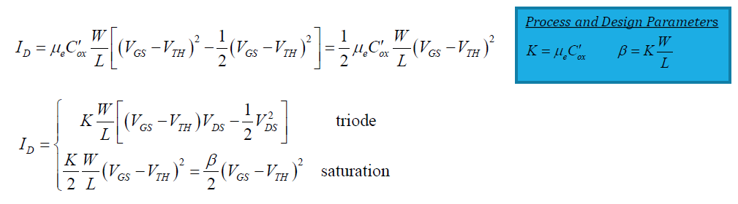
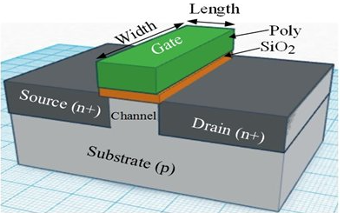
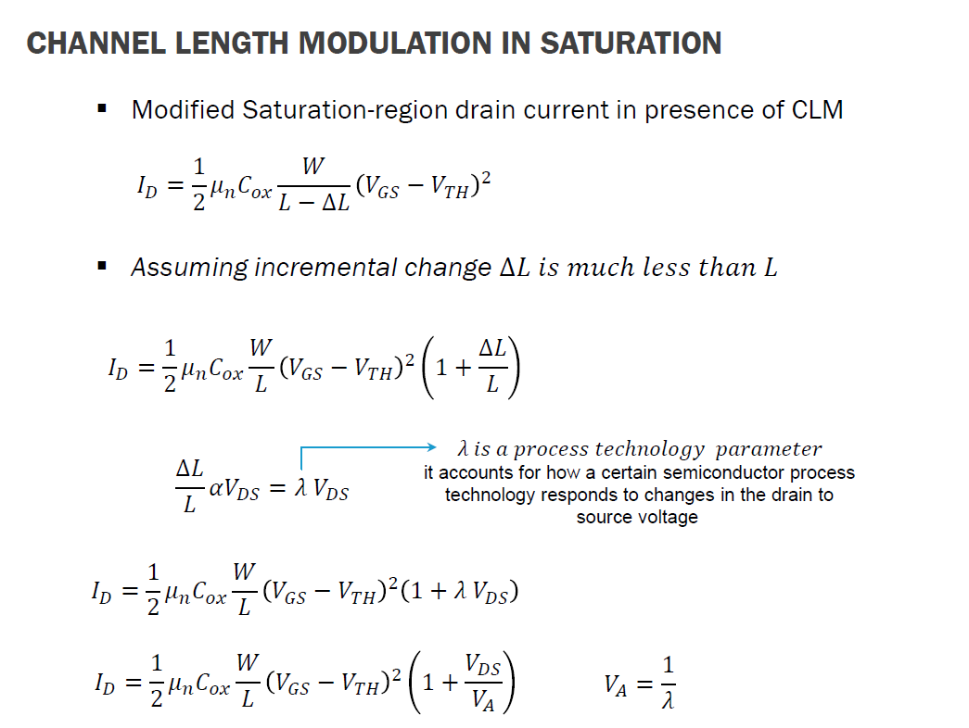
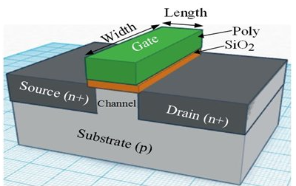
(IEEE Press Series on Microelectronic Systems) R. Jacob Baker - CMOS_ Circuit Design, Layout, and Simulation -Wiley-IEEE Press (2010) (1)

Slide 3
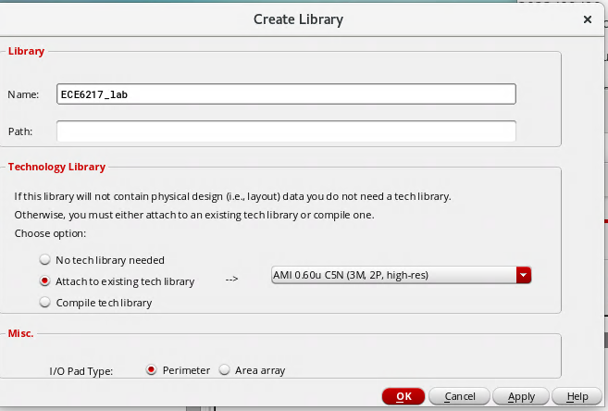
Create a new Library for ECE6217
Go to Library manager window
From the menu, select File ->New ->Library
You will see a dialog like this
NAME: ECE6217_lab
Attach to existing tech library” section,
select: AMI 0.60u C5N (3M, 2P, high-res)
Press OK
Ensure no errors

Slide 4
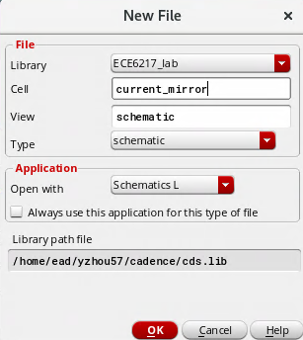
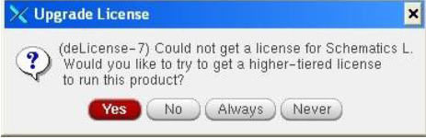
Create a New design
From the Library Manager, click on the “ECE6217_lab” library you just created.
From the menu, choose File->New->Cellview, and fill in the form as shown below.
In the cell Field, type “Current_mirror”
Click always when you see “Upgrade License”

Slide 5
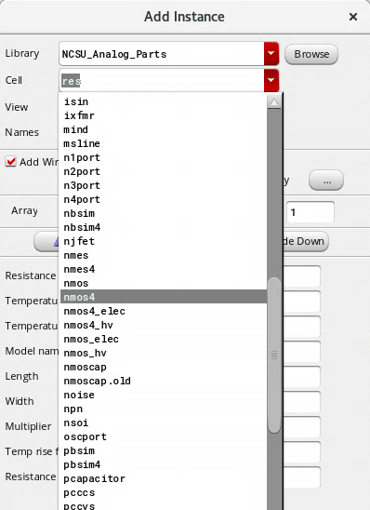
Instancing parts to create the Current Mirror circuit
From the Menu choose: Create -> Instance
Choose “nmos4”
The default size for this “nmos” is
W/L = 1.5um/0.6um
Then create another nmos with the
same parameters

Slide 6
Build mirror current circuit
From the instance menu, choose “gnd” and place it under the the transistors.
Adding I/O Pins, press P to add “Vin” and “Vout” as input signal and output signal.
Then connect the Pins and electronic components with wires.

Slide 7
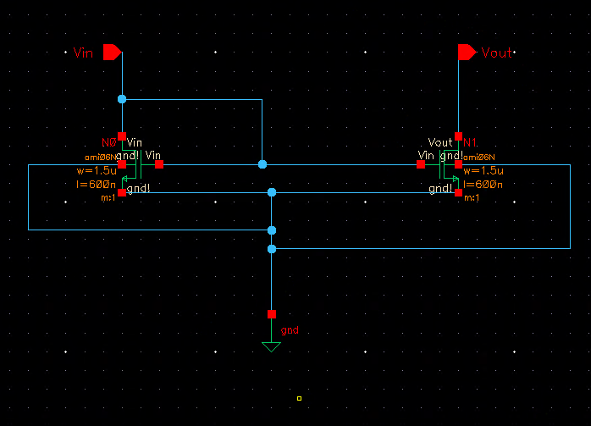
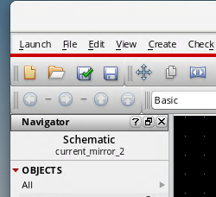
Build mirror current circuit
Click check and save after you build this circuit to see if there are any errors.

Slide 8
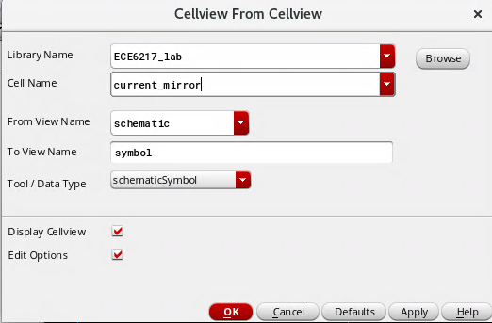
Make a symbol
Create -> Cellview -> From Cellview

Slide 9
Create a Testbench
In the Library Manager, click on your “ECE6217_lab” Library.
• From the Library Manager Menu choose: File-> New-> Cellview...
• Fill it as shown below, to create a new cell called: current_mirror_tb
Click Ok. A new Composer-Schematic window appears.
Create -> Instance:
Vdd X2
vdc: 5V DC voltage X2
res: 1 K ohm
gnd
Create -> ECE6217_lab -> current mirror
Connect the power source component with the current mirror circuit
Save and check if there are any errors

Slide 10
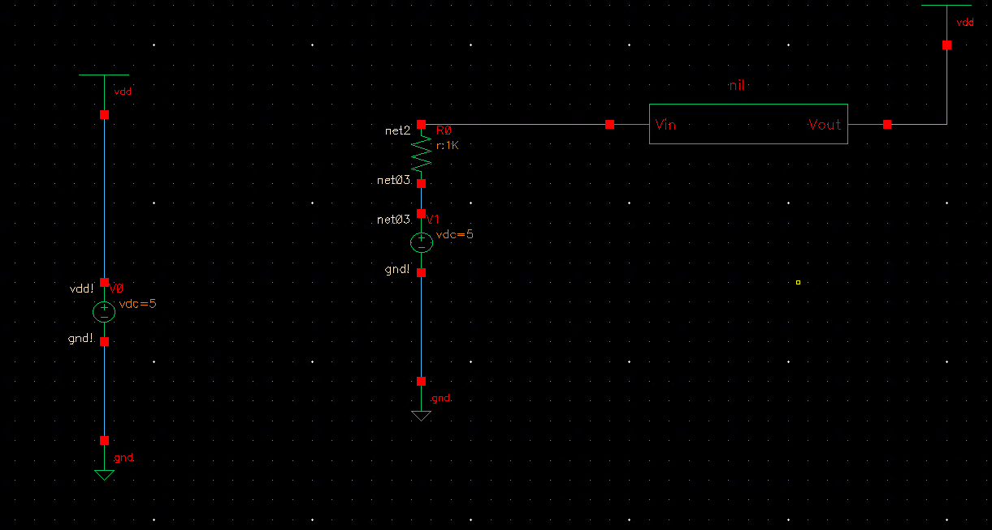
Testbench

Slide 11
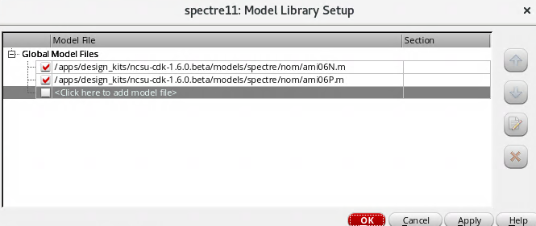
Simulation
Launch ->ADE L
In the Simulation window, select Setup -> Simulator/Directory/Host
Ensure the Simulator cyclic field is reading Spectre. Leave other fields to default.
In the simulation window, select Setup -> Model Libraries…
Ensure that the files shown below are in the list, if not, browse for the following files using the <…> icon

Slide 12
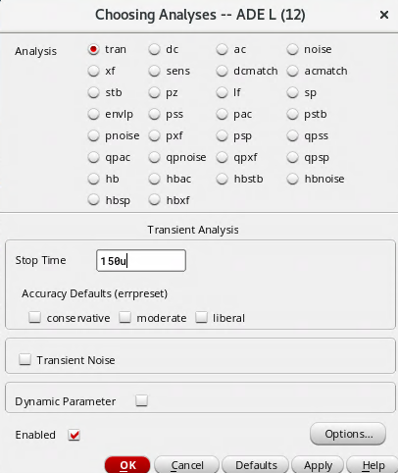
Choosing Analyses
From the menu choose Analysis -> Choose...
The form appears.
Select the “trans” analysis or “dc”
Set stop time = 150u as shown in the figure

Slide 13
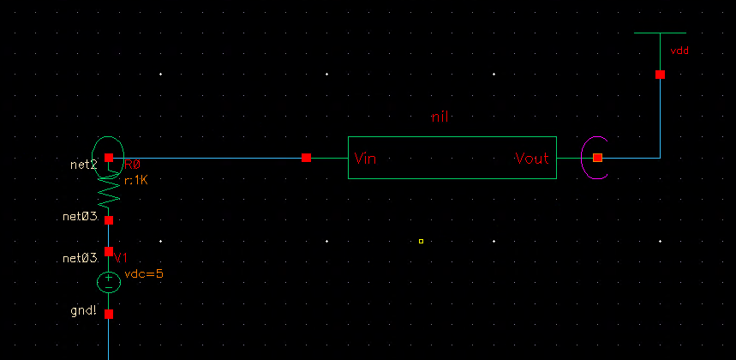
Choose the simulation node
Outputs -> to be plotted ->from schematic
Click on the nodes as shown below.(do not choose wire)

Slide 14
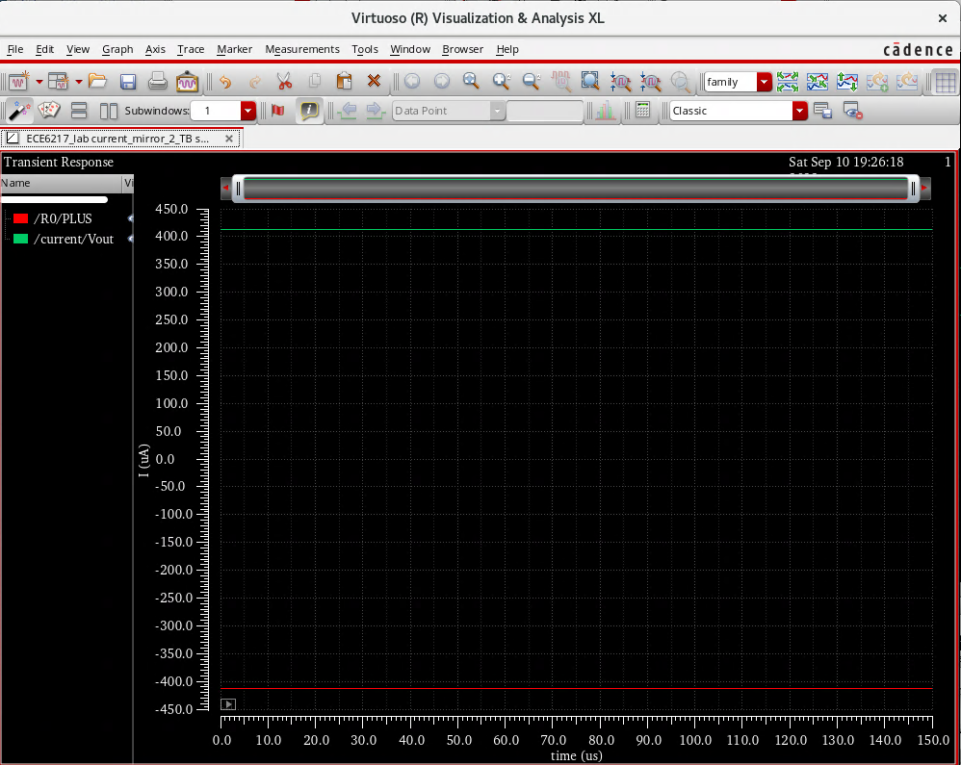
Run simulation

Slide 15
Assignment
Finish the Layout of current mirror circuit
Change the width (w) of the nmos close to the output Pin from 1.5 um to 3 um and see what will happen.

