Slide 1
Spring Security
Let's begin
github地址：https://github.com/HangStarLi/Spring-Security.git

Slide 2
自定义注解
@Target({ElementType.METHOD,ElementType.FIELD}) @Retention(RetentionPolicy.RUNTIME) @Constraint(validatedBy = MyConstraintValidator.class) public @interface MyConstraint { String message() default "这是测试MyConstraint注解"; Class<?>[] groups() default {}; Class<? extends Payload>[] payload() default {}; }

Slide 3
public class MyConstraintValidator implements ConstraintValidator<MyConstraint,Object> { @Autowired HelloService helloService; @Override public void initialize(MyConstraint myConstraint) { System.out.println("init my validator"); } @Override public boolean isValid(Object o, ConstraintValidatorContext constraintValidatorContext) { helloService.hello(o+""); return false; } }

Slide 4
项目介绍
security（root）
security-core
security-app
security-browser
security-demo

Slide 5
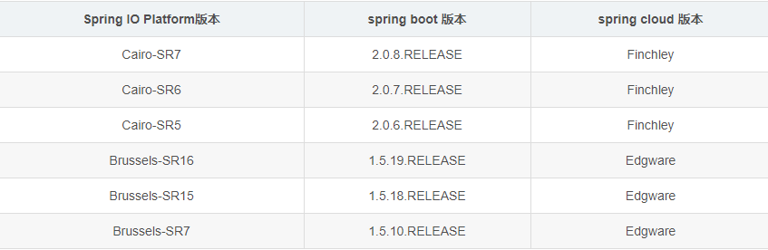
版本对应
Brussels-SR4 | 1.5.6.RELEASE | Dalston.SR2

Slide 6
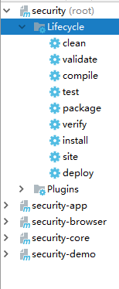
IDEA打包

Slide 7
Spring Boot多模块开发
1、使用io.spring.platform管理依赖版本
引入方式：
1）依赖：
<dependencyManagement> <dependencies> <dependency> <groupId>io.spring.platform</groupId> <artifactId>platform-bom</artifactId> <version>Brussels-SR4</version> <type>pom</type> <scope>import</scope> </dependency> </dependencies> </dependencyManagement>

Slide 8
2）、继承：
<parent> <groupId>io.spring.platform</groupId> <artifactId>platform-bom</artifactId> <version>Cairo-SR7</version> <relativePath/> </parent>

Slide 9
2、maven编译插件：
<build> <plugins> <plugin> <groupId>org.apache.maven.plugins</groupId> <artifactId>maven-compiler-plugin</artifactId> <version>2.3.2</version> <configuration> <source>1.8</source> <target>1.8</target> <encoding>UTF-8</encoding> </configuration> </plugin> </plugins> </build>

Slide 10
各个pom文件
1：security(root)
<modules> <module>security-core</module> <module>security-demo</module> <module>security-app</module> <module>security-browser</module> </modules> <dependencyManagement> <dependencies> <dependency> <groupId>io.spring.platform</groupId> <artifactId>platform-bom</artifactId> <version>Brussels-SR4</version> <type>pom</type> <scope>import</scope> </dependency> <dependency> <groupId>org.springframework.cloud</groupId> <artifactId>spring-cloud-dependencies</artifactId> <version>Dalston.SR2</version> <type>pom</type> <scope>import</scope> </dependency> </dependencies> </dependencyManagement> <build> <plugins> <plugin> <groupId>org.apache.maven.plugins</groupId> <artifactId>maven-compiler-plugin</artifactId> <version>2.3.2</version> <configuration> <source>1.8</source> <target>1.8</target> <encoding>UTF-8</encoding> </configuration> </plugin> </plugins> </build>

Slide 11
2:security-core:

Slide 12
3:security-app:

Slide 13
4:security-browser

Slide 14
将项目打包成可运行的jar
<build> <plugins> <plugin> <groupId>org.springframework.boot</groupId> <artifactId>spring-boot-maven-plugin</artifactId> <version>1.3.3.RELEASE</version> <executions> <execution> <goals> <goal>repackage</goal> </goals> </execution> </executions> </plugin> </plugins> <finalName>demo</finalName> </build>

Slide 15
使用Spring MVC 开发RESTful API
传统 RESTful
查询 /user/query?name=tom GET /user?name=tom GET
详情 /user/getInfo?id=1 GET /user/1 GET
创建 /user/create?name=tom POST /user POST
修改 /user/update?id=1&name=jerry POST /user/1 PUT
删除 /user/delete?id=1 GET /user/1 DELETE
1:用URL描述资源
2使用HTTP方法描述行为，使用HTTP状态码表示不同的返回结果
3：使用JSON交互数据
4：REST 是一种风格

Slide 16
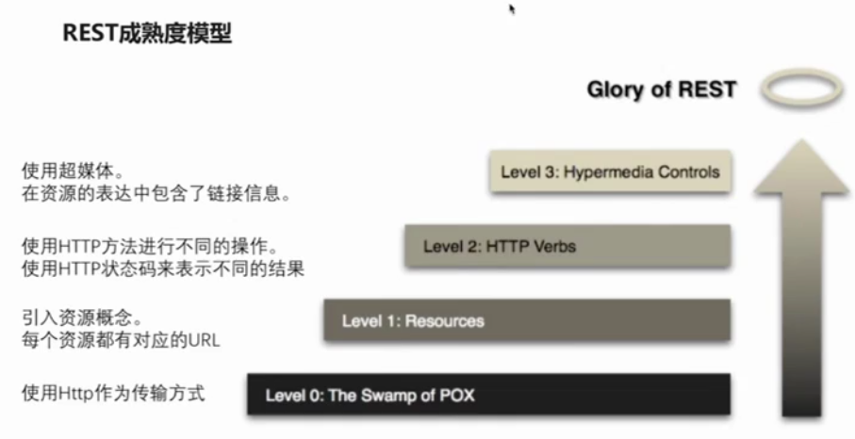

Slide 17
通过反射输出ton一个对象的字符串
ReflectionToStringBuilder.toString(condition, ToStringStyle.MULTI_LINE_STYLE)
data-jpa中的分页：
Pageable类

Slide 18
JsonView的使用
1：使用接口来声明多个视图
2：在值对象的get方法上指定视图
3：在Controller方法上指定视图

Slide 19
例：简单视图不显示密码，详细视图显示
User.class
public class User { public interface UserSimpleView{} public interface UserDetailView extends UserSimpleView{} private String username; private String password; private Integer age; @JsonView(UserSimpleView.class) public String getUsername() { return username; } @JsonView(UserDetailView.class) public String getPassword() { return password; } @JsonView(UserSimpleView.class) public Integer getAge() { return age; } public void setUsername(String username) { this.username = username; } public void setPassword(String password) { this.password = password; } public void setAge(Integer age) { this.age = age; } }

Slide 20
Controller.class
{id:\\d+}:只能传递数字
@RequestMapping(value = "/user/{id:\\d+}",method = RequestMethod.GET)//注意反斜杠\\ @JsonView(User.UserDetailView.class) public User getUserInfoTest(@PathVariable Integer id){ System.out.println(id); User user = new User(); user.setUsername("tom"); return user; }

Slide 21
@RequestBody
post请求，识别content中的参数
请求：
@Test public void whenCreateSuccess() throws Exception{ Date date = new Date(); Long time = date.getTime(); String content = "{\"id\":1,\"username\":\"tom\",\"password\":null,\"age\":18,\"birthday\":"+time+"}"; String result = mockMvc.perform(MockMvcRequestBuilders.post("/user") .content(content) .contentType(MediaType.APPLICATION_JSON_UTF8)) .andExpect(MockMvcResultMatchers.status().isOk()) .andExpect(MockMvcResultMatchers.jsonPath("$.id").value("1")) .andReturn().getResponse().getContentAsString(); System.out.println(result); }

Slide 22
Controller
@PostMapping public User createUser(@RequestBody User user){ System.out.println(ReflectionToStringBuilder.toString(user,ToStringStyle.MULTI_LINE_STYLE)); return user; }

Slide 23
对于时间的处理
我们不用转换器，而是直接传递一个时间戳，又调用端自己解析出自己想要的时间
pojo: private Date birthday;
请求：
@Test public void whenCreateSuccess() throws Exception{ Date date = new Date(); Long time = date.getTime(); String content = "{\"id\":1,\"username\":\"tom\",\"password\":null,\"age\":18,\"birthday\":"+time+"}"; String result = mockMvc.perform(MockMvcRequestBuilders.post("/user") .content(content) .contentType(MediaType.APPLICATION_JSON_UTF8)) .andExpect(MockMvcResultMatchers.status().isOk()) .andExpect(MockMvcResultMatchers.jsonPath("$.id").value("1")) .andReturn().getResponse().getContentAsString(); System.out.println(result); }

Slide 24
对请求参数的限制（不为空为例）
1、pojo: @NotBlank
private String password;
2、Controller:
@PostMapping public User createUser(@Valid @RequestBody User user, BindingResult errors){ if (errors.hasErrors()){ errors.getAllErrors().stream().forEach(error -> System.out.println(error.getDefaultMessage())); } System.out.println(ReflectionToStringBuilder.toString(user,ToStringStyle.MULTI_LINE_STYLE)); return user; }

Slide 25
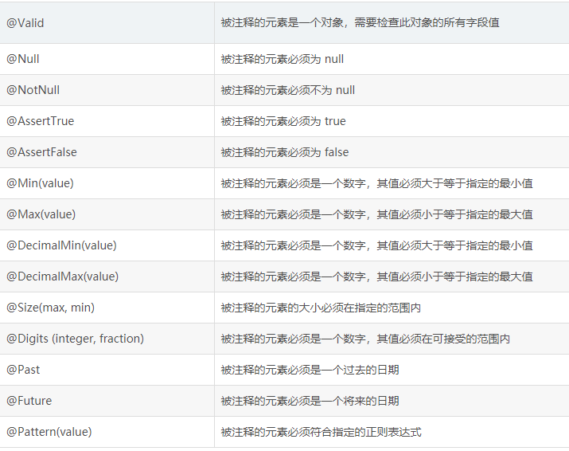
Hibernate Volidator

Slide 26
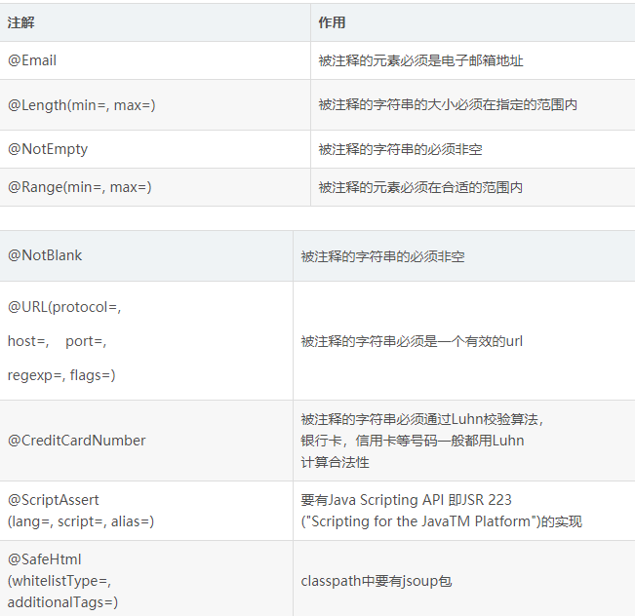

Slide 27
过滤器（Filter）
方式一：自己定义的filter,不能定义过滤规则，不能处理第三方的filter
l
@Component public class TimeFilter implements Filter { @Override public void init(FilterConfig filterConfig) throws ServletException { System.out.println("time filter init"); } @Override public void doFilter(ServletRequest request, ServletResponse response, FilterChain filterChain) throws IOException, ServletException { System.out.println("time filter start"); long start = new Date().getTime(); filterChain.doFilter(request,response); long end = new Date().getTime(); System.out.println("time filter: " + (end-start)); System.out.println("time filter end"); } @Override public void destroy() { System.out.println("time filter destroy"); } }

Slide 28
方式二：可以处理第三方的过滤器，可以定义过滤规则，以自己定义的filter举例(无@Conponent)
1：MyFilter
public class TimeFilter implements Filter { @Override public void init(FilterConfig filterConfig) throws ServletException { System.out.println("time filter init"); } @Override public void doFilter(ServletRequest request, ServletResponse response, FilterChain filterChain) throws IOException, ServletException { System.out.println("time filter start"); long start = new Date().getTime(); filterChain.doFilter(request,response); long end = new Date().getTime(); System.out.println("time filter: " + (end-start)); System.out.println("time filter end"); } @Override public void destroy() { System.out.println("time filter destroy"); } }

Slide 29
2：处理：（加入Spring容器）
@Bean public FilterRegistrationBean timeFilter(){ FilterRegistrationBean bean = new FilterRegistrationBean(); TimeFilter filter = new TimeFilter(); bean.setFilter(filter); List<String> urls = new ArrayList<>(); urls.add("/*");//过滤所有请求 bean.setUrlPatterns(urls); return bean; }

Slide 30
拦截器（Interceptor）
定义拦截器：
@Component public class TimeInterceptor implements HandlerInterceptor { @Override public boolean preHandle(HttpServletRequest httpServletRequest, HttpServletResponse httpServletResponse, Object o) throws Exception { System.out.println("preHandle"); httpServletRequest.setAttribute("startTime",new Date().getTime()); return true; } @Override public void postHandle(HttpServletRequest httpServletRequest, HttpServletResponse httpServletResponse, Object o, ModelAndView modelAndView) throws Exception { System.out.println("postHandle"); long start = (long) httpServletRequest.getAttribute("startTime"); System.out.println("Interceptor time : "+(new Date().getTime()-start)); } @Override public void afterCompletion(HttpServletRequest httpServletRequest, HttpServletResponse httpServletResponse, Object o, Exception e) throws Exception { System.out.println("afterCompletion"); long start = (long) httpServletRequest.getAttribute("startTime"); System.out.println("Interceptor time : "+(new Date().getTime()-start)); } }

Slide 31
让拦截器生效
@Configuration public class WebConfig extends WebMvcConfigurerAdapter { @Autowired TimeInterceptor interceptor; @Override public void addInterceptors(InterceptorRegistry registry) { registry.addInterceptor(interceptor); } }

Slide 32
切面（Aspect）
@Aspect @Component public class TimeAspect { @Around("execution(* com.lihang.web.controller.UserController.*(..))") public Object handleControllerMethod(ProceedingJoinPoint pjp) throws Throwable { System.out.println("aspect: 执行之前"); //可获取参数的值 Object[] objects = pjp.getArgs(); for (Object o:objects) { System.out.println(o); } //执行真正的方法 Object result = pjp.proceed(); System.out.println("aspect: 方法返回值："+ReflectionToStringBuilder.toString(result,ToStringStyle.MULTI_LINE_STYLE)); System.out.println("aspect: 切面执行之后"); return result; } }

Slide 33
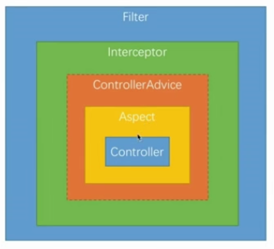
拦截顺序

Slide 34
Spring Boot文件上传下载
文件上传（post请求） 下载（get请求）
@RestController
@RequestMapping("/file")
public class FileController {
private String path = "E:\\Program2\\security\\security-demo\\src\\main\\resources\\file";
@PostMapping("/upload")
public File uploadFile(MultipartFile file) throws IOException {
System.out.println(file.getName());
System.out.println(file.getSize());
System.out.println(file.getOriginalFilename());
File newFile = new File(path,new Date().getTime()+".txt");
file.transferTo(newFile);
return new File(newFile.getAbsolutePath());
}
@GetMapping("/download/{id}")
public void downloadFile(@PathVariable String id, HttpServletRequest request, HttpServletResponse response){
try (
InputStream in = new FileInputStream(new File(path,id+".txt"));
OutputStream out = response.getOutputStream();
){
response.setContentType("application/x-download");
response.addHeader("Content-Disposition","attachment;filename=test.txt");
IOUtils.copy(in,out);
out.flush();
} catch (Exception e) {
e.printStackTrace();
}
}
}

Slide 35
测试：
@Test public void whenUploadFileSuccess() throws Exception{ String path = mockMvc.perform(MockMvcRequestBuilders.fileUpload("/file/upload") .file(new MockMultipartFile("file","test.txt","multipart/form-data","hello lihang".getBytes("utf-8")))) .andExpect(MockMvcResultMatchers.status().isOk()) .andReturn().getResponse().toString(); System.out.println(path); }

Slide 36
Swagger2
自动生成restFul API文档
1、添加依赖
<!-- https://mvnrepository.com/artifact/io.springfox/springfox-swagger2 --> <dependency> <groupId>io.springfox</groupId> <artifactId>springfox-swagger2</artifactId> <version>2.9.2</version> </dependency> <!-- https://mvnrepository.com/artifact/io.springfox/springfox-swagger-ui --> <dependency> <groupId>io.springfox</groupId> <artifactId>springfox-swagger-ui</artifactId> <version>2.9.2</version> </dependency>

Slide 37
2、配置类
@Configuration @EnableSwagger2 public class SwaggerConfig { @Bean Docket docket(){ return new Docket(DocumentationType.SWAGGER_2) .select() .apis(RequestHandlerSelectors.basePackage("com.lihang.web.controller")) .paths(PathSelectors.any()) .build().apiInfo(new ApiInfoBuilder() .description("安全框架测试文档") .contact(new Contact("李航","https://github.com/HangStarLi","1838705553@qq.com")) .version("1.6.version") .title("API测试文档") .license("Apache2.0") .licenseUrl("http://www.apache.org/licenses/LICENSE-2.0") .build()); } }

Slide 38
3、注解参数：
@Api(tags = "用户数据接口")
@ApiOperation(value="查询用户",notes = "查询所有")
@ApiImplicitParam(paramType = "path",name = "id",value = "用户ID",required = true)
@ApiResponses({
@ApiResponse(code=200,message = "删除成功"),
@ApiResponse(code=500,message = "删除失败"),
})
@ApiParam("用户id")
@ApiModelProperty(value = "用户名")

Slide 39
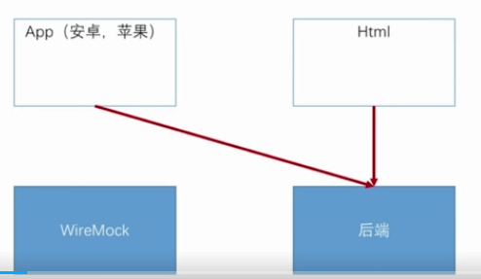
WireMock
伪造restful接口供前端调用

Slide 40
1：打开wiremock服务器
java -jar wiremock-standalone-2.25.1.jar --port=8081
e:JAR/wiremock-standalone-2.25.1.jar
2:向服务器添加接口
public class MockServer { public static void main(String[] args) throws IOException { ClassPathResource resource = new ClassPathResource("file/json.txt"); String content =StringUtils.join( FileUtils.readLines(resource.getFile(),"utf-8").toArray(),"\n"); System.out.println(content); WireMock.configureFor(8081); WireMock.removeAllMappings(); WireMock.stubFor(WireMock.get(WireMock.urlPathEqualTo("/order/1")).willReturn(WireMock.aResponse().withBody(content).withStatus(200))); } }

Slide 41
Spring Security
认证（登陆）
授权（能干什么）
防攻击

Slide 42
自定义登陆方式：
@Configuration public class SecurityConfirg extends WebSecurityConfigurerAdapter { @Bean public PasswordEncoder passwordEncoder(){ return new BCryptPasswordEncoder(); } @Override protected void configure(HttpSecurity http) throws Exception { http.formLogin()//表单登陆 .and() .authorizeRequests() .anyRequest() .authenticated(); /* http.httpBasic()//默认普通登陆 .and() .authorizeRequests() .anyRequest() .authenticated();*/ } }

Slide 43
用户登陆：
@Component public class MyUserDetailsService implements UserDetailsService { @Autowired private PasswordEncoder passwordEncoder; @Override public UserDetails loadUserByUsername(String username) throws UsernameNotFoundException { //查找数据库用户名的密码 System.out.println(passwordEncoder.encode("1234")); return new User(username,passwordEncoder.encode("1234"),AuthorityUtils.commaSeparatedStringToAuthorityList("admin")); } }

Slide 44
个性化登陆流程
1.自定义登陆页面
如果自己配置了登陆页面就到自己的登陆页面，否则就是默认的登陆页
2、自定义登陆成功处理
3、自定义登陆失败处理

Slide 45
一、自定义登陆页面
http.formLogin()//表单登陆 .loginPage("/authentication/require") //跳转到Controller .loginProcessingUrl("/authentication/form") .and() .authorizeRequests() .antMatchers("/authentication/require",securityProperties.getBrowser().getLoginPage()).permitAll() .anyRequest() .authenticated() .and().csrf().disable();

Slide 46
@RestController public class BrowserSecurityController { private Logger logger = LoggerFactory.getLogger(getClass()); private RequestCache requestCache = new HttpSessionRequestCache(); private RedirectStrategy redirectStrategy = new DefaultRedirectStrategy(); @Autowired private SecurityProperties securityProperties ; /*@Autowired private ProviderSignInUtils providerSignInUtils;*/ /* * 当需要身份认证时，跳转到这里 * */ @RequestMapping("/authentication/require") @ResponseStatus(code = HttpStatus.UNAUTHORIZED) public SimpleResponse requireAuthentication(HttpServletRequest request, HttpServletResponse response) throws IOException { SavedRequest savedRequest = requestCache.getRequest(request,response); if (savedRequest != null){ String targetUrl = savedRequest.getRedirectUrl(); logger.info("引发跳转的请求："+targetUrl); if (StringUtils.endsWithIgnoreCase(targetUrl,".html")){ redirectStrategy.sendRedirect(request,response,securityProperties.getBrowser().getLoginPage()); } } return new SimpleResponse("请跳转到登陆页"); } }

Slide 47
读取配置文件的相关配置
public class BrowserProperties { private String loginPage = "/defaultLogin.html"; public String getLoginPage() { return loginPage; } public void setLoginPage(String signUpUrl) { this.loginPage = signUpUrl; } }

Slide 48
@ConfigurationProperties(prefix = "lihang.security") public class SecurityProperties { private BrowserProperties browser = new BrowserProperties(); public BrowserProperties getBrowser() { return browser; } public void setBrowser(BrowserProperties browser) { this.browser = browser; } }

Slide 49
让SecurityProperties类起作用
@Configuration @EnableConfigurationProperties(SecurityProperties.class) public class SecurityCoreConfig { }

Slide 50
使用
配置文件：lihang.security.browser.loginPage= /demoLogin.html @Autowired private SecurityProperties securityProperties ; securityProperties.getBrowser().getLoginPage()

Slide 51
二、自定义登陆成功处理
@Component public class MyAuthenticationSuccessHandler implements AuthenticationSuccessHandler { private Logger logger = LoggerFactory.getLogger(getClass()); @Autowired private ObjectMapper objectMapper; @Override public void onAuthenticationSuccess(HttpServletRequest request, HttpServletResponse response, Authentication authentication) throws IOException, ServletException { logger.info("登陆成功"); response.setContentType("application/json;charset=utf-8"); System.out.println(objectMapper.writeValueAsString(authentication)); } }

Slide 52
http.formLogin()//表单登陆 .loginPage("/authentication/require") .loginProcessingUrl("/authentication/form") .successHandler(myAuthenticationSuccessHandler)

Slide 53
图形验证码功能
1、开发生成图形验证码的接口
2、在认证流程中加入图形验证码验证
3、重构代码

Slide 54
一、开发生成图形验证码的接口
验证码封装：
public class ImageCode {
private BufferedImage image;
private String code;
private LocalDateTime expireTime;
public ImageCode(BufferedImage image, String code, Integer expireTime) {
this.image = image;
this.code = code;
this.expireTime = LocalDateTime.now().plusSeconds(expireTime);
}
public boolean isExpired() {
return LocalDateTime.now().isAfter(expireTime);
}
<gtter++++setter+++++>
}

Slide 55
生成验证码的Controller
//接收表单中的验证码生成请求 @RestController public class ValidateCodeController { public static final String SESSION_KEY = "SESSION_KEY_CODE"; private SessionStrategy sessionStrategy = new HttpSessionSessionStrategy(); @GetMapping("/code/image") public void createCode(HttpServletRequest request, HttpServletResponse response) throws IOException { ImageCode imageCode = createImageCode(request); sessionStrategy.setAttribute(new ServletWebRequest((request)),SESSION_KEY,imageCode); ImageIO.write(imageCode.getImage(),"JPEG",response.getOutputStream()); } //生成验证码 private ImageCode createImageCode(HttpServletRequest request) { int width = 67; int height = 23; BufferedImage image = new BufferedImage(width,height,BufferedImage.TYPE_INT_RGB); Graphics g = image.getGraphics(); Random random = new Random(); g.setColor(getRandColor(200,250)); g.fillRect(0,0,width,height); g.setFont(new Font("Times new Roman",Font.ITALIC,20)); g.setColor(getRandColor(160,200)); for (int i = 0; i < 155; i++) { int x = random.nextInt(width); int y = random.nextInt(height); int xl = random.nextInt(12); int yl = random.nextInt(12); g.drawLine(x, y, x + xl, y + yl); } String sRand = ""; for (int i = 0; i < 4; i++) { String rand = String.valueOf(random.nextInt(10)); sRand += rand; g.setColor(new Color(20 + random.nextInt(110), 20 + random.nextInt(110), 20 + random.nextInt(110))); g.drawString(rand, 13 * i + 6, 16); } g.dispose(); return new ImageCode(image, sRand,60); } /** * 生成随机背景条纹 * * @param fc * @param bc * @return */ private Color getRandColor(int fc, int bc) { Random random = new Random(); if (fc > 255) { fc = 255; } if (bc > 255) { bc = 255; } int r = fc + random.nextInt(bc - fc); int g = fc + random.nextInt(bc - fc); int b = fc + random.nextInt(bc - fc); return new Color(r, g, b); } }

Slide 56
重构登陆表单
<tr>
<td>图形验证码：：/td>
<td>
<input type="text" name="imageCode">
<img src="/code/image">//请求生成验证码
</td>
</tr>

Slide 57
在认证流程中加入图形验证码验证
思路：在验证用户名密码的filter之前加入自己的filter，用于验证验证码 public class ValidateCodeFilter extends OncePerRequestFilter { private AuthenticationFailureHandler authenticationFailureHandler; private SessionStrategy sessionStrategy = new HttpSessionSessionStrategy(); @Override protected void doFilterInternal(HttpServletRequest httpServletRequest, HttpServletResponse httpServletResponse, FilterChain filterChain) throws ServletException, IOException { System.out.println("myFilter++++++++++++++++++++++++++"+httpServletRequest.getRequestURI()); if (StringUtils.equals("/authentication/form",httpServletRequest.getRequestURI()) &&StringUtils.equalsIgnoreCase(httpServletRequest.getMethod(),"post")){ try { validate(new ServletWebRequest(httpServletRequest)); }catch (ValidateCodeExecution e ){ authenticationFailureHandler.onAuthenticationFailure(httpServletRequest,httpServletResponse,e); return; } } filterChain.doFilter(httpServletRequest,httpServletResponse); } //验证验证码是否正确 private void validate(ServletWebRequest request) throws ServletRequestBindingException { ImageCode codeInSession =(ImageCode) sessionStrategy.getAttribute(request,ValidateCodeController.SESSION_KEY); String codeInRequest = ServletRequestUtils.getStringParameter(request.getRequest(),"imageCode"); if (StringUtils.isBlank(codeInRequest)){ throw new ValidateCodeExecution("验证码不能为空空); } if (codeInRequest == null){ throw new ValidateCodeExecution("验证码不存在在); } if (codeInSession.isExpired()){ sessionStrategy.removeAttribute(request,ValidateCodeController.SESSION_KEY); throw new ValidateCodeExecution("验证码已失效效); } if (!StringUtils.equals(codeInSession.getCode(),codeInRequest)){ throw new ValidateCodeExecution("验证码不匹配配); } sessionStrategy.removeAttribute(request,ValidateCodeController.SESSION_KEY); } public AuthenticationFailureHandler getAuthenticationFailureHandler() { return authenticationFailureHandler; } public void setAuthenticationFailureHandler(AuthenticationFailureHandler authenticationFailureHandler) { this.authenticationFailureHandler = authenticationFailureHandler; } }

Slide 58
加入Filter
ValidateCodeFilter validateCodeFilter = new ValidateCodeFilter();
validateCodeFilter.setAuthenticationFailureHandler(myAuthenticationFailureHandler);
http.addFilterBefore(validateCodeFilter,UsernamePasswordAuthenticationFilter.class)
.formLogin()//表单登陆
.
.

Slide 59
重构验证码登陆
1、基本参数可配置
2、验证请求可配置
3、验证码生成逻辑可更改

Slide 60
1、基本参数可配置
3、验证请求可配置
public class ImageCodeProperties { private Integer width = 67; private Integer height = 23; private Integer length = 4; private Integer expireInt = 60; private String url ;//需要验证的请求url <++++++++++++getter --- setter+++++++++++++++++> }

Slide 61
//封装验证
public class ValidateCodeProperties {
private ImageCodeProperties image = new ImageCodeProperties();
<getter setter>
}

Slide 62
@ConfigurationProperties(prefix = "lihang.security")
public class SecurityProperties {
private BrowserProperties browser = new BrowserProperties();
private ValidateCodeProperties code = new ValidateCodeProperties();
gettter --setter
}

Slide 63
配置文件中
#验证码基本参数配置
lihang.security.code.image.length= 6
lihang.security.code.image.width= 200
#配置需要验证码验证的请求路径
lihang.security.code.image.url= /user,/user/*

Slide 64
更改验证码生成代码
@Autowired private SecurityProperties securityProperties; @Override public ImageCode generate(ServletWebRequest request) { int width = ServletRequestUtils.getIntParameter(request.getRequest(),"width",securityProperties.getCode().getImage().getWidth()); int height = ServletRequestUtils.getIntParameter(request.getRequest(),"height",securityProperties.getCode().getImage().getHeight()); BufferedImage image = new BufferedImage(width,height,BufferedImage.TYPE_INT_RGB); Graphics g = image.getGraphics(); Random random = new Random(); g.setColor(getRandColor(200,250)); g.fillRect(0,0,width,height); g.setFont(new Font("Times new Roman",Font.ITALIC,20)); g.setColor(getRandColor(160,200)); for (int i = 0; i < 155; i++) { int x = random.nextInt(width); int y = random.nextInt(height); int xl = random.nextInt(12); int yl = random.nextInt(12); g.drawLine(x, y, x + xl, y + yl); } String sRand = ""; for (int i = 0; i < securityProperties.getCode().getImage().getLength(); i++) { String rand = String.valueOf(random.nextInt(10)); sRand += rand; g.setColor(new Color(20 + random.nextInt(110), 20 + random.nextInt(110), 20 + random.nextInt(110))); g.drawString(rand, 13 * i + 6, 16); } g.dispose(); return new ImageCode(image, sRand,securityProperties.getCode().getImage().getExpireInt()); } public SecurityProperties getSecurityProperties() { return securityProperties; } public void setSecurityProperties(SecurityProperties securityProperties) { this.securityProperties = securityProperties; } /** * 生成随机背景条纹 * * @param fc * @param bc * @return */ private Color getRandColor(int fc, int bc) { Random random = new Random(); if (fc > 255) { fc = 255; } if (bc > 255) { bc = 255; } int r = fc + random.nextInt(bc - fc); int g = fc + random.nextInt(bc - fc); int b = fc + random.nextInt(bc - fc); return new Color(r, g, b); }

Slide 65
2、读取配置的url及匹配请求
public class ValidateCodeFilter extends OncePerRequestFilter implements InitializingBean { private AuthenticationFailureHandler authenticationFailureHandler; private SessionStrategy sessionStrategy = new HttpSessionSessionStrategy(); private Set<String> urls = new HashSet<>(); private SecurityProperties securityProperties ; private AntPathMatcher pathMatcher = new AntPathMatcher(); @Override public void afterPropertiesSet() throws ServletException { super.afterPropertiesSet(); String[] urlsConfig = StringUtils.splitByWholeSeparatorPreserveAllTokens(securityProperties.getCode().getImage().getUrl(),","); for (String url :urlsConfig) { urls.add(url); } urls.add("/authentication/form"); } @Override protected void doFilterInternal(HttpServletRequest httpServletRequest, HttpServletResponse httpServletResponse, FilterChain filterChain) throws ServletException, IOException { System.out.println("myFilter++++++++++++++++++++++++++"+httpServletRequest.getRequestURI()); boolean action = false; for (String url:urls) { if (pathMatcher.match(url,httpServletRequest.getRequestURI())) action = true; } if (action){ try { validate(new ServletWebRequest(httpServletRequest)); }catch (ValidateCodeExecution e ){ authenticationFailureHandler.onAuthenticationFailure(httpServletRequest,httpServletResponse,e); return; } } filterChain.doFilter(httpServletRequest,httpServletResponse); }

Slide 66
让其起作用
@Configuration public class SecurityConfirg extends WebSecurityConfigurerAdapter { @Autowired private SecurityProperties securityProperties; @Autowired private MyAuthenticationSuccessHandler myAuthenticationSuccessHandler; @Autowired private MyAuthenticationFailureHandler myAuthenticationFailureHandler; @Bean public PasswordEncoder passwordEncoder(){ return new BCryptPasswordEncoder(); } @Override protected void configure(HttpSecurity http) throws Exception { ValidateCodeFilter validateCodeFilter = new ValidateCodeFilter(); validateCodeFilter.setAuthenticationFailureHandler(myAuthenticationFailureHandler); validateCodeFilter.setSecurityProperties(securityProperties); validateCodeFilter.afterPropertiesSet(); http.addFilterBefore(validateCodeFilter,UsernamePasswordAuthenticationFilter.class) .formLogin()//表单登陆 .loginPage("/authentication/require")//登陆请求 .loginProcessingUrl("/authentication/form")//表单中的提交交RL .successHandler(myAuthenticationSuccessHandler) .failureHandler(myAuthenticationFailureHandler) .and() .authorizeRequests() .antMatchers("/authentication/require" ,securityProperties.getBrowser().getLoginPage() ,"/code/image" ).permitAll()//跳过这些请求，不验证 .anyRequest() .authenticated() .and().csrf().disable(); /* http.httpBasic()//默认普通登陆 .and() .authorizeRequests() .anyRequest() .authenticated();*/ } }

Slide 67
2、验证码生成代码可更改
//抽取验证码生成接口 /** * 生成验证码的逻辑 */ public interface ValidateCodeGenerator { ImageCode generate(ServletWebRequest request) ; }

Slide 68
//默认的验证码生成逻辑 ，增量型 ，在类上不加@Component,而是通过后面的配置 public class ImageCodeGenerator implements ValidateCodeGenerator { private SecurityProperties securityProperties; @Override public ImageCode generate(ServletWebRequest request) { int width = ServletRequestUtils.getIntParameter(request.getRequest(),"width",securityProperties.getCode().getImage().getWidth()); int height = ServletRequestUtils.getIntParameter(request.getRequest(),"height",securityProperties.getCode().getImage().getHeight()); BufferedImage image = new BufferedImage(width,height,BufferedImage.TYPE_INT_RGB); Graphics g = image.getGraphics(); Random random = new Random(); g.setColor(getRandColor(200,250)); g.fillRect(0,0,width,height); g.setFont(new Font("Times new Roman",Font.ITALIC,20)); g.setColor(getRandColor(160,200)); for (int i = 0; i < 155; i++) { int x = random.nextInt(width); int y = random.nextInt(height); int xl = random.nextInt(12); int yl = random.nextInt(12); g.drawLine(x, y, x + xl, y + yl); } String sRand = ""; for (int i = 0; i < securityProperties.getCode().getImage().getLength(); i++) { String rand = String.valueOf(random.nextInt(10)); sRand += rand; g.setColor(new Color(20 + random.nextInt(110), 20 + random.nextInt(110), 20 + random.nextInt(110))); g.drawString(rand, 13 * i + 6, 16); } g.dispose(); return new ImageCode(image, sRand,securityProperties.getCode().getImage().getExpireInt()); } public SecurityProperties getSecurityProperties() { return securityProperties; } public void setSecurityProperties(SecurityProperties securityProperties) { this.securityProperties = securityProperties; } /** * 生成随机背景条纹 * * @param fc * @param bc * @return */ private Color getRandColor(int fc, int bc) { Random random = new Random(); if (fc > 255) { fc = 255; } if (bc > 255) { bc = 255; } int r = fc + random.nextInt(bc - fc); int g = fc + random.nextInt(bc - fc); int b = fc + random.nextInt(bc - fc); return new Color(r, g, b); } }

Slide 69
配置类
@Configuration public class ValidateBeanConfig { @Autowired private SecurityProperties securityProperties; @Bean @ConditionalOnMissingBean(name = "imageCodeGenerator") public ValidateCodeGenerator imageCodeGenerator(){ ImageCodeGenerator generator = new ImageCodeGenerator(); generator.setSecurityProperties(securityProperties); return generator; } }

Slide 70
@Component("imageCodeGenerator") public class DemoImageCodeGenerator implements ValidateCodeGenerator { @Override public ImageCode generate(ServletWebRequest request) { System.out.println("更高级的验证码生成逻辑辑); return null; } }

Slide 71
记住我功能
1、修改页面
2、PersistentTokenRepository 加入Spring
3、加入配置

Slide 72
1、修改页面
<input type="checkbox" name="remember-me" value="true">记住我 注意：name=”remember-me”是必须的

Slide 73
2、PersistentTokenRepository 加入Spring
@Autowired private DataSource dataSource; @Bean public PersistentTokenRepository persistentTokenRepository(){ JdbcTokenRepositoryImpl tokenRepository = new JdbcTokenRepositoryImpl(); tokenRepository.setDataSource(dataSource); // tokenRepository.setCreateTableOnStartup(true); return tokenRepository; }

Slide 74
配置
.rememberMe() .tokenRepository(persistentTokenRepository()) .tokenValiditySeconds(securityProperties.getBrowser().getRemermberMeSeconds()) .userDetailsService(userDetailsService) .and()

Slide 75
短信验证码开发
1、开发短信验证码接口 2、校验短信验证码并登陆 3、重构

Slide 76
1、开发短信验证码接口
图形验证码和短信验证码相比只是多了一个图形，所以重构下代码： public class ValidateCode { private String code; private LocalDateTime expireTime; } public class ImageCode extends ValidateCode { private BufferedImage image; public ImageCode(BufferedImage image, String code, Integer expireTime) { super(code,expireTime); this.image = image; } }

Slide 77
发送验证码的接口
及默认实现
public interface SmsCodeSender { public void send(String mobile,String code); } public class DefaultSmsCodeSender implements SmsCodeSender { @Override public void send(String mobile, String code) { System.out.println("向手机号：：+mobile+" 发送了验证码：：+code); } } 发送方可配置，如果没有SmsCodeSender的实现类就用默认的实现 @Bean @ConditionalOnMissingBean(SmsCodeSender.class) public SmsCodeSender smsCodeSender(){ return new DefaultSmsCodeSender(); }

Slide 78
处理发送短信的请求的Controller
@Autowired private ValidateCodeGenerator smsCodeGenerate;//生成验证码 @Autowired private SmsCodeSender smsCodeSender;//发送验证码 @GetMapping("/code/sms") public void createCodeSMS(HttpServletRequest request, HttpServletResponse response) throws IOException, ServletRequestBindingException { ValidateCode smsCode = validateCodeGenerate.generate(new ServletWebRequest(request)); sessionStrategy.setAttribute(new ServletWebRequest((request)), SESSION_KEY, smsCode); String mobile = ServletRequestUtils.getRequiredStringParameter(request, "mobile"); smsCodeSender.send(mobile, smsCode.getCode()); }

Slide 79
发送短信验证码的页面
重构验证码生成，验证码格式可配置 public class SmsCodeProperties { private Integer length = 6; private Integer expireInt = 60; private String url ; } public class ImageCodeProperties extends SmsCodeProperties{ private Integer width = 67; private Integer height = 23; public ImageCodeProperties() { setLength(4); } } @ConfigurationProperties(prefix = "lihang.security") public class SecurityProperties { private BrowserProperties browser = new BrowserProperties(); private ValidateCodeProperties code = new ValidateCodeProperties(); }

Slide 80
@Component("smsCodeGenerator") public class SmsCodeGenerator implements ValidateCodeGenerator { @Autowired private SecurityProperties securityProperties; @Override public ValidateCode generate(ServletWebRequest request) { String code = RandomStringUtils.randomNumeric(securityProperties.getCode().getSms().getLength()); return new ValidateCode(code,securityProperties.getCode().getSms().getExpireInt()); } }

Slide 81
@RestController
public class ValidateCodeController {
@Autowired
private ValidateCodeGenerator imageCodeGenerator;
@Autowired
private ValidateCodeGenerator smsCodeGenerator;//生成验证码
@Autowired
private SmsCodeSender smsCodeSender;
public static final String SESSION_KEY = "SESSION_KEY_CODE";
private SessionStrategy sessionStrategy = new HttpSessionSessionStrategy();
@GetMapping("/code/image")
public void createCode(HttpServletRequest request, HttpServletResponse response) throws IOException {
ImageCode imageCode = (ImageCode) imageCodeGenerator.generate(new ServletWebRequest(request));
sessionStrategy.setAttribute(new ServletWebRequest((request)),SESSION_KEY,imageCode);
ImageIO.write(imageCode.getImage(),"JPEG",response.getOutputStream());
}
@GetMapping("/code/sms")
public void createCodeSMS(HttpServletRequest request, HttpServletResponse response) throws IOException, ServletRequestBindingException {
ValidateCode smsCode = smsCodeGenerator.generate(new ServletWebRequest(request));
sessionStrategy.setAttribute(new ServletWebRequest((request)), SESSION_KEY, smsCode);
String mobile = ServletRequestUtils.getRequiredStringParameter(request, "mobile");
smsCodeSender.send(mobile, smsCode.getCode());
}
}

Slide 82
配置不拦截URL
.antMatchers("/authentication/require"
,securityProperties.getBrowser().getLoginPage()
,"/code/*"
).permitAll()//跳过这些请求，不验证

Slide 83
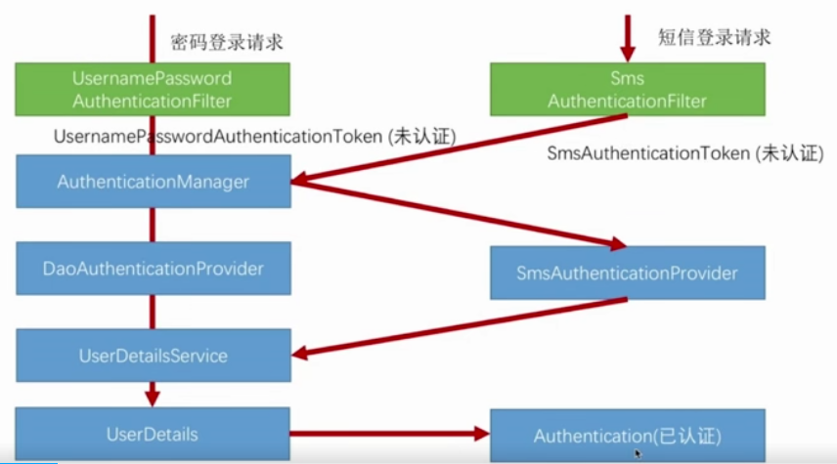
自己写短信验证码校验逻辑

Slide 84
SmsCodeAuthenticationToken
参照UsernamePasswordAuthenticationToken
public class SmsCodeAuthenticationToken extends AbstractAuthenticationToken { private static final long serialVersionUID = 420L; private final Object principal; public SmsCodeAuthenticationToken(String mobile) { super((Collection)null); this.principal = mobile; this.setAuthenticated(false); } public SmsCodeAuthenticationToken(Object principal, Collection<? extends GrantedAuthority> authorities) { super(authorities); this.principal = principal; super.setAuthenticated(true); } @Override public Object getCredentials() { return null; } public Object getPrincipal() { return this.principal; } public void setAuthenticated(boolean isAuthenticated) throws IllegalArgumentException { if (isAuthenticated) { throw new IllegalArgumentException("Cannot set this token to trusted - use constructor which takes a GrantedAuthority list instead"); } else { super.setAuthenticated(false); } } public void eraseCredentials() { super.eraseCredentials(); } }

Slide 85
SmsCodeAuthenticationFilter
参照UsernamePasswordAuthenticationFilter
public class SmsCodeAuthenticationFilter extends AbstractAuthenticationProcessingFilter { public static final String LIHANG_FORM_MOBILE_KEY = "mobile"; private String mobileParameter = LIHANG_FORM_MOBILE_KEY; private boolean postOnly = true; public SmsCodeAuthenticationFilter() { super(new AntPathRequestMatcher("/authentication/mobile", "POST"));//处理的请求 } public Authentication attemptAuthentication(HttpServletRequest request, HttpServletResponse response) throws AuthenticationException { if (this.postOnly && !request.getMethod().equals("POST")) { throw new AuthenticationServiceException("Authentication method not supported: " + request.getMethod()); } else { String mobile = this.obtainMobile(request); if (mobile == null) { mobile = ""; } mobile = mobile.trim(); SmsCodeAuthenticationToken authRequest = new SmsCodeAuthenticationToken(mobile); this.setDetails(request, authRequest); return this.getAuthenticationManager().authenticate(authRequest); } } protected String obtainMobile(HttpServletRequest request) { return request.getParameter(this.mobileParameter); } protected void setDetails(HttpServletRequest request, SmsCodeAuthenticationToken authRequest) { authRequest.setDetails(this.authenticationDetailsSource.buildDetails(request)); } public void setMobileParameter(String mobileParameter) { Assert.hasText(mobileParameter, "Mobile parameter must not be empty or null"); this.mobileParameter = mobileParameter; } public void setPostOnly(boolean postOnly) { this.postOnly = postOnly; } public final String getMobileParameter() { return this.mobileParameter; } }

Slide 86
SmsCodeAuthenticationProvider
public class SmsCodeAuthenticationProvider implements AuthenticationProvider { private UserDetailsService userDetailsService; @Override public Authentication authenticate(Authentication authentication) throws AuthenticationException { SmsCodeAuthenticationToken authenticationToken = (SmsCodeAuthenticationToken) authentication; UserDetails user = userDetailsService.loadUserByUsername((String) authenticationToken.getPrincipal()); if (user == null){ throw new InternalAuthenticationServiceException("无法获取用户信息息); } SmsCodeAuthenticationToken authenticationTokenResult = new SmsCodeAuthenticationToken(user,user.getAuthorities()); authenticationTokenResult.setDetails(authenticationToken.getDetails()); return authenticationTokenResult; } @Override public boolean supports(Class<?> aClass) { return SmsCodeAuthenticationToken.class.isAssignableFrom(aClass); } public UserDetailsService getUserDetailsService() { return userDetailsService; } public void setUserDetailsService(UserDetailsService userDetailsService) { this.userDetailsService = userDetailsService; } }

Slide 87
SmsCodeAuthenticationSecurityConfig
@Component public class SmsCodeAuthenticationSecurityConfig extends SecurityConfigurerAdapter<DefaultSecurityFilterChain,HttpSecurity> { @Autowired private AuthenticationSuccessHandler myAuthenticationSuccessHandler; @Autowired private AuthenticationFailureHandler myAuthenticationFailureHandler; @Autowired private UserDetailsService userDetailsService; @Override public void configure(HttpSecurity http) throws Exception { SmsCodeAuthenticationFilter smsCodeAuthenticationFilter = new SmsCodeAuthenticationFilter(); smsCodeAuthenticationFilter.setAuthenticationManager(http.getSharedObject(AuthenticationManager.class)); smsCodeAuthenticationFilter.setAuthenticationSuccessHandler(myAuthenticationSuccessHandler); smsCodeAuthenticationFilter.setAuthenticationFailureHandler(myAuthenticationFailureHandler); SmsCodeAuthenticationProvider smsCodeAuthenticationProvider = new SmsCodeAuthenticationProvider(); smsCodeAuthenticationProvider.setUserDetailsService(userDetailsService); http.authenticationProvider(smsCodeAuthenticationProvider) .addFilterAfter(smsCodeAuthenticationFilter,UsernamePasswordAuthenticationFilter.class); } }

Slide 88
创建自己的过滤器
校验验证码
public class SmsValidateCodeFilter extends OncePerRequestFilter implements InitializingBean { private AuthenticationFailureHandler authenticationFailureHandler; private SessionStrategy sessionStrategy = new HttpSessionSessionStrategy(); private Set<String> urls = new HashSet<>(); private SecurityProperties securityProperties ; private AntPathMatcher pathMatcher = new AntPathMatcher(); @Override public void afterPropertiesSet() throws ServletException { super.afterPropertiesSet(); if (StringUtils.isNotBlank(securityProperties.getCode().getImage().getUrl())) { String[] urlsConfig = StringUtils.splitByWholeSeparatorPreserveAllTokens(securityProperties.getCode().getImage().getUrl(), ","); for (String url : urlsConfig) { urls.add(url); } } urls.add("/authentication/mobile"); } @Override protected void doFilterInternal(HttpServletRequest httpServletRequest, HttpServletResponse httpServletResponse, FilterChain filterChain) throws ServletException, IOException { System.out.println("myFilter++++++++++++++++++++++++++"+httpServletRequest.getRequestURI()); boolean action = false; for (String url:urls) { if (pathMatcher.match(url,httpServletRequest.getRequestURI())) action = true; } if (action){ try { validate(new ServletWebRequest(httpServletRequest)); }catch (ValidateCodeExecution e ){ authenticationFailureHandler.onAuthenticationFailure(httpServletRequest,httpServletResponse,e); return; } } filterChain.doFilter(httpServletRequest,httpServletResponse); } private void validate(ServletWebRequest request) throws ServletRequestBindingException { ValidateCode codeInSession = (ValidateCode)sessionStrategy.getAttribute(request,ValidateCodeController.SESSION_KEY_PREFIX+"SMS"); String codeInRequest = ServletRequestUtils.getStringParameter(request.getRequest(),"smsCode"); System.out.println(codeInRequest); if (StringUtils.isBlank(codeInRequest)){ throw new ValidateCodeExecution("手机验证码不能为空空); } if (codeInRequest == null){ throw new ValidateCodeExecution("手机验证码不存在在); } if (codeInSession.isExpired()){ sessionStrategy.removeAttribute(request,ValidateCodeController.SESSION_KEY_PREFIX+"SMS"); throw new ValidateCodeExecution("手机验证码已失效效); } if (!StringUtils.equals(codeInSession.getCode(),codeInRequest)){ throw new ValidateCodeExecution("手机验证码不匹配配); } sessionStrategy.removeAttribute(request,ValidateCodeController.SESSION_KEY_PREFIX+"SMS"); } public AuthenticationFailureHandler getAuthenticationFailureHandler() { return authenticationFailureHandler; } public void setAuthenticationFailureHandler(AuthenticationFailureHandler authenticationFailureHandler) { this.authenticationFailureHandler = authenticationFailureHandler; } public SecurityProperties getSecurityProperties() { return securityProperties; } public void setSecurityProperties(SecurityProperties securityProperties) { this.securityProperties = securityProperties; } }

Slide 89
配置让前面几个类生效
SmsValidateCodeFilter smsValidateCodeFilter = new SmsValidateCodeFilter(); smsValidateCodeFilter.setAuthenticationFailureHandler(myAuthenticationFailureHandler); smsValidateCodeFilter.setSecurityProperties(securityProperties); smsValidateCodeFilter.afterPropertiesSet(); http.addFilterBefore(smsValidateCodeFilter,UsernamePasswordAuthenticationFilter.class) .addFilterBefore(validateCodeFilter,UsernamePasswordAuthenticationFilter.class) .formLogin()//表单登陆 .loginPage("/authentication/require")//登陆请求 .loginProcessingUrl("/authentication/form")//表单中的提交交RL .successHandler(myAuthenticationSuccessHandler) .failureHandler(myAuthenticationFailureHandler) .and() .rememberMe() .tokenRepository(persistentTokenRepository()) .tokenValiditySeconds(securityProperties.getBrowser().getRemermberMeSeconds()) .userDetailsService(userDetailsService) .and() .authorizeRequests() .antMatchers("/authentication/require" ,securityProperties.getBrowser().getLoginPage() ,"/code/*" ).permitAll()//跳过这些请求，不验证 .anyRequest() .authenticated() .and().csrf().disable() .apply(smsCodeAuthenticationSecurityConfig);

Slide 90
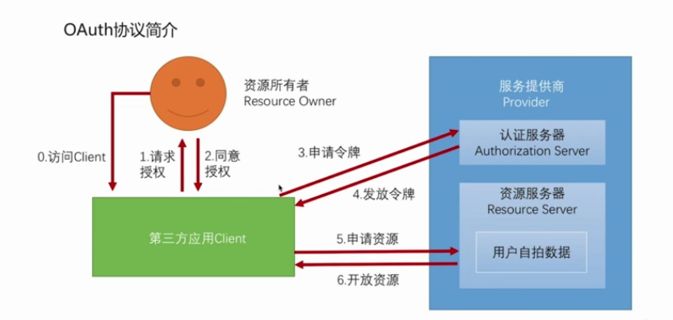
OAuth协议认证流程

Slide 91
OAuth协议的授权模式
1、授权码模式（authorization code）
2、密码模式（resource owner password credentials）
3、客户端模式（client credentials）
4、简化模式（implicit）

Slide 92
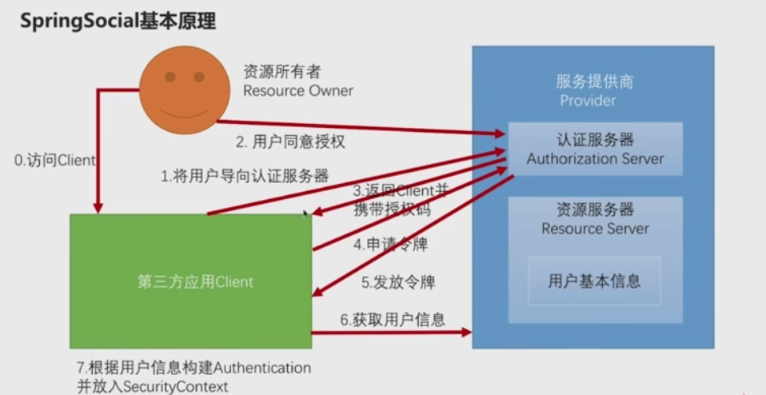
授权码模式

Slide 93
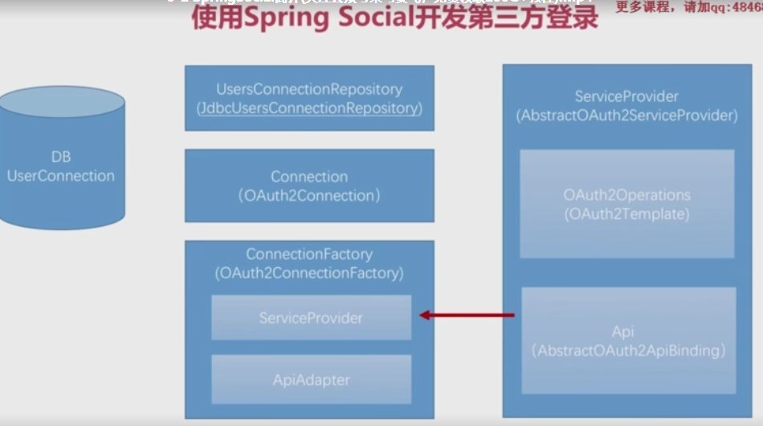

Slide 94
QQ登陆开发
第一步
1、建立获取qq用户信息的接口
public interface QQ {
QQUserInfo getUserInfo();
}
2、实现类的接口
public class QQImpl extends AbstractOAuth2ApiBinding implements QQ {
private static final String URL_GET_OPENID ="https://graph.qq.com/oauth2.0/me?access_token=%s";
private String URL_GET_USERINFO ="https://graph.qq.com/user/get_user_info?oauth_consumer_key=%s&openid=%s";
private String appId;
private String openId;
private ObjectMapper objectMapper = new ObjectMapper();
public QQImpl(String accessToken,String appId){
super(accessToken, TokenStrategy.ACCESS_TOKEN_PARAMETER);
this.appId = appId;
String url = String.format(URL_GET_OPENID,accessToken);
String result = getRestTemplate().getForObject(url,String.class);//获取openId
System.out.println(result);
this.openId = StringUtils.substringBetween(result, "\"openid\":\"", "\"}");
}
@Override
public QQUserInfo getUserInfo() {
String url = String.format(URL_GET_USERINFO, appId, openId);
String result = getRestTemplate().getForObject(url, String.class);//获取用户信息
System.out.println(result);
try {
return objectMapper.readValue(result,QQUserInfo.class);
}catch (Exception e){
throw new RuntimeException("获取用户信息出错错,e);
}
}
}

Slide 95
3、建立QQ用户详情信息实体
public class QQUserInfo {
/**
* 返回码
*/
private String ret;
/**
* 如果果et<0，会有相应的错误信息提示，返回数据全部用用TF-8编码。
*/
private String msg;
/**
*
*/
private String openId;
/**
* 不知道什么东西，文档上没写，但是实际际pi返回里有。
*/
private String is_lost;
/**
* 省省直辖市市
*/
private String province;
/**
* 市市直辖市区区
*/
private String city;
/**
* 出生年月
*/
private String year;
/**
* 用户在在Q空间的昵称。
*/
private String nickname;
/**
* 大小为为0××0像素的的Q空间头像像RL。
*/
private String figureurl;
/**
* 大小为为0××0像素的的Q空间头像像RL。
*/
private String figureurl_1;
/**
* 大小为为00××00像素的的Q空间头像像RL。
*/
private String figureurl_2;
/**
* 大小为为0××0像素的的Q头像像RL。
*/
private String figureurl_qq_1;
/**
* 大小为为00××00像素的的Q头像像RL。需要注意，不是所有的用户都拥有有Q的的00××00的头像，但但0××0像素则是一定会有。
*/
private String figureurl_qq_2;
/**
* 性别。。如果获取不到则默认返回”男”
*/
private String gender;
/**
* 标识用户是否为黄钻用户（（：不是；；：是）。
*/
private String is_yellow_vip;
/**
* 标识用户是否为黄钻用户（（：不是；；：是）
*/
private String vip;
/**
* 黄钻等级
*/
private String yellow_vip_level;
/**
* 黄钻等级
*/
private String level;
/**
* 标识是否为年费黄钻用户（（：不是；；1：是）
*/
private String is_yellow_year_vip;

Slide 96
第二步
1、创建Adapter
public class QQAdapter implements ApiAdapter<QQ> { @Override public boolean test(QQ qq) { return true; } @Override public void setConnectionValues(QQ api, ConnectionValues connectionValues) { QQUserInfo userInfo = api.getUserInfo(); connectionValues.setDisplayName(userInfo.getNickname()); connectionValues.setImageUrl(userInfo.getFigureurl_qq_1()); connectionValues.setProfileUrl(null); connectionValues.setProviderUserId(userInfo.getOpenId()); } @Override public UserProfile fetchUserProfile(QQ qq) { return null; } @Override public void updateStatus(QQ qq, String s) { //none } }

Slide 97
2、创建Provider
public class QQServiceProvider extends AbstractOAuth2ServiceProvider<QQ> { private String appId; private static final String URL_AUTHORIZE = "https://graph.qq.com/oauth2.0/authorize"; private static final String URL_ACCESS_TOKEN = "https://graph.qq.com/oauth2.0/token"; public QQServiceProvider(String appId,String appSecret) { super(new OAuth2Template(appId,appSecret,URL_AUTHORIZE,URL_ACCESS_TOKEN)); } @Override public QQ getApi(String accessToken) { return new QQImpl(accessToken,appId); } }

Slide 98
3、创建Factory
public class QQConnectionFactory extends OAuth2ConnectionFactory<QQ> { public QQConnectionFactory(String providerId,String appId,String appSecret) { super(providerId, new QQServiceProvider(appId,appSecret), new QQAdapter()); } }

Slide 99
4、将用户与userId之间建立对应关系，并存入数据库
@Configuration @EnableSocial public class SocialConfig extends SocialConfigurerAdapter { @Autowired private DataSource dataSource; @Override public UsersConnectionRepository getUsersConnectionRepository(ConnectionFactoryLocator connectionFactoryLocator) { JdbcUsersConnectionRepository jdbcUsersConnectionRepository = new JdbcUsersConnectionRepository(dataSource,connectionFactoryLocator,Encryptors.noOpText()); jdbcUsersConnectionRepository.setTablePrefix("my_"); return jdbcUsersConnectionRepository; } @Bean public SpringSocialConfigurer mySocialConfig(){ return new SpringSocialConfigurer(); } }

Slide 100
加入总配置类
@Autowired private SpringSocialConfigurer mySocialConfig; .and() .apply(mySocialConfig) .and()

Slide 101
重构UserDetailService
@Component public class MyUserDetailsService implements UserDetailsService,SocialUserDetailsService { //+++++++++++++++++ private org.slf4j.Logger logger = LoggerFactory.getLogger(getClass()); @Autowired private PasswordEncoder passwordEncoder; /* * (non-Javadoc) * * @see org.springframework.security.core.userdetails.UserDetailsService# * loadUserByUsername(java.lang.String) */ @Override public UserDetails loadUserByUsername(String username) throws UsernameNotFoundException { logger.info("表单登录用户名名" + username); return buildUser(username); } @Override public SocialUserDetails loadUserByUserId(String userId) throws UsernameNotFoundException { logger.info("设计登录用户户d:" + userId); return buildUser(userId); } private SocialUserDetails buildUser(String userId) { // 根据用户名查找用户信息 //根据查找到的用户信息判断用户是否被冻结 String password = passwordEncoder.encode("1234"); logger.info("数据库密码是是"+password); return new SocialUser(userId, password, true, true, true, true, AuthorityUtils.commaSeparatedStringToAuthorityList("admin")); } }

Slide 102
配置app-id和app-secret
public class QQProperties extends SocialProperties {
private String providerId = "qq";
public String getProviderId() {
return providerId;
}
public void setProviderId(String providerId) {
this.providerId = providerId;
}
}
public class SocialProperties {
private QQProperties qq = new QQProperties();
public QQProperties getQq() {
return qq;
}
public void setQq(QQProperties qq) {
this.qq = qq;
}
}

Slide 103
@ConfigurationProperties(prefix = "lihang.security")
public class SecurityProperties {
private BrowserProperties browser = new BrowserProperties();
private ValidateCodeProperties code = new ValidateCodeProperties();
private SocialProperties social = new SocialProperties();
}

Slide 104
配置与页面
lihang.security.social.qq.app-id =
lihang.security.social.qq.app-secret =
<a href="/auth/qq">QQ登陆陆/a>
注意：点击QQ登陆时发送请求的URL必须与回调URL一致，/auth/qq也应该是回调地址中填的
例如回调地址：http://www.hangstarli.com/auth/qq,端口是80
下面我们更改请求路径：http://www.hangstarli.com/qqLogin/callback.do

Slide 105
1、修改host文件：127.0.0.1 www.hangstarli.com
2、修改端口：80
3、修改auth为qqLogin
public class MySpringSocialConfigurer extends SpringSocialConfigurer {
private String filterProcessesUrl;
public MySpringSocialConfigurer(String filterProcessesUrl) {
this.filterProcessesUrl = filterProcessesUrl;
}
@Override
protected <T> T postProcess(T object) {
SocialAuthenticationFilter filter = (SocialAuthenticationFilter)super.postProcess(object);
filter.setFilterProcessesUrl(filterProcessesUrl);
return super.postProcess(object);
}
}
+++++++++++++++++++++++++++++++++++++++++++++++++++++++++++++++++++++++
@Configuration
@EnableSocial
public class SocialConfig extends SocialConfigurerAdapter {
@Autowired
private DataSource dataSource;
@Autowired
private SecurityProperties securityProperties;
@Bean
public SpringSocialConfigurer mySocialConfig(){
String filterProcessesUrl = securityProperties.getSocial().getFilterProcessesUrl();
return new MySpringSocialConfigurer(filterProcessesUrl);
}
}

Slide 106
4、配置
lihang.security.social.filterProcessesUrl = /qqLogin
lihang.security.social.qq.providerId = callback.do
#注意：callback.do前万不能写成/callback.do
页面：
<a href="/qqLogin/callback.do">QQ登陆陆/a>

Slide 107
5、配置一个Template
public class QQOAuth2Template extends OAuth2Template {
// public QQOAuth2Template(String clientId, String clientSecret, String authorizeUrl, String accessTokenUrl) {
// super(clientId, clientSecret, authorizeUrl, accessTokenUrl);
// }
private Logger logger = LoggerFactory.getLogger(getClass());
public QQOAuth2Template(String clientId, String clientSecret, String authorizeUrl, String accessTokenUrl){
super(clientId, clientSecret, authorizeUrl, accessTokenUrl);
setUseParametersForClientAuthentication(true);
}
@Override
protected AccessGrant postForAccessGrant(String accessTokenUrl, MultiValueMap<String, String> parameters) {
String responseStr = getRestTemplate().postForObject(accessTokenUrl,parameters,String.class);
logger.info("获取取ccessToken的响应应+responseStr);
String[] items = StringUtils.splitByWholeSeparatorPreserveAllTokens(responseStr,"&");
String accessToken = StringUtils.substringAfterLast(items[0],"=");
Long expiresIn = new Long(StringUtils.substringAfterLast(items[1],"="));
String refreshToken = StringUtils.substringAfterLast(items[2],"=");
return new AccessGrant(accessToken,null, refreshToken, expiresIn);
}
@Override
protected RestTemplate createRestTemplate() {
RestTemplate restTemplate = super.createRestTemplate();
restTemplate.getMessageConverters().add(new StringHttpMessageConverter(Charset.forName("utf-8")));
return restTemplate;
}
}

Slide 108
在QQServiceProvider中
public QQServiceProvider(String appId,String appSecret) {
super(new QQOAuth2Template(appId,appSecret,URL_AUTHORIZE,URL_ACCESS_TOKEN));
this.appId = appId;
}

Slide 109
6、由于是第一次登陆，所以需要注册，默认跳转到/signUp
配置默认注册页
注册页可配置
lihang.security.browser.signUpUrl= /demoRegist.html
将找不到UserID时，加到过滤器上跳转：
@Configuration
@EnableSocial
public class SocialConfig extends SocialConfigurerAdapter {
@Autowired
private DataSource dataSource;
@Autowired
private SecurityProperties securityProperties;
@Bean
public SpringSocialConfigurer mySocialConfig(){
String filterProcessesUrl = securityProperties.getSocial().getFilterProcessesUrl();
MySpringSocialConfigurer configurer = new MySpringSocialConfigurer(filterProcessesUrl);
configurer.signupUrl(securityProperties.getBrowser().getSignUpUrl());
return configurer;
}
}
不拦截： SecurityConstants.DEFAULT_VALIDATE_CODE_URL_PREFIX+"/*",
securityProperties.getBrowser().getSignUpUrl()
).permitAll()//跳过这些请求，不验证
.anyRequest()
.authenticated()
.and().csrf().disable();

Slide 110
7、注册时得到Social的信息，如名称，头像，并把UserId传给Social
class:SocialConfig
/*
* connectionFactoryLocator由由pringBoot提供，自动注入到参数里
* */
@Bean
public ProviderSignInUtils providerSignInUtils(ConnectionFactoryLocator connectionFactoryLocator){
return new ProviderSignInUtils(connectionFactoryLocator,getUsersConnectionRepository(connectionFactoryLocator)){
};
}
创建一个：
public class SocialUserInfo {
private String providerId;
private String providerUserId;
private String nickname;
private String headimg;
}
class:BrawserController

Slide 111
@Autowired
private ProviderSignInUtils providerSignInUtils;
@GetMapping("/social/user")
public SocialUserInfo getSocialUserInfo(HttpServletRequest request){
SocialUserInfo socialUserInfo socialUserInfo = new SocialUserInfo();
Connection<?> connection = providerSignInUtils.getConnectionFromSession(new ServletWebRequest(request));
socialUserInfo.setProviderId(connection.getKey().getProviderId());
socialUserInfo.setProviderUserId(connection.getKey().getProviderUserId());
socialUserInfo.setNickname(connection.getDisplayName());
socialUserInfo.setHeadimg(connection.getImageUrl());
return socialUserInfo;
}
Class:userController
@Autowired
private ProviderSignInUtils providerSignInUtils;
@PostMapping("/regist")
public void regist(User user, HttpServletRequest request){
//注册用户户绑定，都会拿到一个用户唯一标识
String userName = user.getUsername();
providerSignInUtils.doPostSignUp(userName,new ServletWebRequest(request));
}

Slide 112
不用注册，直接登陆进系统
@Component
public class DemoConnectionSignUp implements ConnectionSignUp {
@Override
public String execute(Connection<?> connection) {
return connection.getDisplayName();
}
}
//注意：将下面的getUsersConnectionRepository放到QQAutoConfig中
@Configuration
@EnableSocial
public class SocialConfig extends SocialConfigurerAdapter {
@Autowired
private DataSource dataSource;
@Autowired
private SecurityProperties securityProperties;
@Autowired(required = false)
private ConnectionSignUp connectionSignUp;
@Override
public UsersConnectionRepository getUsersConnectionRepository(ConnectionFactoryLocator connectionFactoryLocator) {
JdbcUsersConnectionRepository jdbcUsersConnectionRepository = new JdbcUsersConnectionRepository(dataSource,connectionFactoryLocator,Encryptors.noOpText());
jdbcUsersConnectionRepository.setTablePrefix("my_");
if (connectionSignUp != null){
jdbcUsersConnectionRepository.setConnectionSignUp(connectionSignUp);
}
return jdbcUsersConnectionRepository;
}
}

Slide 113
解决Mysql中rank为关键字
新建JdbcConnectionRepository和
JdbcUsersConnectionRepository两个类，修改其中的rank为socialrank,然后在QQAutoConfig中new 自己的JdbcUsersConnectionRepository

Slide 114
绑定与解除绑定
获取是否绑定：URL：/connect
@Component("connect/status")
public class MyConnectionStatusView extends AbstractView {
@Autowired
private ObjectMapper objectMapper;
@Override
protected void renderMergedOutputModel(Map<String, Object> model, HttpServletRequest httpServletRequest, HttpServletResponse httpServletResponse) throws Exception {
Map<String,List<Connection<?>>> connection = (Map<String, List<Connection<?>>>) model.get("connectionMap");
System.out.println(connection);
Map<String,Boolean> result = new HashMap<>();
for (String key :connection.keySet()) {
result.put(key,CollectionUtils.isNotEmpty(connection.get(key)));
}
httpServletResponse.setContentType("application/json;charset=UTF-8");
httpServletResponse.getWriter().write(objectMapper.writeValueAsString(result));
}
}

Slide 115
public class MyConnectedView extends AbstractView {
@Override
protected void renderMergedOutputModel(Map<String, Object> map, HttpServletRequest httpServletRequest, HttpServletResponse httpServletResponse) throws Exception {
httpServletResponse.setContentType("text/html;charset=UTF-8");
if(map.get("connection") == null){
httpServletResponse.getWriter().write("<h3>解除绑定成功功/h3>");
}else {
httpServletResponse.getWriter().write("<h3>绑定成功功/h3>");
}
}
}

Slide 116
@Bean({"connect/weixinConnect", "connect/weixinConnected"})
@ConditionalOnMissingBean(name = "weixinConnectedView")
public View weixinConnectedView(){
return new MyConnectedView();
}
页面：
<form action="/connect/weixin" method="post">
<input type="submit" value="微信绑定定>
</form>
<form action="/connect/weixin" method="delete">
<input type="submit" value="解除微信绑定定>
</form>

Slide 117
Session管理
1、Session超时处理
2、Session 并发控制
3、Session集群

