Slide 1
RabbitMQ学习笔记

Slide 2
启动
点击命令窗口：RabbitMQ Command Prompt（C:\Users\a\AppData\Roaming\Microsoft\Windows\Start Menu\Programs\RabbitMQ Server）
输入：rabbitmq-plugins.bat enable rabbitmq_management
http://localhost:15672/

Slide 3
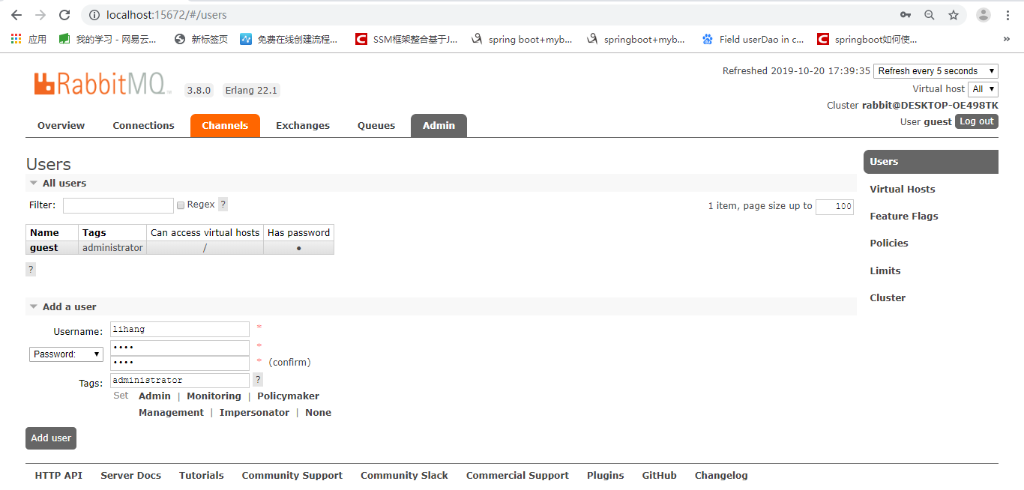
添加用户

Slide 4
登陆
用户名 密码
超级用户： guest guest
用户1 ： lihang 1234

Slide 5
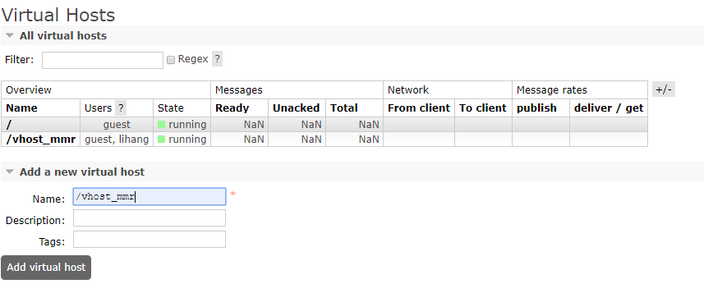
Virtual Host 相当于数据库
通常以/开头

Slide 6
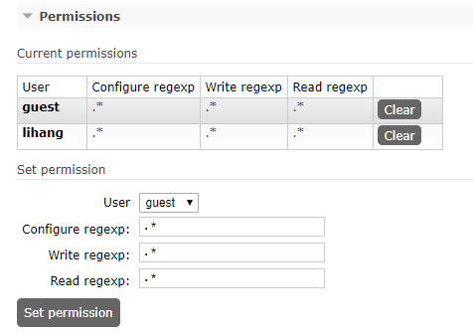
授权给用户

Slide 7
java操作Rabbit MQ

Slide 8
简单队列
P
C

Slide 9
添加Maven依赖
<dependencies> <dependency> <groupId>junit</groupId> <artifactId>junit</artifactId> <version>4.11</version> <scope>test</scope> </dependency> <dependency> <groupId>com.rabbitmq</groupId> <artifactId>amqp-client</artifactId> <version>4.0.2</version> </dependency> <dependency> <groupId>org.slf4j</groupId> <artifactId>slf4j-api</artifactId> <version>1.7.28</version> </dependency> <dependency> <groupId>org.slf4j</groupId> <artifactId>slf4j-log4j12</artifactId> <version>1.7.26</version> </dependency> <dependency> <groupId>log4j</groupId> <artifactId>log4j</artifactId> <version>1.2.17</version> </dependency> </dependencies>

Slide 10
建立连接
public static Connection getConnection(){ //创建链接工厂 ConnectionFactory factory = new ConnectionFactory(); //设置host factory.setHost("127.0.0.1"); //设置AMQP端口号 factory.setPort(5672); //设置数据库 factory.setVirtualHost("/vhost_mmr"); //设置用户名密码 factory.setUsername("lihang"); factory.setPassword("1234"); try { return factory.newConnection(); } catch (IOException e) { e.printStackTrace(); } catch (TimeoutException e) { e.printStackTrace(); } return null; }

Slide 11
生产者发送消息
public class SendMessage { private static final String QUEUE_NAME = "test-simple-queue"; public static void main(String[] args) throws IOException { //获取连接 Connection connection = ConnectionUtil.getConnection(); //从连接中获取通道 Channel channel = connection.createChannel(); //创建队列声明 channel.queueDeclare(QUEUE_NAME,false,false,false,null); //创建发送消息 String message = "hello simple queue"; channel.basicPublish("",QUEUE_NAME,null,message.getBytes()); //关闭资源 try { channel.close(); } catch (TimeoutException e) { e.printStackTrace(); } connection.close(); } }

Slide 12
消费者接收消息（旧）
public class RecieveMessage { private static final String QUEUE_NAME = "test-simple-queue"; public static void main(String[] args) throws IOException, InterruptedException { //获取连接 Connection connection = ConnectionUtil.getConnection(); //获取通道 Channel channel = connection.createChannel(); //定义队列消费者 QueueingConsumer consumer = new QueueingConsumer(channel); //监听队列 channel.basicConsume(QUEUE_NAME,true,consumer); while(true){ QueueingConsumer.Delivery delivery = consumer.nextDelivery(); String message = new String(delivery.getBody()); System.out.println(message); } } }

Slide 13
消费者接收消息（新）
private static final String QUEUE_NAME = "test-simple-queue"; public static void main(String[] args) throws IOException, InterruptedException { /*新方法*/ //获取连接 Connection connection = ConnectionUtil.getConnection(); //获取通道 Channel channel = connection.createChannel(); //声明队列 channel.queueDeclare(QUEUE_NAME,false,false,false,null); Consumer consumer = new DefaultConsumer(channel){ @Override public void handleDelivery(String consumerTag, Envelope envelope, AMQP.BasicProperties properties, byte[] body) throws IOException { String message = new String(body,"utf-8"); System.out.println(message); } }; //监听队列 channel.basicConsume(QUEUE_NAME,true,consumer); }

Slide 14
简单队列的不足
耦合性高，更改队列名时都得更改
生产设消费者一一对应，不能存在多个消费者

Slide 15
Work Queue工作队列
C
C
P
QUEUE
C
C

Slide 16
工作队列的引用场景
生产者发送消息是很快的，但是消费者消费消息是很慢的，因为消费者是结合业务处理的，所以一对一的简单队列就很容易出现消息积压
所以工作队列可以多个消费者同时对一批消息进行处理，以加快处理流程

Slide 17
轮询方式（round-robin）
两个消费者处理的消息一样多，无论谁处理消息的快

Slide 18
生产者
private static final String QUEUE_NAME = "test-work-queue"; public static void main(String[] args) throws IOException, InterruptedException, TimeoutException { Connection connection = ConnectionUtil.getConnection(); Channel channel = connection.createChannel(); channel.queueDeclare(QUEUE_NAME,false,false,false,null); for (int i = 0; i <100 ; i++) { String message = "hello work queue:"+i; channel.basicPublish("",QUEUE_NAME,null,message.getBytes()); Thread.sleep(50*i); } channel.close(); connection.close(); }

Slide 19
消费者1
private static final String QUEUE_NAME = "test-work-queue"; public static void main(String[] args) throws IOException { Connection connection = ConnectionUtil.getConnection(); Channel channel = connection.createChannel(); channel.queueDeclare(QUEUE_NAME,false,false,false,null); Consumer consumer = new DefaultConsumer(channel){ @Override public void handleDelivery(String consumerTag, Envelope envelope, AMQP.BasicProperties properties, byte[] body) throws IOException { String message = new String(body,"utf-8"); System.out.println("recieve-1: "+message); try { Thread.sleep(2000); } catch (InterruptedException e) { e.printStackTrace(); }finally { System.out.println("recieve-1 has finished"); } } }; boolean ACK = true; channel.basicConsume(QUEUE_NAME,ACK,consumer); }

Slide 20
消费者2
private static final String QUEUE_NAME = "test-work-queue"; public static void main(String[] args) throws IOException { Connection connection = ConnectionUtil.getConnection(); Channel channel = connection.createChannel(); channel.queueDeclare(QUEUE_NAME,false,false,false,null); Consumer consumer = new DefaultConsumer(channel){ @Override public void handleDelivery(String consumerTag, Envelope envelope, AMQP.BasicProperties properties, byte[] body) throws IOException { String message = new String(body,"utf-8"); System.out.println("recieve-2: "+message); try { Thread.sleep(1000); } catch (InterruptedException e) { e.printStackTrace(); }finally { System.out.println("recieve-2 has finished"); } } }; boolean ACK = true; channel.basicConsume(QUEUE_NAME,ACK,consumer); }

Slide 21
公平分发（fair-dipatch）
这种模式下，谁处理消息快，谁就能处理更多的消息
实现原理：关闭自动应答（autoACK），采用手动反馈的方式;让消息队列每次只能分发一条消息给消费者处理，消费者处理完消息后，反馈给消息队列，然后消息队列再分发一条消息给他，这样，谁处理消息的速度快，谁就能得到更多的消息

Slide 22
生产者
private static final String QUEUE_NAME = "test-work-queue"; public static void main(String[] args) throws IOException, InterruptedException, TimeoutException { Connection connection = ConnectionUtil.getConnection(); Channel channel = connection.createChannel(); channel.queueDeclare(QUEUE_NAME,false,false,false,null); //保证一次只分发一个消息 channel.basicQos(1); for (int i = 0; i <100 ; i++) { String message = "hello work queue:"+i; channel.basicPublish("",QUEUE_NAME,null,message.getBytes()); // Thread.sleep(50*i); } channel.close(); connection.close(); }

Slide 23
消费者1
private static final String QUEUE_NAME = "test-work-queue"; public static void main(String[] args) throws IOException { Connection connection = ConnectionUtil.getConnection(); final Channel channel = connection.createChannel(); channel.queueDeclare(QUEUE_NAME,false,false,false,null); //保证一次只分发一个消息 channel.basicQos(1); Consumer consumer = new DefaultConsumer(channel){ @Override public void handleDelivery(String consumerTag, Envelope envelope, AMQP.BasicProperties properties, byte[] body) throws IOException { String message = new String(body,"utf-8"); System.out.println("recieve-1: "+message); try { Thread.sleep(2000); } catch (InterruptedException e) { e.printStackTrace(); }finally { System.out.println("recieve-1 has finished"); //手动应答 channel.basicAck(envelope.getDeliveryTag(),false); } } }; //关闭自动应答 boolean autoACK = false; channel.basicConsume(QUEUE_NAME,autoACK,consumer); }

Slide 24
消费者2
private static final String QUEUE_NAME = "test-work-queue"; public static void main(String[] args) throws IOException { Connection connection = ConnectionUtil.getConnection(); final Channel channel = connection.createChannel(); channel.queueDeclare(QUEUE_NAME,false,false,false,null); //每次只分发一条消息 channel.basicQos(1); Consumer consumer = new DefaultConsumer(channel){ @Override public void handleDelivery(String consumerTag, Envelope envelope, AMQP.BasicProperties properties, byte[] body) throws IOException { String message = new String(body,"utf-8"); System.out.println("recieve-2: "+message); try { Thread.sleep(1000); } catch (InterruptedException e) { e.printStackTrace(); }finally { System.out.println("recieve-2 has finished"); //手动应答，消息处理完了，可以处理下一条信息了 channel.basicAck(envelope.getDeliveryTag(),false); } } }; //关闭自动应答 boolean ACK = false; channel.basicConsume(QUEUE_NAME,ACK,consumer); }

Slide 25
消息应答和消息持久化
一、消息应答（autoACK）:
boolean autoACK = true;
channel.basicConsume(QUEUE_NAME,autoACK,consumer);
1、boolean autoACK = true;
自动应答，即消息队列发送消息给消费者后，消息就会从内存中马上删除
问题：如果某个正在处理消息的消费者突然挂掉，那么正被处理的这个消 息就会丢失
2、boolean autoACK = false;
手动应答，当消费者处理完成消息后，会给消息队列一个反馈（我处理完了），这时这个消息才会从内存中删除如果这个消费者挂掉，消息队列会重新将这个消息分给其他的消费者处理。
3、默认 autoACK = true;

Slide 26
二、消息持久化
boolean durable = false;//消息持久化参数
channel.queueDeclare(QUEUE_NAME,durable ,false,false,null);
如果rabbitmq服务器挂掉，那么所有的消息将会丢失，所以我们需要将消息队列持久化；即将 durable 设置成 true.
注意：已经定义好的队列（queue），我们不能更改他的定义参数，即，如果定义队列时，将durable设置成false,下一次不能将同名的队列的durable设置成true.

Slide 27
发布订阅模式（Publish/Subscribe）
1、一个生产者，多个消费者
2、每个消费者都有自己的队列
3、生产者没有直接把消息发送到队列，而是发给了交换机转发器
4、每个队列都绑定到交换机上
5、生产者发送的消息经过交换机，到达队列，这样一个消息就可以被多个消费者消费
queue
C
P
E
queue
C

Slide 28
生产者
private static final String EXCHANGE_NAME = "text-exchange-fanout"; public static void main(String[] args) throws IOException, TimeoutException { Connection connection = ConnectionUtil.getConnection(); Channel channel = connection.createChannel(); //声明交换机 channel.exchangeDeclare(EXCHANGE_NAME,"fanout");//分发 //发送消息 String msg = "hello publish and subscribe"; channel.basicPublish(EXCHANGE_NAME,"",null,msg.getBytes()); System.out.println("send successful"); channel.close(); connection.close(); }

Slide 29
消费者1
private static final String QUEUE_NAME = "test-publish-queue-email"; private static final String EXCHANGE_NAME = "test-exchange-fanout"; public static void main(String[] args) throws IOException, TimeoutException { Connection connection = ConnectionUtil.getConnection(); final Channel channel = connection.createChannel(); channel.queueDeclare(QUEUE_NAME,false,false,false,null); //绑定到交换机 channel.queueBind(QUEUE_NAME,EXCHANGE_NAME,""); channel.basicQos(1);//每次只发一个 //定义一个消费者 Consumer consumer = new DefaultConsumer(channel){ //消息到达时，触发这个方法 @Override public void handleDelivery(String consumerTag, Envelope envelope, AMQP.BasicProperties properties, byte[] body) throws IOException { String msg = new String(body,"utf-8") ; System.out.println("consumer1:"+msg); try { Thread.sleep(1000); } catch (InterruptedException e) { e.printStackTrace(); }finally { System.out.println("consumer[1] has done"); //手动应答 channel.basicAck(envelope.getDeliveryTag(),false); } } }; boolean autoACK = false;//关闭自动应答 channel.basicConsume(QUEUE_NAME,autoACK,consumer); }

Slide 30
消费者2
private static final String QUEUE_NAME = "test-publish-queue-sms"; private static final String EXCHANGE_NAME = "test-exchange-fanout"; public static void main(String[] args) throws IOException, TimeoutException { Connection connection = ConnectionUtil.getConnection(); final Channel channel = connection.createChannel(); channel.queueDeclare(QUEUE_NAME,false,false,false,null); //绑定到交换机 channel.queueBind(QUEUE_NAME,EXCHANGE_NAME,""); channel.basicQos(1);//每次只发一个 //定义一个消费者 Consumer consumer = new DefaultConsumer(channel){ //消息到达时，触发这个方法 @Override public void handleDelivery(String consumerTag, Envelope envelope, AMQP.BasicProperties properties, byte[] body) throws IOException { String msg = new String(body,"utf-8") ; System.out.println("consumer2:"+msg); try { Thread.sleep(2000); } catch (InterruptedException e) { e.printStackTrace(); }finally { System.out.println("consumer[2] has done"); //手动应答 channel.basicAck(envelope.getDeliveryTag(),false); } } }; boolean autoACK = false;//关闭自动应答 channel.basicConsume(QUEUE_NAME,autoACK,consumer); }

Slide 31
Exchange(交换机)
一方面接受生产者的消息，另一方面向队列发送消息
一：匿名转发 “”
channel.basicPublish(EXCHANGE_NAME,"",null,msg.getBytes());
fanout --不处理路由键，即会给每个队列都发送同样的消息
direct --处理路由键，发送时，每个消息需要一个key,如果这个 key和某个队列的queue匹配的话，就将这个消息发送给这个queue,这种模式称为路由模式

Slide 32
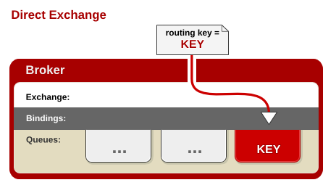
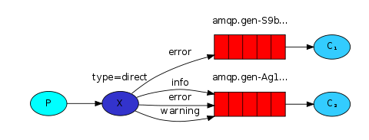
routing路由模式

Slide 33
发送者
private static final String EXCHANGE_NAME = "test-exchange-direct"; public static void main(String[] args) throws IOException, TimeoutException { Connection connection = ConnectionUtil.getConnection(); Channel channel = connection.createChannel(); //设置交换机 channel.exchangeDeclare(EXCHANGE_NAME,"direct"); String msg = "hello exchange direct"; //设置路由 String routingKey = "info"; channel.basicPublish(EXCHANGE_NAME,routingKey,null,msg.getBytes()); System.out.println("send successfully"); channel.close(); connection.close(); }

Slide 34
消费者1
private static final String EXCHANGE_NAME = "test-exchange-direct"; private static final String QUEUE_NAME = "test-queue-direct1"; public static void main(String[] args) throws IOException { Connection connection = ConnectionUtil.getConnection(); final Channel channel = connection.createChannel(); //定义queue channel.queueDeclare(QUEUE_NAME,false,false,false,null); //绑定exchange channel.queueBind(QUEUE_NAME,EXCHANGE_NAME,"error"); channel.basicQos(1); Consumer consumer = new DefaultConsumer(channel) { @Override public void handleDelivery(String consumerTag, Envelope envelope, AMQP.BasicProperties properties, byte[] body) throws IOException { String msg = new String(body,"utf-8"); System.out.println("recieve[1] : "+msg); try { Thread.sleep(1000); } catch (InterruptedException e) { e.printStackTrace(); }finally { System.out.println("recieve[1] done"); channel.basicAck(envelope.getDeliveryTag(),false); } } }; //关闭自动应答 Boolean autoAck = false; channel.basicConsume(QUEUE_NAME,autoAck,consumer); }

Slide 35
消费者2
private static final String EXCHANGE_NAME = "test-exchange-direct"; private static final String QUEUE_NAME = "test-queue-direct2"; public static void main(String[] args) throws IOException { Connection connection = ConnectionUtil.getConnection(); final Channel channel = connection.createChannel(); //定义queue channel.queueDeclare(QUEUE_NAME,false,false,false,null); //绑定exchange channel.queueBind(QUEUE_NAME,EXCHANGE_NAME,"info"); channel.queueBind(QUEUE_NAME,EXCHANGE_NAME,"warning"); channel.queueBind(QUEUE_NAME,EXCHANGE_NAME,"error"); channel.basicQos(1); Consumer consumer = new DefaultConsumer(channel) { @Override public void handleDelivery(String consumerTag, Envelope envelope, AMQP.BasicProperties properties, byte[] body) throws IOException { String msg = new String(body,"utf-8"); System.out.println("recieve[2] : "+msg); try { Thread.sleep(1000); } catch (InterruptedException e) { e.printStackTrace(); }finally { System.out.println("recieve[2] done"); channel.basicAck(envelope.getDeliveryTag(),false); } } }; //关闭自动应答 Boolean autoAck = false; channel.basicConsume(QUEUE_NAME,autoAck,consumer); }

Slide 36
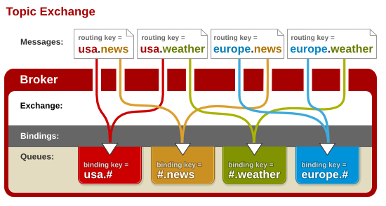
Topic主题模式
将路由键和某模式匹配
*：表示匹配一个
#：表示匹配多个

Slide 37
生产者
private static final String EXCHANGE_NAME = "test-exchange-topic"; public static void main(String[] args) throws IOException, TimeoutException { Connection connection = ConnectionUtil.getConnection(); Channel channel = connection.createChannel(); //声明exchange为topic主题模式 channel.exchangeDeclare(EXCHANGE_NAME,"topic"); //发送消息 String msg ="hello topic "; //设置路由 String routingKey = "goods.add"; channel.basicPublish(EXCHANGE_NAME,routingKey,null,msg.getBytes()); channel.close(); connection.close(); }

Slide 38
消费者1
/*接收者1：只接受goods.add消息*/ private static final String EXCHANGE_NAME = "test-exchange-topic"; private static final String QUEUE_NAME = "test-queue-topic1"; public static void main(String[] ages) throws IOException { Connection connection = ConnectionUtil.getConnection(); final Channel channel = connection.createChannel(); //声明queue channel.queueDeclare(QUEUE_NAME,false,false,false,null); //绑定exchange,匹配goods.add消息 channel.queueBind(QUEUE_NAME,EXCHANGE_NAME,"goods.add"); channel.basicQos(1); //发送消息 Consumer consumer = new DefaultConsumer(channel){ @Override public void handleDelivery(String consumerTag, Envelope envelope, AMQP.BasicProperties properties, byte[] body) throws IOException { String msg = new String(body,"utf-8"); System.out.println("recieve[1]: "+msg); try { Thread.sleep(1000); } catch (InterruptedException e) { e.printStackTrace(); }finally { System.out.println("recieve[1] done"); channel.basicAck(envelope.getDeliveryTag(),false); } } }; channel.basicConsume(QUEUE_NAME,false,consumer); }

Slide 39
生产者2
/*接收者2：接受goods所有消息*/ private static final String EXCHANGE_NAME = "test-exchange-topic"; private static final String QUEUE_NAME = "test-queue-topic2"; public static void main(String[] ages) throws IOException { Connection connection = ConnectionUtil.getConnection(); final Channel channel = connection.createChannel(); //声明queue channel.queueDeclare(QUEUE_NAME,false,false,false,null); //绑定exchange,匹配所有消息 channel.queueBind(QUEUE_NAME,EXCHANGE_NAME,"goods.#"); channel.basicQos(1); //发送消息 Consumer consumer = new DefaultConsumer(channel){ @Override public void handleDelivery(String consumerTag, Envelope envelope, AMQP.BasicProperties properties, byte[] body) throws IOException { String msg = new String(body,"utf-8"); System.out.println("recieve[2]: "+msg); try { Thread.sleep(1000); } catch (InterruptedException e) { e.printStackTrace(); }finally { System.out.println("recieve[2] done"); channel.basicAck(envelope.getDeliveryTag(),false); } } }; channel.basicConsume(QUEUE_NAME,false,consumer); }

Slide 40
Rabbitmq 的消息确认机制
（事务+confirm）
在rabbitmq中，我们可以通过持久化数据解决服务器异常的数据丢失问题
问题：生产者将消息发送出去之后，无法确认消息到达了rabbitmq服务器
两种解决方式：
AMQP实现了事务机制
Confirm模式

Slide 41
一、事务机制
txSelect txCommit txRollback
txSelect:用于将当前的channel设置成transaction
2. txCommit:用于提交事务
3. txRollback:回滚事务
缺点：比较耗时，降低了服务器的吞吐量
例子如下：

Slide 42
生产者
private static final String QUEUE_NAME = "test-queue-tx"; public static void main(String[] args) throws IOException, TimeoutException { Connection connection = ConnectionUtil.getConnection(); Channel channel = connection.createChannel(); channel.queueDeclare(QUEUE_NAME,false,false,false,null); String msg = "hello tx"; try { //开启事务 channel.txSelect(); channel.basicPublish("",QUEUE_NAME,null,msg.getBytes()); channel.txCommit(); }catch (Exception e){ e.printStackTrace(); channel.txRollback(); }finally { channel.close(); connection.close(); } }

Slide 43
消费者
private static final String QUEUE_NAME = "test-queue-tx"; public static void main(String[] args) throws IOException { Connection connection = ConnectionUtil.getConnection(); Channel channel = connection.createChannel(); channel.queueDeclare(QUEUE_NAME,false,false,false,null); channel.basicConsume(QUEUE_NAME,true,new DefaultConsumer(channel){ @Override public void handleDelivery(String consumerTag, Envelope envelope, AMQP.BasicProperties properties, byte[] body) throws IOException { System.out.println("tx recieve: "+new String(body,"utf-8")); } }); }

Slide 44
二、Confirm
最大的优点是异步
Nack
开启confirm模式
channel.confirmSelect()
编程模式：
1、普通 , 发一条，waitForConfirms()
2、批量，发一批，waitForConfirms
3、异步，提供一个回掉

Slide 45
普通模式（只发一条）
生产者
/*普通模式，只发一条*/ private static final String QUEUE_NAME = "test-queue-confirm"; public static void main(String[] args) throws IOException, TimeoutException { Connection connection = ConnectionUtil.getConnection(); Channel channel = connection.createChannel(); channel.queueDeclare(QUEUE_NAME,false,false,false,null); String msg = "hello confirm"; try { //开启confirm channel.confirmSelect(); channel.basicPublish("",QUEUE_NAME,null,msg.getBytes()); if(!channel.waitForConfirms()){ System.out.println("send failed"); }else{ System.out.println("send successed"); } }catch (Exception e){ e.printStackTrace(); channel.txRollback(); }finally { channel.close(); connection.close(); } }

Slide 46
普通模式（只发一条）
消费者
/*普通模式，只发送一条*/ private static final String QUEUE_NAME = "test-queue-confirm"; public static void main(String[] args) throws IOException { Connection connection = ConnectionUtil.getConnection(); Channel channel = connection.createChannel(); channel.queueDeclare(QUEUE_NAME,false,false,false,null); channel.basicConsume(QUEUE_NAME,true,new DefaultConsumer(channel){ @Override public void handleDelivery(String consumerTag, Envelope envelope, AMQP.BasicProperties properties, byte[] body) throws IOException { System.out.println("confirm recieve: "+new String(body,"utf-8")); } }); }

Slide 47
发送一批
生产者
/*普通模式，只发一批*/ private static final String QUEUE_NAME = "test-queue-confirm"; public static void main(String[] args) throws IOException, TimeoutException { Connection connection = ConnectionUtil.getConnection(); Channel channel = connection.createChannel(); channel.queueDeclare(QUEUE_NAME,false,false,false,null); String msg = "hello confirm"; try { //开启confirm channel.confirmSelect(); for (int i = 0; i < 10; i++) { channel.basicPublish("",QUEUE_NAME,null,(msg+i).getBytes()); } if(!channel.waitForConfirms()){ System.out.println("send failed"); }else{ System.out.println("send successed"); } }catch (Exception e){ e.printStackTrace(); channel.txRollback(); }finally { channel.close(); connection.close(); } }

Slide 48
发送一批
消费者
/*普通模式，发送一批*/ private static final String QUEUE_NAME = "test-queue-confirm"; public static void main(String[] args) throws IOException { Connection connection = ConnectionUtil.getConnection(); Channel channel = connection.createChannel(); channel.queueDeclare(QUEUE_NAME,false,false,false,null); channel.basicConsume(QUEUE_NAME,true,new DefaultConsumer(channel){ @Override public void handleDelivery(String consumerTag, Envelope envelope, AMQP.BasicProperties properties, byte[] body) throws IOException { System.out.println("confirm recieve: "+new String(body,"utf-8")); } }); }

Slide 49
异步模式
Channel对象提供的ConfirmListener()回调方法只包含deliveryTag(当前Channel发出的消息序列号)，我们需要自己为每个Channel维护一个unconfirm的消息序列号集合，每publish一条数据，集合中元素加1，每回调一次handleAck方法，unconfirm集合删掉相应的一条（multiple=false）或多条（multiple=true）记录，从程序运行效率上看，这个unconfirm集合最好采用有序集合SortedSet存储结构。

Slide 50
/*异步方式*/ private static final String QUEUE_NAME = "test-queue-confirms"; public static void main(String[] args) throws IOException, TimeoutException { Connection connection = ConnectionUtil.getConnection(); Channel channel = connection.createChannel(); channel.queueDeclare(QUEUE_NAME,false,false,false,null); channel.confirmSelect(); final SortedSet<Long> confirmSet = Collections.synchronizedSortedSet(new TreeSet<Long>()); channel.addConfirmListener(new ConfirmListener() { //发送成功的 @Override public void handleAck(long deliveryTag, boolean multiple) throws IOException { if (multiple){//多条回值 confirmSet.headSet(deliveryTag+1).clear(); }else{ confirmSet.remove(deliveryTag); } } //发送失败的 @Override public void handleNack(long deliveryTag, boolean multiple) throws IOException { if (multiple){//多条回值 confirmSet.headSet(deliveryTag+1).clear(); }else{ confirmSet.remove(deliveryTag); } } }); String msg = "hello confirm"; for (int i = 0; i < 50; i++) { Long seqNo = channel.getNextPublishSeqNo(); channel.basicPublish("",QUEUE_NAME,null,(msg+i).getBytes()); confirmSet.add(seqNo); } channel.close(); connection.close(); }

