Slide 1





SCALE 0.3
거리로 계산 뭐띄울지
< 112.6 >
< 225.2 >
< 112.6 >
< 85 >
< 215 >
< 345 >
< 475 >
< 130 >
< 65 >
< 195 >

Slide 2
SCALE 0.3
거리로 계산 뭐띄울지
14
15
16
< 112.6 >
6
7
8
9
< 225.2 >
< 112.6 >
-2
-1
Sn
1
2
< 130 >
< 65 >
< 195 >
-8
-7
-6
-5
-13
-12
-11

Slide 3

35
36
37
38
39
40
41
35
36
37
38
39
40
41
28
29
30
31
32
33
34
28
29
30
31
32
33
34
21
22
23
24
25
26
27
21
22
23
24
25
26
27
14
15
16
17
18
19
20
14
15
16
17
18
19
20
7
8
9
10
11
12
13
7
8
9
10
11
12
13
0
1
2
3
4
5
6
0
1
2
3
4
5
6
13
14
15
13
14
15
5
8
6
9
-2
16_몫2
2
-2
23_몫3
2
-9
-6
-8
-5
-15
-14
-13
-15
-14
-13

Slide 4


9
< 130 >
<112.6>
< 130 >
< 130 >
< 195 >
< 65 >
<112.6>
<112.6>
<112.6>
<112.6>
9

Slide 5
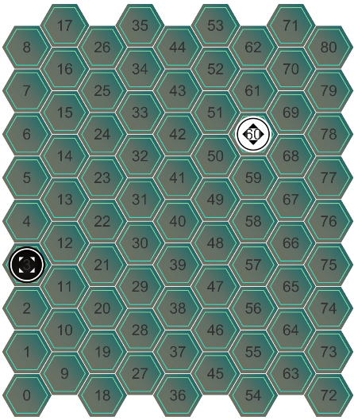
2
-8
10
-17
1
19
-9
9
-18
0
18
0
-10
8
-19
-1
17
2
-11
7
-7
11
-2
-17
1
19
1
-8
10
-18
/1
18
-9
9
-19
-1
17
-10
8
-2

Slide 6
2
-8
10
-17
1
19
-9
9
-18
(23)
18
-10
8
-19
-1
17
-11
7
-2
2
-7
11
-17
1
19
-8
10
-18
(47)
18
-9
9
-19
-1
17
-10
8
-2

