Slide 1
Hawk: Progressive Speculative Decoding for On-Device MLLMs

Slide 2
Speculative Decoding
Draft fast. Verify once.
A small draft model generates γ candidate tokens cheaply:
x₁, x₂, …, xᵧ
The large target model checks every candidate in a single forward pass.
• Accept the longest valid prefix
• At the first rejection, sample a correction
Correction: a replacement token sampled from the normalized residual max(0, pᵗ − pᵈ)
• Discard the unverified suffix and repeat
The win: replace several expensive target-model decoding steps with one parallel, prefill-shaped verification step.

Slide 3
Why the Output Is Exact
For a drafted token x, let pᵈ(x) and pᵗ(x) be its draft- and target-model probabilities. Accept it with
P(accept | x) = min( 1 , pᵗ(x) / pᵈ(x) )
The probability that x is both proposed and accepted is therefore
pᵈ(x) · P(accept | x) = min( pᵈ(x) , pᵗ(x) )
If the proposal is rejected, sample from the target's missing probability mass:
p_res(x) ∝ max( 0 , pᵗ(x) − pᵈ(x) )
Accepted mass + residual mass reconstructs pᵗ exactly. Thus speculative decoding only changes how tokens are computed, not their distribution.

Slide 4
When Is Speculative Decoding Faster?
One iteration costs a draft phase plus one target verification:
T_iter = T_draft + T_verify
If it advances the sequence by τ tokens on average, latency per output token is
L = (T_draft + T_verify) / τ
where τ includes accepted draft tokens and the target's bonus or correction token.
Three ways to win:
1. Draft faster — reduce T_draft
2. Draft better — accept more tokens and increase τ
3. Verify efficiently — reduce T_verify and wasted work

Slide 5
EAGLE-3: The General Idea
EAGLE-3 is a small draft model attached to the target model.
1. The target model processes the current verified sequence and exposes its internal features.
2. The EAGLE-3 drafter uses those features to generate several candidate tokens autoregressively (each draft token helps predict the next).
3. The target model verifies all candidates together and accepts a valid prefix.
Then the process repeats.
Core idea: borrow the target model's knowledge to draft accurately, while keeping drafting much cheaper than running the target model token by token.

Slide 6
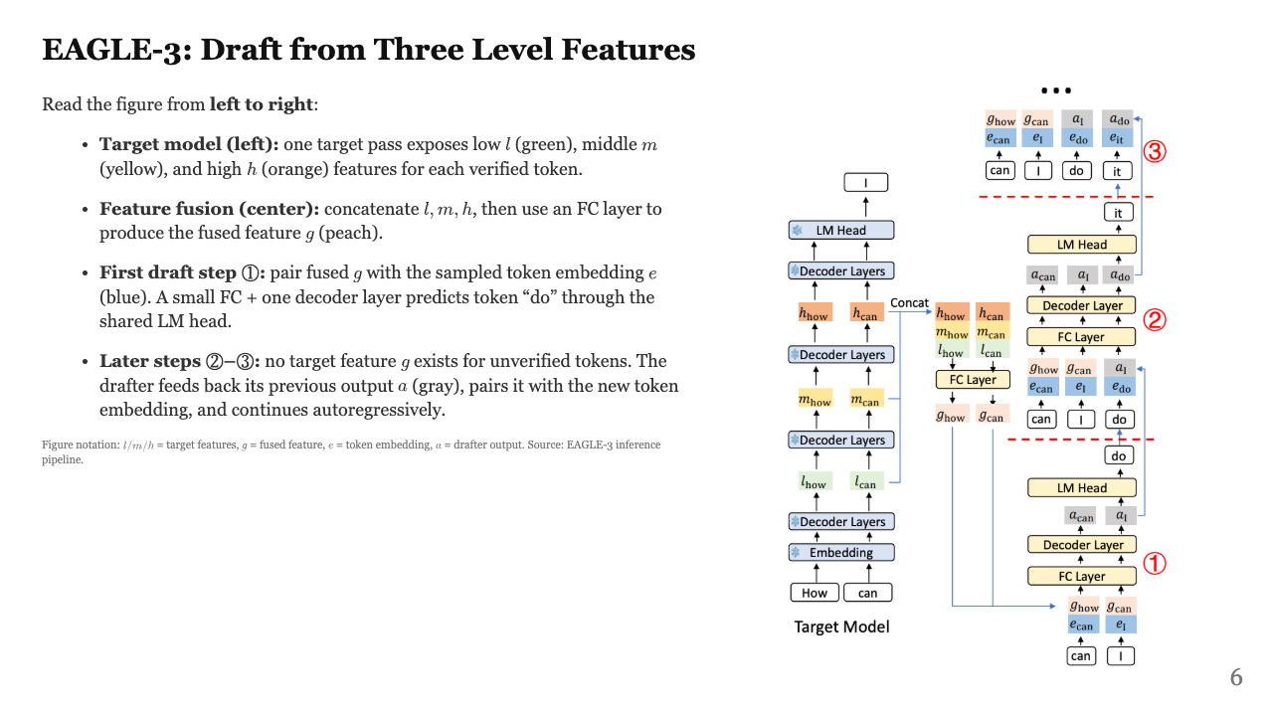

Slide 7
EAGLE-3: LLM Results
Benchmark | Llama 3.1 8B |  | DeepSeek-R1-Distill-Llama-8B
 | Speedup | τ | Speedup | τ
MT-Bench | 3.07× | 4.24 | 3.20× | 4.49
HumanEval | 4.13× | 5.82 | 3.77× | 5.28
GSM8K | 3.32× | 4.59 | 4.38× | 6.10
Alpaca | 3.90× | 5.56 | 3.16× | 4.30
Mean | 3.61× | 5.05 | 3.63× | 5.04
Temperature T=1. Source: Li et al., "EAGLE-3," Table 1. Means shown here are computed over the four displayed tasks.

Slide 8
EAGLE-3: MLLM Results
Benchmark | Qwen3-VL-2B |  | SmolVLM-256M
 | Speedup | τ | Speedup | τ
COCO-Caption | 1.62× | 2.28 | 1.85× | 2.40
Math-500 | 1.93× | 2.59 | 2.56× | 3.63
MMMU | 1.78× | 2.62 | 2.30× | 2.77
OCRBench V2 | 1.31× | 2.52 | 0.98× | 1.50
TextVQA | 1.50× | 2.36 | 1.22× | 1.95
Mean | 1.63× | 2.47 | 1.78× | 2.45
Temperature T=1. Results from IMG_3020 / IMG_3021. SmolVLM speedup is measured by time; means cover the five displayed benchmarks.

Slide 9
Problem: EAGLE-3 on MLLMs and Small Models
1. Weaker generalization
On MLLMs and smaller target models, EAGLE-3 shows lower speedup and shorter acceptance length than on larger language models.
Possible causes:
• Information is lost when intermediate features are fused and compressed
• Intermediate representations receive no direct supervision
• The draft model does not reuse pretrained weights; it is trained from scratch
2. Storage overhead
The draft model introduces a separate set of parameters, consuming substantial on-device storage alongside the target model.

Slide 10
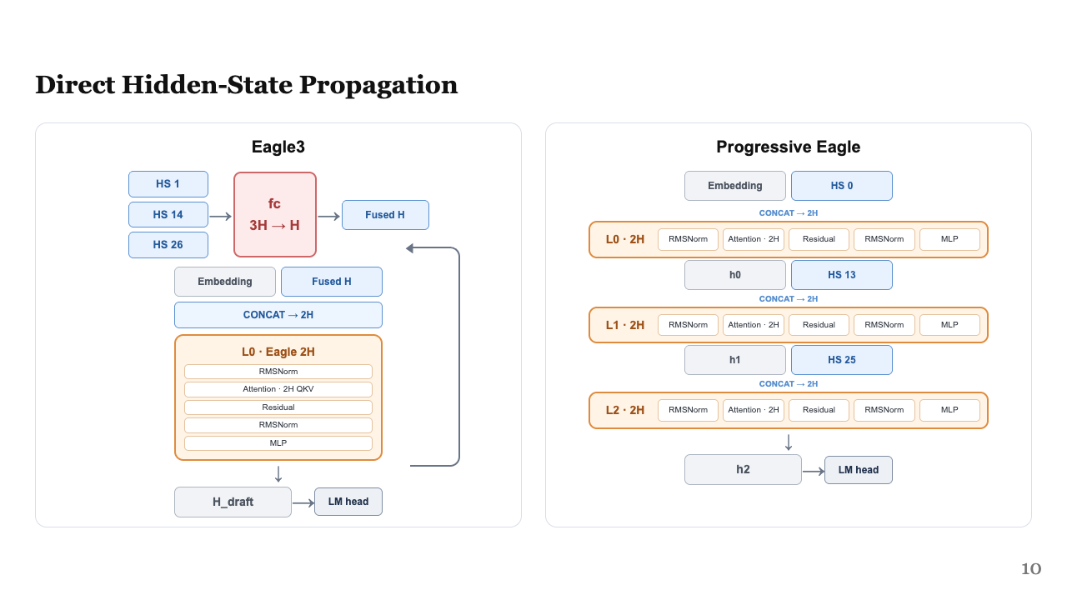

Slide 11
