Slide 1
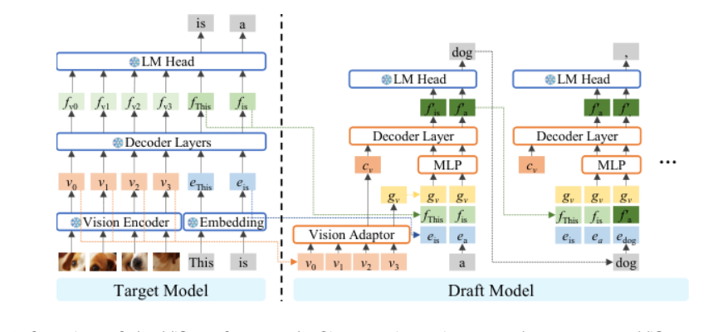

Slide 2
is
a
dog
.
❄ LM Head
❄ LM Head
❄ LM Head
fᵥ₀
fᵥ₁
fᵥ₂
fᵥ₃
f_This
f_is
is
a
a
r
Decoder Layer
Decoder Layer
❄ Decoder Layers
cᵥ
MLP
cᵥ
MLP
⋯
v₀
v₁
v₂
v₃
e_This
e_is
gᵧ
gᵧ
gᵧ
gᵧ
gᵧ
gᵧ
gₓ
❄ Vision Encoder
❄ Embedding
f_This
f_is
f_This
f_is
f_a
Vision Adaptor
e_is
e_a
e_is
e_a
e_dog
This
is
v₀
v₁
v₂
v₃
a
dog
Target Model
Draft Model

