Slide 1
CASE STUDY
HOW DOES A BIKE-SHARE NAVIGATE SPEEDY SUCCESS

Slide 2
CONTENT
Background
Objectives
Datasets
Process and Findings
Recommendations

Slide 3
BACKGROUND
Cyclistic launched a successful bike-share offering. Since then, the program has grown to a fleet of 5,824 bicycles that are geotracked and locked into a network of 692 stations across Chicago. The bikes can be unlocked from one station and returned to any other station in the system anytime. Until now, Cyclistic’s marketing strategy relied on building general awareness and appealing to broad consumer segments. One approach that helped make these things possible was the flexibility of its pricing plans: single-ride passes, full-day passes, and annual memberships. Customers who purchase single-ride or full-day passes are referred to as casual riders. Customers who purchase annual memberships are Cyclistic members. Cyclistic’s finance analysts have concluded that annual members are much more profitable than casual riders. Although the pricing flexibility helps Cyclistic attract more customers, Moreno believes that maximizing the number of annual members will be key to future growth. Rather than creating a marketing campaign that targets all-new customers, Moreno believes there is a very good chance to convert casual riders into members. She notes that casual riders are already aware of the Cyclistic program and have chosen Cyclistic for their mobility needs. Moreno has set a clear goal: Design marketing strategies aimed at converting casual riders into annual members

Slide 4
Objectives
Understands how do annual members and casual riders use Cyclistic bikes differently
Understands why casual riders buy Cyclistic memberships
How digital media can be used to influence casual riders to become members

Slide 5
Dataset
Source: Monthly data directly from the company’s website.
Link : https://divvy-tripdata.s3.amazonaws.com/index.html
Period covered: January 2022 to December 2022

Slide 6
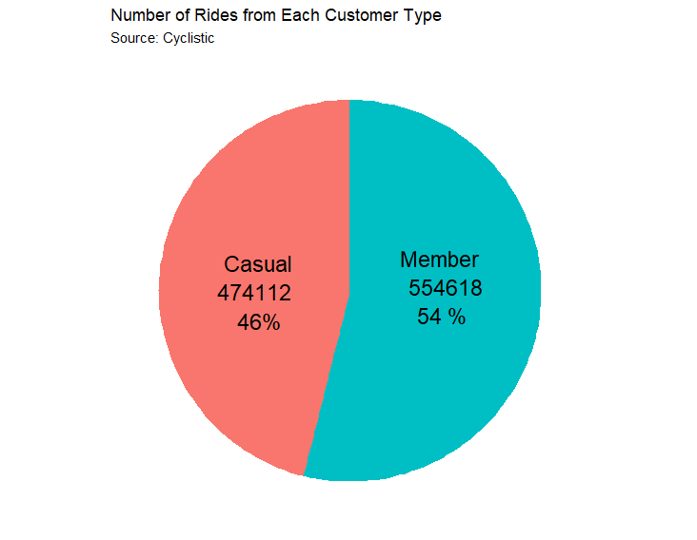
Findings - Number of Rides from Customer type
Members make the most trips overall
Members take 8% more trips than casual riders

Slide 7
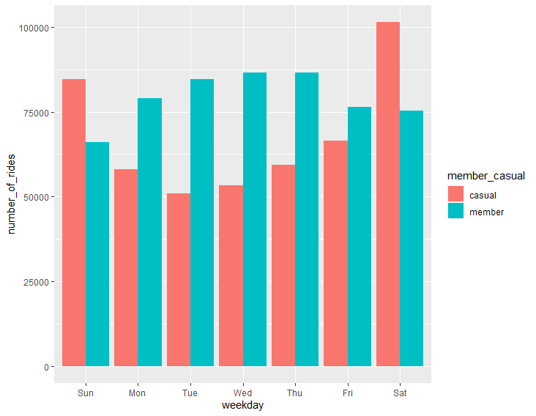
Number of Rides: Weekday
Number of member trips are relative consistent during the week
Casual riders take more trip in weekend

Slide 8
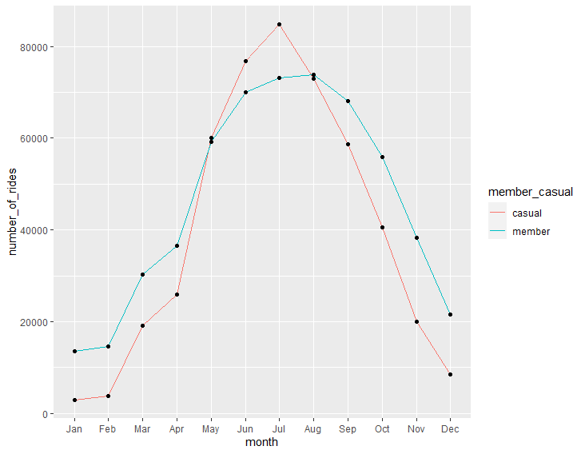
Number of Rides: Month
Most of trips taken between June-October with the peak is in July

Slide 9
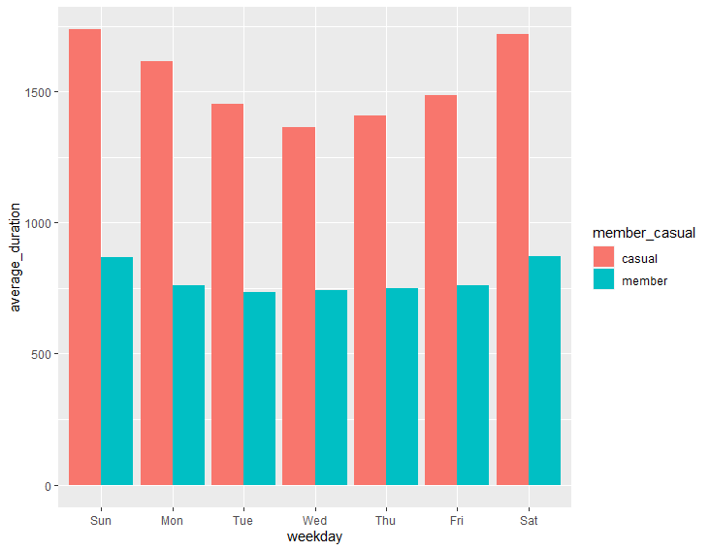
Average Ride Duration: Weekday
Casual riders take significanty longer duration compared to member rider everyday of the week
Casual rider take longer trips in weekend

Slide 10
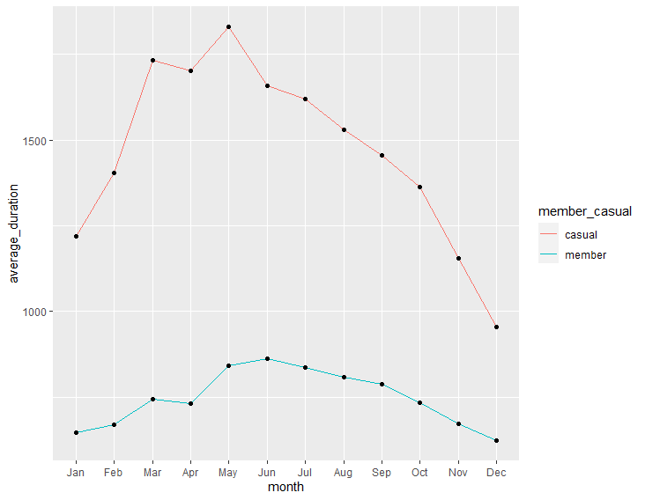
Average Ride Duration: Month
Casual riders hits its peak for ride duration in May
Member have trip duration relatively the same over the year

Slide 11
SUMMARY
Overall, eventhough casual riders take less number than member, but casual rider has longer trip duration
Casual riders are most active in weekends and in accordance with the duration of the trip
Most of rider has a trip on the months of June, July, August

Slide 12
Recommendations
Offer a weekend only membership
Offer a monthly_membership (from June-August)
Creating creative event, such as weekend contests, recreational acitivites, etc.

