Slide 1
자율주행을 위한 컴퓨터 시스템 최적화
최항기 박중석
DCSLAB

Slide 2
Motivation
The car needs to make an accurate judgment according to the surrounding environment.
In order to autonomous drive better, we need to get more useful informations.

Slide 3
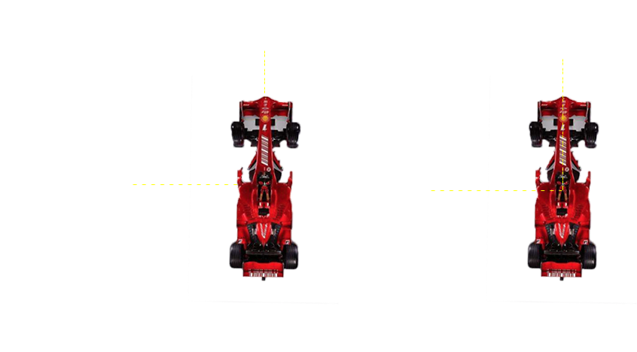
Puzzle ?

Slide 4
SPEED
RPM
TRACK_ANGLE
TRACK_WIDTH YAW DISTANCE PASSED_TIME
ACCEL
BREAK STEER

Slide 5
Not enough!
SPEED
RPM
TRACK_ANGLE
TRACK_WIDTH YAW DISTANCE PASSED_TIME
ACCEL
BREAK STEER
We need more informations

Slide 6
The purpose of S/W improvements
Whether the vehicle in the straight, or in the corner.
How much is the curvature of the corner?
Whether we can speed up to save time, or slow down to get stability.

Slide 7
Speed sensor
distance sensor
angle sensor
Speed control
Lane keeping
CAR

Slide 8
Speed sensor
distance sensor
angle sensor
Storage
Speed control
Lane keeping
CAR

Slide 9
Achievement
We can know whether the car in the straight or in the corner, by comparing the angle of two adjacent periods.
Through the track curvature value, we can optimize the steering in the corner.
Speed up in the straight, and slow down in the corner.

Slide 10
Thank you.
Q&A

