Slide 1
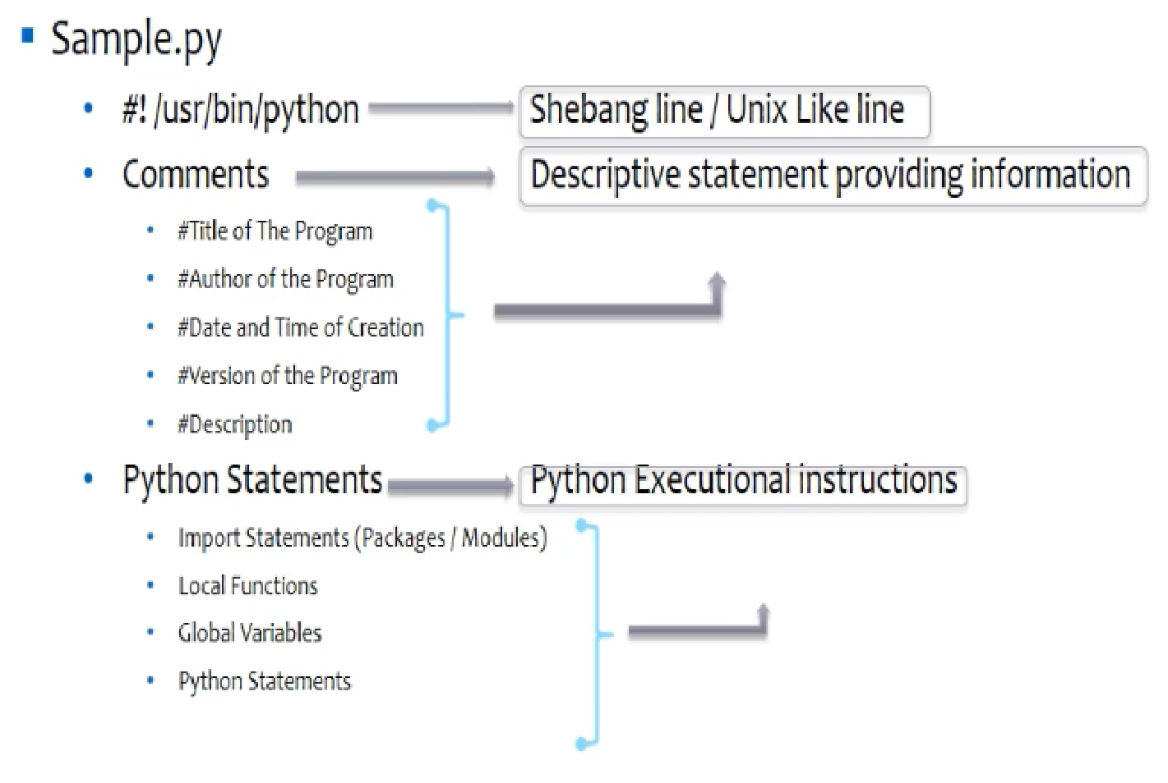
Python –Program Structure

Slide 2
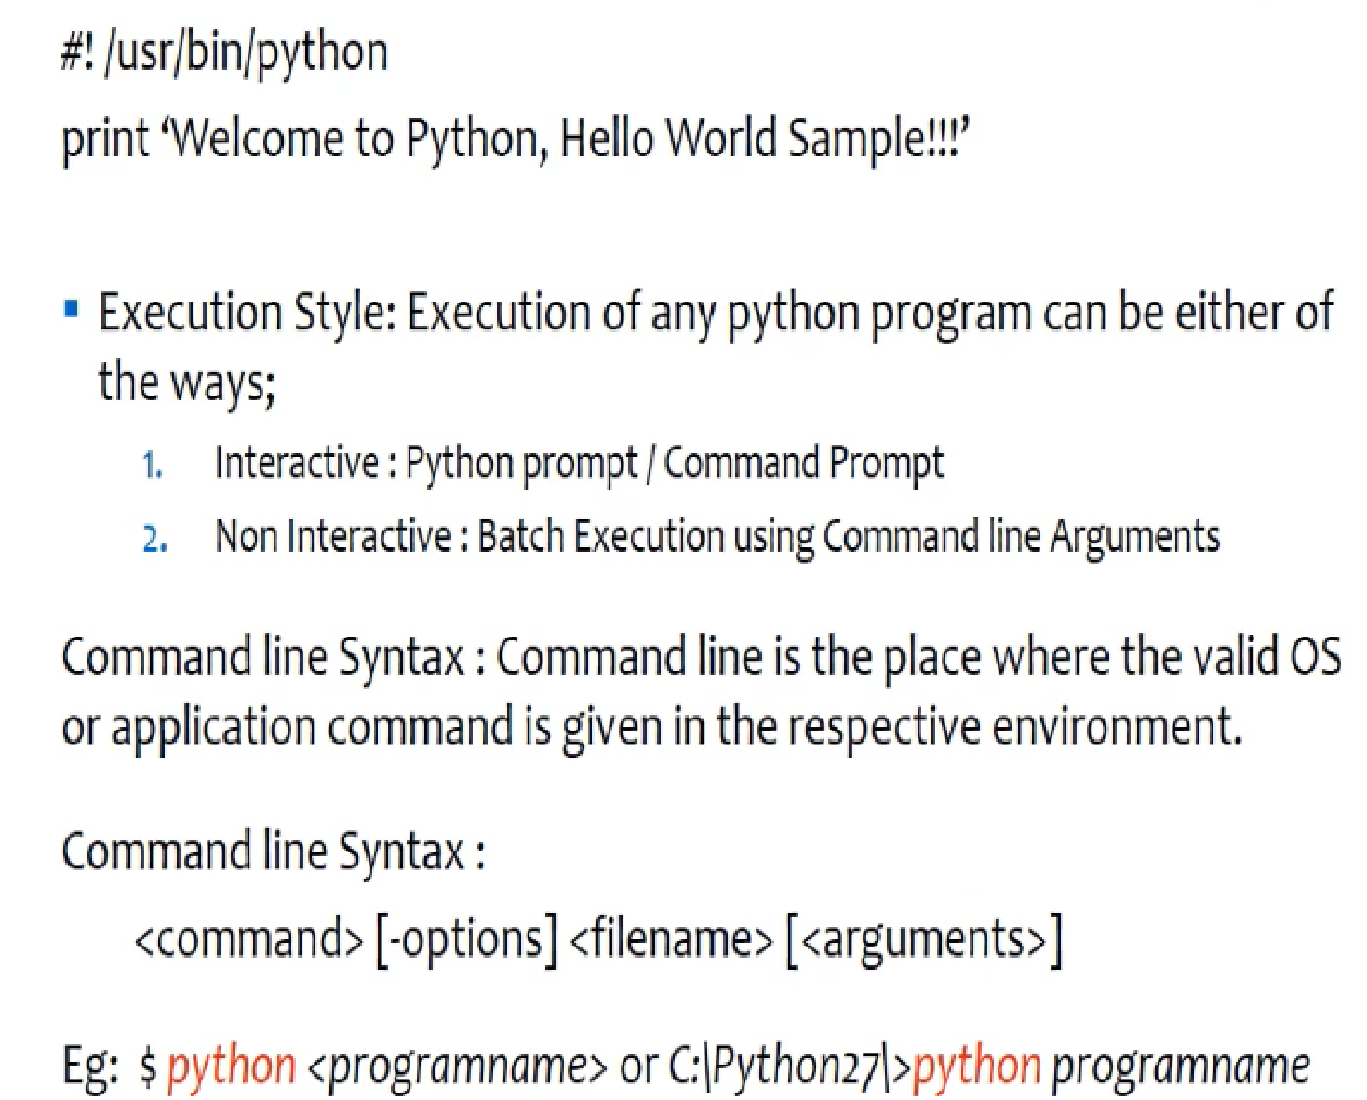
Hello World

Slide 3
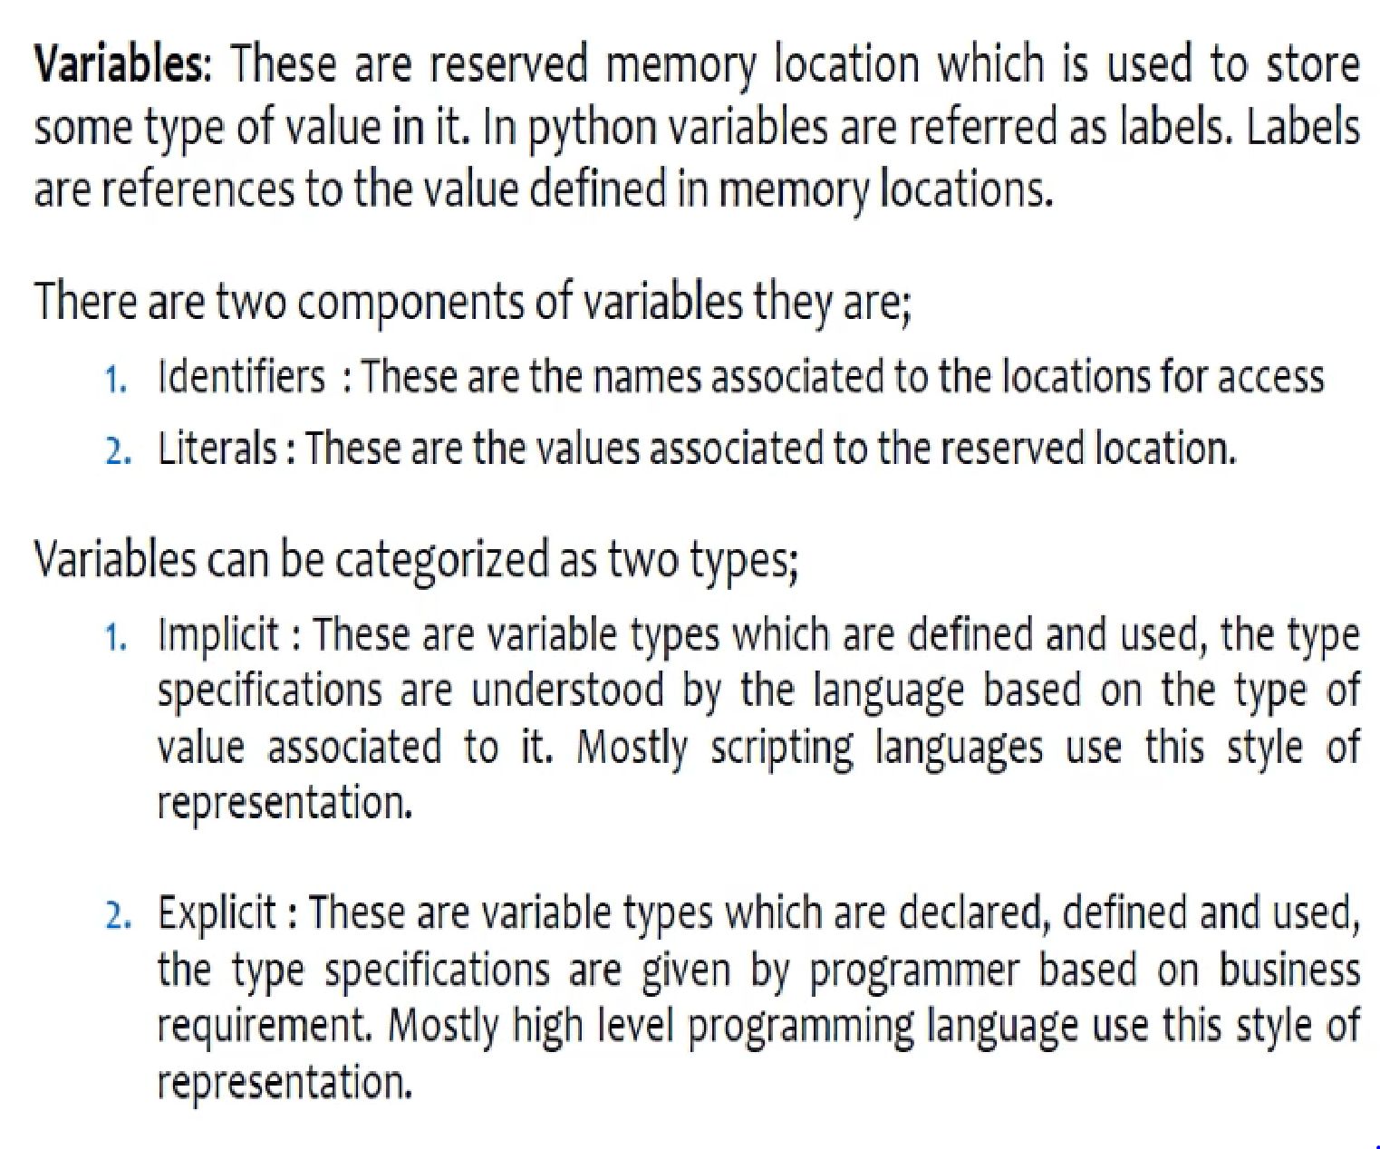
Python Variables/Labels

Slide 4
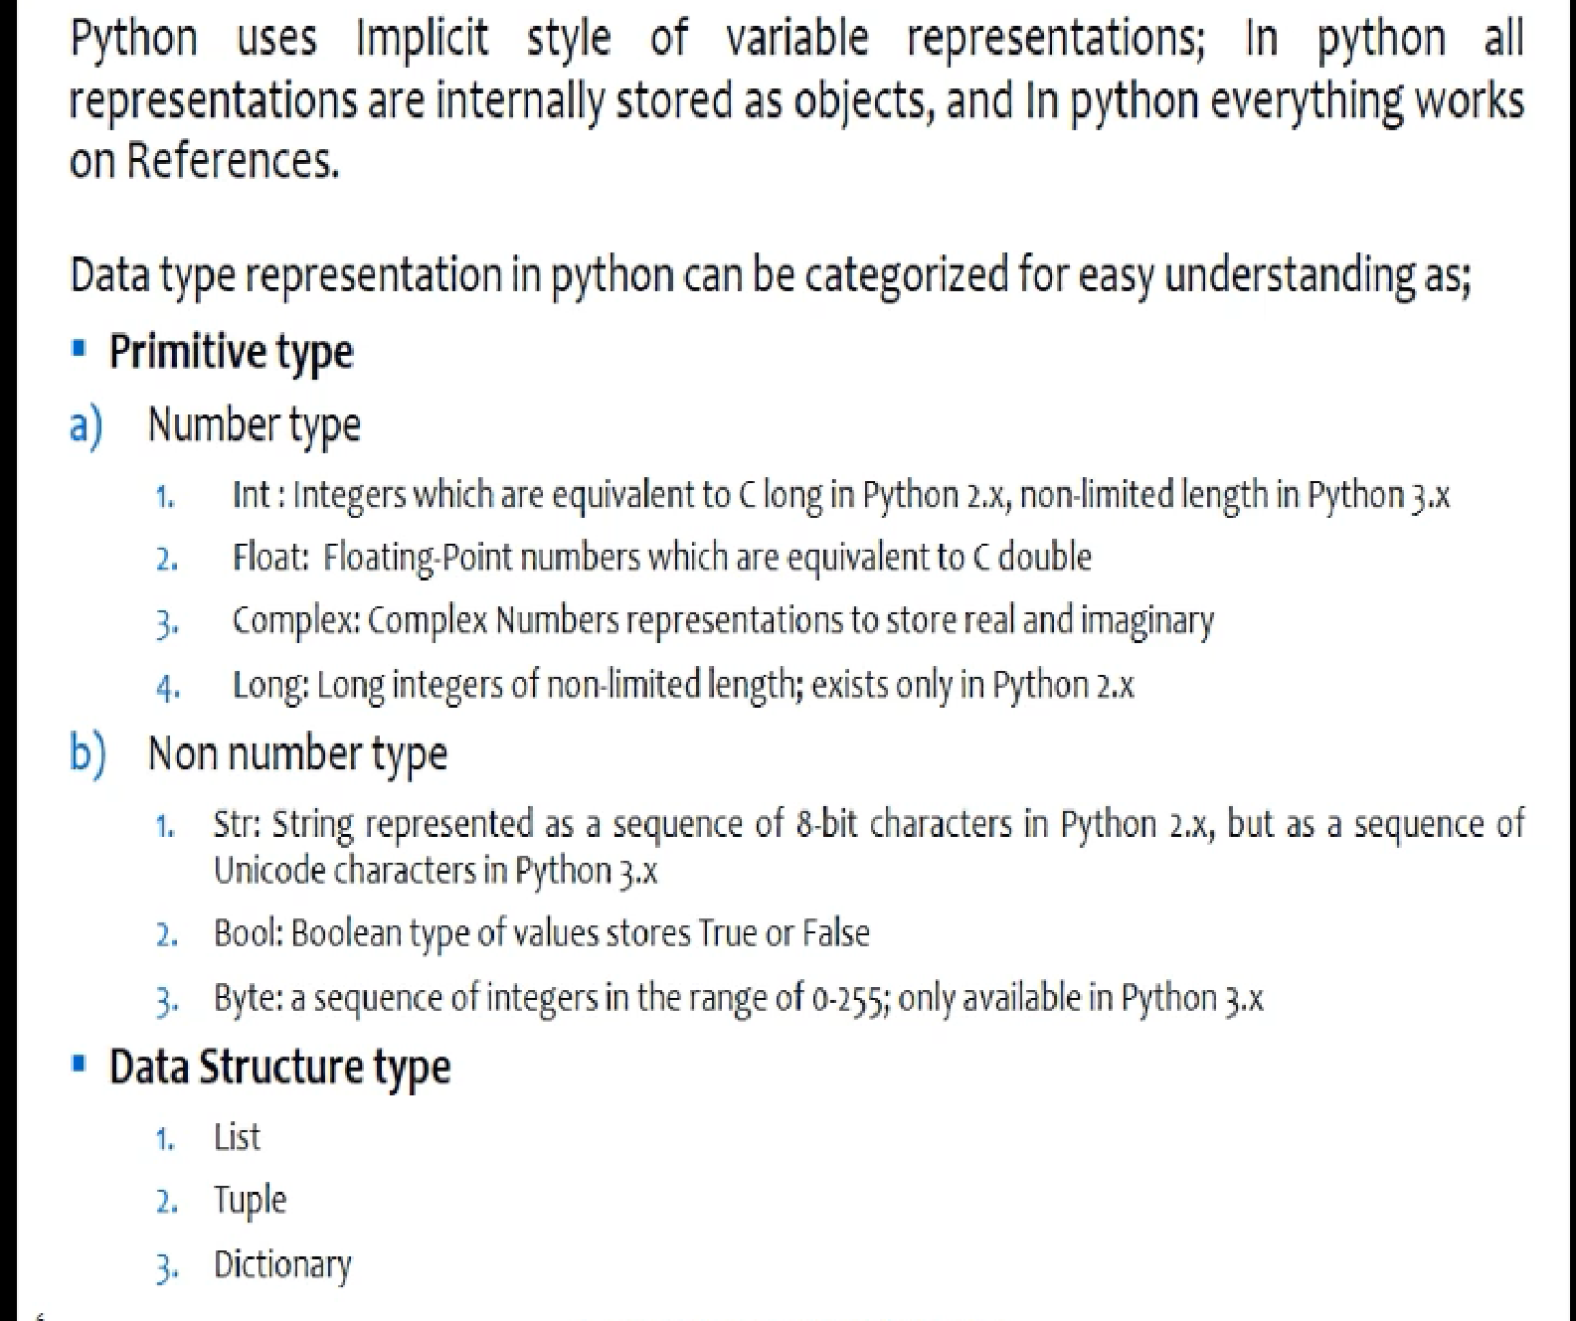
Python Variables/Python

Slide 5
