Slide 1
Mitigating dataset bias by using per-sample gradient

Slide 2
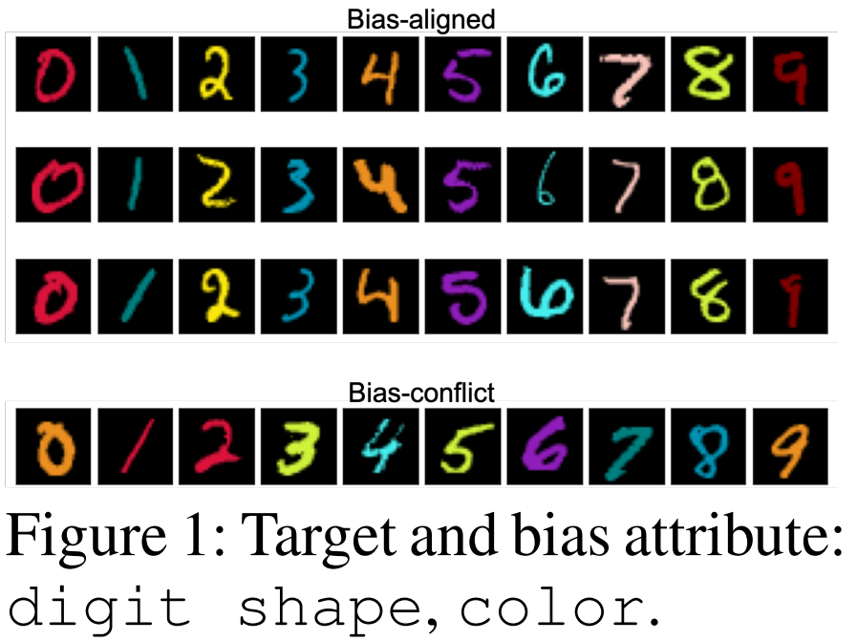



Mitigating dataset bias by using per-sample gradient
Attribute : bias attributes, target attributes;
Data Bias : Easier-to-learn bias attributes have a strong correlation with the target;
Bias-aligned: samples of data that have a strong correlation;
Bias-conflict: samples of data that have a weak correlation;

Slide 3
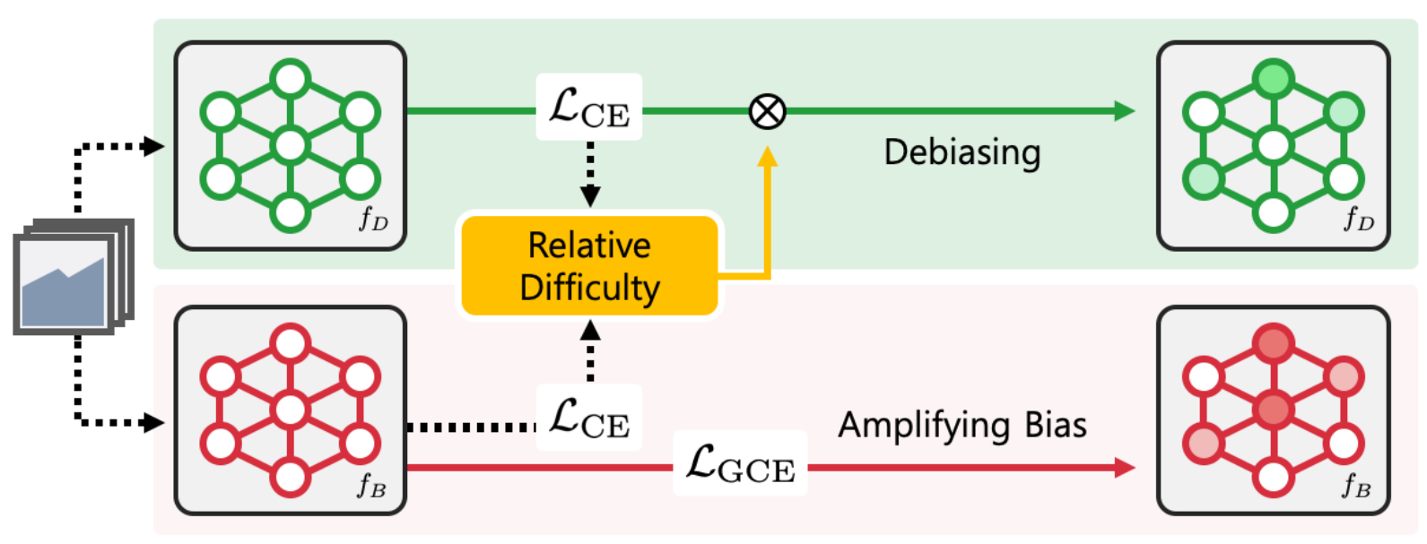
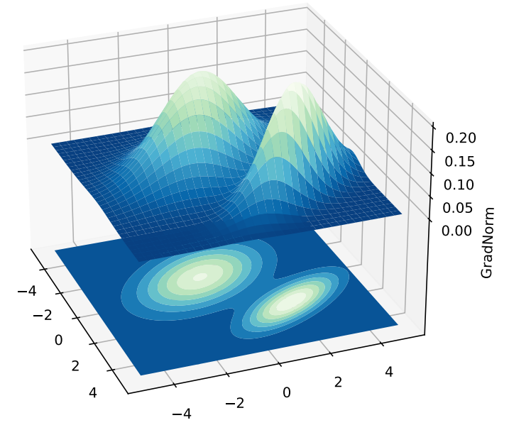
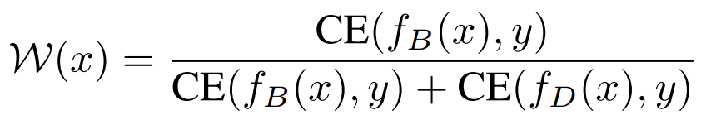
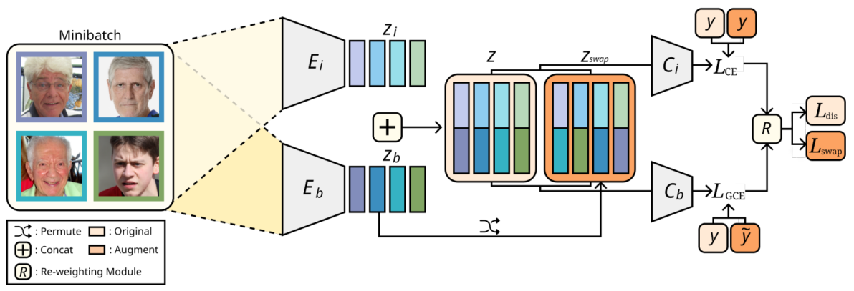
Mitigating dataset bias by using per-sample gradient
Motivation:
Output Space
Parameter Space
《Learning from Failure: Training Debiased Classifier from Biased Classifier》
《 On the Importance of Gradients for Detecting Distributional Shifts in the Wild 》
《Learning Debiased Representation via Disentangled Feature Augmentation》

Slide 4
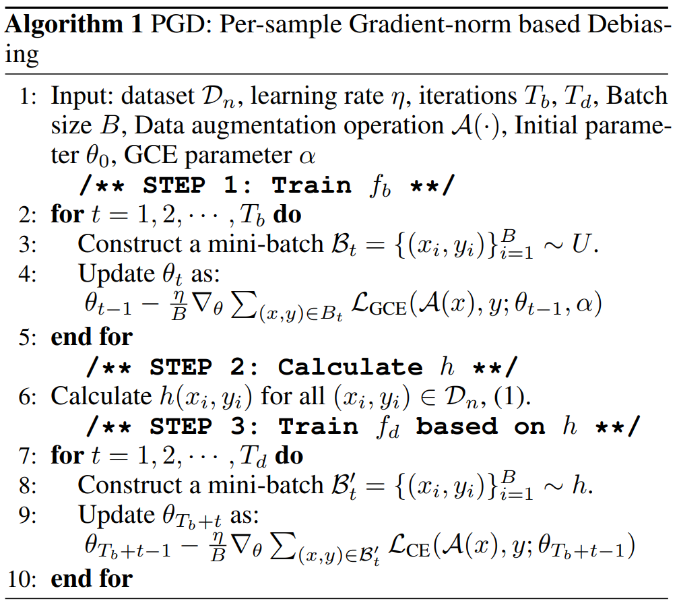

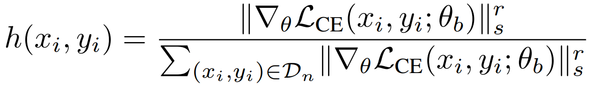

Mitigating dataset bias by using per-sample gradient
PGD: Per-sample Gradient-norm based Debiasing
Step 1: Training the biased model;
Step 2: Compute the gradient-based sampling probability;
Step 3: Ultimate debiased model training;
$$−f{\left(y | x,ө\right)}^{(α−1)}$$

Slide 5
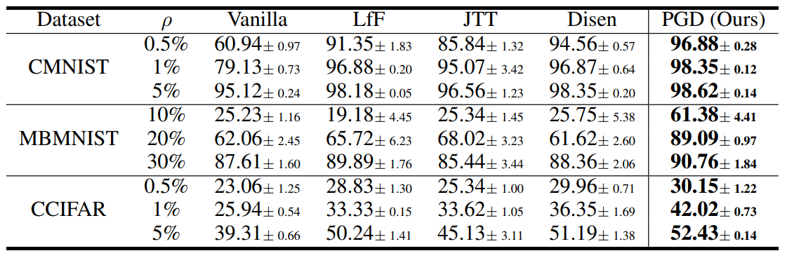
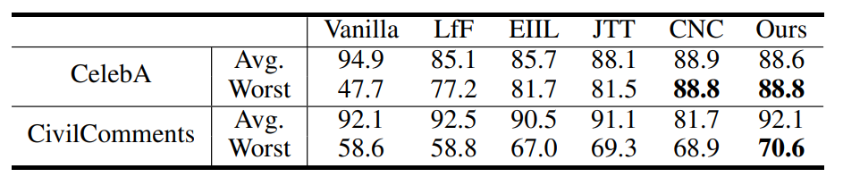
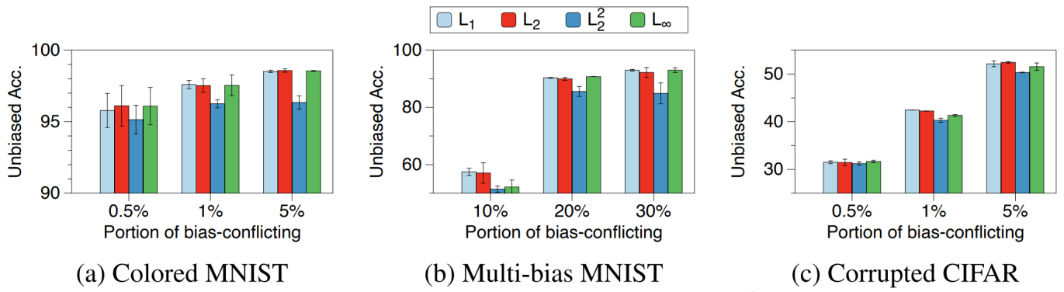
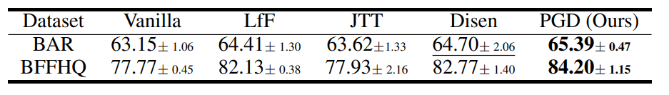
Mitigating dataset bias by using per-sample gradient
Experiments:

Slide 6
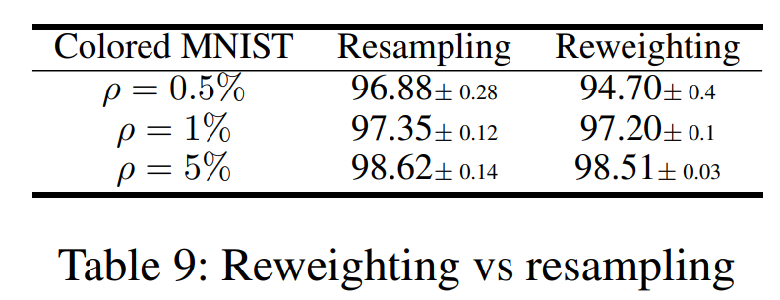
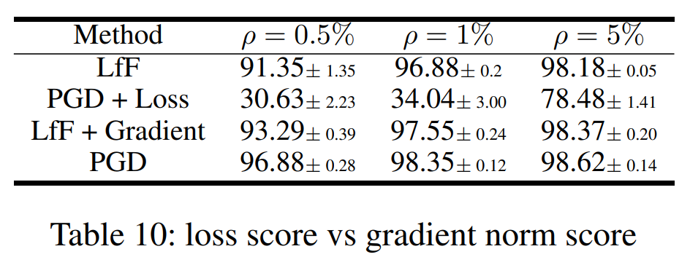
Mitigating dataset bias by using per-sample gradient
Experiments:

Slide 7

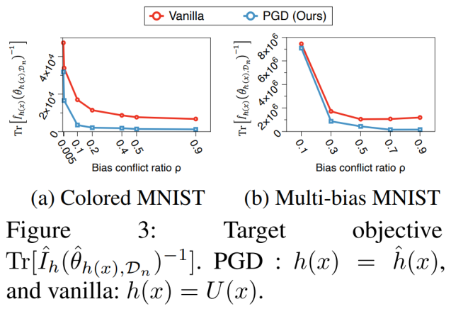
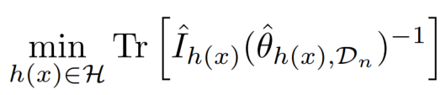
Mitigating dataset bias by using per-sample gradient
Mathematical understanding of PGD:
Formulate the dataset bias problem as a min-max problem:

Slide 8
Thanks

